Slide 1


JUSTICE AND LAW
Виконала: Танасієнко Аліна, Ю18З

Slide 2
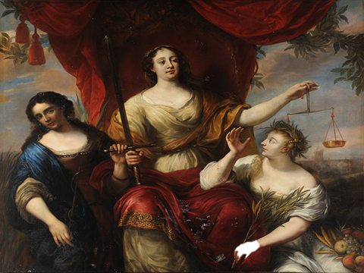
The word "justice "comes from the word" right " (right, Truth), and in Latin means justita (justice) — from jus (right).
Law is inseparable from justice: it is the core of law. Justice, as the basic principle of natural law, is intrinsically inherent in law, which is not so much an external coercive force as a prescription to act fairly. It is no coincidence that the words "right", "Truth", "Justice" and "law" have the same root; hence the identity of the ancient Roman concepts "jus" (law) and "justitia" (Justice).

Slide 3
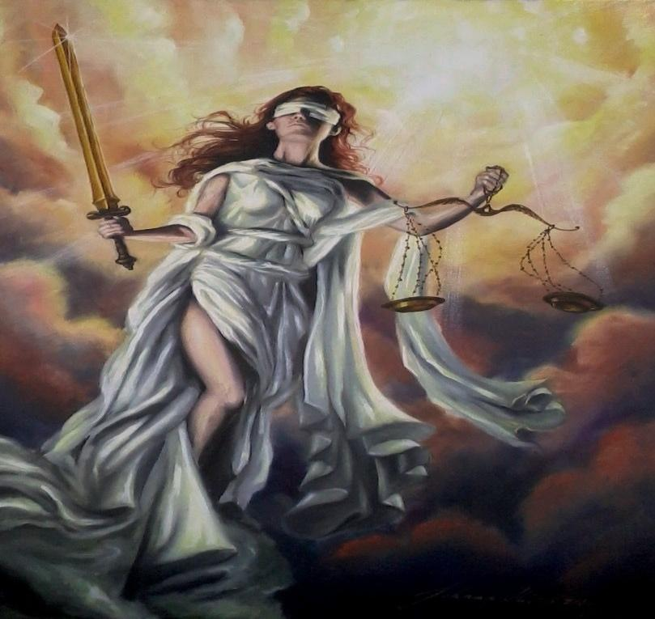

The essence of law lies in the fact that it is a way (tool, form) of establishing a fair balance of interests of all and everyone: individuals, social strata, classes, social communities and entities. Only this point is a measure (criterion) of compliance of the written (positive) law of any country with the general nature and essence of law as such.

Slide 4
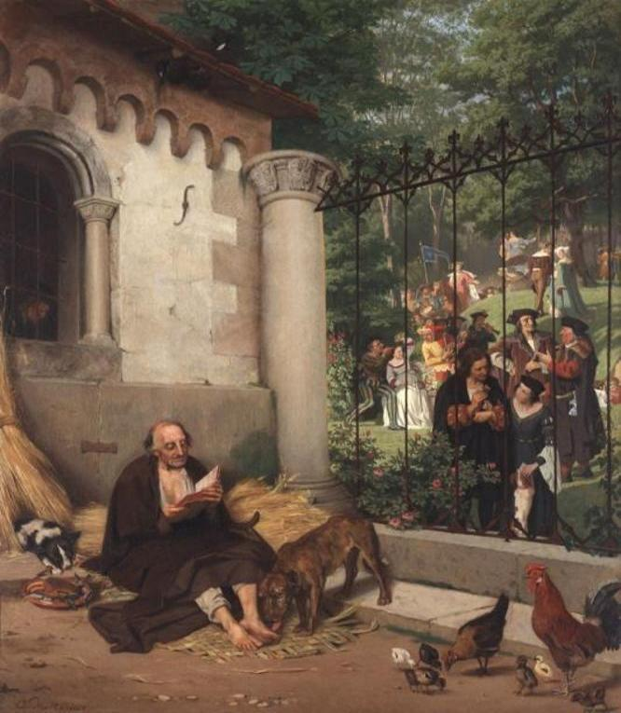
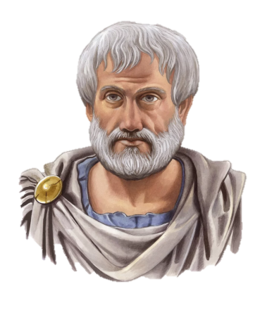

The concept of Justice has been developed since ancient times. Aristotle created a detailed theory of justice as the basis of law. He distinguished between two types of Justice: equalizing and distributing.
Equalizing justice is the one that guides people when exchanging values or compensating for damages. This is like a tool for observing measures between the harm and benefit of each of the parties.
Distributive justice recognizes as fair both equal and unequal distribution among different individuals, depending on their contribution to the public good.

Slide 5
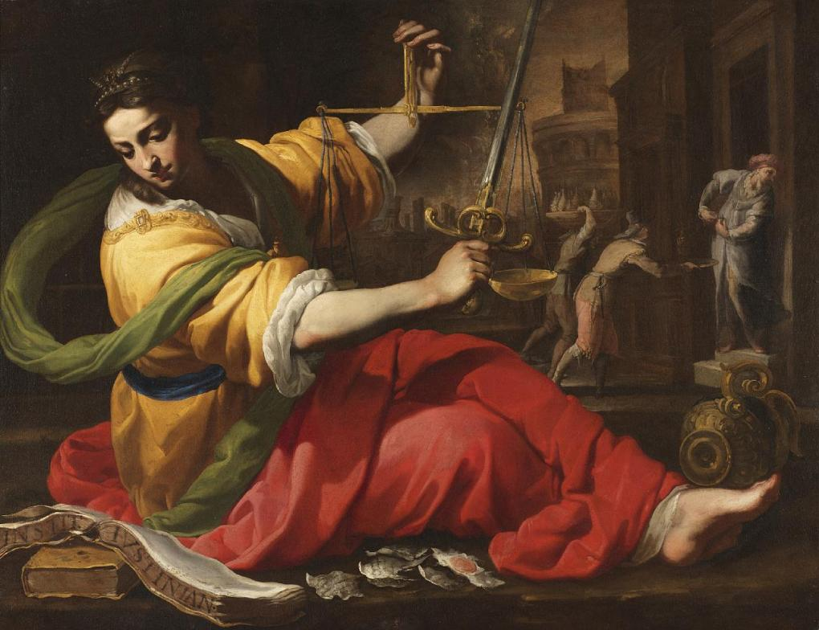
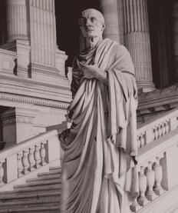
The idea of justice was further developed by the lawyers of Ancient Rome, including Ciceron. The unity of law and justice is fixed in the formulas of Roman law: "law is the art of good and justice"; "in law it is necessary to pay maximum attention to justice"; "the precepts of law are as follows: to live honestly, not to offend, to pay tribute to everyone".

Slide 6
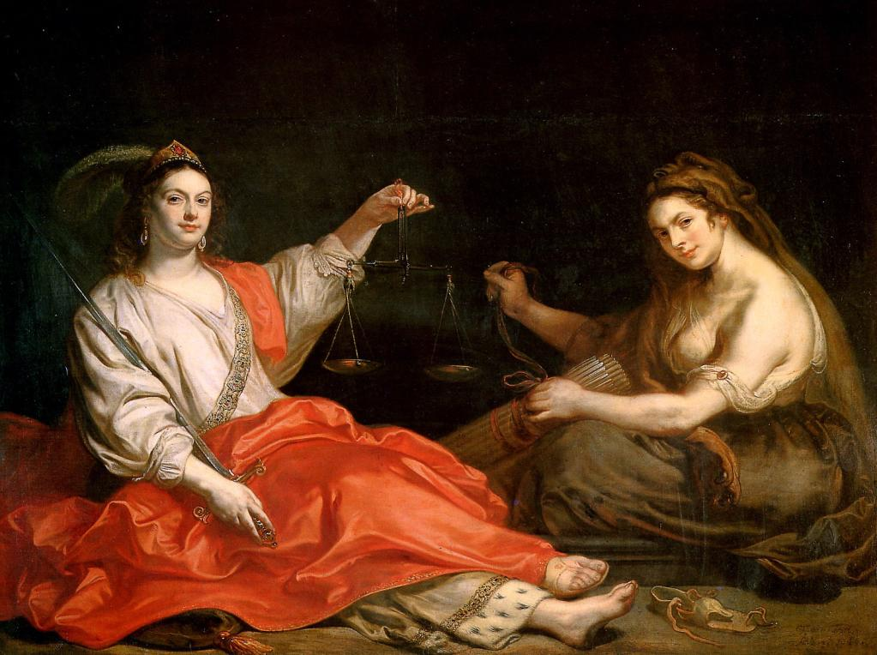
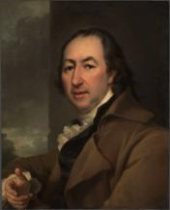
As one of the modern Russian philosophers A. I. Novikov noted, "it was in Rome that the concept of justice was translated from the language of philosophical reasoning into the exact language of legal formulas."

Slide 7
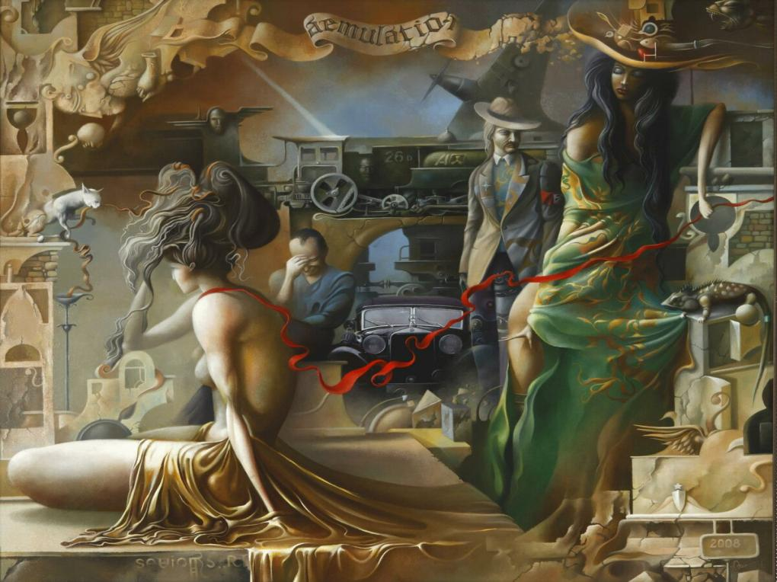
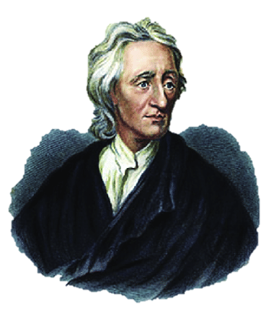
J. Locke, in his work «Тwo treatises on the statehood of government", expressed his concept of law and social contract, where he divided justice as a contract, submission to the law and as achieving harmony between personal and public interests.

Slide 8

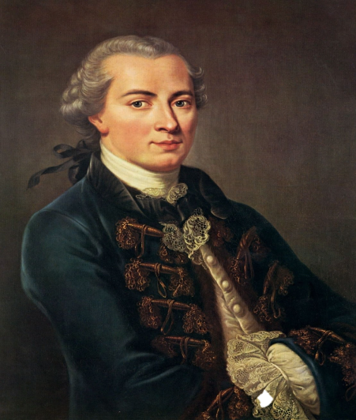
Kant emphasized the difference between ethical and legal justice, and based on these differences, he drew the following conclusion: the "court of Justice" contains contradictions and consists of two courts: the "court of conscience", which refers to ethical justice, and the "court of law", which expresses legal justice.

Slide 9
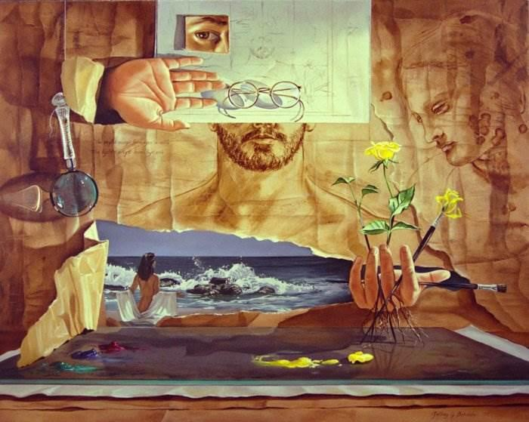
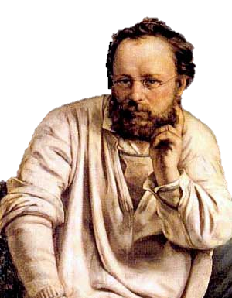
The French philosopher Pierre Joseph Proudhon considered justice to be the basic concept of morality. In his work "on justice in the church and in the revolution", he noted that the first sign of justice and its beginning are a sense of human dignity, mutual respect, and harmony of personal interests.

Slide 10

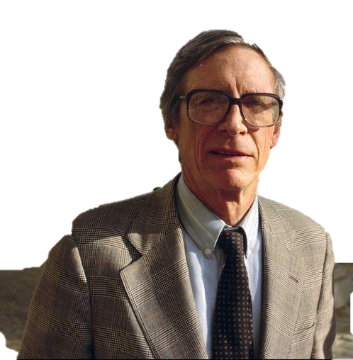
John Rawls emphasizes that justice primarily fixes the real position of the individual in society, testifies to the impossibility of normal life in society without meeting the elementary economic, political, spiritual, and legal needs of its members, without protecting their rights and freedoms.

Slide 11


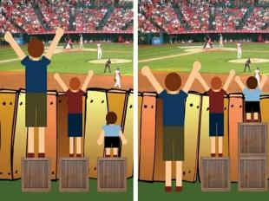
Law by its very nature is a regulator that acts on the basis of applying equal measures to different subjects. And this is the fairness of law, because such regulation is based on the principles of proportionality, balance of interests, equal bearing of a particular burden.

Slide 12
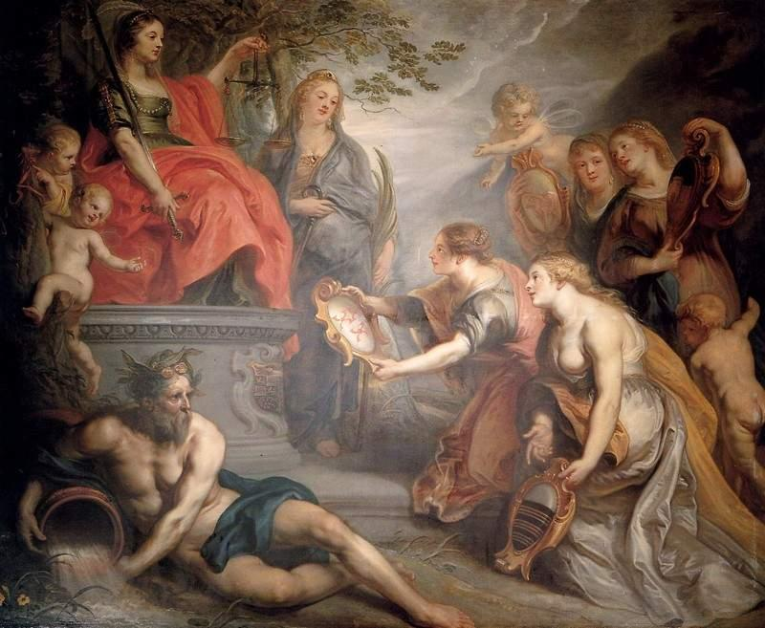
Of particular importance is justice in the sphere of jurisdictional application of law in the resolution of social conflicts, the imposition of punishment, where retribution on the part of the state must correspond to the measure committed by the offender.

Slide 13

Contradictions between law and justice can be expressed not only in the unfair application of legal norms, but also in the publication by the state of initially unfair legal norms. Therefore, a fair approach should be ensured first of all in the process of issuing normative legal acts by the state.

Slide 14
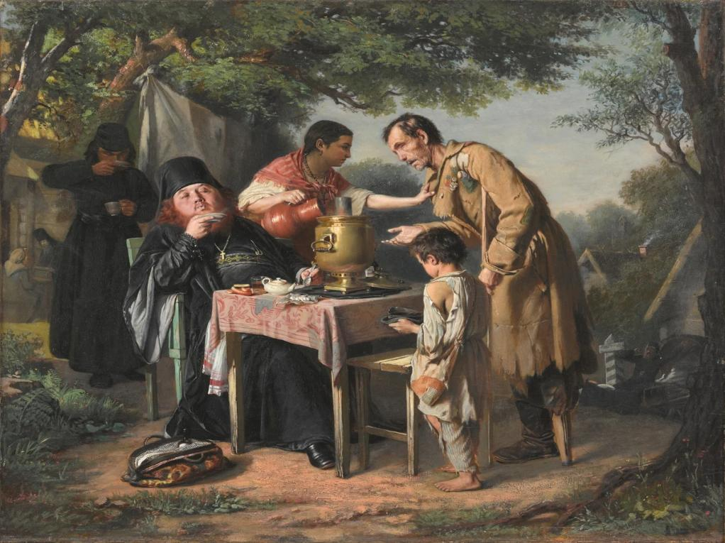
Thus, law, on the one hand, should be based on the moral principles of truth and justice, and on the other - be a form of bringing justice into the law of society.

Slide 15
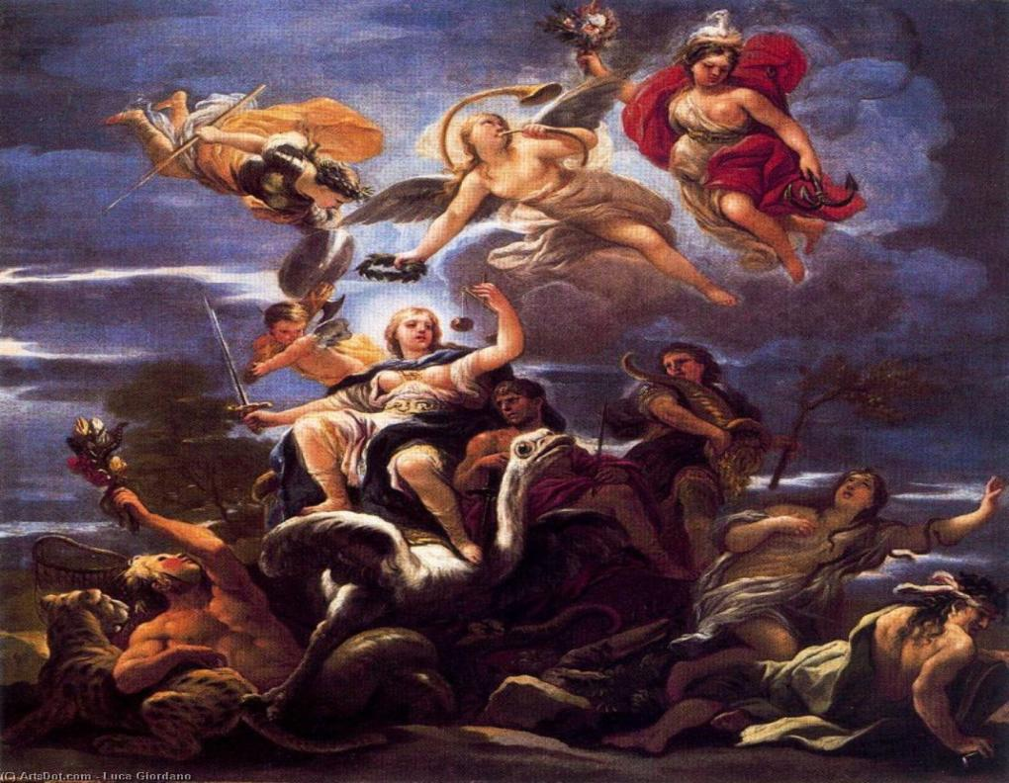
At the moment, the principle of Justice occupies a primary place in legislation, because justice is certainly one of the most important and fundamental principles of law. No matter what meanings philosophers, theorists, and specialists put into this concept, one thing remains indisputable — they all put justice on a pedestal of the principles of law.

Slide 16
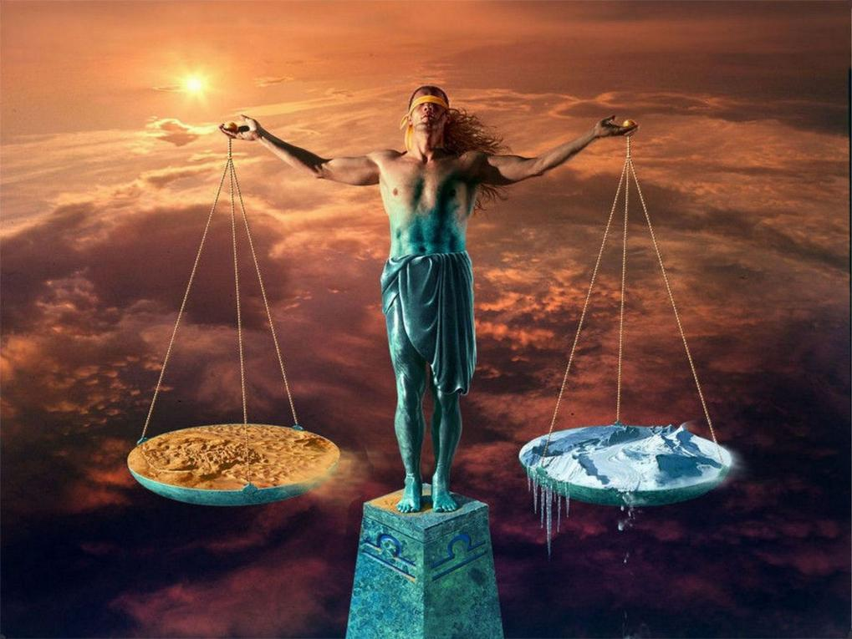




THANK YOU FOR YOUR ATTENTION

