Slide 1
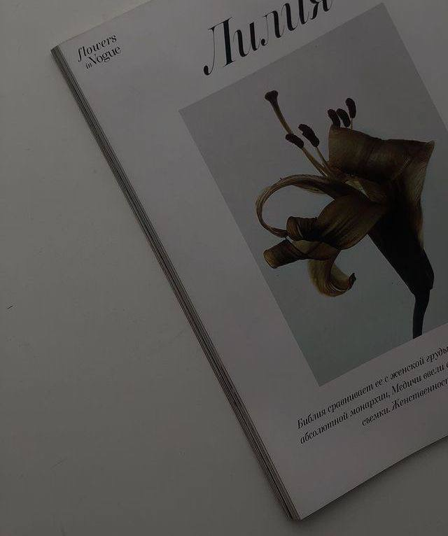
MINIMALISM

Slide 2
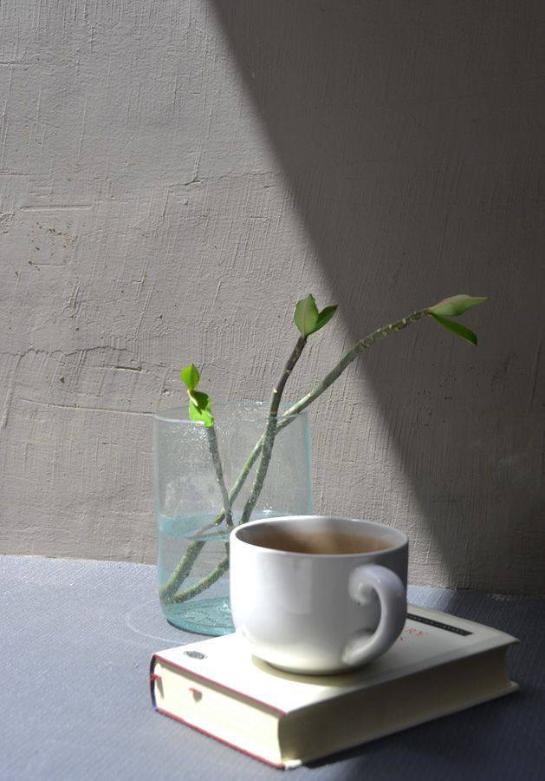
I can
feel
this vibe.
—————————
What Is Minimalism?

Slide 3
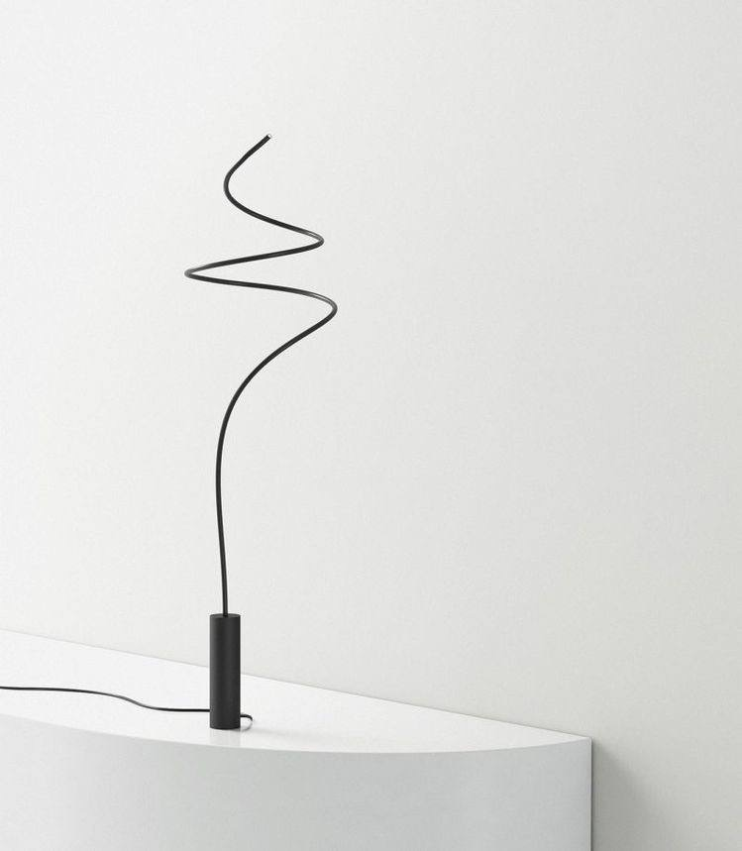
So…Minimalism is the conscious promotion of the things we love most and the elimination of anything that distracts us from them.

Slide 4
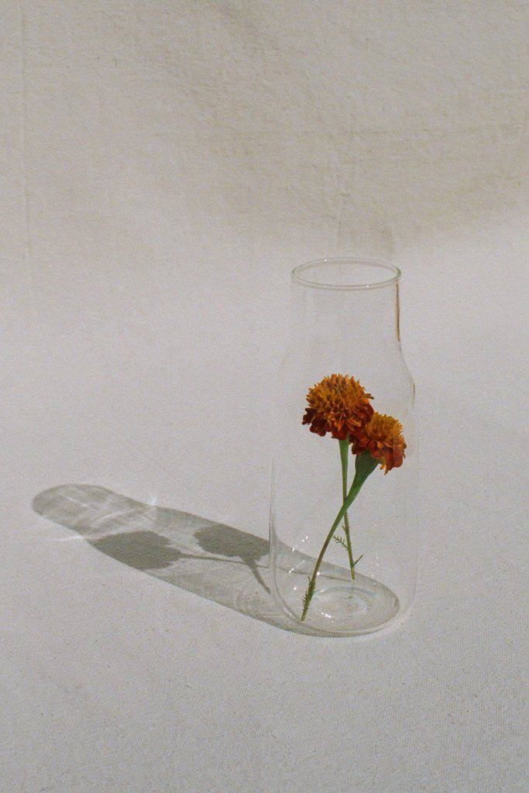
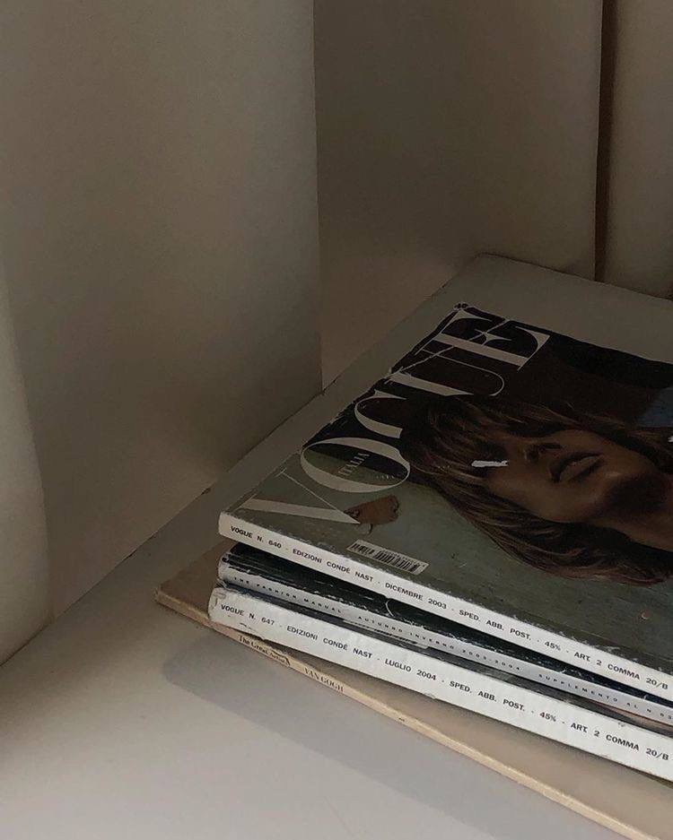
So aesthetic

Slide 5
That’s End?
…maybe…

