Slide 1

BMW Group
History and Development
Dubliak V., Lyashenko M. 101FM

Slide 2
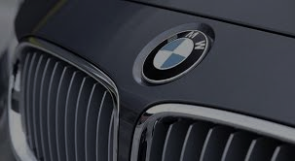
Today, the BMW Group, with more than 30 production and assembly facilities as well as a global sales network, is the world’s leading manufacturer of premium automobiles and motorcycles, and provider of premium financial and mobility services. The so-called BMW Group also includes such brands as MINI and Rolls-Royce Motor Cars.

Slide 3
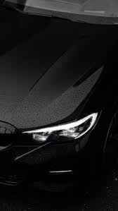

The motto of BMW is "with pleasure behind the wheel".

Slide 4
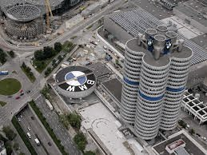


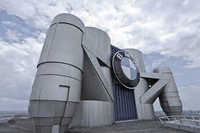
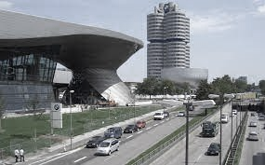
The BMW Headquarters, also known as the BMW Tower, is a high-rise building located in the Am Riesenfeld area of Munich, Germany. The building has served as the global corporate headquarters of German automaker BMW since 1973. It was declared a protected historic building in 1999, and it is often cited as one of the most notable examples of modern architecture in Munich.

Slide 5
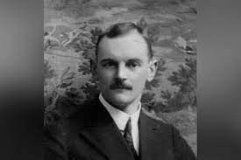
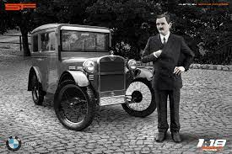


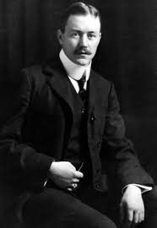
The official date when the German company for the production of BMW cars was founded is March 7, 1916, by Carl Friedrich Rapp, when an aircraft manufacturer called Bayerische Flugzeugwerke was founded. This company was renamed Bayerische Motoren Werke (BMW) in 1922. However, the BMW name dates back to 1917, when Rapp Motorenwerke changed its name to Bayerische Motoren Werke.

Slide 6
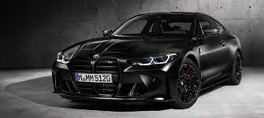



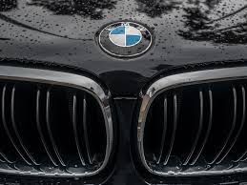
Benefits Package.
Car Program.
BMW company vehicle program gives our associates the opportunity to enjoy driv- ing their own BMW through assignment or lease programs. We believe this is a great way for you to experience the ben- efits of our vehicles so all employees can become advocates for our brand and share our pride in their quality.

Slide 7
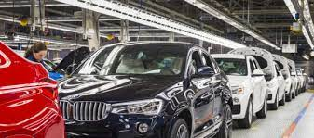

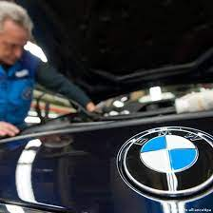
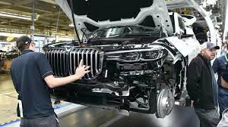
Benefits Package.
The BMW company has developed a comprehensive program that includes:
Medical, Dental, Prescription and Vision coverage
Paid time off
Retirement Income Account
Life Insurance
BMW Associates Assistance Program
Medical Flexible Spending Account (FSA & HSA)

Slide 8
Thank you for your attention

