Slide 1
Addictions
B1/B2

Slide 2
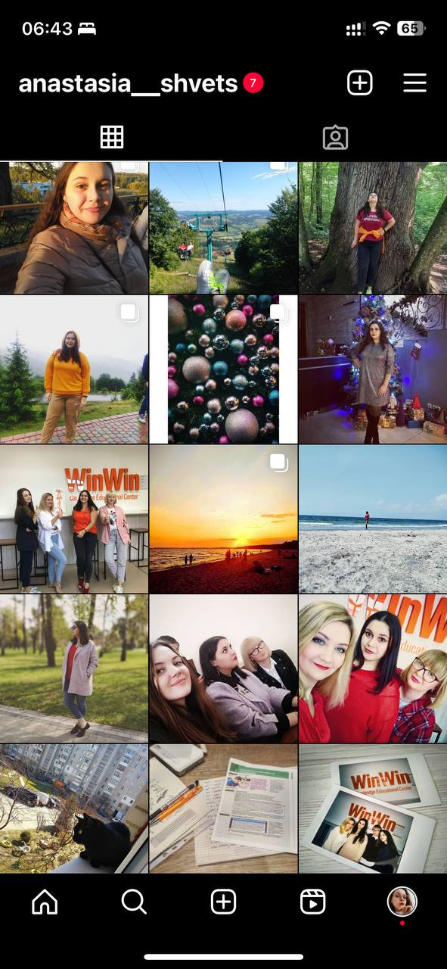
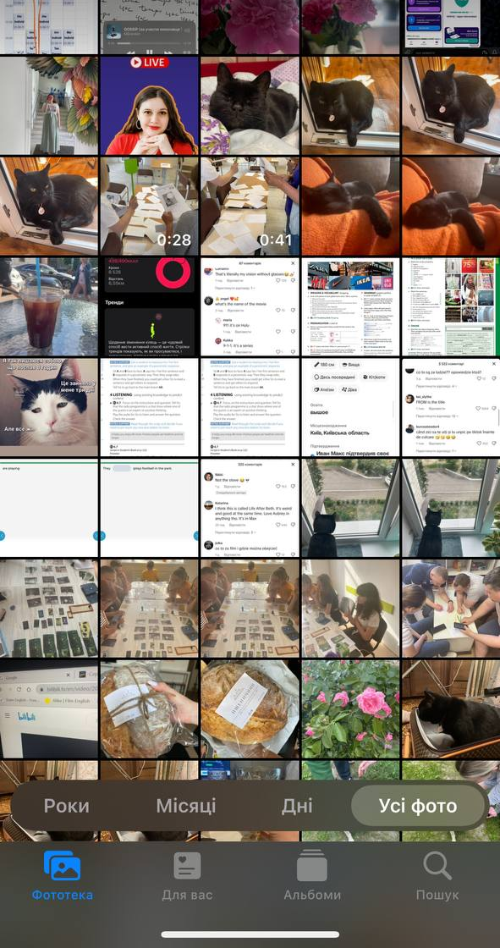
What information can you find about me?

Slide 3
Talk to your partner
Show your partner some of your photos, or your social media profile

Slide 4


Slide 5
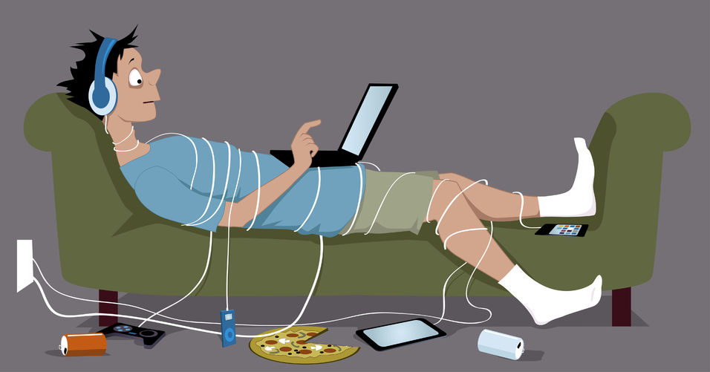

Slide 6
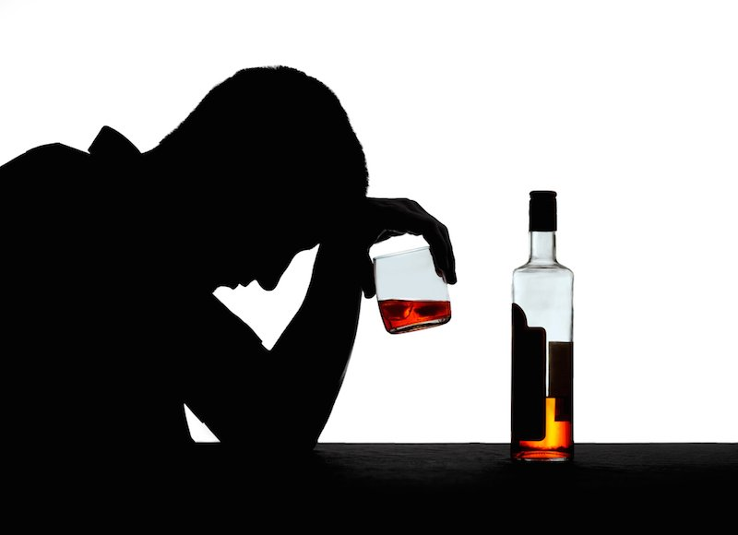

Slide 7
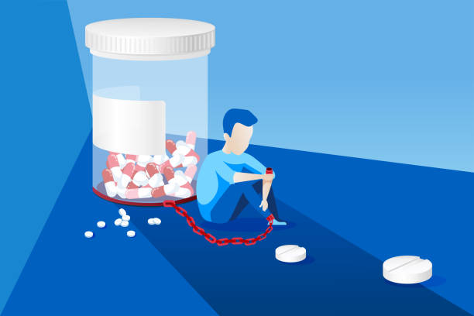

Slide 8
Which addiction is the worst? Why?

Slide 9
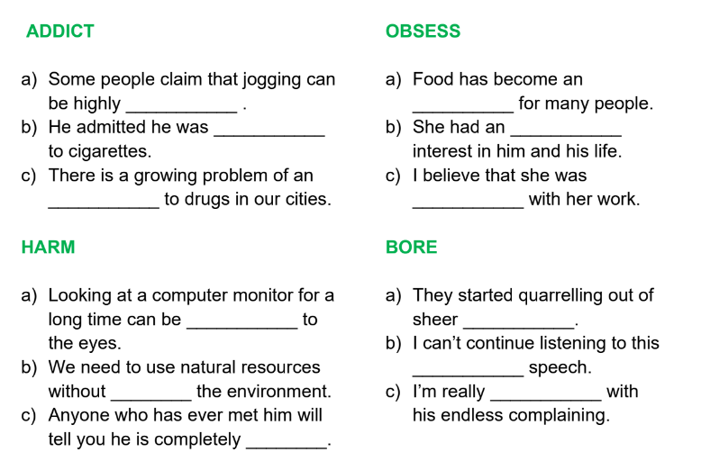

Slide 10
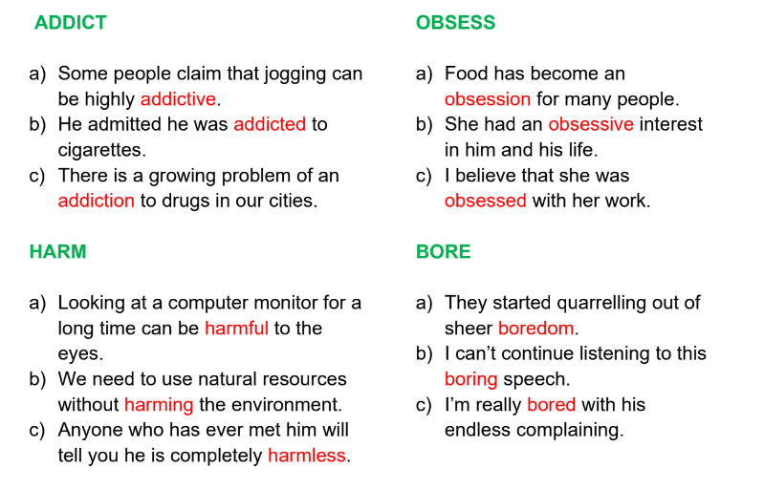

Slide 11
Talk to your partner
What are some things that people are addicted to?
Brainstorm.

Slide 12
Talk to your partner
Are you addicted to anything?
Talk about it.
Is it dangerous?

Slide 13
Talk to your partner
Is TV important to you?
How many hours do you watch every week?

Slide 14
Talk to your partner
Which addictions are dangerous?
Which aren’t?

Slide 15
Talk to your partner
Do you know anyone who is addicted? Talk about it.
(don’t use real names)

Slide 16
Talk to your partner
Have you ever played cards (or any other game) for money?
Talk about it.

Slide 17
Talk to your partner
Do you ever buy things on the Internet or from a catalogue? How often do you do this?

Slide 18
Talk to your partner
What’s your favourite restaurant? How often do you eat pizza or hamburgers?

Slide 19
Talk to your partner
How can you stop being addicted to something? How can we help people with addictions?

Slide 20
Talk to your partner
How often do you drink coffee?
Could you live without it?

Slide 21
Talk to your partner
Do you ever drink alcohol? How much do you usually drink?

Slide 22
Talk to your partner
Are you a workaholic?
How many hours a week do you work? Do you take work home?

Slide 23
Talk to your partner
Do you have a mobile phone? How often do you use it?
What do you use it for?

Slide 24
Talk to your partner
Do you smoke? If not, why not? If so, could you stop if you wanted to?

Slide 25
Talk to your partner
Are you a shopaholic?
How often do you go shopping?
Is it dangerous? Explain.

Slide 26
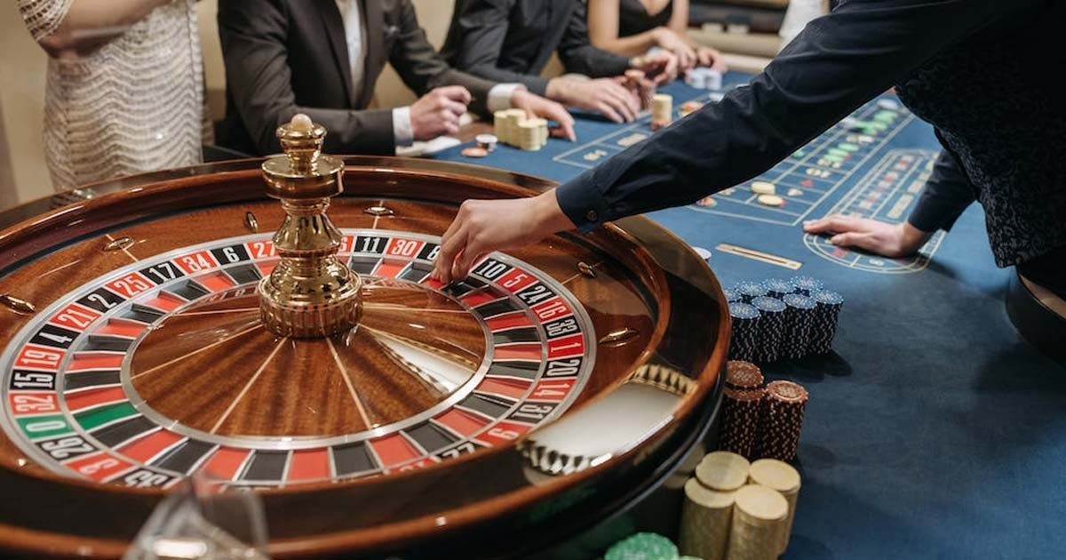
Talk to your partner
Is gambling popular in your country? Is it legal?
What do people gamble on?

Slide 27
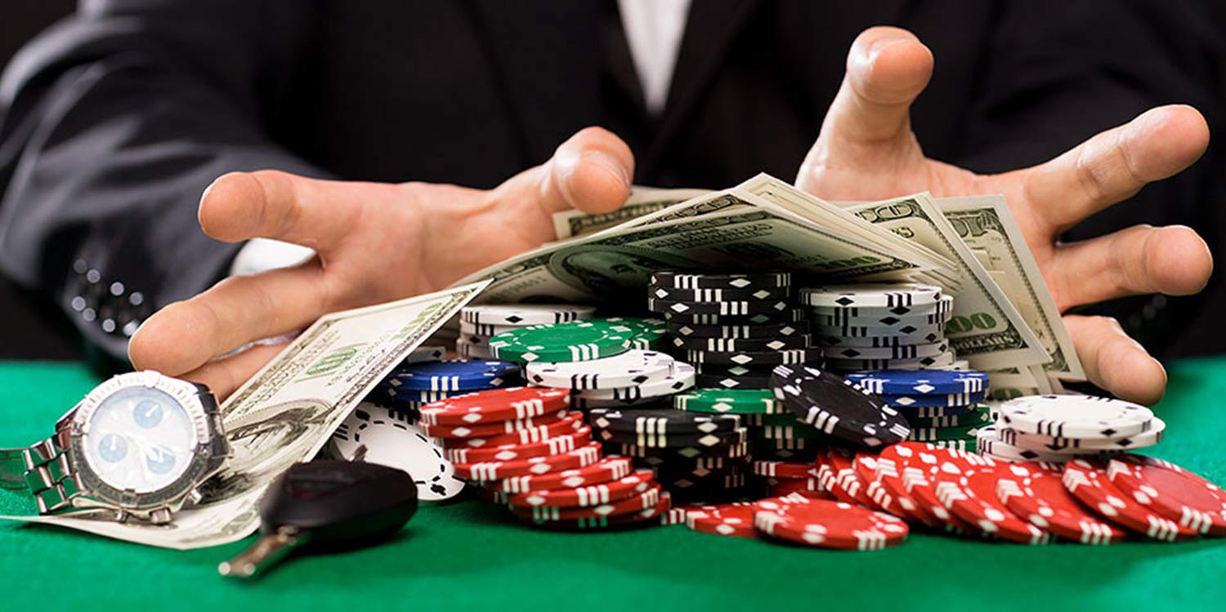
Person A
You are at a bar complaining to one of your friends about your wife’s gambling addictions
Person B
You are listening to your friend talk about his wife’s gambling problem. Give him some advice on how to solve the problem.

Slide 28
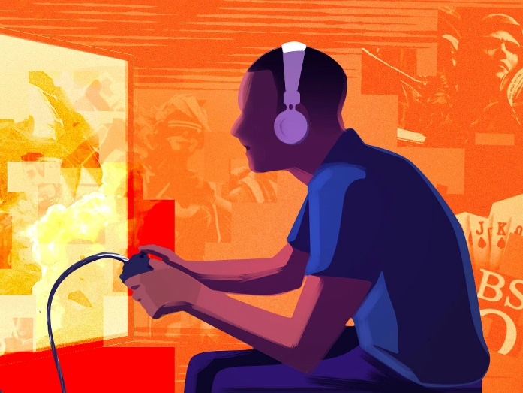
Person A
You are a students who loves video games and hates homework.. Your mother keeps telling you to stop playing video games, but you don’t want to stop.
Person B
You are worried your child plays video games to much. He has many important exams and soon and you are worred he will get a bad score. You think he should study more.

Slide 29
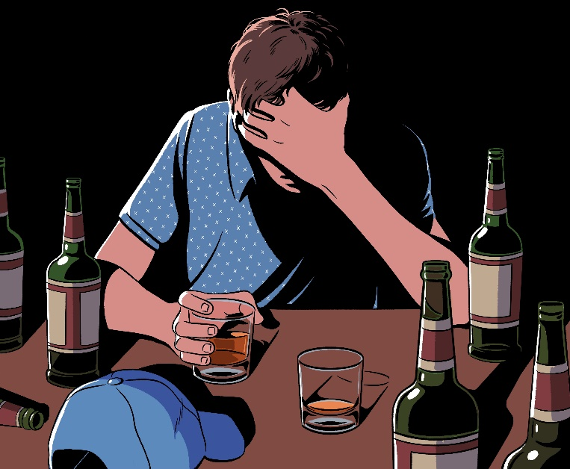
Person A
Your co-worker who is also your friend has a drinking problem and it is affecting his performance. You heard the boss mention that he was thinking about firing him. You want your friend to stop drinking so much and be more responsible.
Person B
Your wife has just told you she wants a divorce, so you don’t want to go home after work and go to bars and drink every night instead.

Slide 30
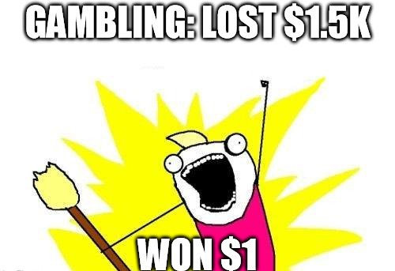
Person A
Your brother/sister has a gambling problem and doesn’t have a job. He wants to borrow money from you because he doesn’t have enough money to pay his rent.
Person B
You don’t like to work and think you can get rich through luck. You have tried several times to gamble your way to wealth but have failed many times. Your landlord is threatening to evict you if you don’t pay your rent, so you ask your brother for help.

Slide 31
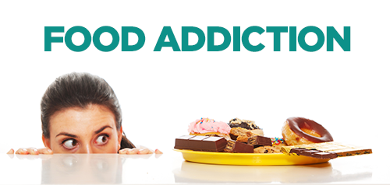
Person A
Your friend is gaining weight and is afraid that guys will not like her if she is fat. Your friend asks you for help.
Person B
You are gaining weight and don’t know how to stop. You like eating junk food too much. You ask your friend for advice on how to stop.

Slide 32
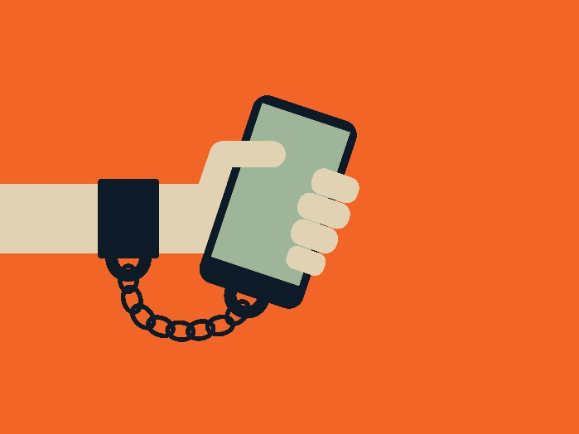
Person A
Your best friend used to talk to you all the time and you would share everything with each other. Now she bought a cell phone and when you are together she spends most of her time texting her friends.
Person B
You just bought a new cell phone and enjoy chatting with your friends. You pay less attention to those around you and more attention to your phone.

Slide 33
