Slide 1
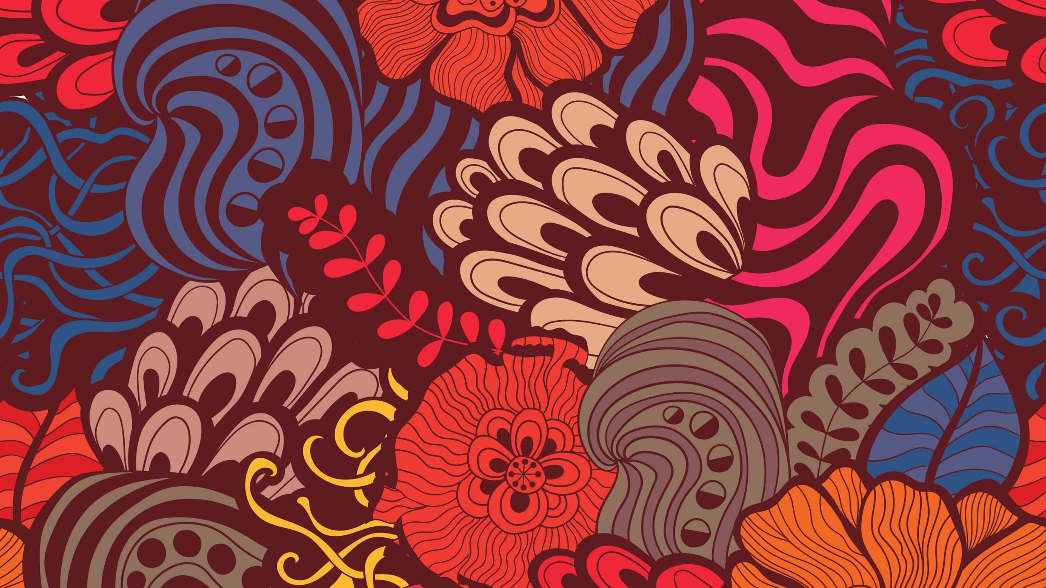
Youth Subcultures

Slide 2
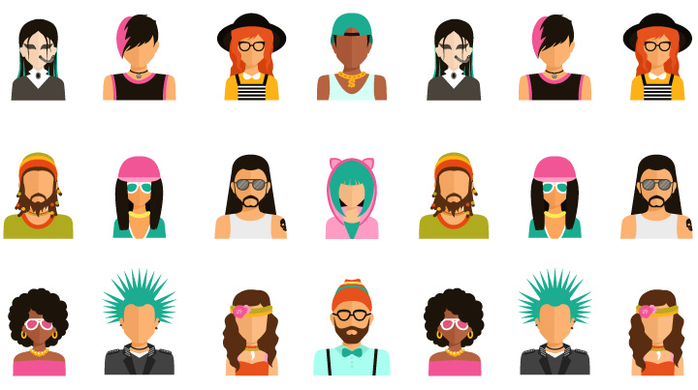
Belonging to a social group or youth subculture is often about exploring who you are and what you stand for.
During adolescence, teenagers strive to form independent adult identities. Experimenting with different social groups is one way of doing this. It’s how your child can test out being someone new.

Slide 3
Youth music genres are associated with many youth subcultures, such as hip hop, punks, ravers, Juggalos, metalheads and goths. The study of subcultures often consists of the study of the symbolism attached to clothing, music, other visible affections by members of the subculture, and also the ways in which these same symbols are interpreted by members of the dominant culture

Slide 4
Goths
Hippies
Grunge
Gangsta
Emo
The most popular Subcultures
Rockers
Geek Chic
Punks

Slide 5
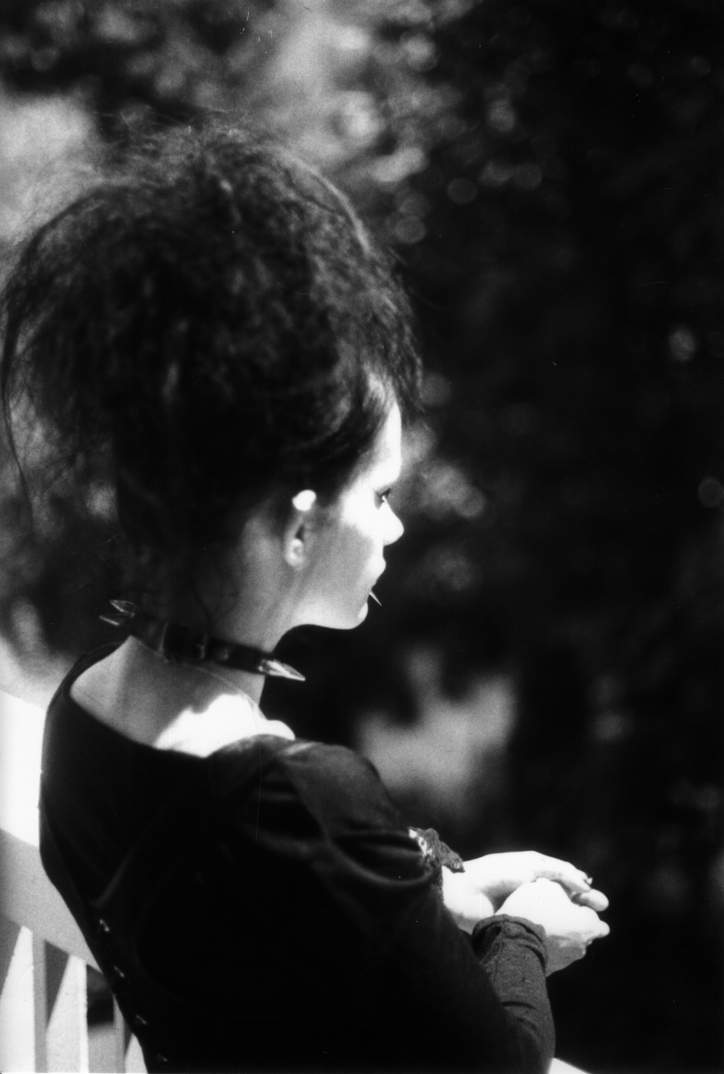
The goth subculture is a subculture that began in England during the early 1980s, where it developed from the audience of gothic rock, an offshoot of the post-punk genre.

Slide 6
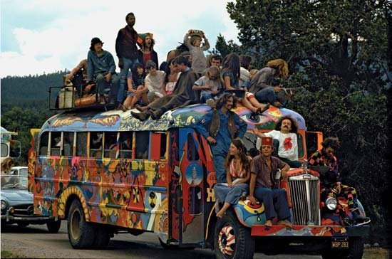
Hippie, member, of a countercultural movement that rejected the mores of mainstream American life, during the 1960s and 1970s. The movement originated on college campuses in the United States. The movement arose in part as opposition to U.S. involvement in the Vietnam War (1955–75).

Slide 7
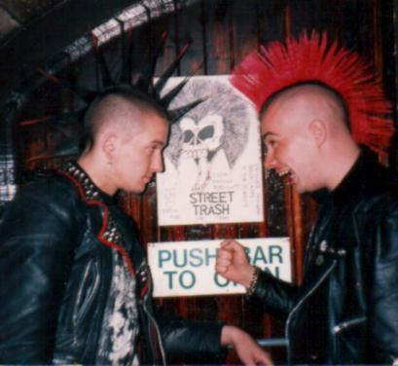
The punk subculture includes a diverse array of ideologies, fashion, and other forms of expression, visual art, dance, literature and film. It is largely characterised by anti-establishment views, the promotion of individual freedom, DIY ethics, and is centred on a loud, aggressive genre of rock music called punk rock.

Slide 8
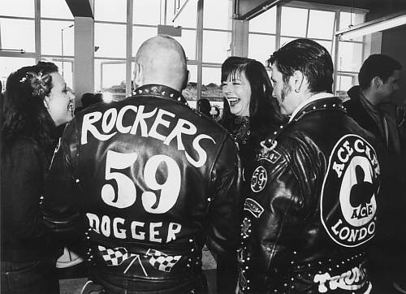
Rockers originally a British youth
subculture that evolved out of the
teddy boys in the 1960s; wore black leather jackets and jeans and boots; had greased hair and rode
motorcycles and listened to
rock'n'roll

Slide 9
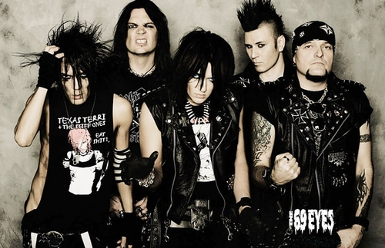
The emo subculture is a lifestyle based on emocore, or emotional hardcore punk rock music. Emo youth may identify with the expressive and confessional lyrics of this genre. Rites of Spring and Embrace were the pioneer emocore bands of the 1980s

Slide 10
Thank you for Attention

