Slide 1
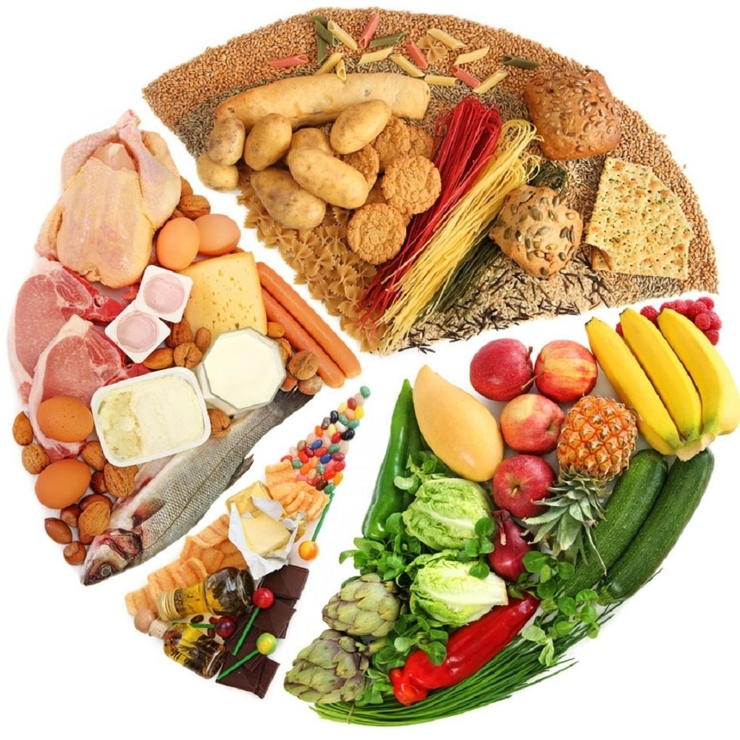
Healthy and unhealthy food

Slide 2
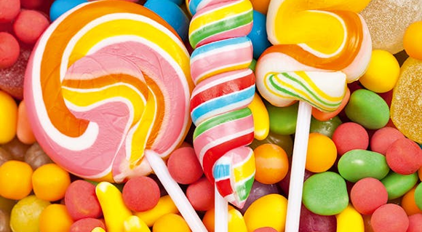
Harmful products
Nutritionists have compiled a list of the most harmful products and habits that destroy teeth, heart disease, and shorten life…

Slide 3
Candies, "Chupa-chupsy"

Slide 4
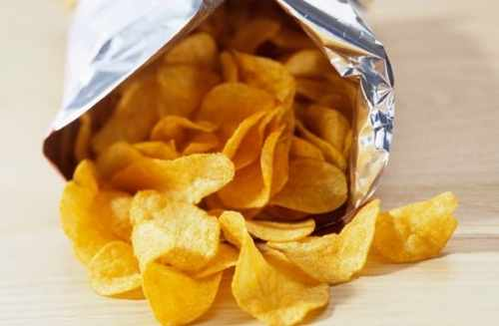
chips

Slide 5
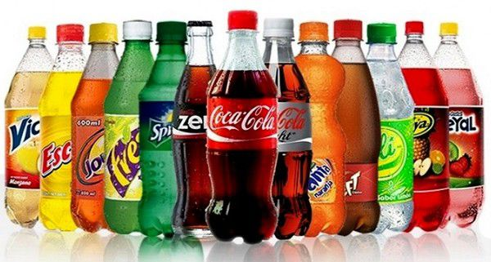
Sweet drinks

Slide 6
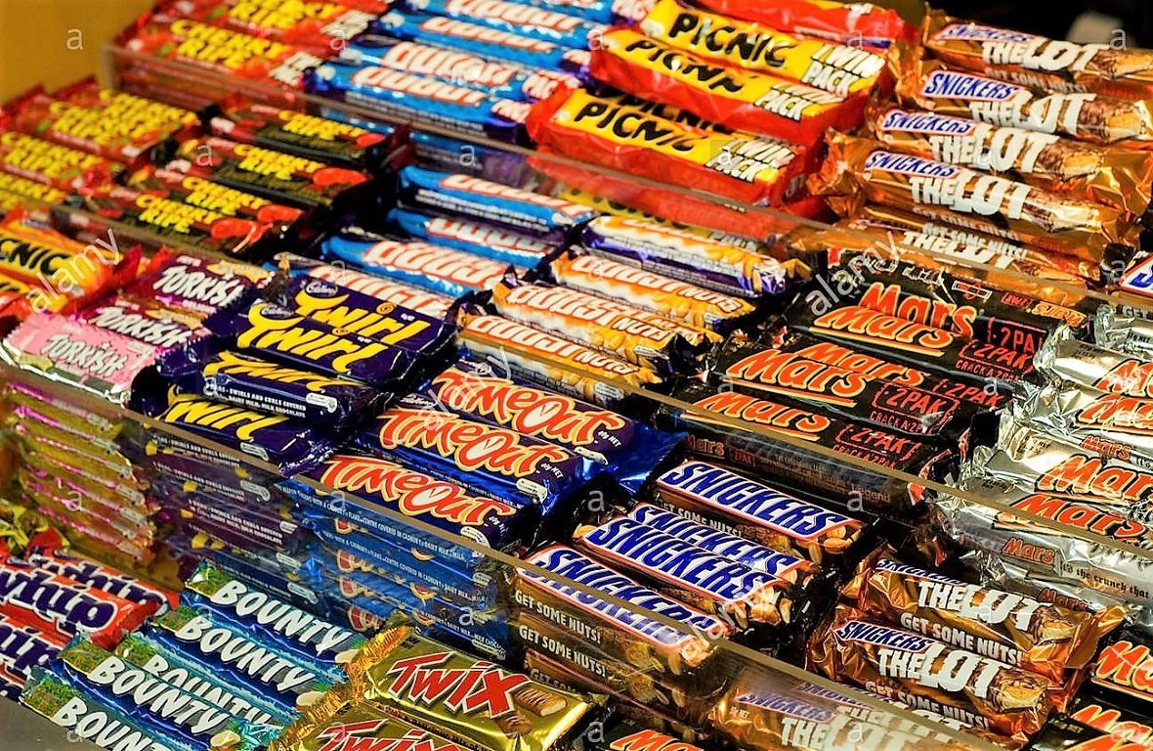
chocolate bars

Slide 7
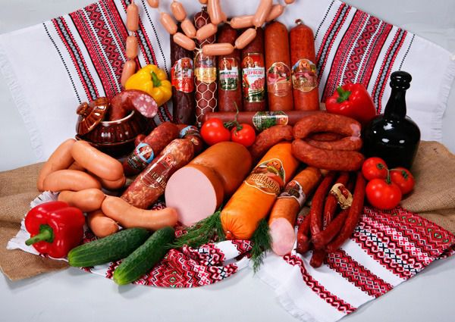
sausages

Slide 8
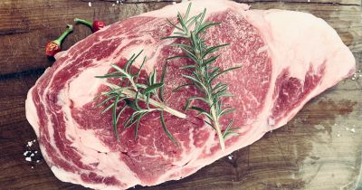
fatty meat

Slide 9
mayonnaise

Slide 10
salt

Slide 11
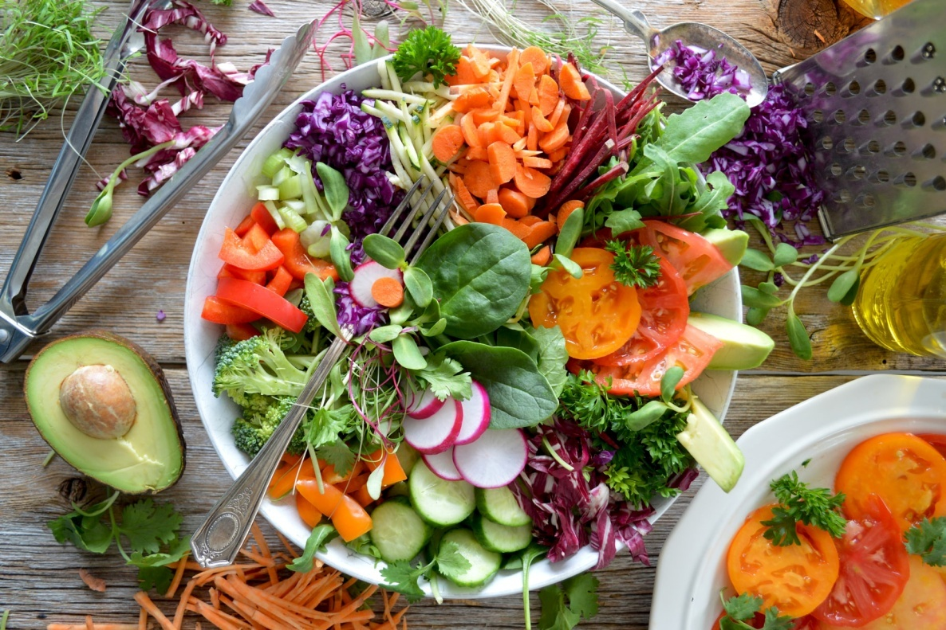
healthy product
Eating well means eating a variety of foods that provide the body with the nutrients it needs to maintain health, well-being, and energy.

Slide 12
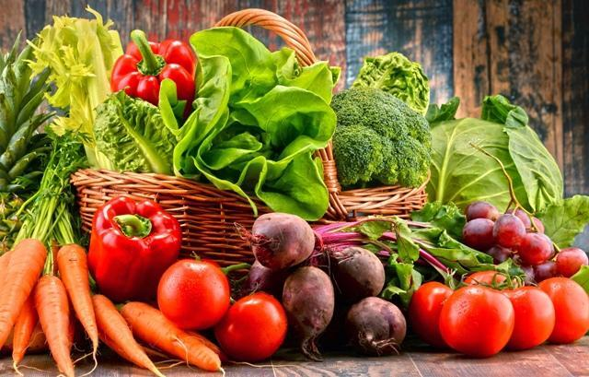
vegetables

Slide 13
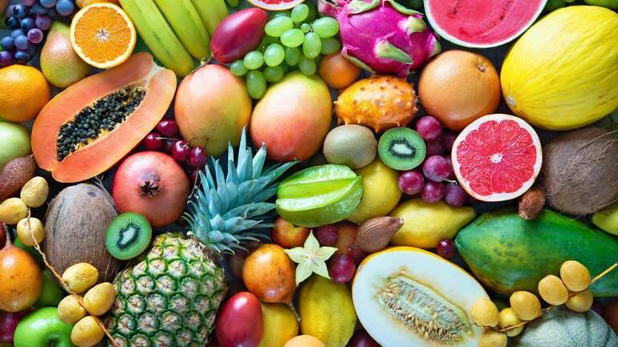
fruits

Slide 14
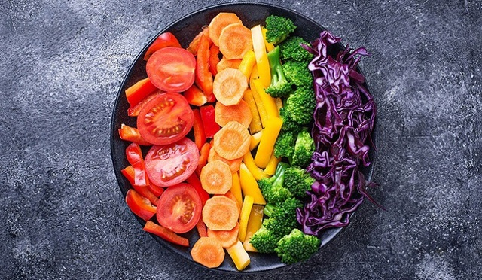
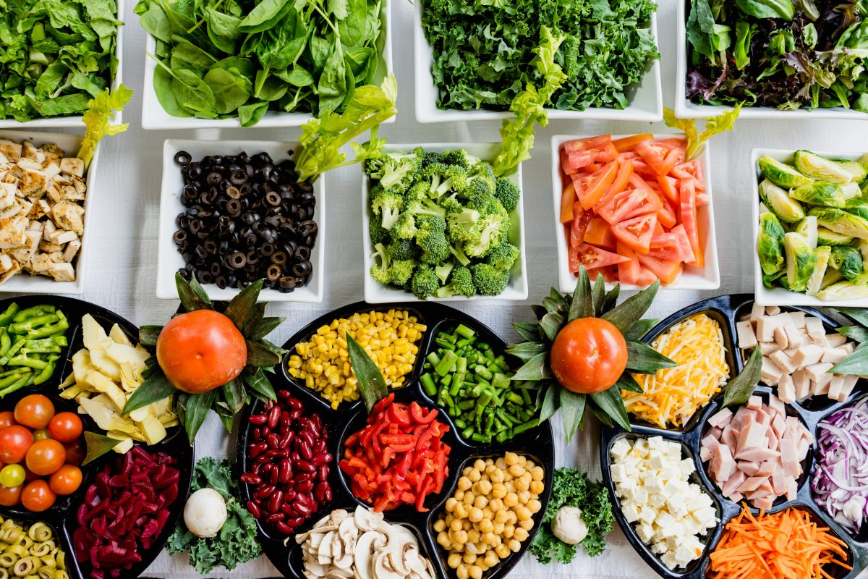
A balanced diet can reduce the long-term risk of diseases such as stroke, diabetes and some cancers, and it also helps maintain a healthy body weight.

