Slide 1






ALL ABOUT WRITER JOJO MOYES

Slide 2

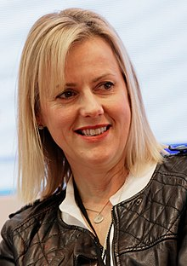



Jojo Moyes, is an English journalist and, since 2002, an award-winning romance novelist.
25%
She is one of only a few authors to have twice won the Romantic Novel of the Year Award by the Romantic Novelists' Association and her works have been translated into twenty-eight languages and have sold over 40 million copies worldwide.
75%

Slide 3
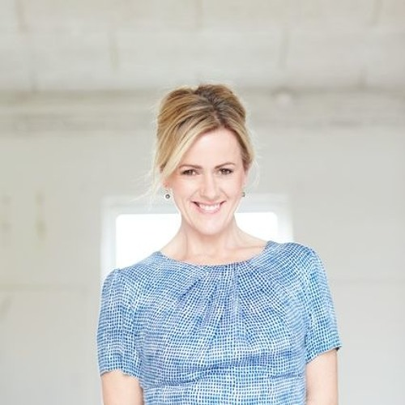
Pauline Sara-Jo Moyes was born on 4 August 1969
Studied at Royal Holloway College and Bedford New College
The scholarship from The Independent allowed Jojo to graduate from City University in London.

Slide 4




Jojo Moyes was born and raised in London. She has described her parents as "bohemian" and her childhood as "eccentric."
Before attending university, Moyes held several jobs: she was a typist at NatWest typing statements in braille for blind people, a brochure writer for Club 18-30, and a minicab controller for a brief time.
While an undergraduate at Royal Holloway, University of London, Moyes worked for the Egham and Staines News.
Characteristics

Slide 5
After the birth of her first child, Moyes realized that she would not be able to travel the world as a correspondent. And in parallel with the articles, a woman started a novel, betting on the love genre.
The first three books did not respond, and Jojo decided that if the fourth did not come out, the writing was not for her. But after reading the first chapters of the new work, immediately 6 publishers began to struggle for the right to publish.

Slide 6
Her most commercially successful book is her eighth one, Me Before You, which has sold over 8 million copies. That novel now has two sequels featuring the same protagonist, After You and Still Me.
The book was first published on 5 January 2012 in the United Kingdom. A sequel titled After You was released on 24 September 2015 through Pamela Dorman Books. A second sequel, Still Me, was published in January 2018.
25%
75%

Slide 7
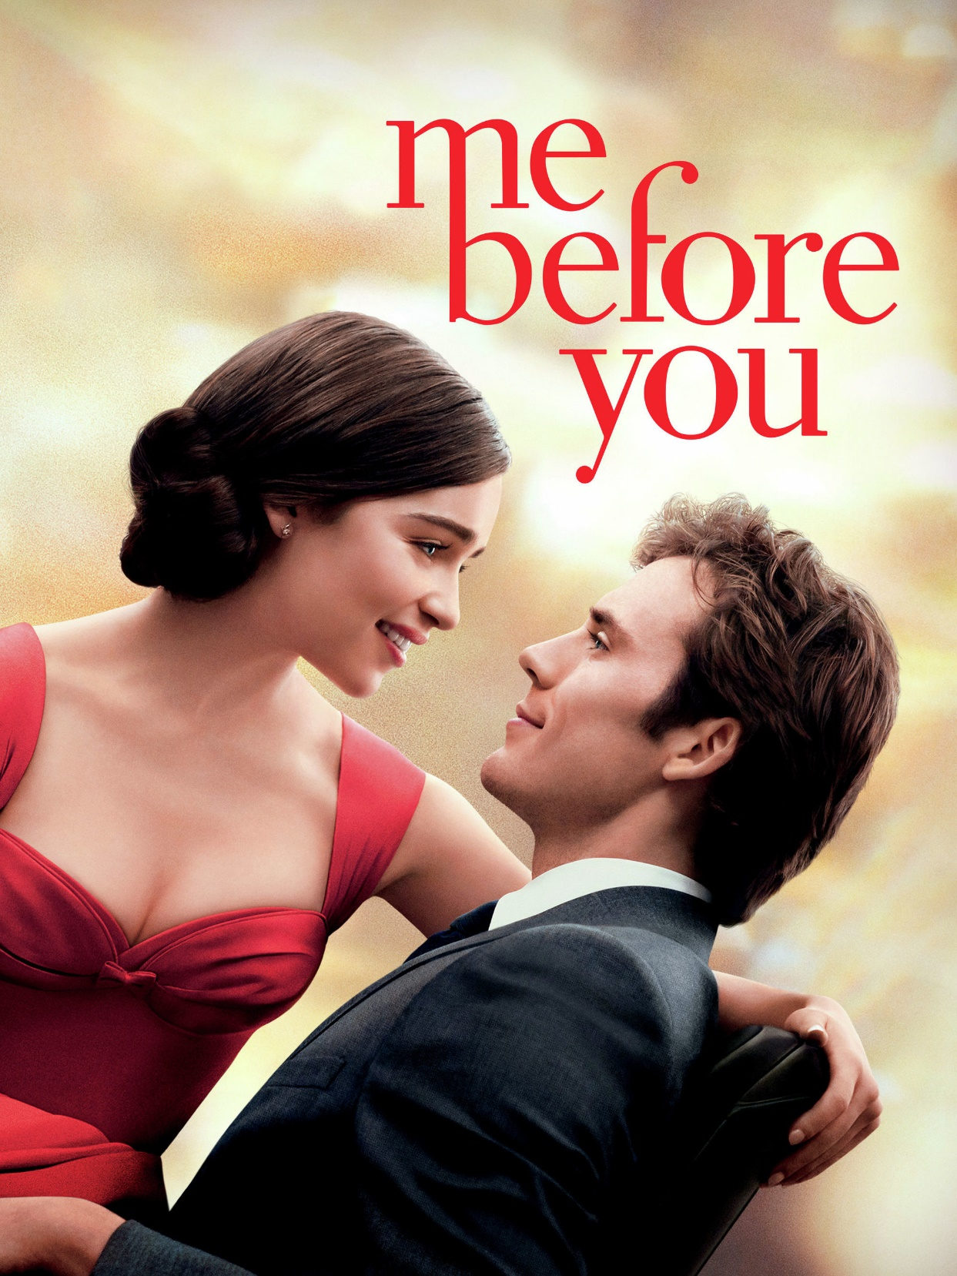
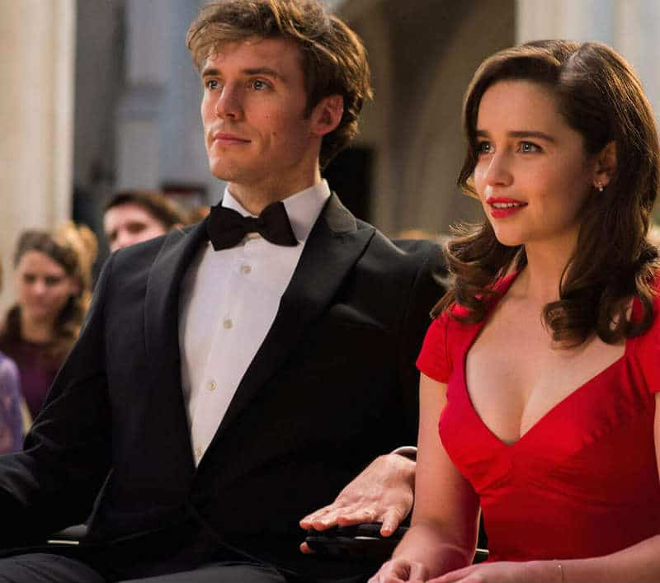
Іn 2013, it was announced that Michael H. Weber and Scott Neustadter had been hired to write an adaptation of Me Before You. In 2016 the film adaptation Me Before You was released and the screenplay was written by Moyes

Slide 8
Jojo Moyes did not want to continue the story of Lou Clark, but she broke that promise by releasing the novel «After You». In the book, the heroine, having survived the death of the beloved, returns to the family, but life will not be the same. In a group of psychological help, the girl meets her soul mate, but past memories interfere with establishing contact.
25%
75%

Slide 9
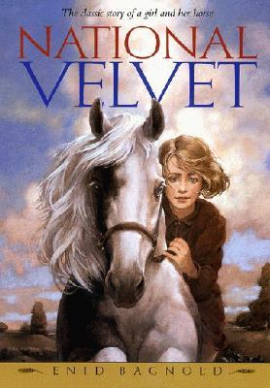
In 2018, Moyes invested £120,000 in the Quick Reads Initiative, an adult literacy project. Her investment gave the program three additional years of funding.
Moyes' favorite book in childhood was National Velvet by Enid Bagnold. She cites Behind the Scenes at the Museum by Kate Atkinson as a book that made her want to be a better writer, and she is inspired by authors such as Nora Ephron,Marian Keyes, Lisa Jewell, Jonathan Tropper, and Jane Austen.
Characteristics

Slide 10
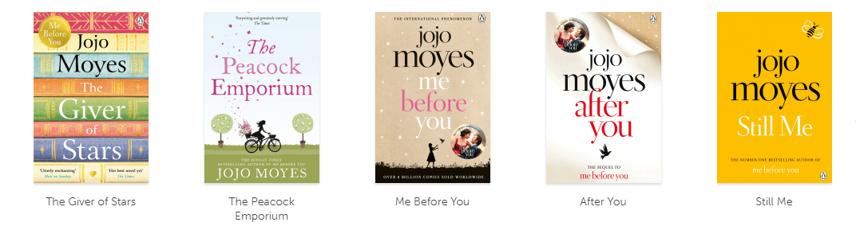
Books by Jojo Moyes

Slide 11
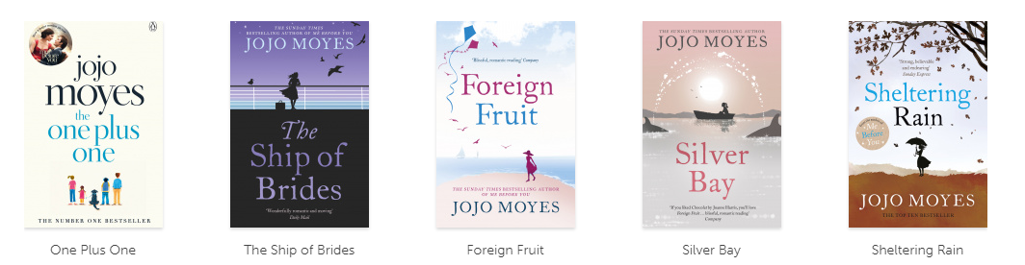

Slide 12
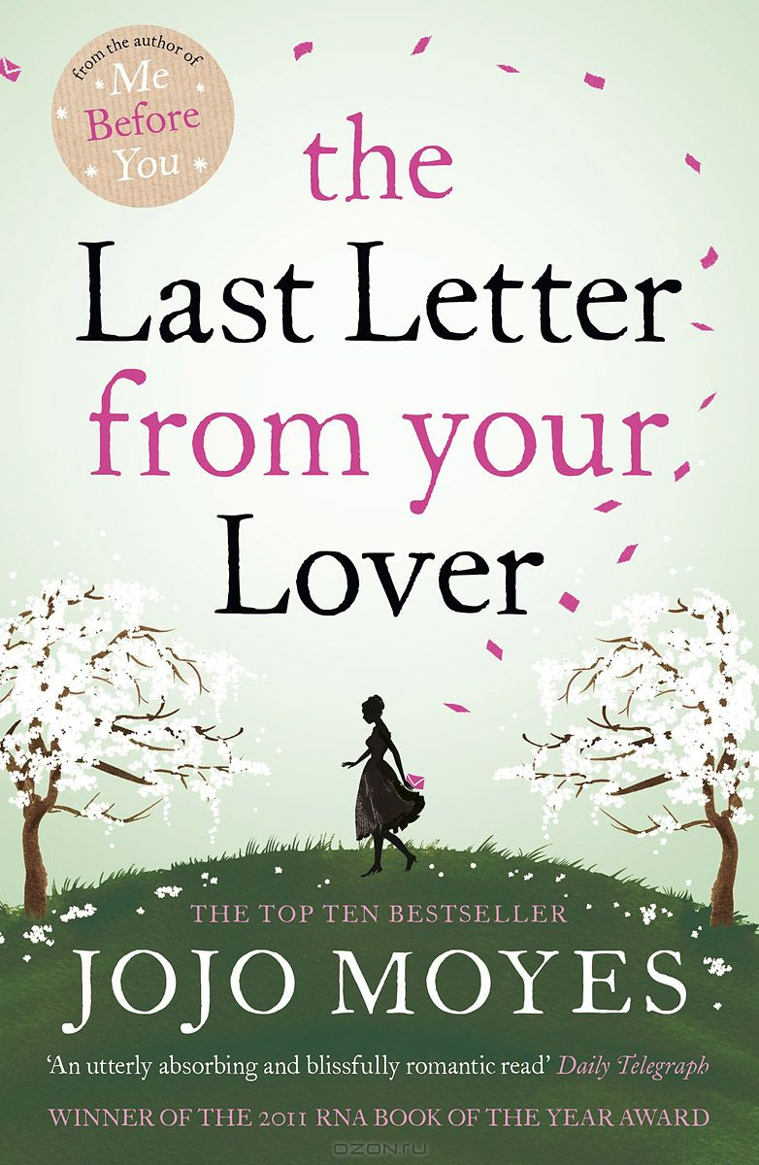
The novel «The Last Letter from Your Beloved» was awarded another award by the Romantic Novelists' Association. Jojo told about a journalist who, in search of material for the article, appeals to archival letters. Romantic and gentle messages were written by a certain Master B, addressed to a married woman, and she, having been in an accident, did not remember her husband or the mysterious stranger.
25%
75%

Slide 13
Awards and achievements
Moyes' books have been translated into forty-six languages, have hit the number one spot in twelve countries and have sold over forty million copies worldwide.
Romantic Novel of the Year Award Winner (2004): Foreign Fruit.
Romantic Novel of the Year Award Nominee (2008): Silver Bay.
Romantic Novel of the Year Award Winner (2011): The Last Letter From Your Lover
old Hall of Fame Winner for After You & Me Before You; Nielsen Awards.
Me Before You hit the New York Times bestseller Top Ten chart in 2016 and spent 19 weeks on the chart.
American Library Association winner for Me Before You, 2014.
Good Reads Best Fiction Award Winner (2018): Still Me.
The Giver of Stars is an international best-seller

Slide 14
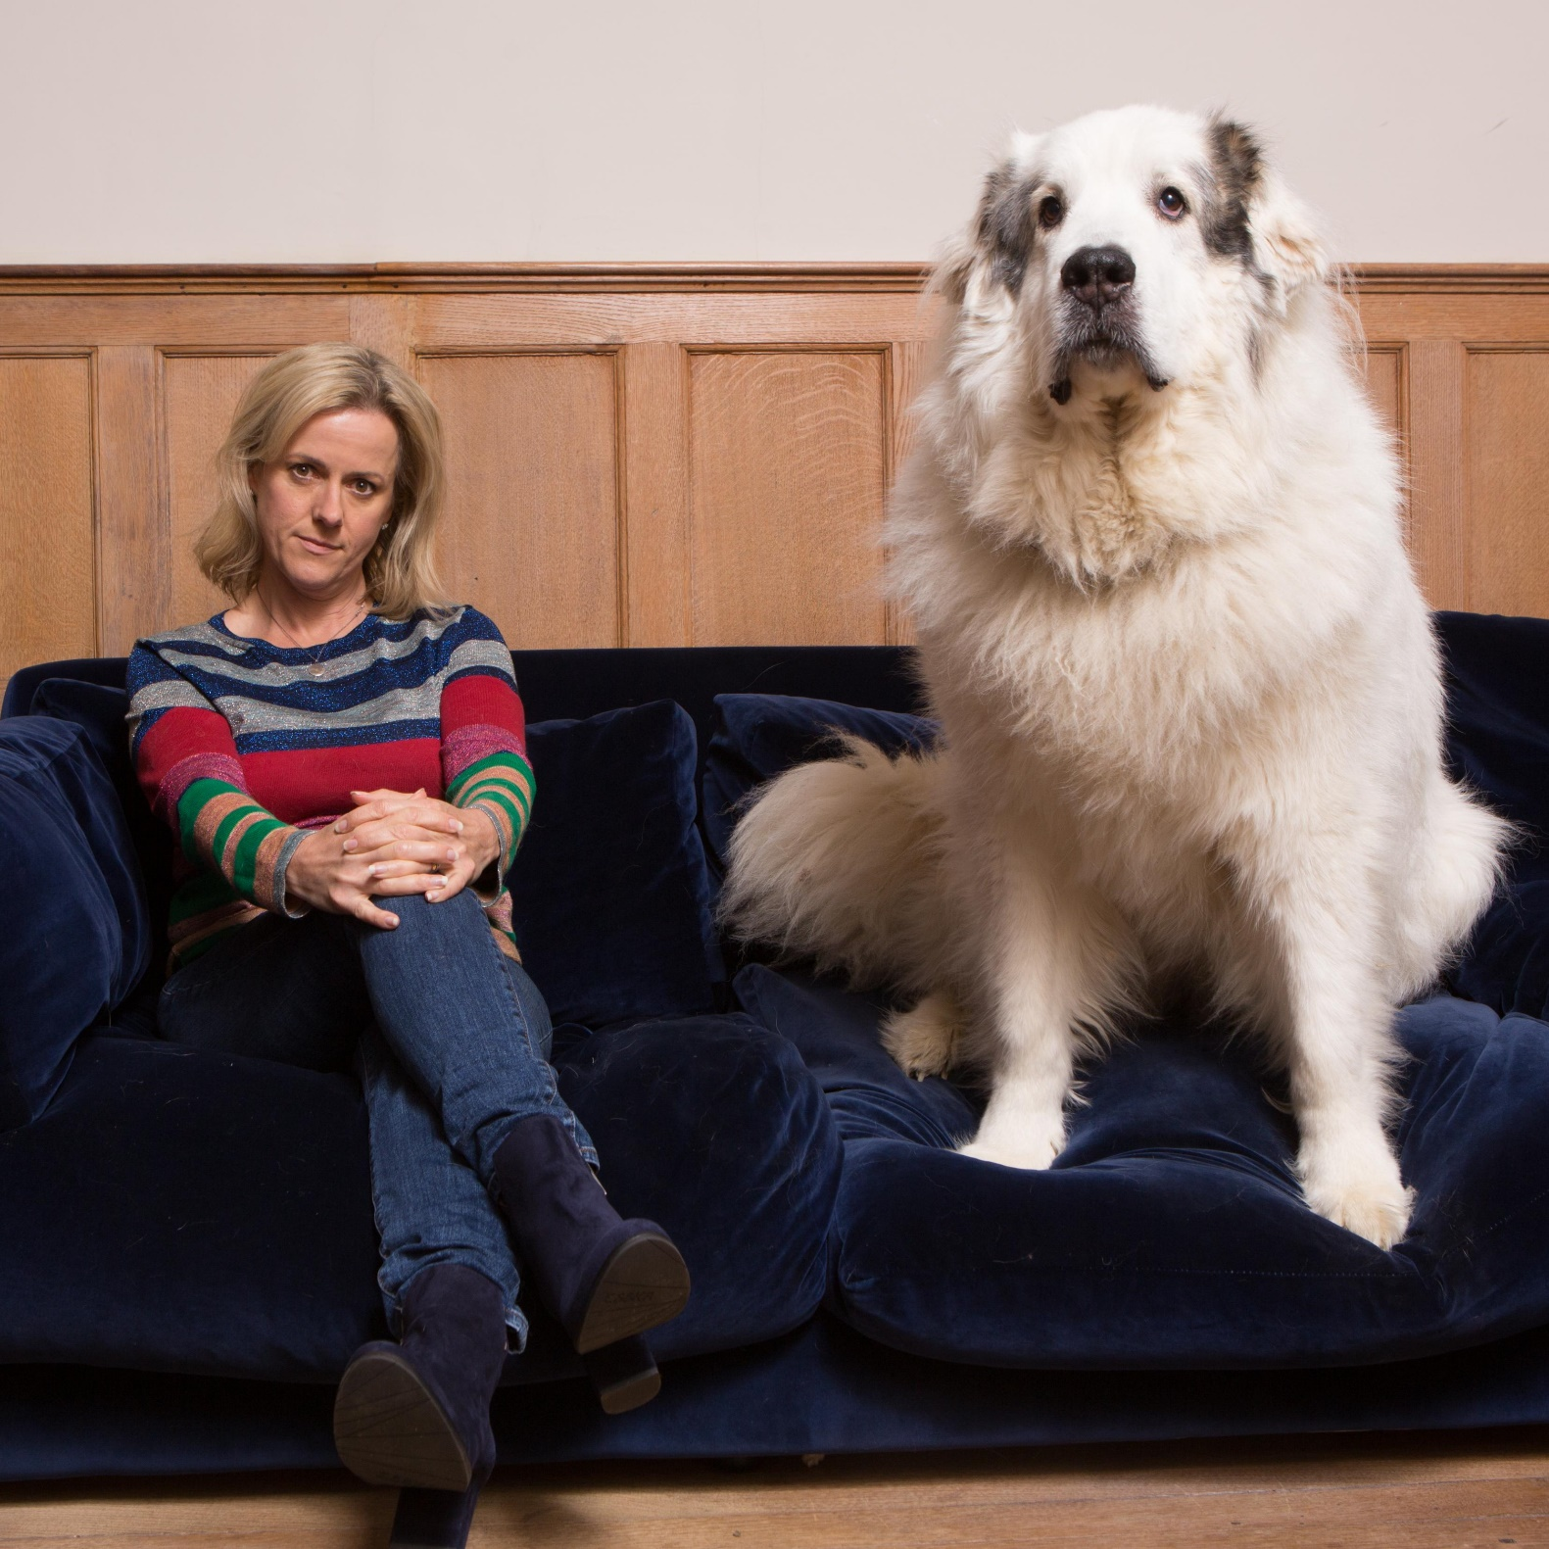
Jojo Moyes lives on a farm in Great Sampford, Essex, with her husband, journalist Charles Arthur, and their three children. Her animals include an ex-racehorse, Brian, and a rescued 58 kg female Pyrenean mountain dog
Characteristics

Slide 15


Thank you for attention!

