Slide 1
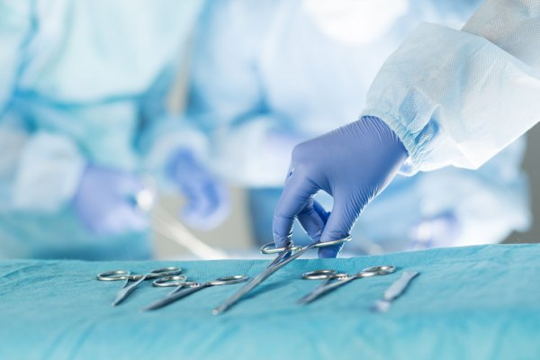
Surgical Toolkit
General direction of surgery

Slide 2
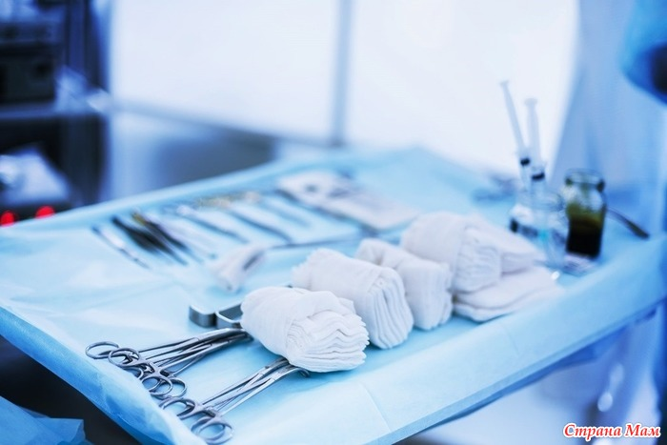
Information
Plan
Surgical instrument, surgical instruments — a set of instruments and mechanical devices used during surgical interventions or manipulations on/with tissues. Sometimes the word "instrument" refers to a single instance of a medical instrument, and the term "instrumentary" is used to refer to the set. A collection of varieties of surgical instruments selected for a specific operation is called a set
Plan
Surgical Toolkit of a general profile and its classification
*Disconnecting tools (slide 3-7)
*Connecting tools (slide 8-10)
* Pushing and pressing tools (slide 11-16)
*Tool holders (slide 17-22)
*Prickly tools (slide 23-26)
Additional Information (slide 27)

Slide 3

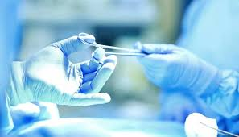
Separating tools

Slide 4

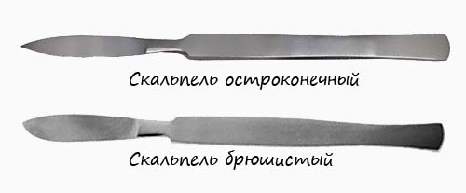
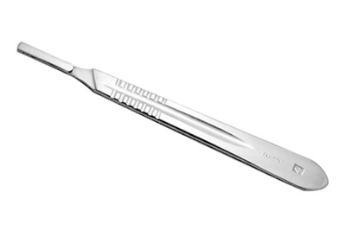
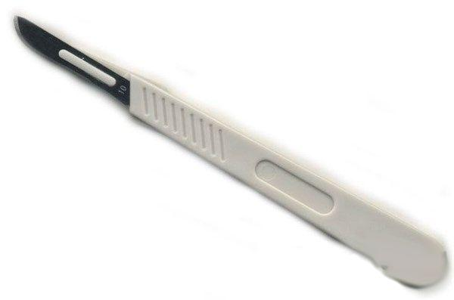
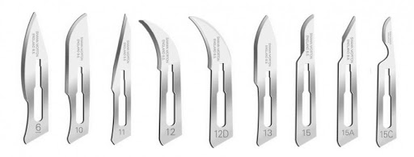
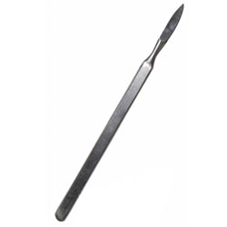
Separating tools
Scalpels
Abdominal (Abdominal) scalpel
Pointed (lanceolate)
With removable blade (blade handle)
Disposable scalpel
Tatum Adams Scalpel
Scalpel blades (replaceable)
2
1
3
4
6
5
. 1. Abdominal scalpel - Intended for making relatively long, rectilinear, deep incisions in the skin, subcutaneous fat, aponeurosis, muscles, for dissecting the capsule of joints, ligaments, and cartilage with significant amplification over a short distance
2. Sharp-pointed scalpel - Intended for punctures of soft tissues: skin from subcutaneous adipose tissue; in the connective tissue wall of an abscess with a chronic inflammatory process; puncture of the wall of the rectum, back wall of the vagina, urinary or gall bladder
3. Scalpel handle - (for different types of operations, can be used as a different type of scalpel from the classification (due to different removable blades)
4. Disposable scalpel - a different type of scalpel from the classification of scalpels, but disposable
5. Tetom Adams scalpel is intended for subcutaneous dissection of tendons
6. Scalpel blades (replaceable) - blades in the form of different classifications of scalpels and types for use in different types of operations, put on the handle of the scalpel (disposable) Recommended for operations in a hospital

Slide 5
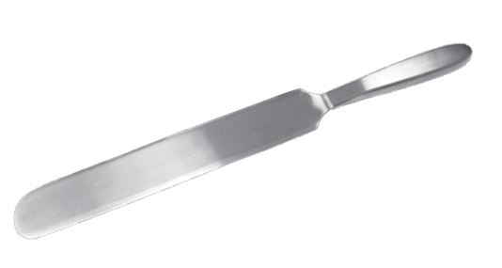
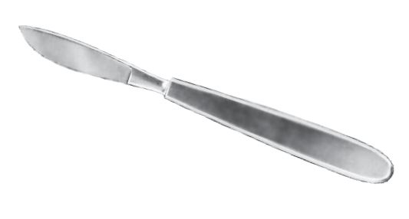
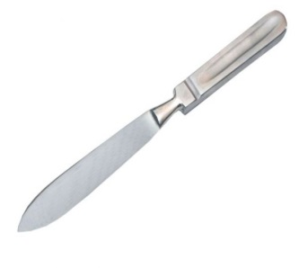
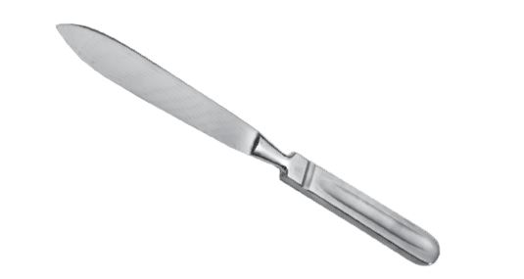
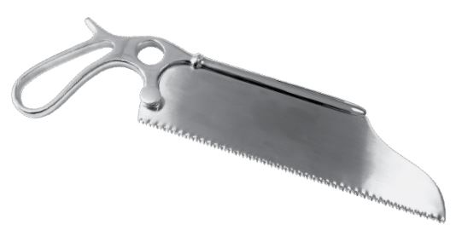
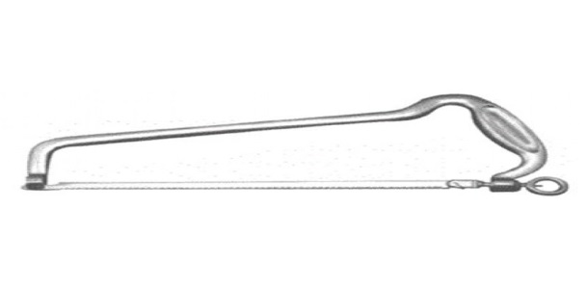
Cutting tools Surgical knives and saws
Brain knife
Amputation knife (large)
Amputation knife (small)
Resection knife
Saw bone sheet
Surgical frame saw
1
1
4
2
3
5
6
1. Brain knife - a double-edged knife with a long flat blade rounded at the end, used during autopsy, for brain incisions
2-3. Amputation knife - intended for use in amputation of limbs and during autopsy
4. Resection knife - intended for dissection of dense tissues (ligaments, cartilage)
5. A bone sheet saw is a tool for separating bone tissue
6. Surgical frame saw - used for sawing hard tissues, larger bones during resection or amputation of limbs and during bone plastic surgery

Slide 6
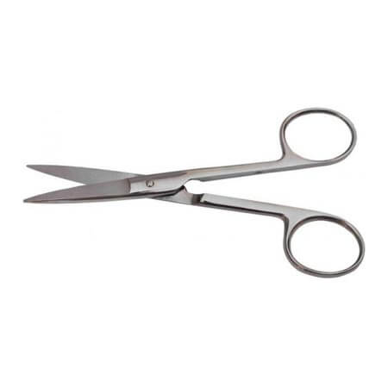
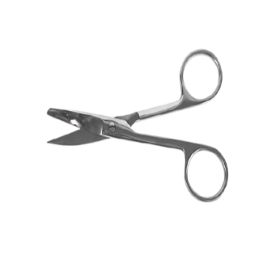
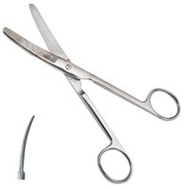
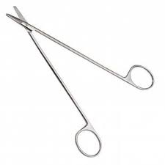
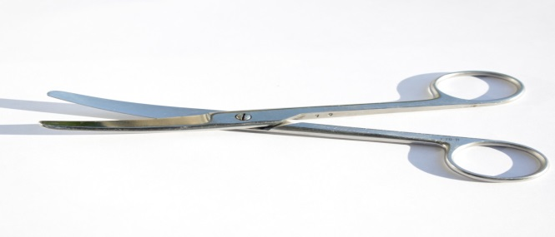
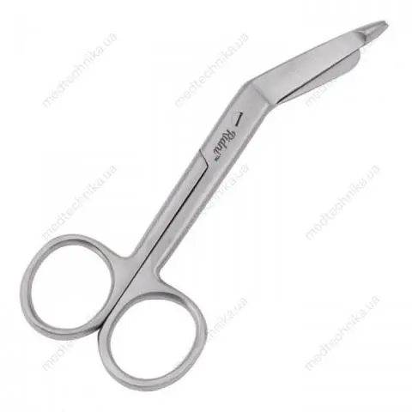
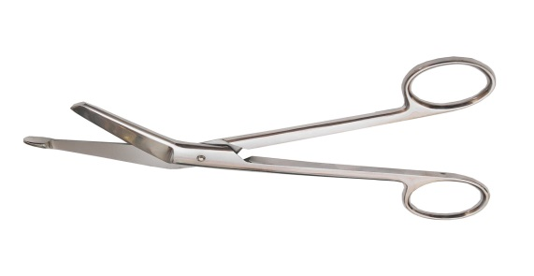
Separating tools Surgical scissors 1
Scissors are sharp and straight
Scissors are bluntly pointed and curved
Scissors are blunt-ended
Scissors curved along the plane (Cooper)
Scissors curved along the rib (Richter)
Lister's scissors
Vascular scissors
1
2
3
7
4
5
6
1. Scissors are sharp and pointed, straight, convenient for adjusting the edges of the wound during cosmetic operations
2. Scissors blunt-pointed curved - the tool is used for cutting soft tissues, in the process of performing dressings, during the removal of sutures, dissection. Extremely convenient when you need to pierce the fabric before cutting
3. Blunt-ended scissors - can be used for preparation and separation of the skin-subcutaneous flap
4. Scissors are curved in a plane (Cooper) - their advantage is that when they make progress, they do not injure the tissues. They can also be used for blunt separation of tissues by diluting the blades. Cooper's scissors dissect tissues that have been pulled with hooks or tweezers
5. Scissors curved along the rib (Richter) - intended mainly for opening the wall of hollow organs (small and large intestine) located in the depth of the wound
6. Lister's scissors are intended for cutting bandages
7. Vascular scissors - intended for dissecting blood vessels. Vascular scissors have elongated branches and a shortened cutting surface

Slide 7
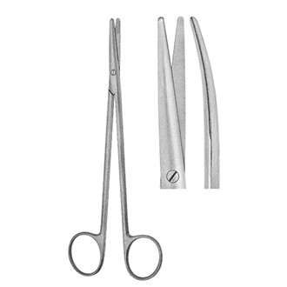
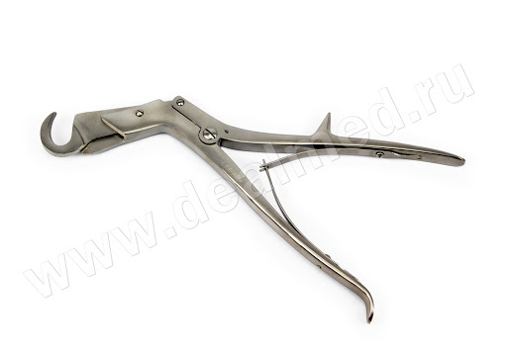
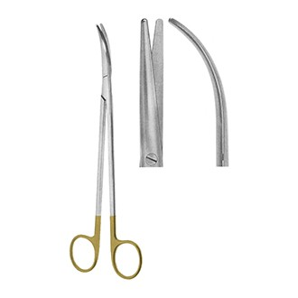
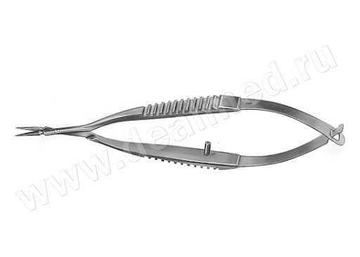
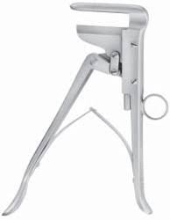
Separating tools Surgical scissors 2
Dissecting scissors (Metzenbaum)
Cavity curved scissors (Metzenbaum)
Sauerbruch-Frey scissors
Vanas scissors
Schumacher-Pirtz scissors
1
3
5
2
4
1. Dissecting scissors (Metzenbaum) are quite convenient for performing dissection of soft tissues. Thanks to the fact that the ends of the blades are blunt, the probability of damage to blood vessels is significantly reduced.
2. Cavity curved (Metzenbaum) scissors are characterized by long handles and relatively short blades compared to the handles. This makes Metzenbaum scissors very convenient when working in a deep surgical wound or in cavities
3. Sauerbruch-Freya scissors - scissors with combined blade edges, belong to the guillotine type scissors. It is used for dissection of cartilages and bones
4. Vanas scissors - scissors for surgical operations on the eyeball, characterized by small sizes and narrow cutting parts
5. Schumacher-Pirtz scissors are scissors with the edges of the blades in the shape of a gentle arc. The guillotine principle excludes the possibility of tissue expression from under the closing blades. As a rule, they are used for dissection of cartilage and bones

Slide 8
Connecting tools

Slide 9
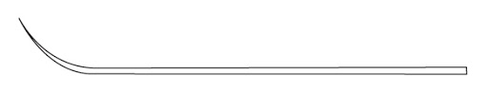
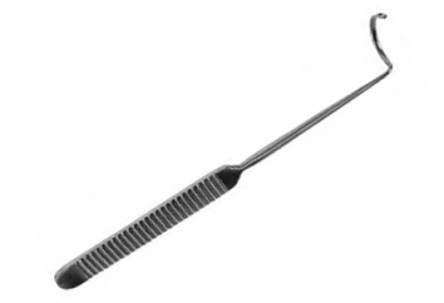
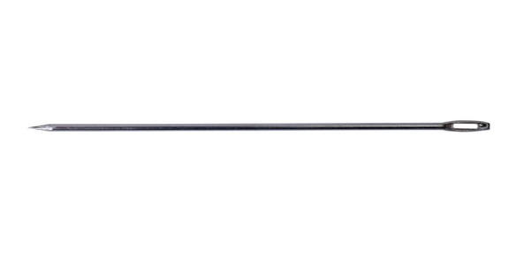
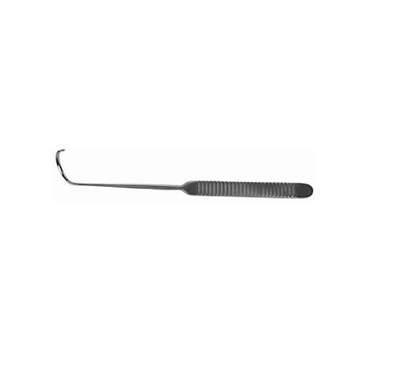
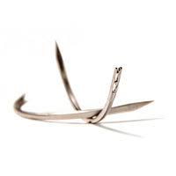
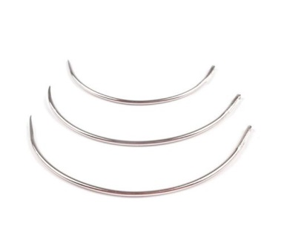
Connecting tools
Surgical needles
The needle is curved and barbed
Curved cutting needle
The needle is ski-shaped
The needle is straight
Deschamps ligature needle
Cooper's ligature needle
3
5
4
6
2
1
1. The needle is curved, barbed-barbed, or round conical needles move tissues apart without dissection. They are used for stitching easily punctured tissues - peritoneum, muscles, intestinal wall
2. Curved cutting needle - cutting needles have two or three cutting edges. They are intended for stitching dense fabrics
3. Ski-shaped needle - intended for suturing the skin
4. Straight needle - allows sewing with fingers without the help of a needle holder. Intended for suturing tendons and imposing some anastomoses on organs of the gastrointestinal tract
5. The ligature needle Deschan-handle is connected to the working part by means of narrowing of the oval shape (neck).
6. Cooper's ligature needle, a pointed needle, is used when it is necessary to puncture tissues and ligate the artery together with them (tissues) in a single block

Slide 10
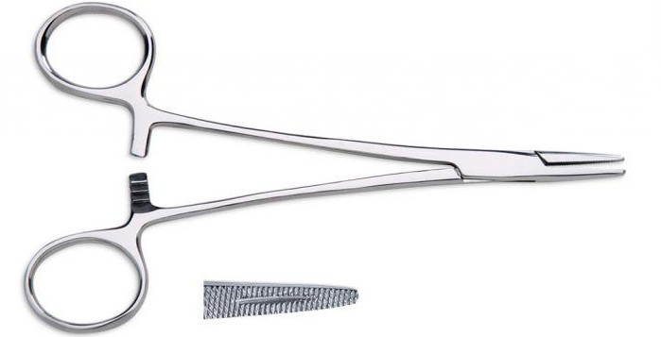
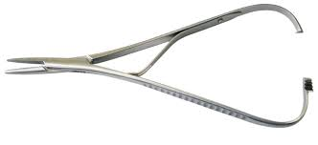
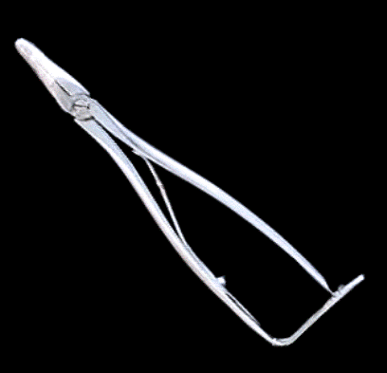
Connecting tools Surgical needle holders
Gegar's needle holder
Needle holder Mathieu
Troyanov's needle holder
1
2
1. The Gegara needle holder is a classic straight needle holder, it has different lengths and widths of the handles, as well as different notches on the branches
2. Mathieu's needle holder is used to hold a surgical needle during suturing, equipped with spring-loaded handles and a ratchet lock that unlocks when the handle is further compressed.
3. Troyanova needle holder - serves to hold the surgical needle during suturing. The rack is located on the end of the handles, so it is unfastened with the 5th (V) finger of the hand

Slide 11
Pushing and pressing tools

Slide 12
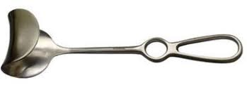
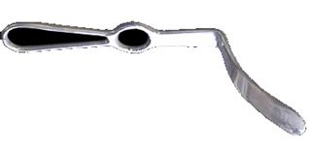
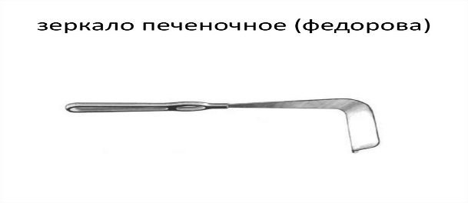
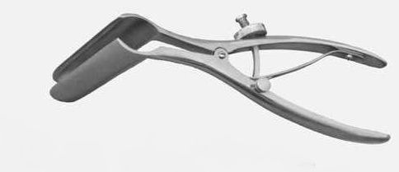
Tools for spreading, depressing Surgical mirrors
Abdominal mirror by Fritch-Dwayne
Liver mirror for pressing the edge of the liver
Fedorov's renal mirror
Rectal mirror
1
3
2
4
1. The Fritz-Dwayne abdominal mirror provides an improved view of the bottom of the operative wound and increases the illumination of the operative field
2. Liver speculum for depressing the edge of the liver - used in surgical operations to depress the edge of the liver
3. Fedorov's kidney mirror - used in surgical operations to squeeze the edge of the kidney
4. The rectal mirror is a mirror in the form of two polished, groove-shaped metal plates connected by a hinge, fixed on a handle. It is used for: examination of the mucous membrane of the rectum; during surgical interventions on the rectum; during diagnostic and therapeutic procedures on the rectum.

Slide 13
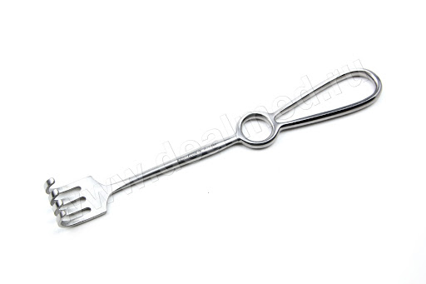
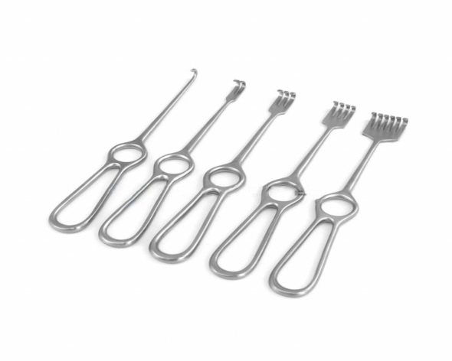
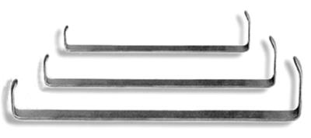
Pushing and pressing tools Surgical hooks
Folkman's sharp hooks
Volkman's blunt hooks (one-toothed, two-toothed, three-toothed, four-toothed)
Farabefa C-shaped leaf hooks
3
2
1
1. Volkman's sharp hooks are intended for abduction of dense tissues, such as skin, subcutaneous fat, and superficial fascia.
2. Volkman's blunt hooks (1,2,3,4-toothed) are placed on the edges of the wound, formed by relatively "tender" tissues - adipose tissue, own fascia and muscles
3. Farabefa's C-shaped sheet hooks are used for diluting the edges of a wound formed by loose, tender and highly vascularized tissues: muscles; subcutaneous fat; intermuscular fiber. It should be used in all cases if it is necessary to divert the vascular nerve bundle or its components

Slide 14
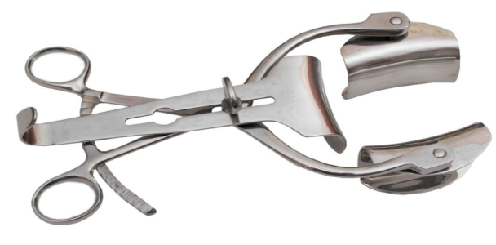
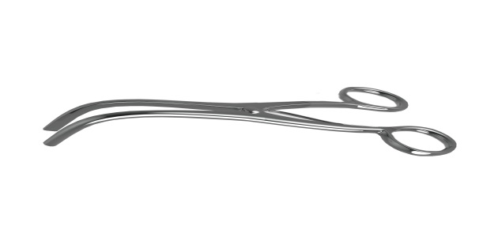
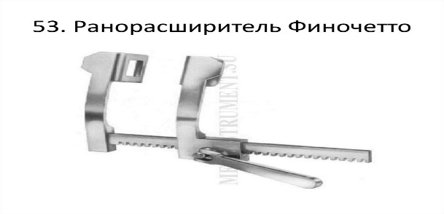
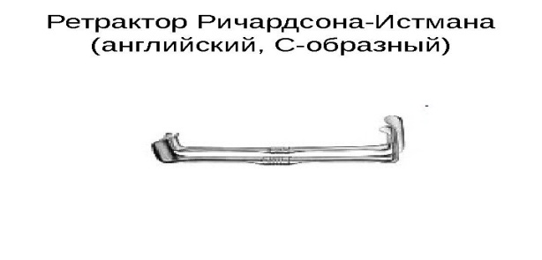
Pushing and pushing tools. Surgical expanders and retractors
Early expander with a rack three-leaf (Mikulycha)
Finochetto rib expander
Trousseau tracheodilator
Richardson-Eastman retractor
1
3
2
4
1. Wound expander with cremalyera three-lobed (Mikulicha) - intended for widening and fixing the edges of wounds. It is equipped with a device for fixing its working parts in the extended position
2. Finochetto's rib dilator is a mechanical wound dilator. It is used to dilate wound edges formed by low-elastic soft tissues or ribs and to keep wound edges in a given fixed position for a long time without the help of an assistant
3. Trousseau tracheodilator - used to dilate the edges of the trachea before inserting a tracheotomy tube into it during surgical interventions
4. The Richardson-Eastman retractor is an instrument used during surgery to expand soft and other human tissues

Slide 15
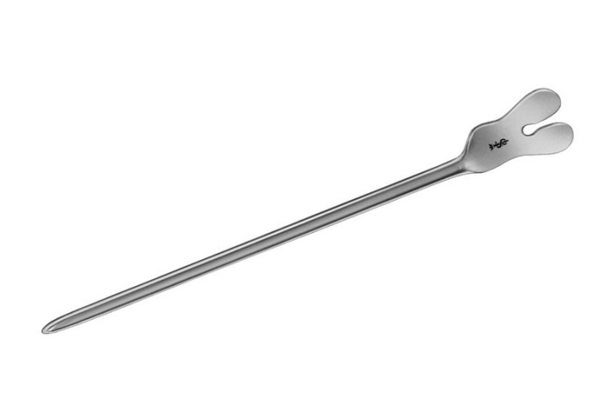
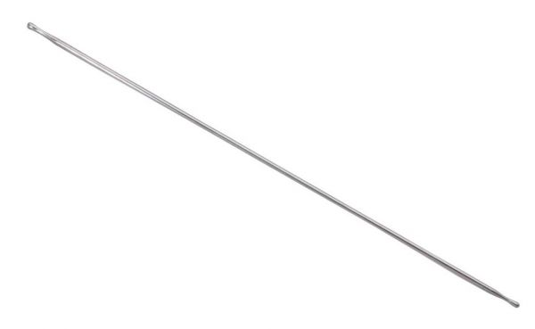
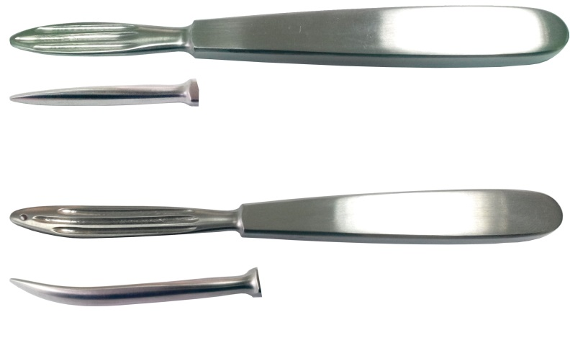
Pushing and pushing tools Surgical probes
Grooved probe
Kocher's probe
Button probe
1
3
2
1. Grooved probe - used to examine deep wounds, cavities and fistula (wound) passages, for safe dissection of own fascia or aponeurosis, as well as as an auxiliary protective tool
2. Kocher's probe was intended to isolate part (lobe) of the thyroid gland from the fascial case. Now it is additionally used to push the muscles along the course of the fibers, as well as to carefully separate the elements of the vascular-nerve bundle from the connective tissue sheath
3. The button probe is used to study deep cavities and fistula passages

Slide 16

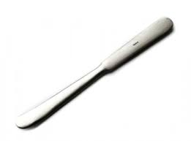
Pushing and pressing tools Surgical blades
Buyalsky's scapula
Reverden's Blade ("Sole")
2
1
1. Buyalsky's scapula is a surgical tool that allows you to push tissues to the side and avoid their damage. It is an oval-shaped, slightly curved, narrow spatula with a flat handle
2. Reverden's blade ("Sole") - used when suturing and suturing the abdominal cavity, to prevent the intestines from being accidentally injured by a needle

Slide 17
Tool holders

Slide 18







Holding tools Surgical tweezers
Anatomical tweezers
Toothed-lobed tweezers
Tweezers Brown Adson
Tweezers for coagulation
Tweezers for applying and removing metal staples
Vascular forceps
Surgical tweezers
1
2
4
5
3
7
6
1. Anatomical tweezers - used for grasping delicate and easily wounded tissues (intestine, ureter, bile ducts, muscles, vessel walls, etc.)
2. Toothed-lobed tweezers - find limited use for comparison of dense areas of skin, fascia, aponeuroses, ends (rests) of tendons.
3. Brown Adson tweezers - classic tweezers, wide platforms for the surgeon's fingers make it easy to hold tissues. Designed for picking up biological tissues and dressing material
4. Tweezers for coagulation are a tool designed for coagulation of soft tissues and blood vessels.
5. Tweezers for applying and removing metal staples - a surgical tool, used for applying staples (staples) when suturing a wound
6. Vascular tweezers - used in surgery when manipulating large and medium vessels, allows to hold them without injury
7. Surgical tweezers - used for manipulations on strong tissues or organs to be removed. The feature is that the teeth at the ends of the tool converge. The introduction of these teeth into the thickness of the tissue allows you to firmly capture your own fascia, aponeurosis, and skin

Slide 19




Holding tools Surgical clamps 1
Hemorrhoidal finished Luer clip
Mikulich clamp is peritoneal
Clamp for grasping the intestinal wall (atraumatic organ clamp) Ellis (Allis)
Billrota's hemostatic clamp (straight and curved)
1
3
4
2
1. Hemorrhoidal finished Luer clamp - used to capture and hold the gallbladder (eg during cholecystectomy), varicose nodes (eg during phlebectomy), hemorrhoidal nodes (eg during hemorrhoidectomy). In some cases, the Luer clamp can be used to extract stones from the lumen gallbladder or bladder.
2. Mikulich's clamp - a tool for fixing the surgical underwear to the peritoneum (main purpose), as well as for long-term pressing and holding of hemostatic tampons after removal of the tonsils (used earlier)
3. Clamp for grasping the intestinal wall (atraumatic organ clamp) Ellis (Allis) - a surgical clamp for grasping the mucous membrane of the stomach or intestine. The working jaws of the clamp have several sharp teeth. It is used to grasp or pull away tissue or structure
4. Billrota hemostatic clamp (straight and curved) - intended for capturing and clamping vessels. It has working sponges with a small notch and a conical outer surface. The notch on the gripping branches is less traumatic to the tissues, but it grips them not firmly

Slide 20




Holding tools Surgical clamps 2
Kocher's hemostatic clamp (straight and curved)
Fedorov's crushing clamp for renal pedicle
Crushing intestinal clamp
Elastic intestinal clamp (straight, curved)
1
3
4
2
4
1. Kocher's hemostatic clamp (straight and curved) - has long, narrow working jaws with sharp teeth, and the only tooth of one jaw enters between two teeth of the second jaw, has teeth on the gripping surfaces, which injures tissues, but grips them firmly
2. Crushing clamp for Fedorov's renal pedicle - rough notches at the ends of Fedorov's clamps contribute to crushing the intima of the vessels of the renal pedicle for the purpose of accelerated thrombus formation. At the ends of the clamps there are holes for passing ligatures. The handles of the clamps for the renal pedicle have a considerable length of 150-200 mm, providing a "leverage effect" for crushing vessels surrounded by a pronounced layer of adipose tissue
3. Crushing Intestinal Clamp - Crushing Intestinal Clamp is applied to the removed part of the intestine
4. Elastic intestinal clamp (straight, curved) - an intestinal clamp is applied to empty organs to demarcate damaged areas, perform high-quality linear cuts of the wall, separate the operating field from the infected contents of the organ or cover the lumen of the organ

Slide 21


Holding tools Surgical Korntsang. Bone fixator
Korntsang Mayer
Farabef's bone fixator
1
2
1. Maier's Korntsang is a clamp with a ratchet, long straight or curved branches and oval jaws with a notch. It is intended for inserting tampons into deep wounds, carrying out drainage through long narrow channels, supplying instruments and operating material, for creating contraptions
2. Farabefa bone fixator - serves to hold (fix) bones during surgery

Slide 22


Holding tools Surgical Pins. Surgical Pins
Backhouse clothes pegs
Jones clothes peg
1
2
1. Hooks for Buckhouse underwear - used to fix surgical underwear around the wound. Sometimes, for strength, the skin is captured together with napkins. They are also used to hold surgical linen on the dressing table and operating tables
2. Jones's underwear cap is used to attach surgical underwear to the skin

Slide 23
Sharp instruments

Slide 24



Sharp instruments Special surgical needles
Kassirsky needle for bone marrow puncture
Spinal puncture needle with mandrel
Needle for treponobiopsy. Yashmidi type
1
2
3
1. Kassirsky's needle for bone marrow puncture is a tubular needle for puncturing bones in order to extract bone marrow from them, as well as for injecting fluids into the bone marrow; Bone piercing is carried out by rotating the needle around its axis
2. Needle for spinal puncture with a mandrel - intended for extracting fluid (cerebral cerebrospinal fluid) from the spinal canal and administering drugs
3. Treponobiopsy needle. Yashmidi type - used in hematological and surgical departments of hospitals. Biopsy needle for taking a sample of bone tissue from the upper crest of the iliac bone

Slide 25


Piercing instruments Surgical Trocars
Nelson trocar
Reiter's trocar (with a flat handle)
1
2
1. Nelson's trocar is necessary for piercing the wall of the chest or abdominal cavity and extracting effusion or transudate
2. Reiter's trocar (with a flat handle) - necessary for puncture of the abdominal or pleural cavities
(for example, with ascites or empyema), as well as for trocar epicystostomy

Slide 26



Additional Information
In addition to the surgical tools of a general profile, there are also specialized tools from each specialized surgery, some tools may be similar to the tools of general surgery, but they perform different functions in the surgical care of patients of different specialized profiles:
* Obstetrics and gynecology (general and specialized).
*Cardiac surgery (specialist, additionally cardiology).
*Neurosurgery (specialist, additionally neurology).
*Traumatology and orthopedics (general and specialized).
*Otolaryngology (general and specialized).
*Ophthalmology (general and specialized).
*Urology (general and specialized).
*Proctology (general and specialized)
*Dentistry and Orthopedic Dentistry.
And assistance in the work of surgery is an important specialization: anesthesiology and resuscitation (general and specialized).

Slide 27

THANK YOU FOR ATTENTION!!!

