Slide 1
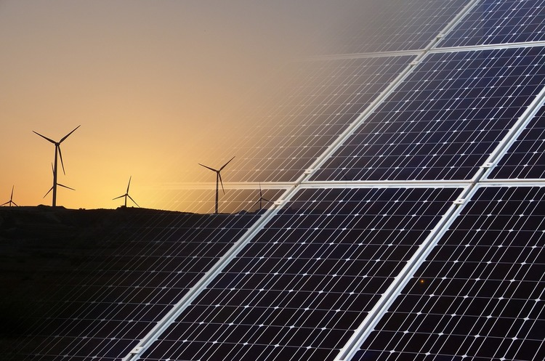
Energy cooperatives

Slide 2

Energy cooperatives are associations of citizens, enterprises and organizations whose goal is to implement various local projects in the field of renewable energy. Most often, such associations focus their efforts on decentralized, environmentally friendly and independent from companies and concerns, energy production.

Slide 3
FEAO gives an example of areas in which an energy cooperative can operate:
energy production (solar energy, wind energy, biogas, cogeneration, ie combined heat and power production);
sale of alternative energy (electricity, heat, gas);
purchase and operation of power grids;
services aimed at efficient use of energy (consulting, energy saving of buildings, implementation of various energy efficiency projects), etc.

Slide 4

Experience of energy cooperatives in Ukraine

Slide 5
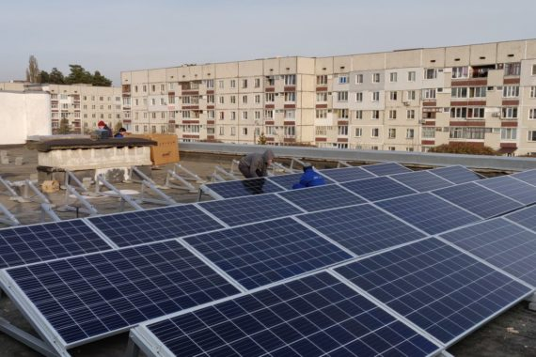
Energy Cooperative«Sunny City » in Slavutych (Kyiv)
The idea implemented by the cooperative is to install solar power plants on the roofs of budget and municipal buildings of the city, which will be rented from the city. The generated electricity will be sold to the grid at a green rate.

Slide 6
The main principles of the cooperative
Equality
Each member of the cooperative has 1 vote. The profits are distributed according to the number of shares (investment size)
Manufacturability
Less bureaucracy and paperwork. Fast decision-making and communication between members of the cooperative via the Internet
Together with the community
5% of net profit goes to city projects under the Slavutych Sustainable Energy Action Plan
Anyone can become a member of the cooperative.

Slide 7
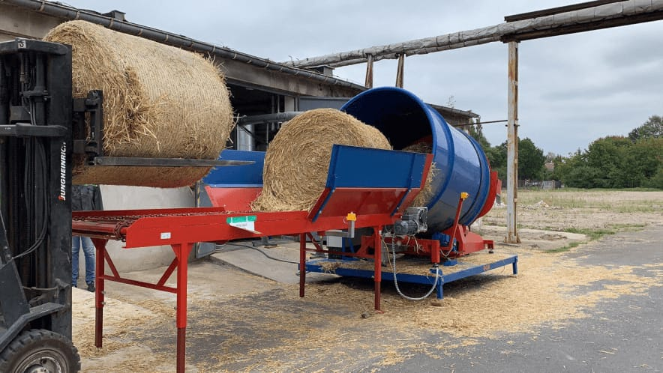
Berezdivsky Energy Cooperative in Berezdiv (Khmelnytsky)

Slide 8
The cooperative will produce fuel briquettes from straw, which will be bought from local farmers. Prior to the establishment of the cooperative, negotiations were held with local farms and an agreement was reached on the purchase of straw residues that had previously remained in the fields. The same farmers are members of the cooperative.
In the first stage, the briquettes will be used to heat one of the schools of the united territorial community.

Slide 9
Basic steps for those who want to establish an energy cooperative:
Step 1. Assess the potential of such a cooperative: analyze what resources are available for use in the selected community, potential participants and professionals.
Step 2. Select the technology to use these resources.
Step 3. The first economic and technical calculations.

Slide 10
Step 4. Involve members of the cooperative and its supporters. Community choice.
Step 5. Choosing the legal model of the cooperative.
Step 6. Development of documentation: the charter and its registration in the registration service. Prospective members should be involved at this stage.
Step 7. Purchase of production equipment.
Step 8. Start of operational activity.

Slide 11
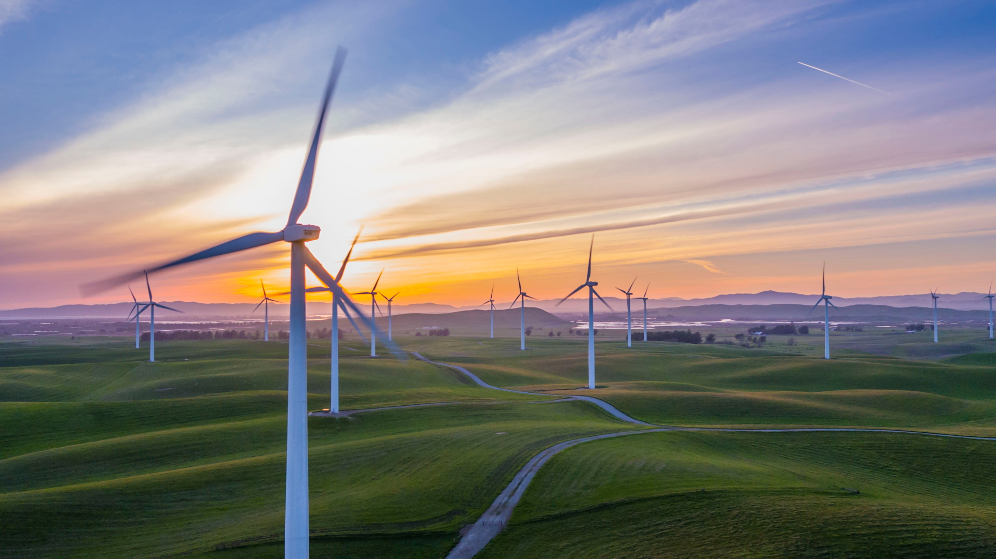
Energy cooperatives in the United States of America

Slide 12
903 distribution cooperatives;
Provide electricity to 42,000,000 customers in 47 states;
The networks of these cooperatives cover 75% of the USA;
Employs 72,000 Americans;
Distribute 11% of electricity in the USA;
Generate 5% of electricity consumed in the USA;
The length of the networks is 4,184,294 kilometers;
$ 800,000,000 in loans are repaid each year for network construction and maintenance;
Assets with a total value of $ 164,000,000,000.

Slide 13


Slide 14
Duke Energy Corporation is an American electric power and natural gas holding company headquartered in Charlotte, North Carolina.
Duke Energy Renewable Services, a subsidiary of Duke Energy, specializes in the development, ownership, and operation of various generation facilities throughout the United States. 240 megawatts of wind generation were under construction and 1,500 additional megawatts of wind generation were in planning stages. On September 9, 2008, DERS updated its projections for future wind power capacity. By the end of 2008, it would have over 500 MW of nameplate capacity of wind power online, and an additional 5,000 MW in development.

Slide 15
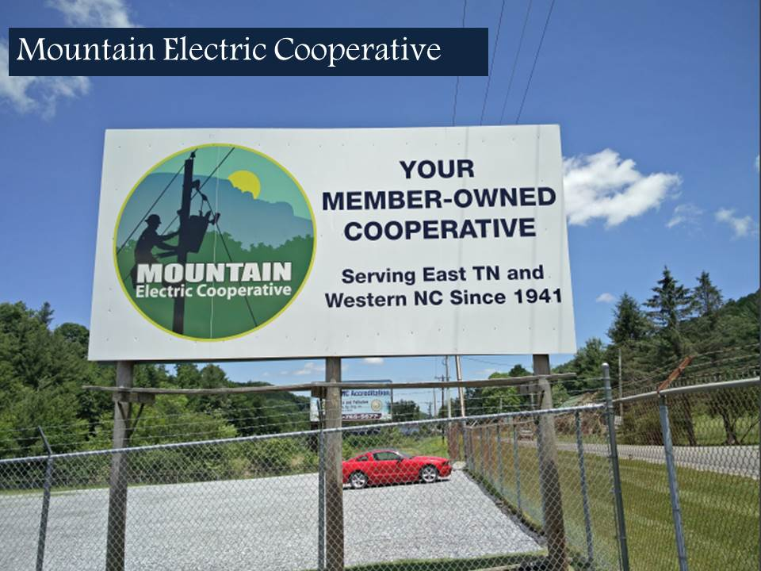

Slide 16
Mountain Electric Cooperative, is a member owned electric cooperative located in northeast Tennessee and northwest North Carolina. Its corporate office is located in Mountain City, TN, with a district office in Newland, NC, and a branch office in Roan Mountain, TN. The cooperative was formed on April 1, 1941 by area farmers and residents. MEC distributes electricity, supplied by the Tennessee Valley Authority, to 34,600 residential and business consumer/members over MEC’s 700 square mile service area.
Mountain Electric Cooperative will strive to fulfill our member’s needs for affordable electricity, utility related services, and community support.

Slide 17
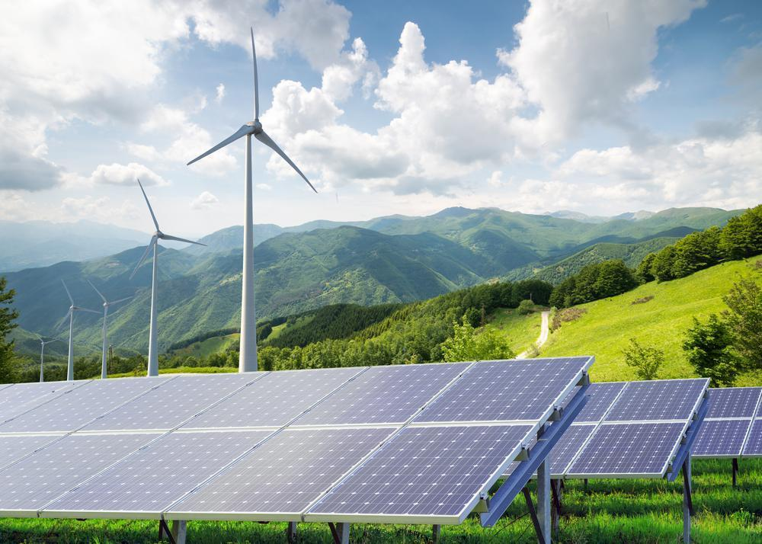
Thank for your attention

