Slide 1

Word
In linguistics, a word of a spoken language can be defined as the smallest sequence of phonemes that can be uttered in isolation with objective or practical meaning. In many languages, words also correspond to sequences of graphemes ("letters") in their standard writing systems that are delimited by spaces wider than the normal inter-letter space, or by other graphical conventions. The concept of "word" is usually distinguished from that of a morpheme, which is the smallest unit of word which has a meaning, even if it will not stand on its own together or in other small words.

Slide 2


In many languages, the notion of what constitutes a "word" may be learned as part of learning the writing system. This is the case for the English language, and for most languages that are written with alphabets derived from the ancient Latin or Greek alphabets.
There still remains no consensus among linguists about the proper definition of "word" in a spoken language that is independent of its writing system, nor about the precise distinction between it and "morpheme". This issue is particularly debated for Chinese and other languages of East Asia.

Slide 3

Semantic definition
Leonard Bloomfield introduced the concept of "Minimal Free Forms" in 1928. Words are thought of as the smallest meaningful unit of speech that can stand by themselves.This correlates phonemes (units of sound) to lexemes (units of meaning). However, some written words are not minimal free forms as they make no sense by themselves (for example, the and of).
Some semanticists have put forward a theory of so-called semantic primitives or semantic primes, indefinable words representing fundamental concepts that are intuitively meaningful. According to this theory, semantic primes serve as the basis for describing the meaning, without circularity, of other words and their associated conceptual denotations.

Slide 4
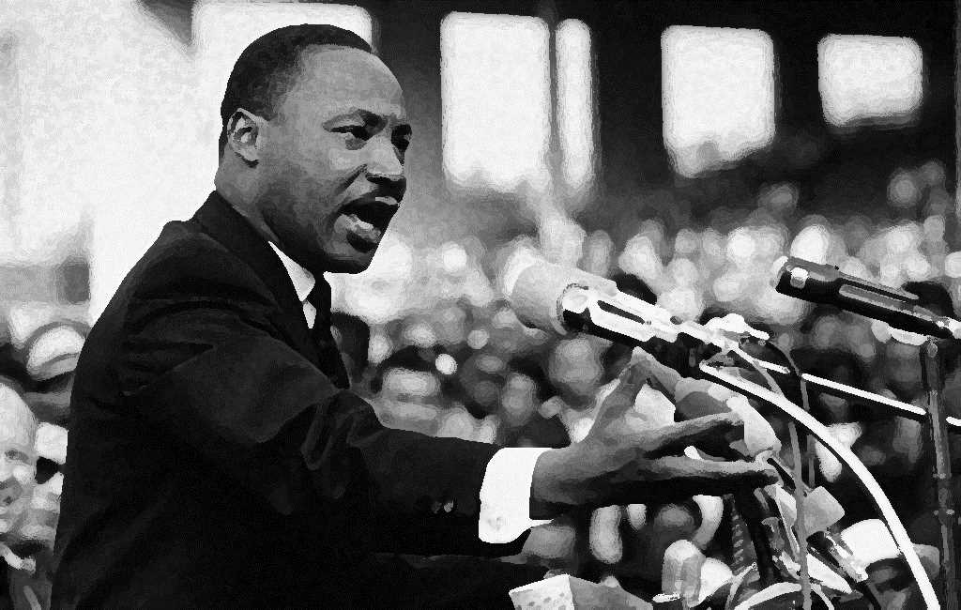
Word boundaries
The task of defining what constitutes a "word" involves determining where one word ends and another word begins—in other words, identifying word boundaries. There are several ways to determine where the word boundaries of spoken language should be placed
Potential pause: A speaker is told to repeat a given sentence slowly, allowing for pauses. The speaker will tend to insert pauses at the word boundaries. However, this method is not foolproof: the speaker could easily break up polysyllabic words, or fail to separate two or more closely linked words (e.g. "to a" in "He went to a house").
Indivisibility: A speaker is told to say a sentence out loud, and then is told to say the sentence again with extra words added to it. Thus, I have lived in this village for ten years might become My family and I have lived in this little village for about ten or so years. These extra words will tend to be added in the word boundaries of the original sentence. However, some languages have infixes, which are put inside a word. Similarly, some have separable affixes: in the German sentence "Ich komme gut zu Hause an", the verb ankommen is separated.

Slide 5
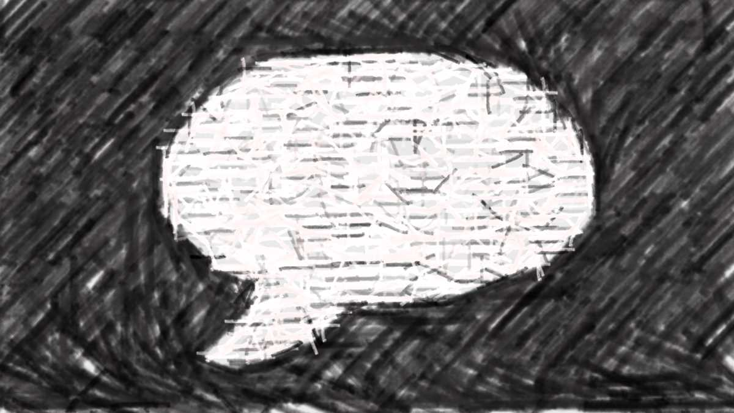
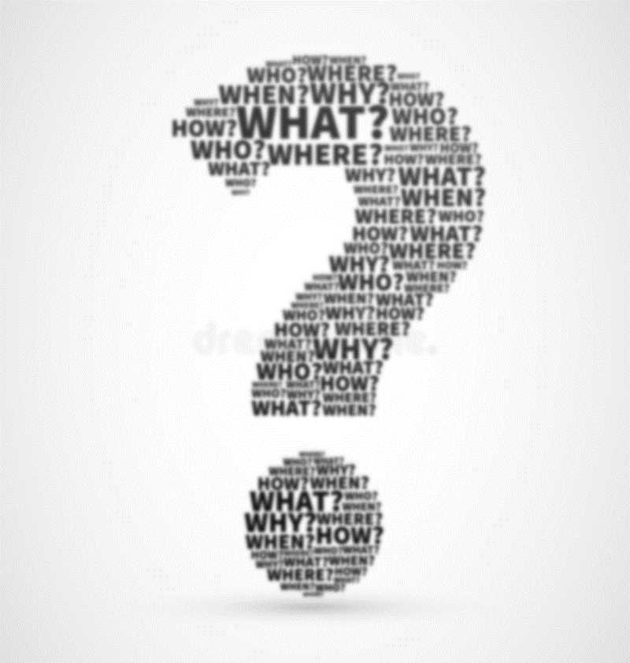
Orthography
In languages with a literary tradition, there is interrelation between orthography and the question of what is considered a single word. Word separators (typically spaces) are common in modern orthography of languages using alphabetic scripts, but these are (excepting isolated precedents) a relatively modern development (see also history of writing).
In English orthography, compound expressions may contain spaces. For example, ice cream, air raid shelter and get up each are generally considered to consist of more than one word (as each of the components are free forms, with the possible exception of get), and so is no one, but the similarly compounded someone and nobody are considered single words.
Not all languages delimit words expressly. Mandarin Chinese is a very analytic language (with few inflectional affixes), making it unnecessary to delimit words orthographically. However, there are many multiple-morpheme compounds in Mandarin, as well as a variety of bound morphemes that make it difficult to clearly determine what constitutes a word.

Slide 6

Philosophy
Classes
Philosophers have found words objects of fascination since at least the 5th century BC, with the foundation of the philosophy of language. Plato analyzed words in terms of their origins and the sounds making them up, concluding that there was some connection between sound and meaning, though words change a great deal over time. John Locke wrote that the use of words "is to be sensible marks of ideas", though they are chosen "not by any natural connexion that there is between particular articulate sounds and certain ideas, for then there would be but one language amongst all men; but by a voluntary imposition, whereby such a word is made arbitrarily the mark of such an idea" Wittgenstein's thought transitioned from a word as representation of meaning to "the meaning of a word is its use in the language.
Grammar classifies a language's lexicon into several groups of words. The basic bipartite division that is possible for virtually every natural language is that of nouns vs verbs.
The classification into such classes is in the tradition of Dionysius Thrax, who distinguished eight categories: noun, verb, adjective, pronoun, preposition, adverb, conjunction and interjection.
In Indian grammatical tradition, Pāṇini introduced a similar fundamental classification into a nominal (nāma, suP) and a verbal (ākhyāta, tiN) class, based on the set of suffixes taken by the word. Some words can be controversial, such as slang in formal contexts; misnomers, due to them not meaning what they would imply; or polysemous words, due to the potential confusion between their various senses

Slide 7

Defining Words
Defining is a way to inform the audience any words or concepts one may not know or may not have a complete grasp on and there are three types of definitions. Some words or terms are defined quite literally, such as a formal definition from the dictionary. That is called a formal definition. Another type of a defining strategy would be an extended definition, where it clarifies terms or concepts through a series of examples and explicit details, which can also include pictures or diagrams. The third type of defining would be a stipulative definition, which is when a term has been given a specific meaning for the sake of one’s argument or purpose. In defining things, It’s important to keep in mind the purpose and audience in order to create a compelling and efficient argument.
For example, Anne Curzan defines the words: “hangry” and “adorkable” in her Ted Talk. She states: “Over the years, I have learned some great new slang this way, including “hangry,” which — (Applause) — which is when you are cranky or angry because you are hungry, and “adorkable,” which is when you are adorable in kind of a dorky way, clearly, terrific words that fill important gaps in the English language.” (2:10). Furthermore, another example of a formal definition that was used by Anne Curzan was the definition of the word “multislacking”.
A formal definition is a definition which helps the reader understand what the speaker or author is talking about. A term can be used in a specific way therefore the speaker/author needs to explain the meaning of that word based on the usage of that word in the sentence. There are three ways to distinguish a formal definition. First one, for a formal definition there has to be the use of easy words so the reader can understand.

Slide 8

Stipulative definitions :- it’s type of definition where the definer uses terms like ” this is how I’m defining X” it’s not available in dictionary and mostly central to the argument of writer. The word also doesn’t necessarily have to have meaning, it’s the author’s why of describing the word and thus it doesn’t have any right or wrong form. This type of definitions is very useful for intended purposes. Example:- Beauty ? Love ? Personal legend of life ?
Example from the ted talk is around 10:23 minutes. When she talks about the note usage and people who are qualified for picking word in dictionary.

Slide 9
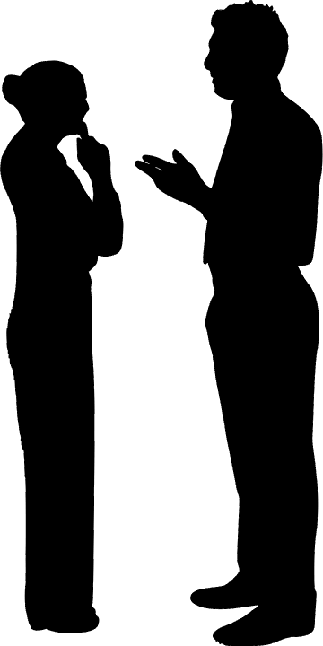
What makes a word a real word?
The word word has a wide range of meanings and uses in English. Yet one of the most often looked for pieces of information regarding word is not something that would be found in its definition. Instead, it is some variant of the question, What makes a word a real word?
One of the most prolific areas of change and variation in English is vocabulary; new words are constantly being coined to name or describe new inventions or innovations, or to better identify aspects of our rapidly changing world. Constraints of time, money, and staff would make it impossible for any dictionary, no matter how large, to capture a fully comprehensive account of all the words in the language. And even if such a leviathan reference was somehow fashioned, the dictionary would be obsolete the instant it was published as speakers and writers continued generating new terms to meet their constantly changing needs.
Most general English dictionaries are designed to include only those words that meet certain criteria of usage across wide areas and over extended periods of time (for more details about how words are chosen for dictionary entry, read "How does a word get into a Merriam-Webster dictionary?" in our FAQ). As a result, they may omit words that are still in the process of becoming established, those that are too highly specialized, or those that are so informal that they are rarely documented in professionally edited writing. But the words left out are as real as those that gain entry; the former simply haven't met the criteria for dictionary entry–at least not yet (newer ones may ultimately gain admission to the dictionary's pages if they gain sufficient use).
However, in preparing your own writings, it is worth remembering that the dictionary encompasses the most widely used terms in English. Words that are left out may have usage limited to specific, isolated, or informal contexts, so they should be used carefully.

Slide 10
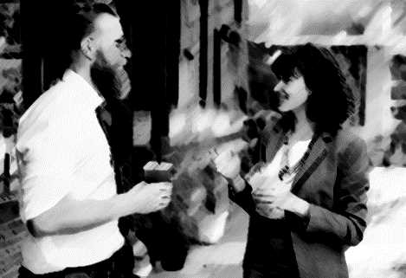
links
https://www.merriam-webster.com/dictionary/word
https://plato.stanford.edu/entries/word-meaning/
https://en.wikipedia.org/wiki/Word

