Slide 1
The relationship between language and culture
By Julia Demchenko

Slide 2

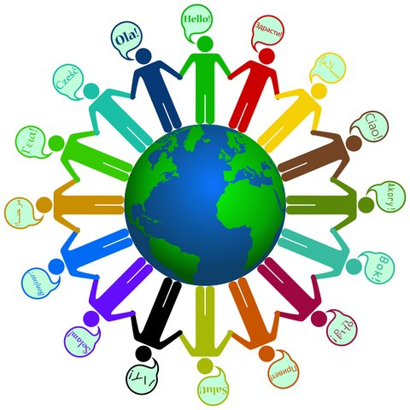
When you interact with another language, it means that you are also interacting with the culture that speaks the language.

Slide 3
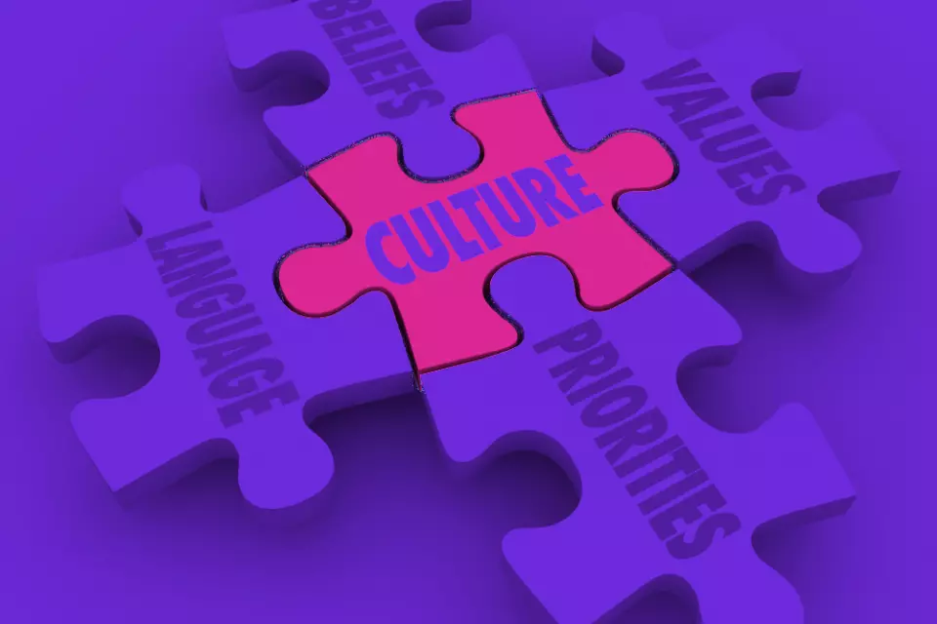
Language is a major component of culture because it is used to maintain and convey culture.

Slide 4
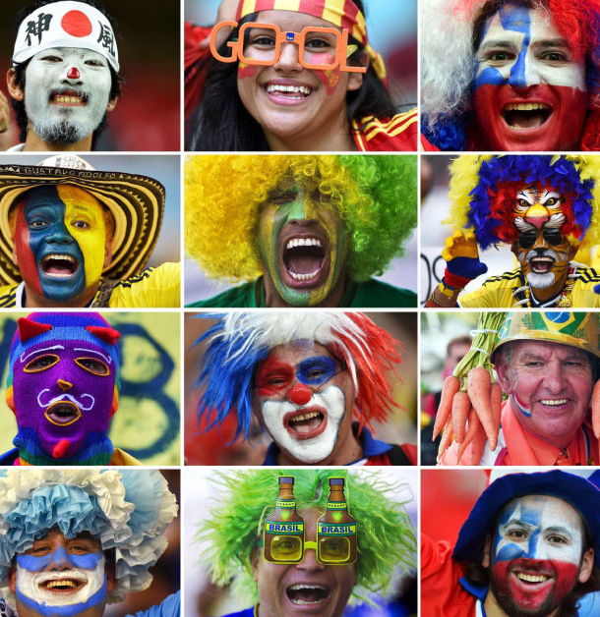
LANGUAGE IS THE MIRROR OF CULTURE

Slide 5
THANK YOU FOR ATTENTION

