Slide 1
What іs the importance of orthography in differentiating homophones?
By Julia Demchenko

Slide 2
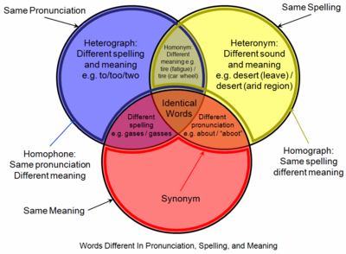

Slide 3


Slide 4

Thank you for your attention!

