Slide 1
KAVA VARTA
The territory of delicious coffee
The most delicious coffee

Slide 2
KAVA VARTA
The handmade coffee house "KAVA VARTA" is a great place where you can not only sit pleasantly, drink a cup of aromatic drink or have a snack, but also buy coffee beans in Kiev.
Our room is decorated in soft coffee colors, beige and rich brown. A large and comfortable bar counter will allow the barista to demonstrate the process of making coffee.
Also in our coffee shop there is a very large selection of syrups and more, there are signature drinks that you can always try.
Also, to complement the delicious coffee, you can choose delicious desserts, for example: waffle cake or croissant.
If you come with children, this is not a problem in the coffee shop itself, if it’s cold outside you can stay inside, in the coffee shop itself there are also children’s drinks and goodies, and in the summer the coffee shop has a trampoline, sun loungers and a playpen for small children age.

Slide 3
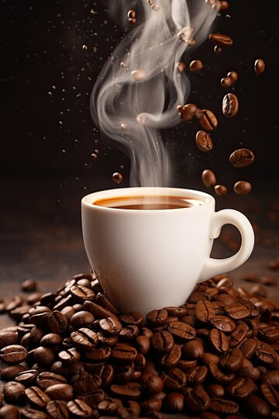
^Coffee^ ^Tea card^ ^ AUTHOR DRINKS^ ^ COLD BEVERAGES^
Espresso 30 ml Black 340/500ml Classic raf 240/340/500ml Baleys Latte 340/500ml
Drunk 60ml Englash 340/500ml Honey raf 240/340/500ml Branded lemonades 340/500ml
American 100ml With Bergamot 340/500ml Bounty 240/340/500ml Cocoa ice 340/500ml
Double Americano 200ml Pomegranate 340/500ml Lavender cappuccino 240/340/500ml Cold Brew 340/500ml
^With milk^ Fruity 340/500ml Warm Orange 240/340/500ml Cherry ice 340/500ml
Cappuccino 175/250/340ml Warm Cherry 240/340/500m Blue Lemonades 340/500ml
Late 250/340/500ml ^Green tea^ ^WHAT TO ADD^ Frappuccino 340/500ml
Double Late 340/500ml Golden snail 340/500ml Arabica Sangria 340/500ml
Mocha 250/340/500ml Alpine meadow 340/500ml Cream Latte ice 340/500ml
Flat White 250/340/500ml Milk Oolong 340/500ml Syrups Classic lemonades 340/500ml
^Not coffee^ Jasmine 340/500ml Marshmallows MOHITO 340/500ml
Cocoa 250/340/500ml Saucep 340/500ml Lemon Orang Fresh 340/500ml
Hot chocolate 250/340/500ml Honey Coffee Tonik 340/500ml
Baby milk 250/340/500ml ^NATURAL TEA^ 340/500ml Decaffeinated coffee Milk Shake 340/500ml
Matcha Latte 250/340/500ml Sea ​​buckthorn / Ginger An additional portion of coffee
Mulled wine 250/340/500ml Raspberry / Currant Whipped cream
^Coffee with you^ Mango / Barberry Condensed milk
Blend Passion fruit
Arabika
Ground coffe

Slide 4
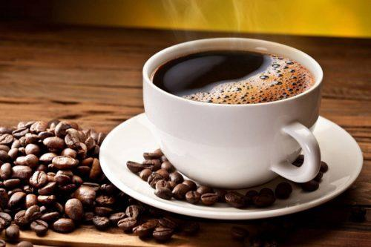
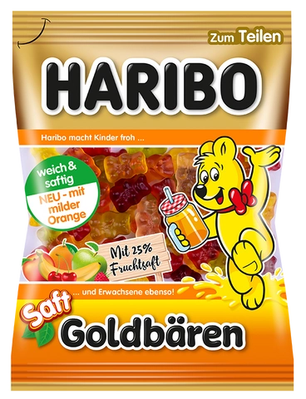
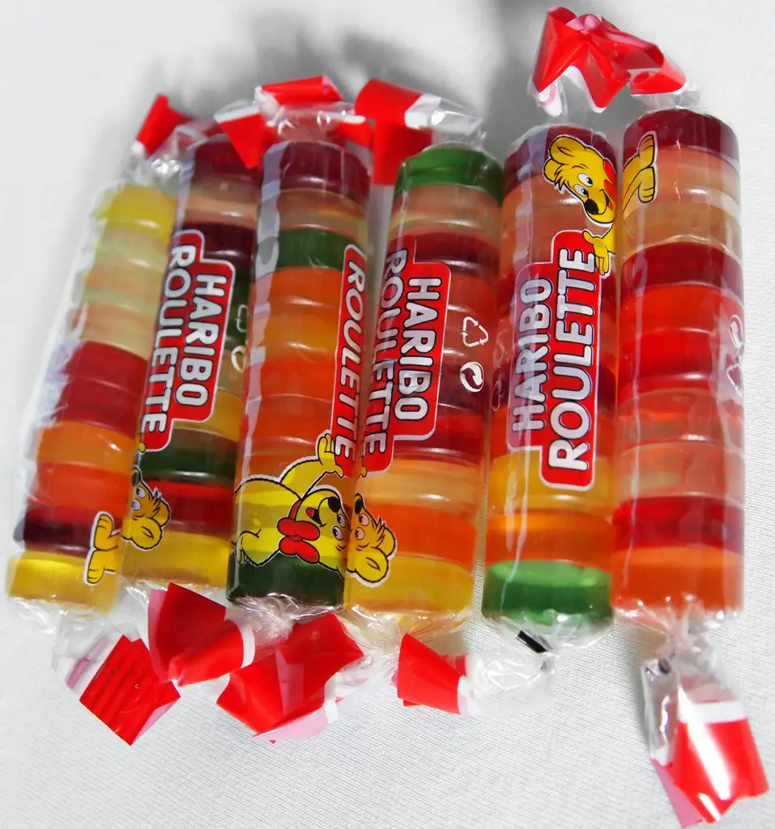
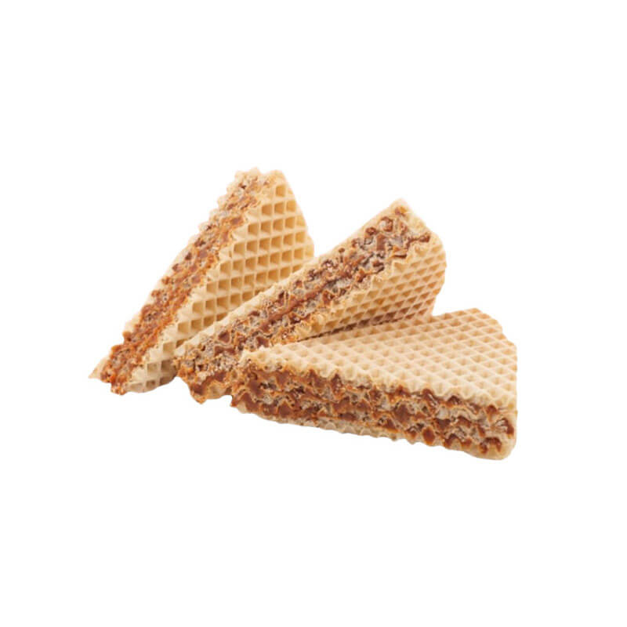
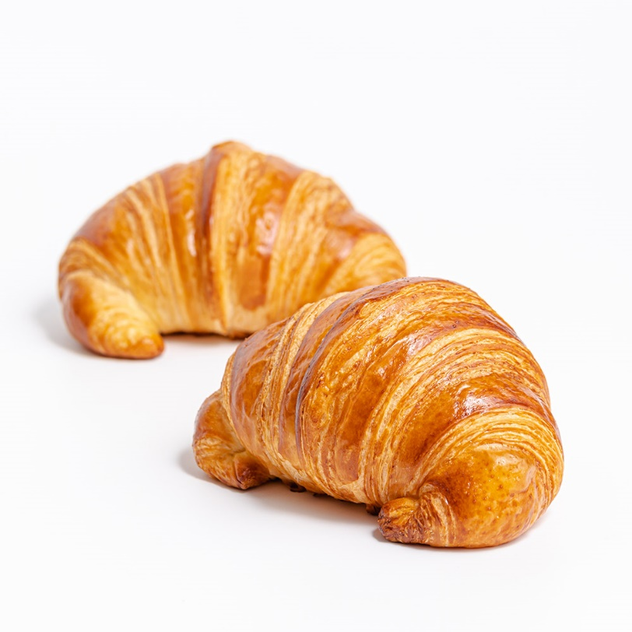
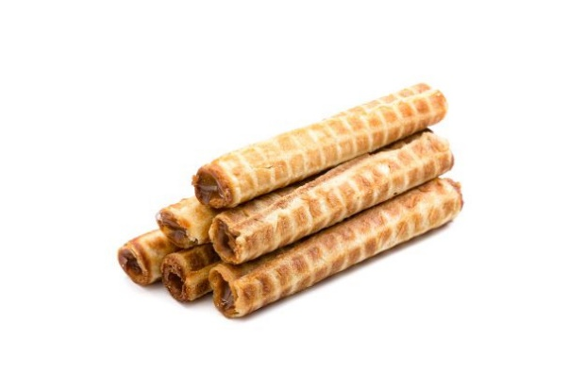
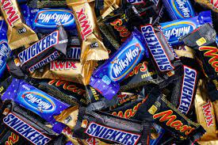
OUR MALTING

Slide 5
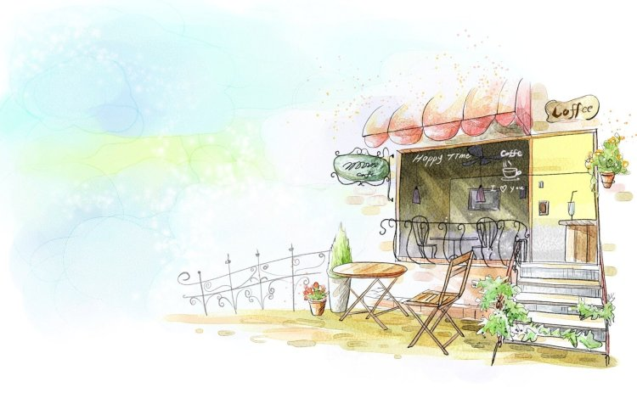
We are waiting for you at our «Kava Varta» coffee shop)

