Slide 1
How Packaging Design Affects Market Success
Created by Nadiia Kotorovych

Slide 2
STRUCTURE:
  Introduction
  Role of First Impression
  Packaging Functions
  How Packaging Influences Buyers
  Current Trends & Future Directions
  Case Studies
  Questions
  Conclusion
  Sources

Slide 3
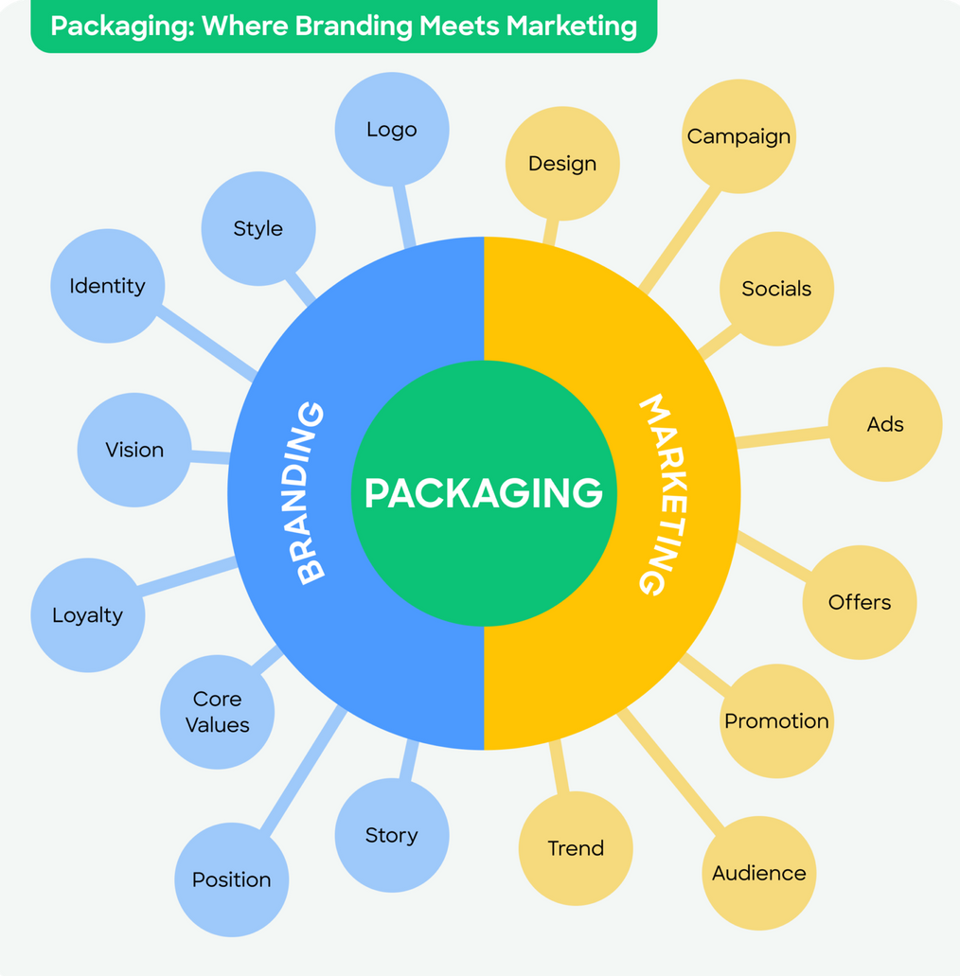
Introduction:
What Are Branding And Marketing In Packaging?

Slide 4
THE ROLE OF FIRST IMPRESSION
Customer makes a decision in the first 7 seconds
First contact point
Can attract attention… or push customers away
Emotional reaction
81% of consumers have bought a new product because the packaging
caught their eye.

Slide 5


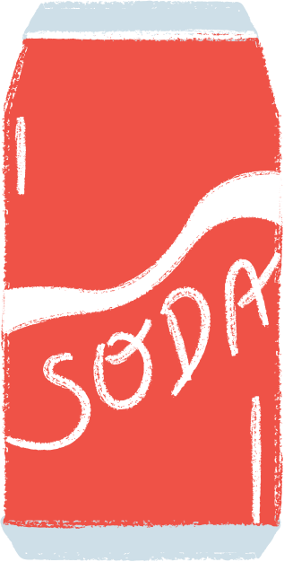

PACKAGING FUNCTIONS
Practical
Practical
Logistical
Marketing
Protection
Convenience
Information
Promotion
52% of people are more likely to be repeat customers for online retailers if their purchases arrive in high quality packaging

Slide 6
HOW PACKAGING INFLUENCES BUYERS
Emotions
Visual
Understanding
Trust
Visual cues:
Shape, size, and materials
Information:
Psychological concepts:
color, typography, imagery
signals about quality/price
labels, certifications, sustainability claims
“first moment of truth” (P&G), signaling theory

Slide 7
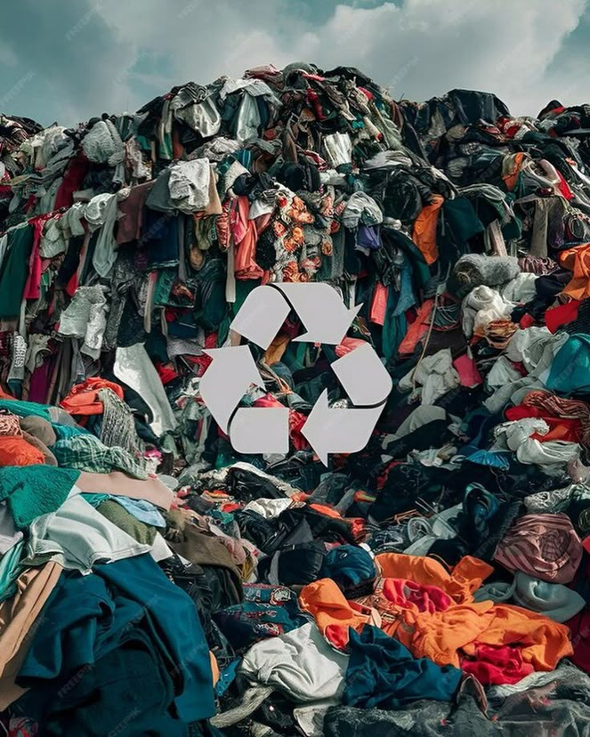
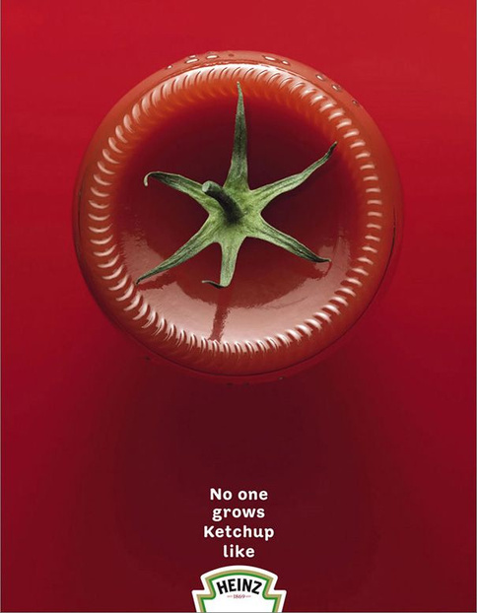
CURRENT TRENDS & FUTURE DIRECTIONS
Smart
Eco
Personalization
Minimalist
Experiential

Slide 8
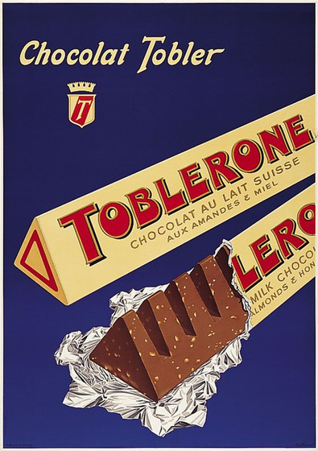

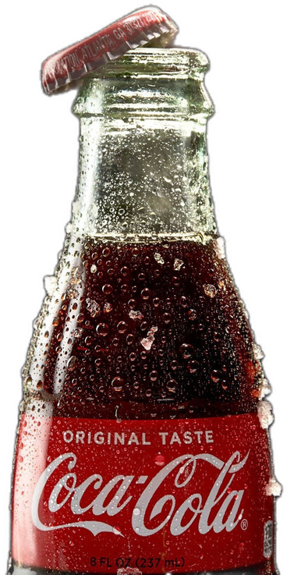
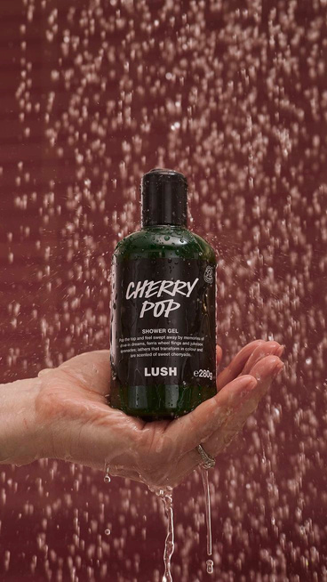
CASE STUDIES
Iconic Branding & Recognition
Minimalism & Premium Experience
Sustainability & Brand Ethics
Shape as Identity
Coca-Cola
Apple
Lush
Toblerone
Distinctive design = lasting brand recognition
Packaging can enhance perceived value and customer satisfaction
Sustainable packaging can differentiate and reinforce values
Shape and structure can become a marketing symbol as powerful as the logo

Slide 9
PACKAGING AS A POWERFUL MARKETING TOOL
Packaging :
Leaves a lasting impression
Helps make the client buy it again
Sparks curiosity at first glance
Helping grab a shopper’s attention within seconds
Eye-catching product packaging design
The way your product can stand out

Slide 10
CONCLUSION: WHY PACKAGING MATTERS?
  Packaging shapes first impressions and consumer perception
  Expresses brand identity and builds trust
  Drives sales and market success
  The right design can make — or break — a product

Slide 11
QUESTIONS
  Why do people often think a product in sleek, minimal packaging is higher quality?
  How can sustainable packaging help a brand succeed in today’s market?
  What happens if a brand changes its packaging too often?

Slide 12
Any questions?

Slide 13

Thank you!
Created by Nadiia Kotorovych

Slide 14
SOURSES
  https://www.businessdasher.com/importance-of-product-packaging/
  https://www.clsmith.com/cl-smith-packaging-academy/the-role-of-packaging-in-product-marketing-strategies-examples-from-c-l-smith/
  https://pakfactory.com/blog/learn/packaging-branding-marketing-sales/?srsltid=AfmBOorHeDsFkSbU3Xx2TZP3AxH9BwdD0Knk8CNN3qUIR3BRJrEWkQVC
  Kotler, P., & Keller, K. (2016). Marketing Management.
  Rundh, B. (2016). “The role of packaging within marketing and value creation.” British Food Journal, 118(10).

