Slide 1
Peculiarities of Ukrainian translation of titles in Stephen King's novel "The Black House"
Prepared by Kateryna Zhelezniak
Supervisor - Candidate of Pedagogical Sciences, Associate Professor O.M. Nikolenko

Slide 2




Steven King –the master of horror
Stephen King's writings have always amazed with their diversity. He was and remains a true master of horror. No wonder most of his novels were later turned into brilliant film adaptations.

Slide 3
Purpose: to trace how translators of Ukrainian publishing houses interpreted proper names, names and nicknames of main and secondary characters.

Slide 4
Variants of transmission
Transcription. As soon as the word is written in Cyrillic letters in the transcription, the translator focuses on the exact correspondence of the sound of the word with the original language.
Transliteration. The ambiguity in transliteration is less than in transcription, since the word is translated literally according to the table of correspondence of symbols.
Calque is the translation of the original lexical unit by replacing its constituent parts - morphemes with their lexical equivalents in the target language.

Slide 5
«Standing in a line against the brick wall of the police station are the Thunder Five. They wear identical denim vests with gold 5’s on the left breast. Five sets of meaty arms are crossed on five broad chests. Doc, Kaiser Bill, and Sonny wear their hair in thick ponytails. Mouse’s is cornrowed tonight. And Beezer’s floods down over his shoulders, «…». Earrings twinkle. Tats flex on huge biceps.»
«Навпроти цегляної стіни вишикувалася в рядок Грізна П’ятірка. Вони одягнені в одинакові джинсові жилети із золотою п’ятіркою з лівого боку. П’ять пар м’ясистих рук схрещені на п’яти широких грудях. У Дока, Диктатора Білла і Сонні во­лосся закладено в товсті хвости. Мишеня заплів сьогодні кілька кісок. У Шнобеля волосся спадає на плечі «….». Сереж­ки мерехтять. На великих біцепсах красуються тату.»

Slide 6
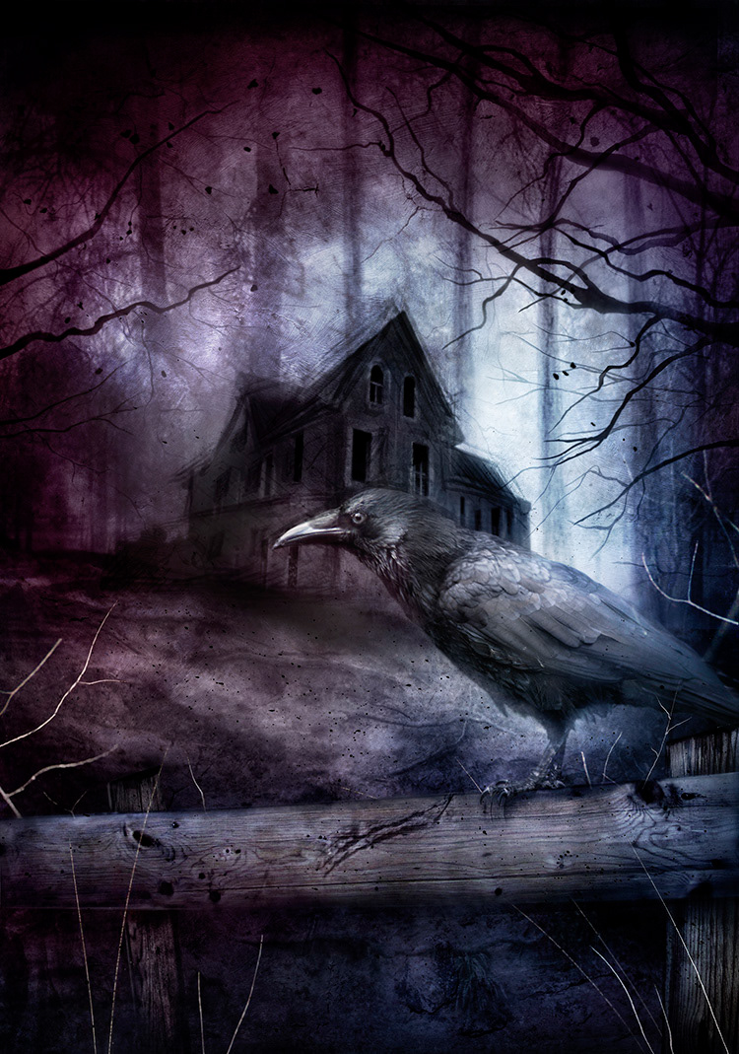
«Does Gorg look like a person, or like something else?”
Tansy shakes her head from side to side with great slowness. She is composing herself again, reinstating a personality that can ignore her real emotions. “Gorg does not look like a person. Not at all.»
…
«— Ґорґ має людську подобу, чи, можливо, він має якийсь інакший вигляд?
Тенсі надто повільно хитає головою з боку в бік. Вона знову заспокоює, опановує себе і може контролювати емоції.
— Ґорґ не має людської подоби. Зовсім ні.»

Slide 7
The conclusions are: in the process of translating proper names, it is customary to distinguish translational transliteration and transcription; calculating, descriptive translater and transformationaltranslation. For example, in order to convey the specificity of a picture from an imaginary world with its own uniqueness, the translator is forced to deviate from the rules and create his own okazionalisms.

Slide 8
Thank you for attention

