Slide 1
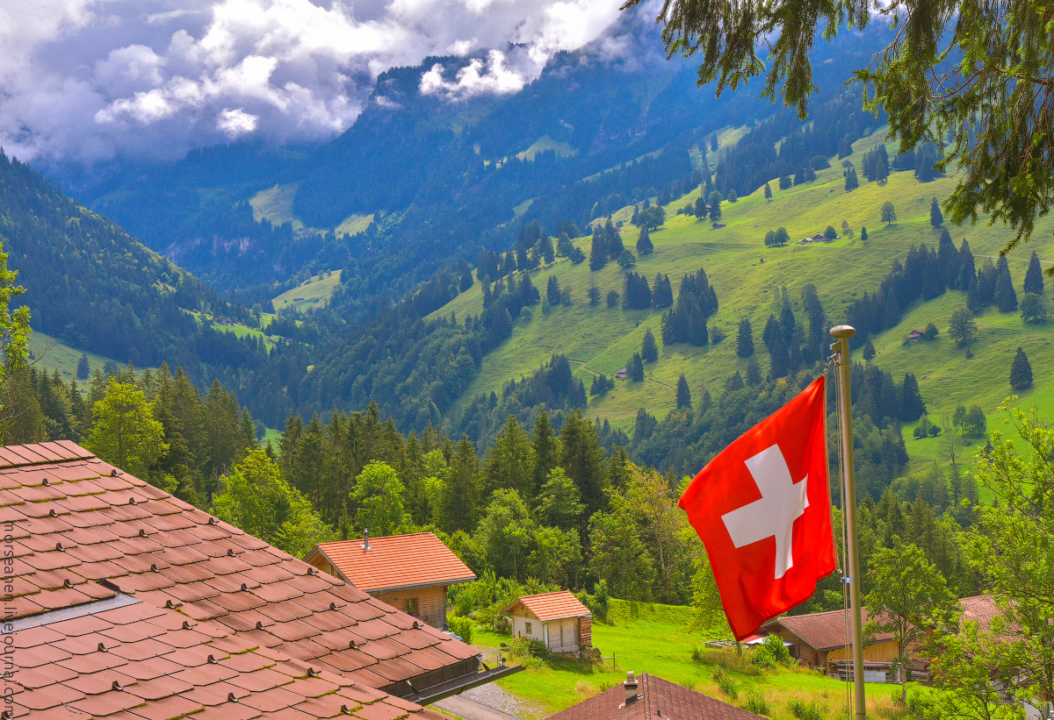
Switzerland

Slide 2
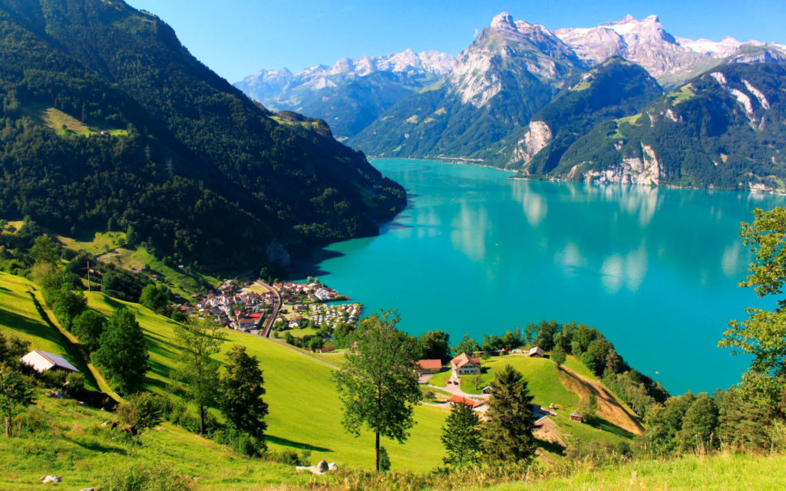
Switzerland is the most mountainous country in Europe. It has no access to the sea. In the south - the Alpine Mountains. The Rhone and Rhine rivers form wide fertile valleys there. In general, the Alps account for 60% of the country. Glaciers are common in the Alps. On the slopes of the mountains throughout the winter lies a thick layer of snow, often avalanches. In the mountains, in addition to forests, there are subalpine and alpine meadows. Mountains are widely used for recreation (hiking, mountaineering, winter sports). In the center of the country - the Swiss plateau. On the outskirts of the plateau are large lakes.

Slide 3
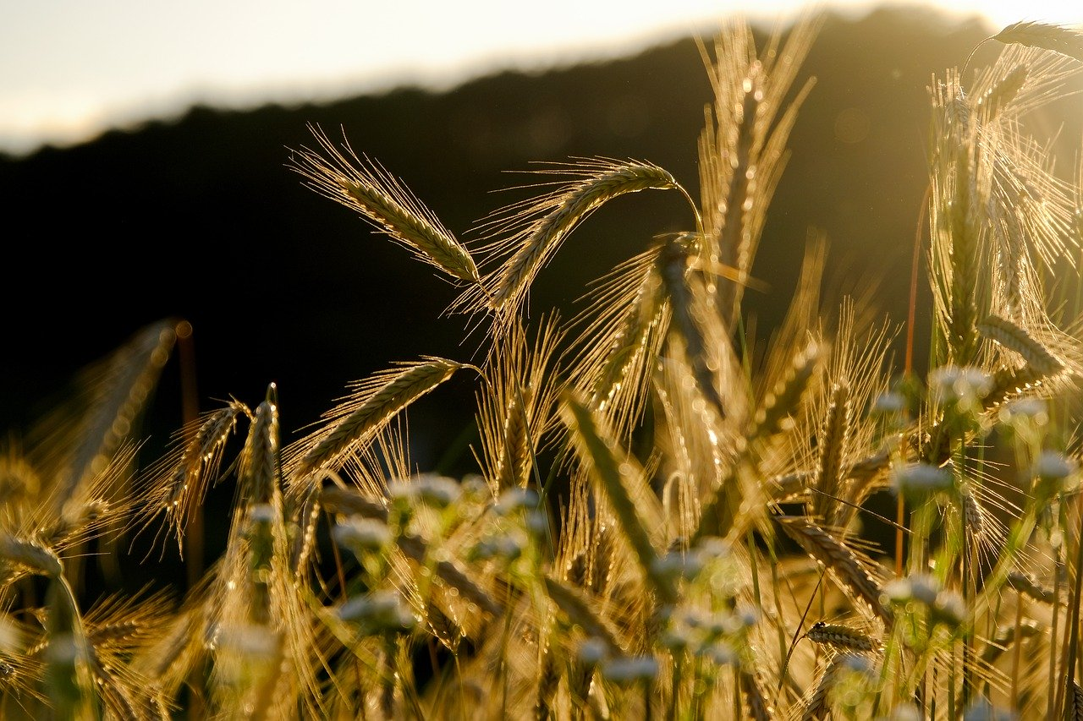
In the structure of the value of agricultural products, livestock has a significant advantage over crop production (ratio - 3 to 1). The agricultural sector employs about 5% of the workforce. More than half of the country's food needs are met by its own agricultural production. Cattle are bred mainly dairy breeds. Developed pig breeding, sheep breeding, poultry farming.

Slide 4
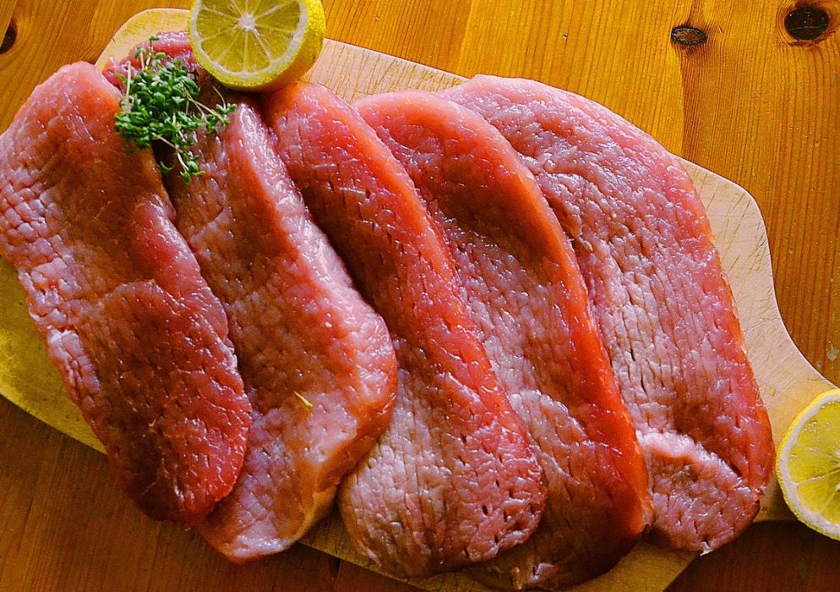
Switzerland provides itself with 94.1% pork and 98.6% veal. Swiss market share of beef is 85.4%. Poultry provides half of domestic consumption. Switzerland consumes 426,000 tons of meat annually (55.4 kg per person), of which 45% is pork, 20% beef and 20% poultry. The cattle herd numbers 1.7 million. 1.5 million pigs are raised on pig farms. About 7 million poultry are raised on poultry farms. There are also about 420,000 sheep and 62,000 goats. Swiss cheese has been well known in many countries for centuries. In general, agriculture meets the country's food needs by 56-57%.

Slide 5
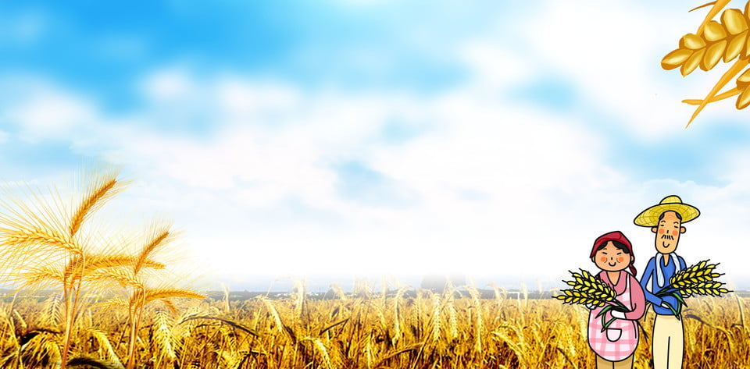
Areas for vegetable growing occupy 10 thousand hectares, potatoes – 13.5 thousand hectares. Cereals are grown on 90 thousand hectares, sugar beets on 18 thousand hectares, rapeseed - 15 thousand hectares. The main crops are wheat, barley, sugar beets, potatoes, fodder grasses, grapes, fruits (including apples), flax, tobacco, hemp, and vegetables. In the mountains - logging.

Slide 6
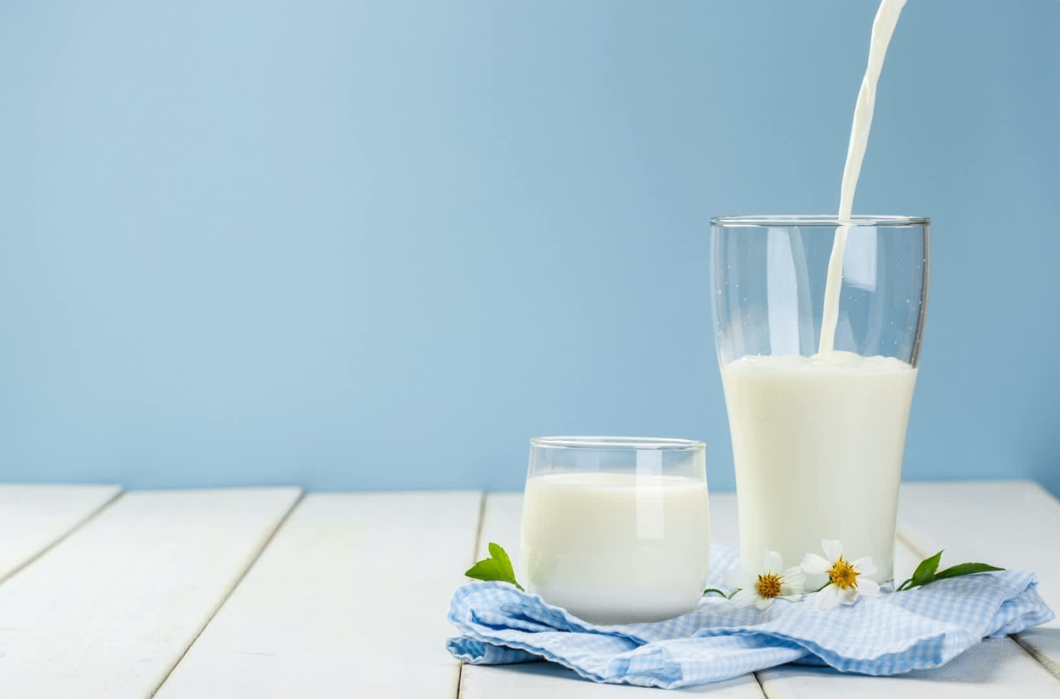
The main industry is dairy farming. 3.8 billion liters of milk are produced annually, 80% of which is processed into cheese, butter, cream, yogurt or powdered milk.

Slide 7
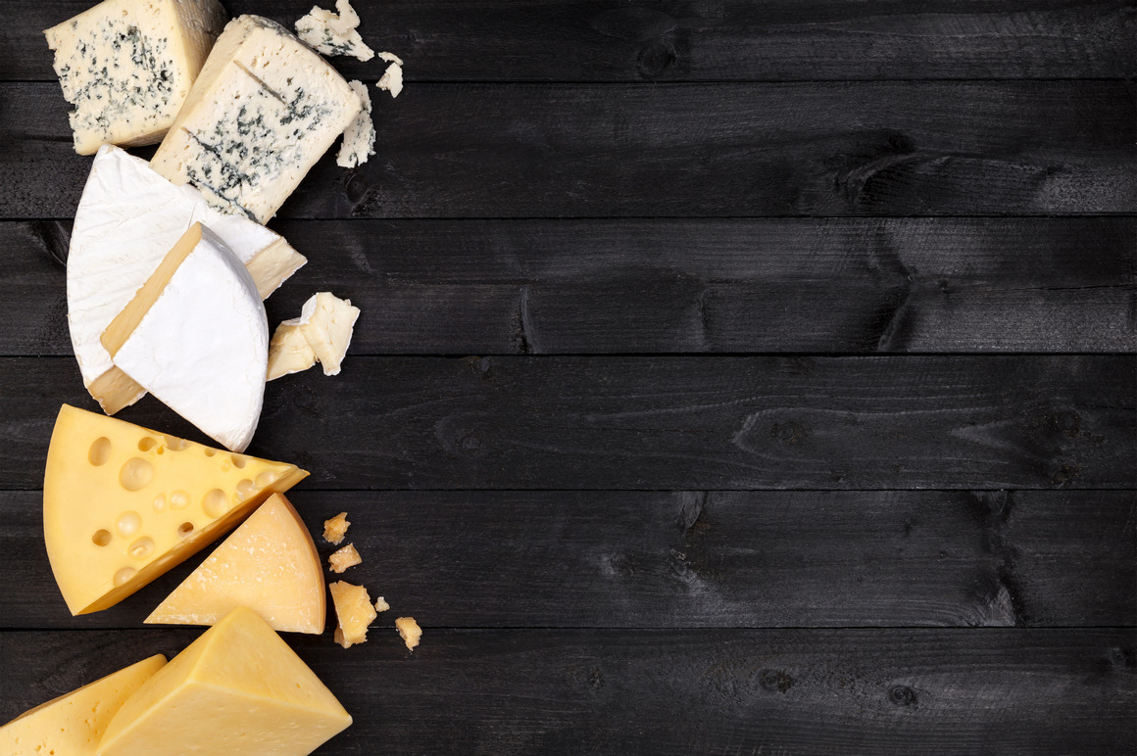
The possibility of loneliness of solids (as well as semi-solid and superhard) raw on the working and entrepreneurial Swiss to create dozens of new varieties that differ in color and structure, aroma and taste, hardness and melting, calories and aftertaste. The range of cheesemakers' products has expanded several times - from cheeses that can be spread on bread, to their counterparts, which need to be disassembled with a special tool.

Slide 8
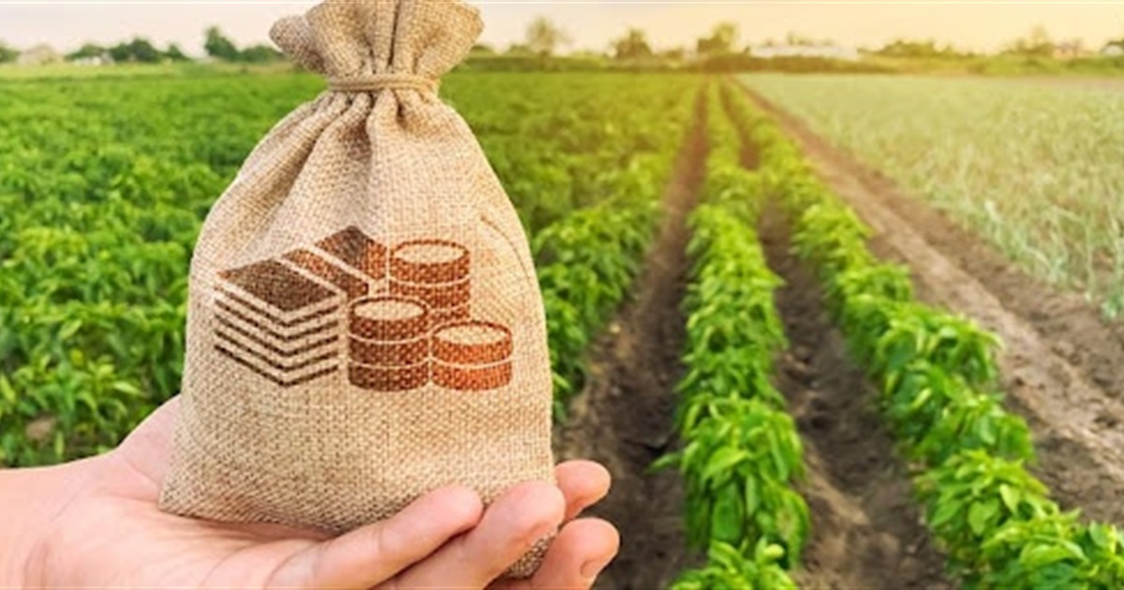
Characteristic predominance of small farms. According to local farmers, Swiss farmers need 2.5 billion Swiss francs in direct payments or government subsidies each year, whether or not they face competition. Some estimates suggest that the Swiss taxpayer spends 4 billion Swiss francs a year to support agriculture. As for subsidies to farmers, today, according to the state program, farmers receive 900 francs of aid per hectare if the land area does not exceed 60 hectares.

Slide 9
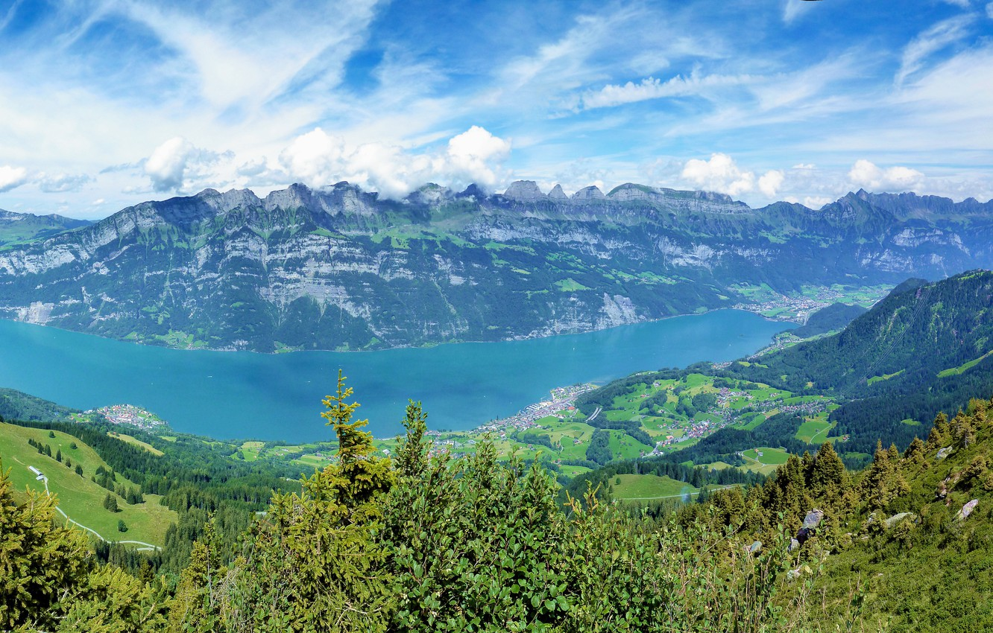
Thus, Swiss agriculture is quite developed using the latest technologies. The livestock industry dominates the crop industry. The main industry is dairy farming. The state provides assistance in the form of subsidies to farmers. The country is able to provide itself with food.

Slide 10
Thank for your attention

