Slide 1

My future speciality

Slide 2


Slide 3
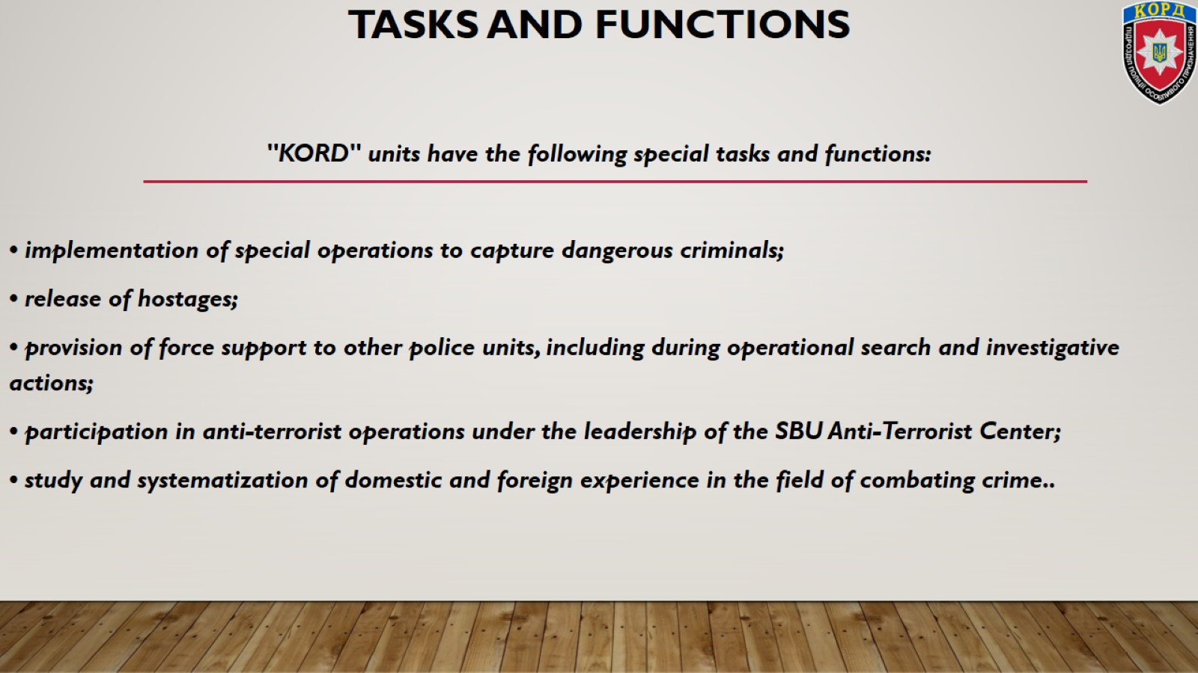
Tasks and functions

Slide 4
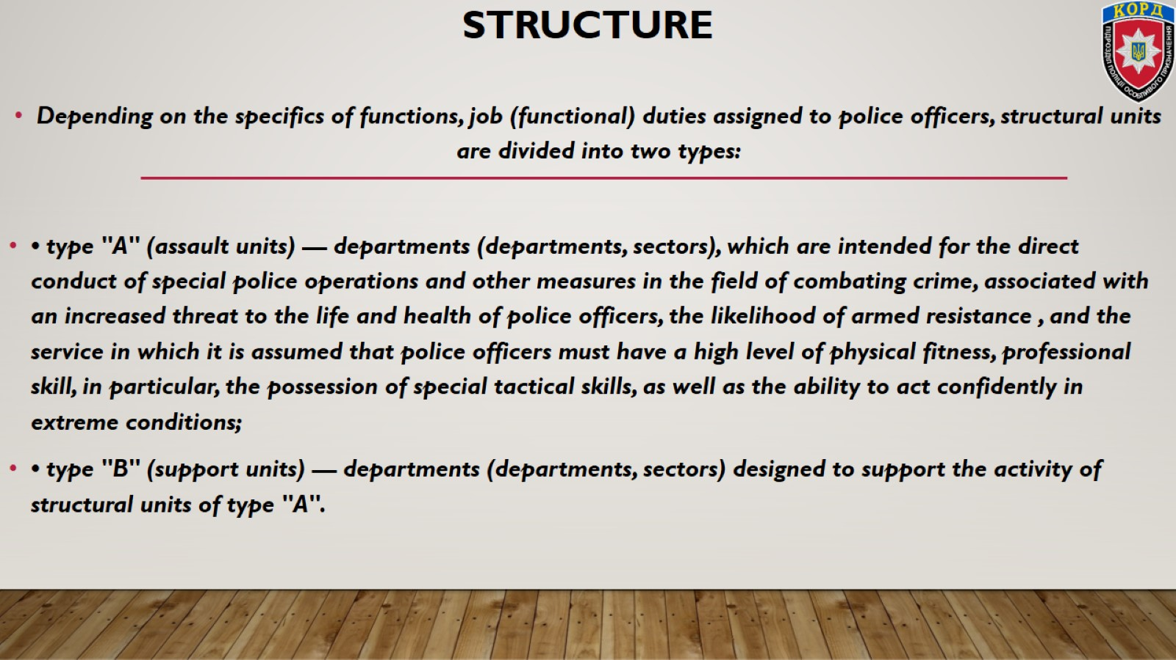
Structure

Slide 5
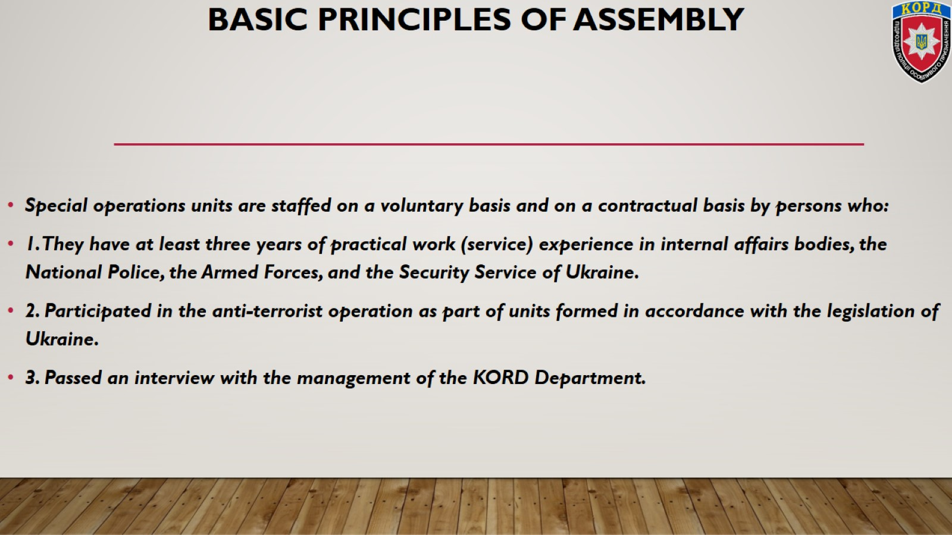
Basic principles of assembly

Slide 6
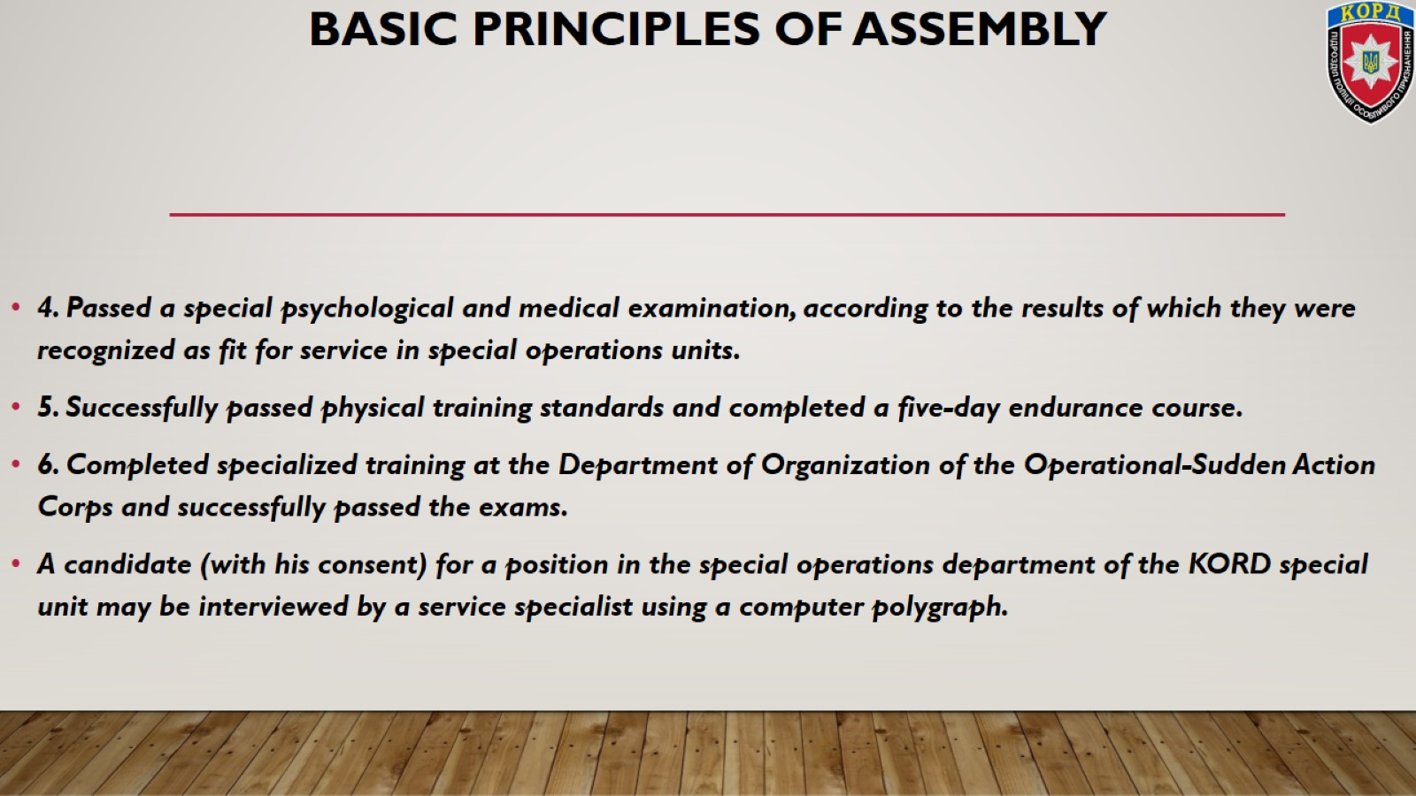
Basic principles of assembly

Slide 7
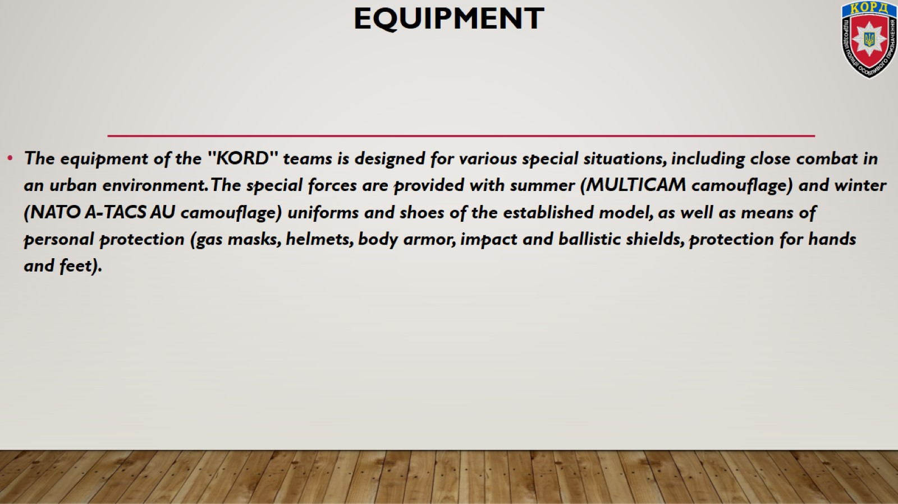
Equipment

Slide 8
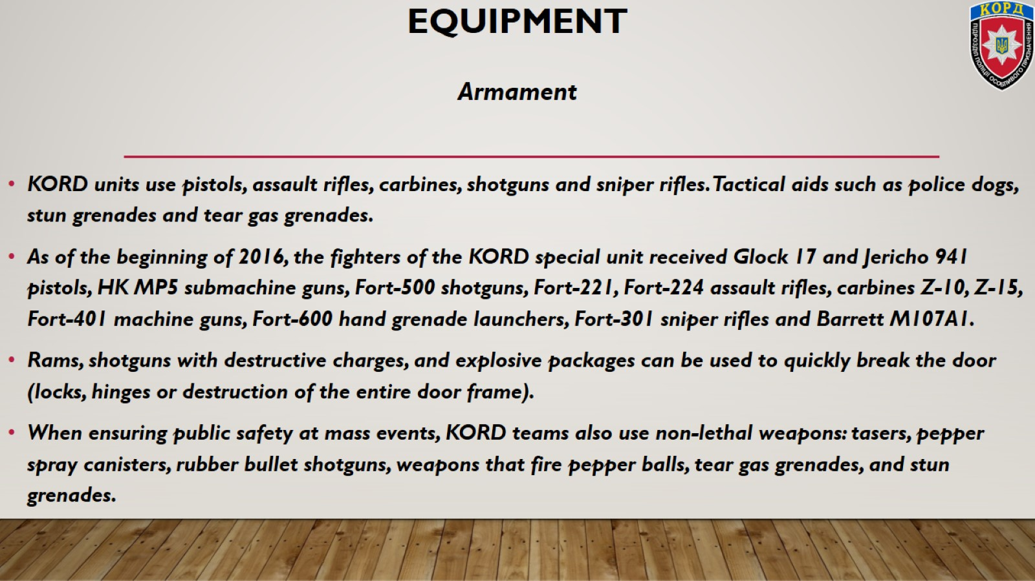
Equipment

Slide 9
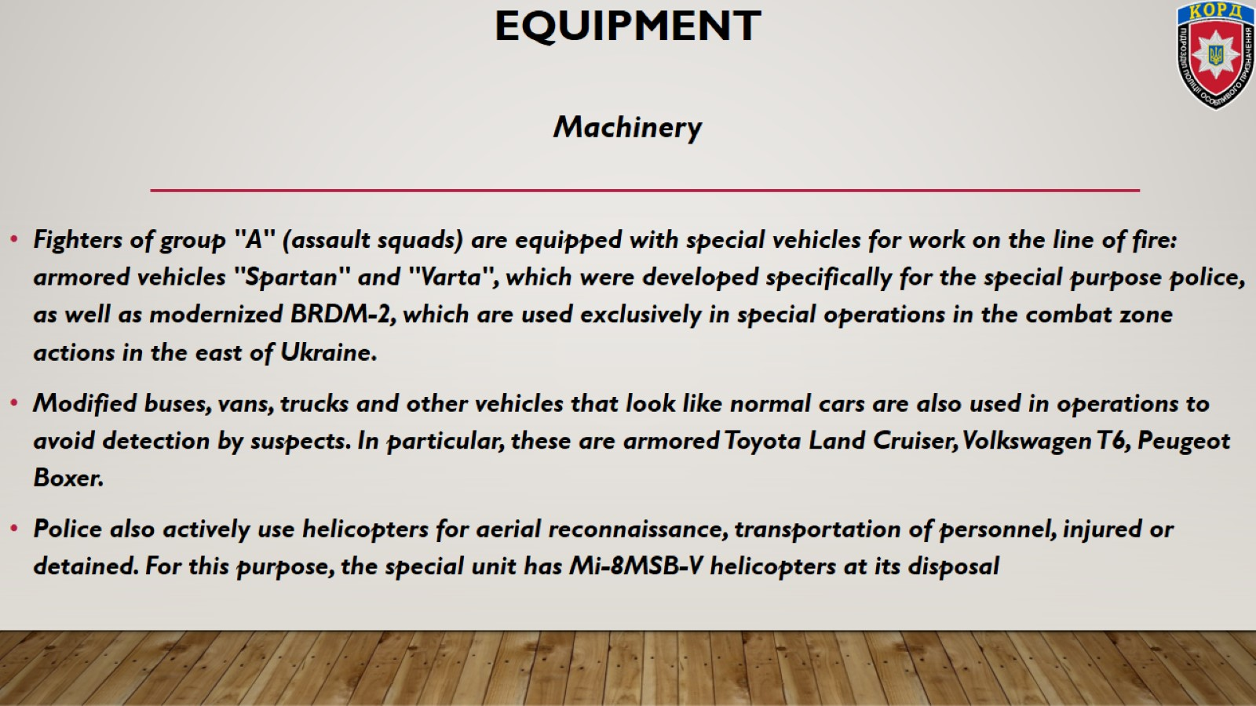
Equipment

Slide 10


Slide 11
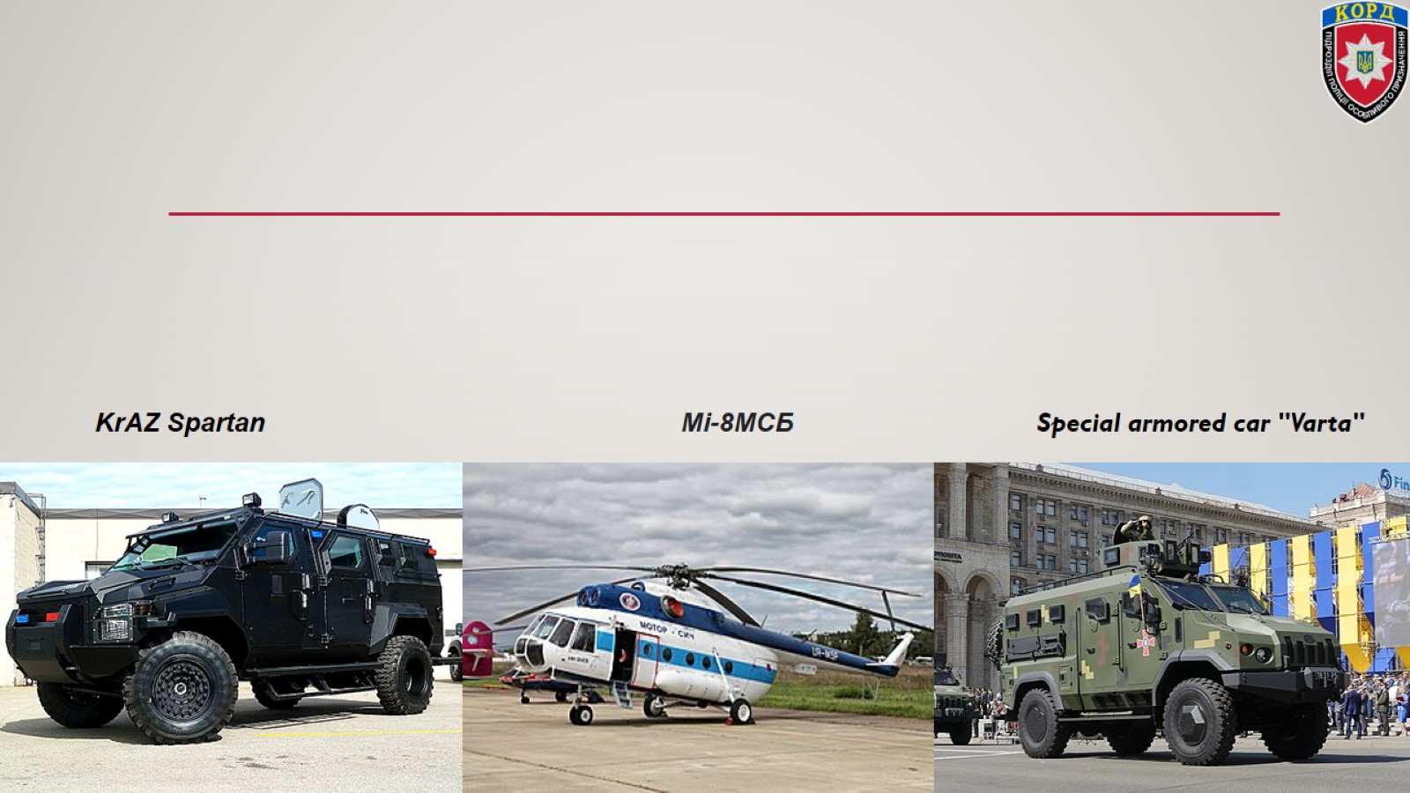

Slide 12

Requirements for KORD police special forces fighters

Slide 13
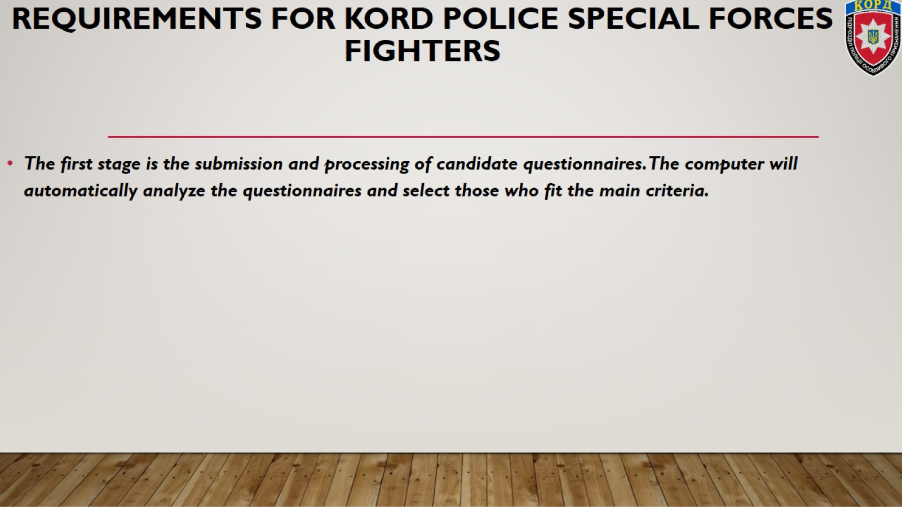
Requirements for KORD police special forces fighters

Slide 14
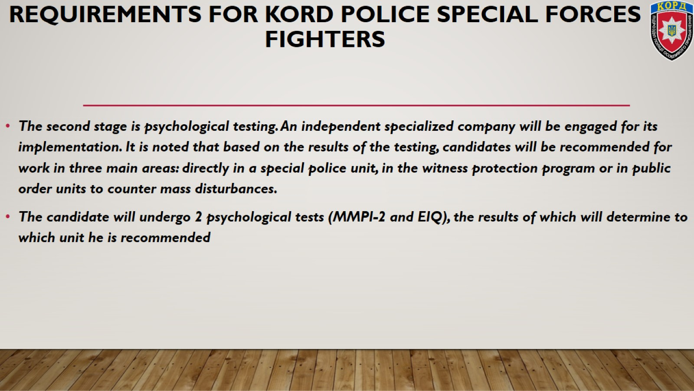

Slide 15


Slide 16


Slide 17
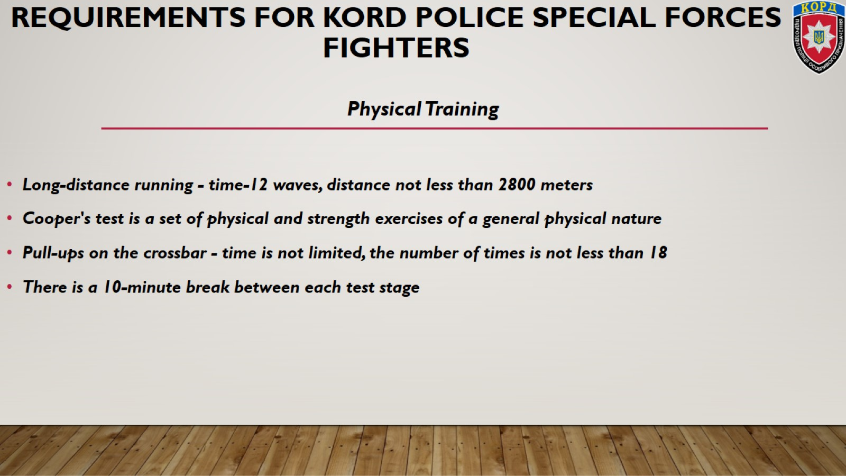
Requirements for KORD police special forces fighters

Slide 18
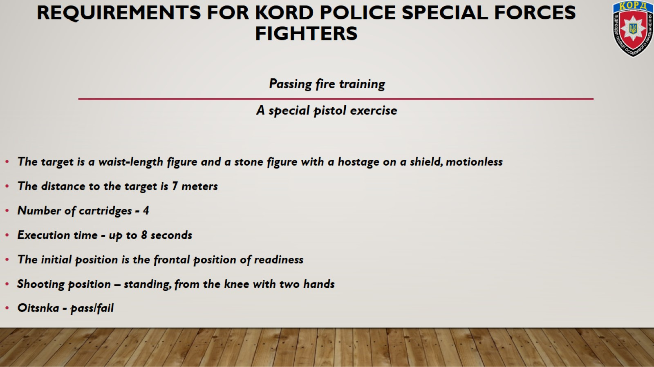
Requirements for KORD police special forces fighters

Slide 19
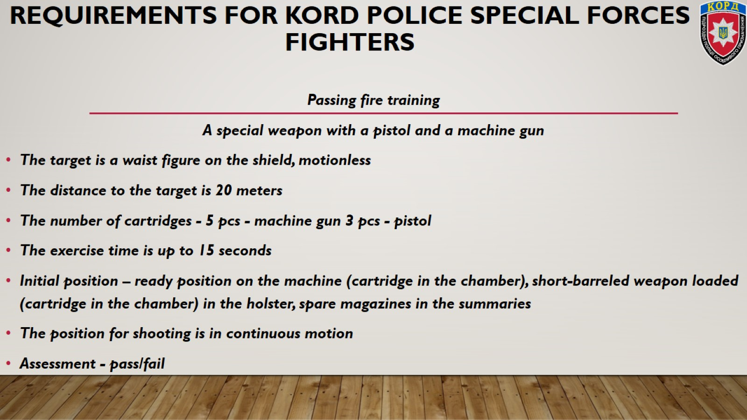

Slide 20
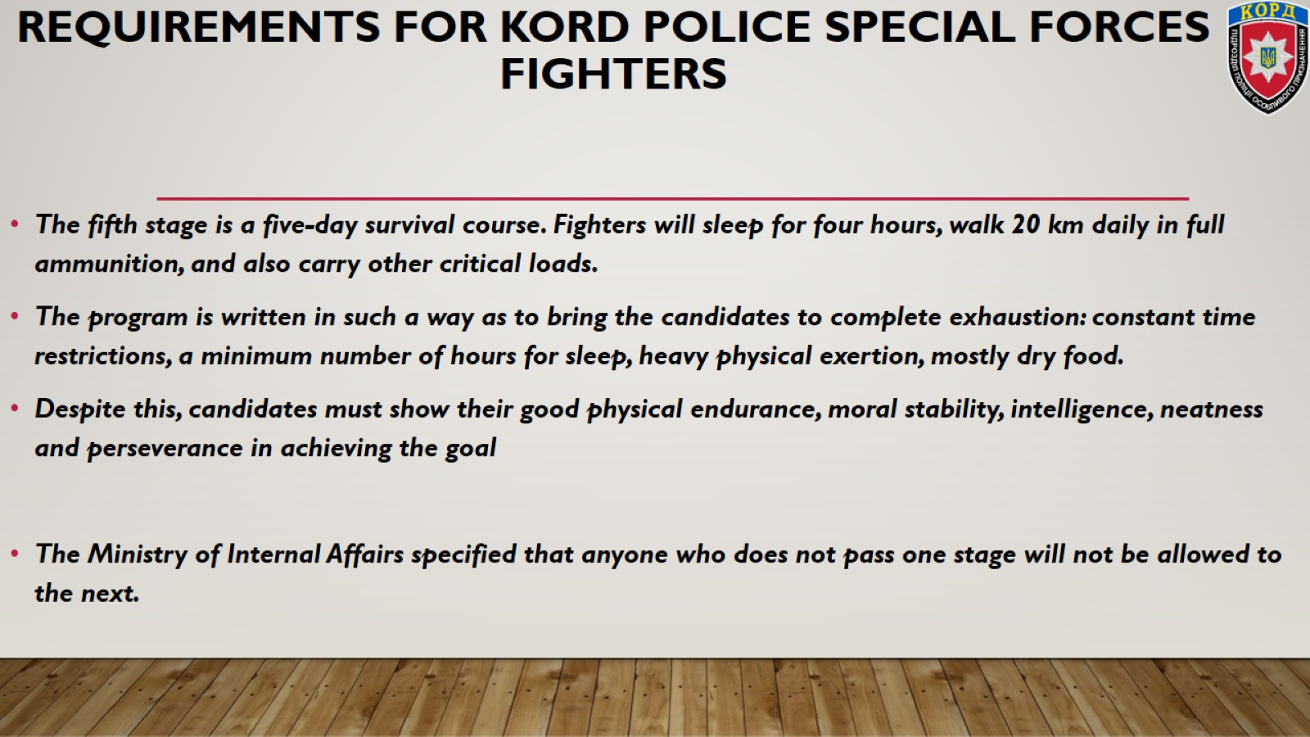
Requirements for KORD police special forces fighters

Slide 21

Thank you for attention

