Slide 1


What should an interpreter / translator learn?

Slide 2
Key words
Massive- масивні
Nullify - визнати недійсним
Manual – керівництво
Apply – застосовувати
Inspiration - натхнення
Random - випадковий
Unpredictable-непередбачуваний
Pattern – шаблон
Tireless - невтомний
Perpetual - вічний
Arousal - збудження
Delusion - маячня
Possession - володіння
Re-express- переформулювати
Convey - передати
Endow – обдаровувати, жертвувати
Accuracy - точність, акуратність
Input - внесок, вхід
Demand - попит, вимога, потреба

Slide 3
Is it possible to learn to translate?
The training of interpreters included a massive ideological preparation, which completely nullified the professional ethics of an interpreter.
In the training of translators and interpreters often practiced (and practice still) thematic principle. This principle is clearly seen on a narrow specialization of training manuals.
Traditionally interpreters have considered the translators of literature. Theorists of translation have focused on fiction as deserving primary attention. Literary translation requires such huge volume of background erudition, additional knowledge such and implements such a complex web of translation tasks.

Slide 4
The hard life of a translator
If the person chose the profession of translator, his whole life turns into studying. Rare, random intervals. He needs to read daily Newspapers, listen to radio, to communicate in these two languages, to accumulate, to expand and update vocabulary. Only their own efforts each translator increases.

Slide 5
Native language
Business of the translator is to understand what constitutes the modern culture of the native language, which is recognized as the literary norm, what are the possible deviations, what are the different genres of writing and speaking - and to work on their active mastery. It is vital for him!
Any person is sure that the mother-tongue, he speaks well and what he needs, he will be able to express. This is not so. The interpreter should from the very first professional steps to get rid of this delusion, to meticulously study your own real level of proficiency in their native language and to make the necessary arrangements.

Slide 6
Translator is a specialist in active possession of speech in two languages in a situation of increased complexity.
Conclusion: the native language is needed for translator in the active form.

Slide 7
The moral code of the interpreter
1. Translator is a TRANSLATOR that re-expressing oral or written text created in one language into text in another language.
2. The TEXT for the translator is INVIOLABLE. The translator has no right at will to change the text of the translation, to reduce or expand if additional task set by the customer.
3. The translation of the translator with the help of known professional action always seeks to convey to the maximum extent INVARIANT of the source text.

Slide 8
4. In other cases, the translator has no right to interfere in the relations of the parties, as well as to make their preferences about the content of the translated text.
5. The interpreter shall maintain confidentiality in relation to the contents of the translated material and without the need not to disclose it.
6. The interpreter shall known ways to provide a high level of competence in the areas of original language, translation language, technique of translation and the subject of the text.

Slide 9
7. The translator is entitled to demand all necessary conditions to ensure a high level of translation competence, including the relevant conditions of their labor.
8. The translator is responsible for the quality of translation and if the translation of literary or journalistic, has a copyright is protected by law, and the publication of the translation of his name should definitely be mentioned.

Slide 10
Summary
Translator is a specialist who correctly and maximally close to the original translates information from one language to another. Translators can translate in writing or orally. Most often, a specialist requires skills of both types of translation. But some translators specialize on one thing – the translation in writing (for example, work in publishing and translating books) or orally (e.g., work guides).

Slide 11
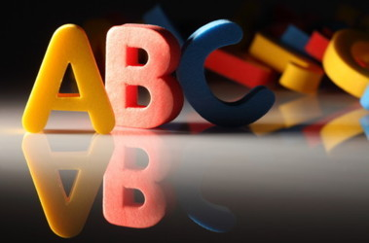
Tests
1.The training of interpreters included
A. a massive ideological preparation
B. thematic principle
C. quality of translation and if the translation of literary or journalistic
2.Traditionally translators were
A. the translators of literature
B. the translators of science
C. the translators dictionaries
3.What needs to be done to the interpreter on a daily basis?
A. nothing
B. to read newspapers, listen to radio, to communicate in these two languages, to accumulate, to expand and update vocabulary
C. whatever

Slide 12

4.The interpreter must be in
A. a state of perpetual educational arousal
B. a state of perpetual educational arousal, sucking and stimulating language material
5.Who is the translator??
A. is a specialist in active possession of speech in two languages in a situation of increased complexity
B. is specialist speech translation
C. Is specialist science
6.The native language is needed for translator
A. in the passive form
B. in the active form
C. in a passive-active forms

Slide 13

7.Maybe the translator to change the text as he wants?
A. Yes
B. No
C. Sometimes
8.The interpreter
A. shall maintain confidentiality in relation to the contents of the translated material and without the need not to disclose it
B. is obliged to maintain confidentiality in relation to the contents of the translated material and to disclose it.
9.The translator is entitled to demand
A. all necessary conditions to ensure a high level of translation competence
B. nothing
C. only the money
10. Does the translator responsible for the translation quality?
A. Yes
B. Never
C. No
D. Sometimes

Slide 14
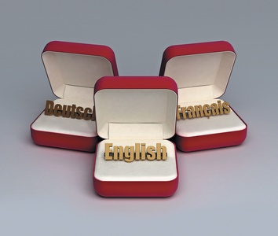
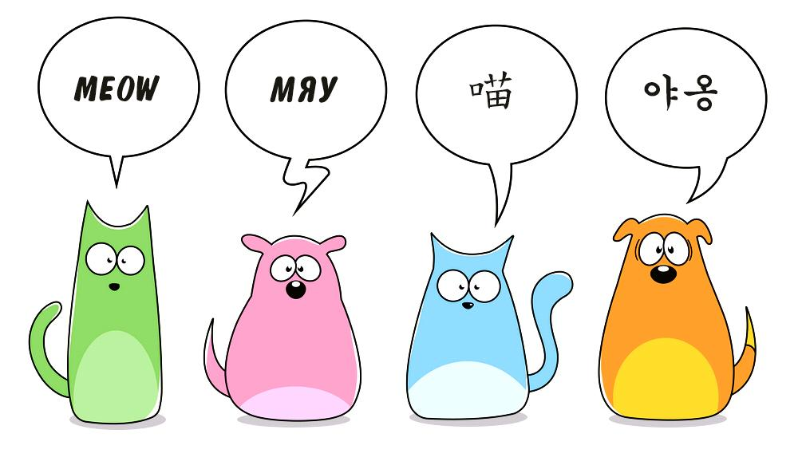
Thank you for
your attention

