Slide 1
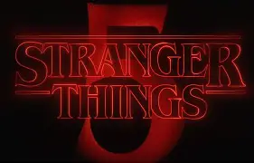
My Favorite TV Series – / Stranger Things
Author: Kravtsova Sofiia
Class: 11-B

Slide 2
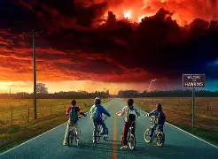
Stranger Things is my favorite TV series. It is an American science fiction and horror series. The show was created by the Duffer Brothers and released on Netflix.

Slide 3
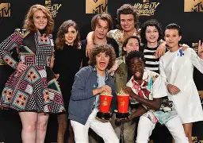
The series is set in the 1980s in a small town called Hawkins. The story begins when a boy named Will disappears. His friends try to find him and discover a mysterious world called the Upside Down.

Slide 4
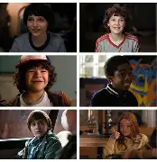
The main characters are Eleven, Mike, Dustin, Lucas, Will and Max. Eleven has special powers and helps her friends fight monsters and save the town

Slide 5
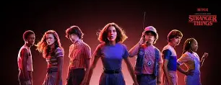
I like….
I like Stranger Things because it is exciting and emotional. It has interesting characters, a mysterious story and great music. The series shows the power of friendship and courage.

Slide 6
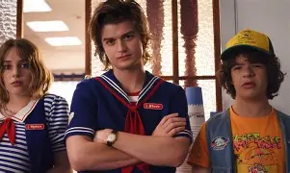
In my opinion, Stranger Things is one of the best TV series. I recommend it to everyone who likes adventure, mystery and science fiction.

