Slide 1


Strategic Economic Partnerships Between Ukraine and Poland

Slide 2
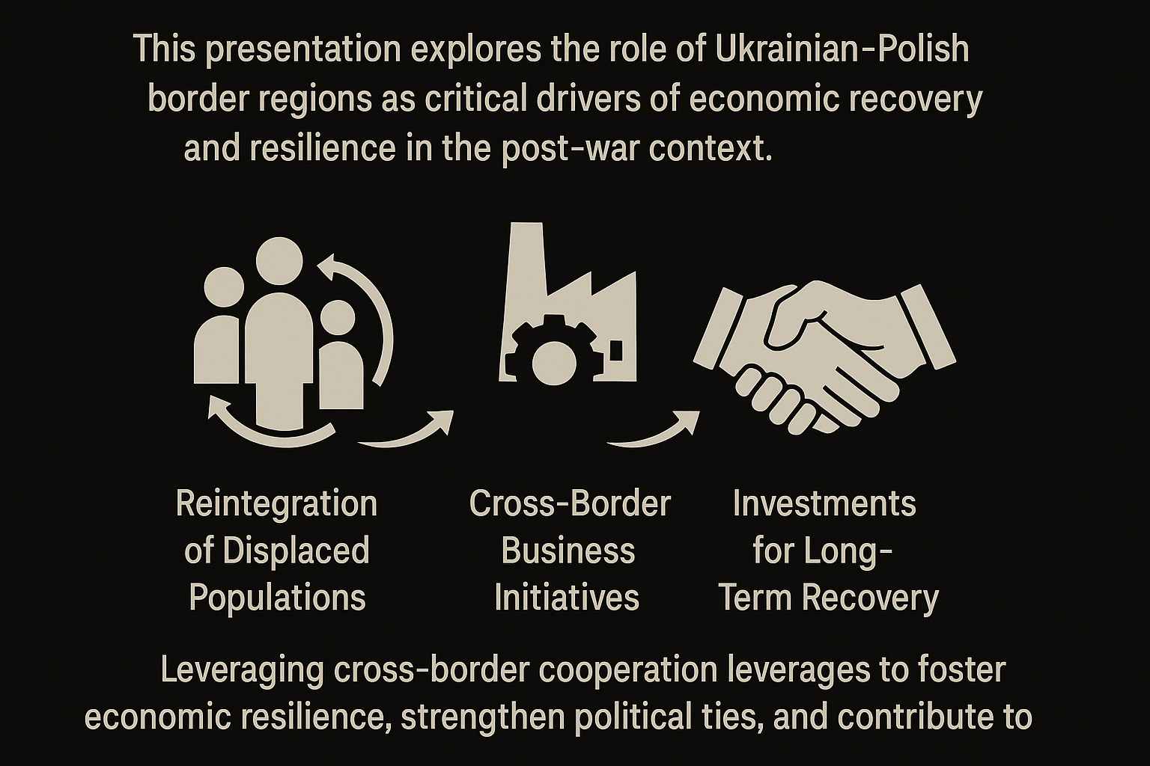


Slide 3
