Slide 1

Do cell phones and social media make family relationship stronger?
Student`s first name, Middle Initial (s), Last name
Institutional Affiliation
Course Number and Name
Instructor`s Name and Title
Assignment Due Data

Slide 2

Phones and social media have become an integral part of our lives and have a significant impact on all aspects of it.
The purpose of the study is to examine their impact on family relationships.

Slide 3
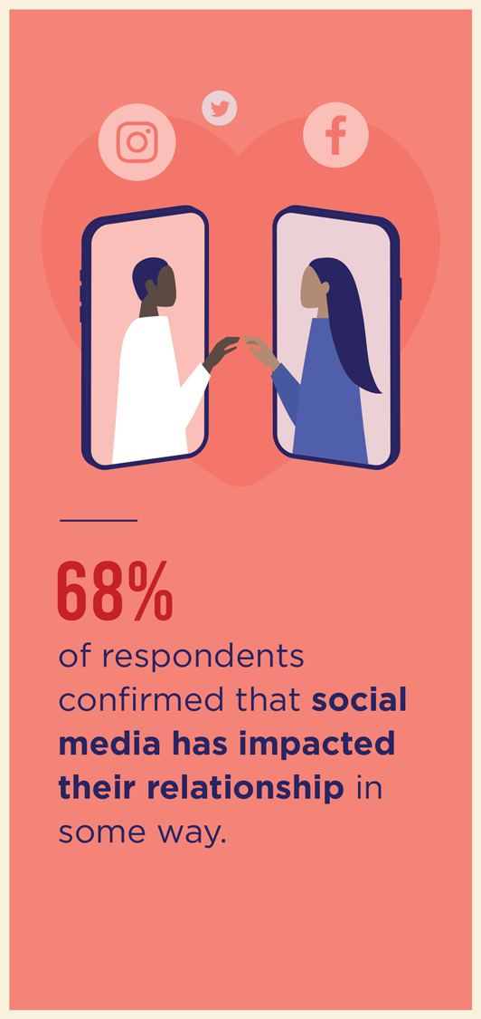
If you're separated due to certain circumstances, cell phones and social media can help keep you closer, but at the same time, they can tear you apart.
The question is, do they make family relationships stronger or not?

Slide 4
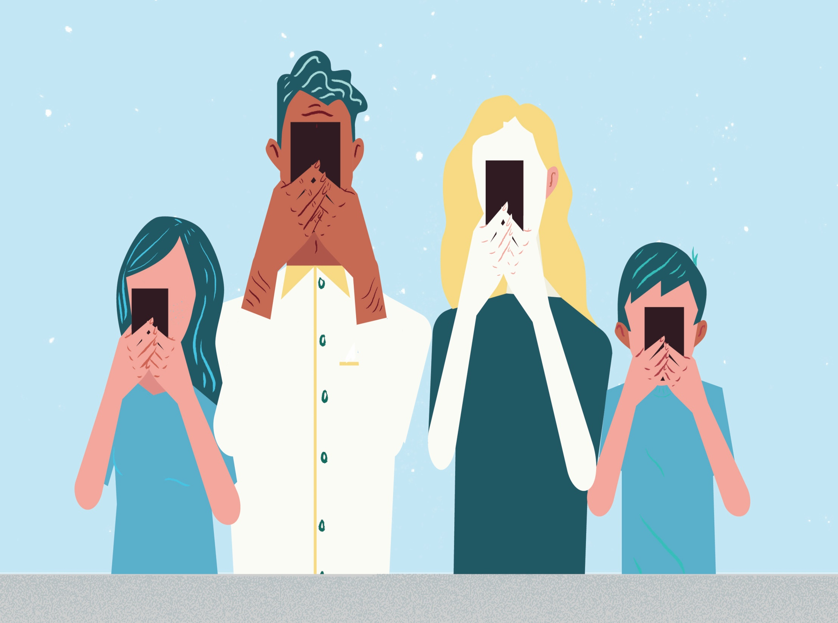
Both qualitative and quantitative methods were used:
Research of the Pew Research Center, Association for Psychological Science and BBC news were analyzed
The survey on the effects of cell phones and social media on relationships was conducted

Slide 5

Analyzing of research of the Pew Research Center, Association for Psychological Science and BBC news helped evaluate the problem from different angles;
the survey showed the attitude of the respondents to the time their partner spends on the screen of mobile phones and in social media

Slide 6

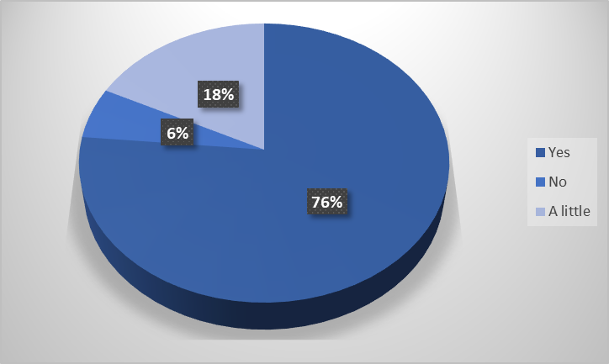
The participants were 100 cellular users aged 18-60 who are married or in a relationship.
The participants answered ten questions, after which the data was analyzed and processed
For example in Figure 2 you can see the answer to the question: Does it annoy you if your partner looks at his phone screen during a conversation?
Figure 2

Slide 7

74% said that social media and mobile phones have a positive effect on family relationships (Lenhart & Duggan, 2014):
opportunity to keep in touch
exchanging SMS or online correspondence helps to be closer to each other
dispute resolution via text message or online

Slide 8

Social media and cell phones spoil relationships in families
more than 70 percent reported that mobile phones frequently interfere in their relationships (APS, 2019)
4 percent of respondents were upset when they found out what their partner was doing online (Lenhart & Duggan, 2014)
there is tension in the relationship due to the use of mobile phones
partners are distracted by a mobile phone while spending time together

Slide 9

Cell phones and social media unite those who are far away but keep apart those who are close. In order to further investigate this issue, it is recommended
collect and analyze more previous research on a certain topic
conduct more surveys
compare the impact of cell phones and social media on family relationships 10 years ago and now

Slide 10
References
How Smartphones Are Affecting Our Relationships. (2019, Feb 11). Association for Psychological Science (APS). https://www.psychologicalscience.org/news/releases/how-smartphones-affect-relationships.html
Lenhart A. & Duggan M.. (2014, Feb 11). Couples, the Internet, and Social Media. Pew Research Center. https://www.pewresearch.org/internet/2014/02/11/couples-the-internet-and-social-media/

