Slide 1
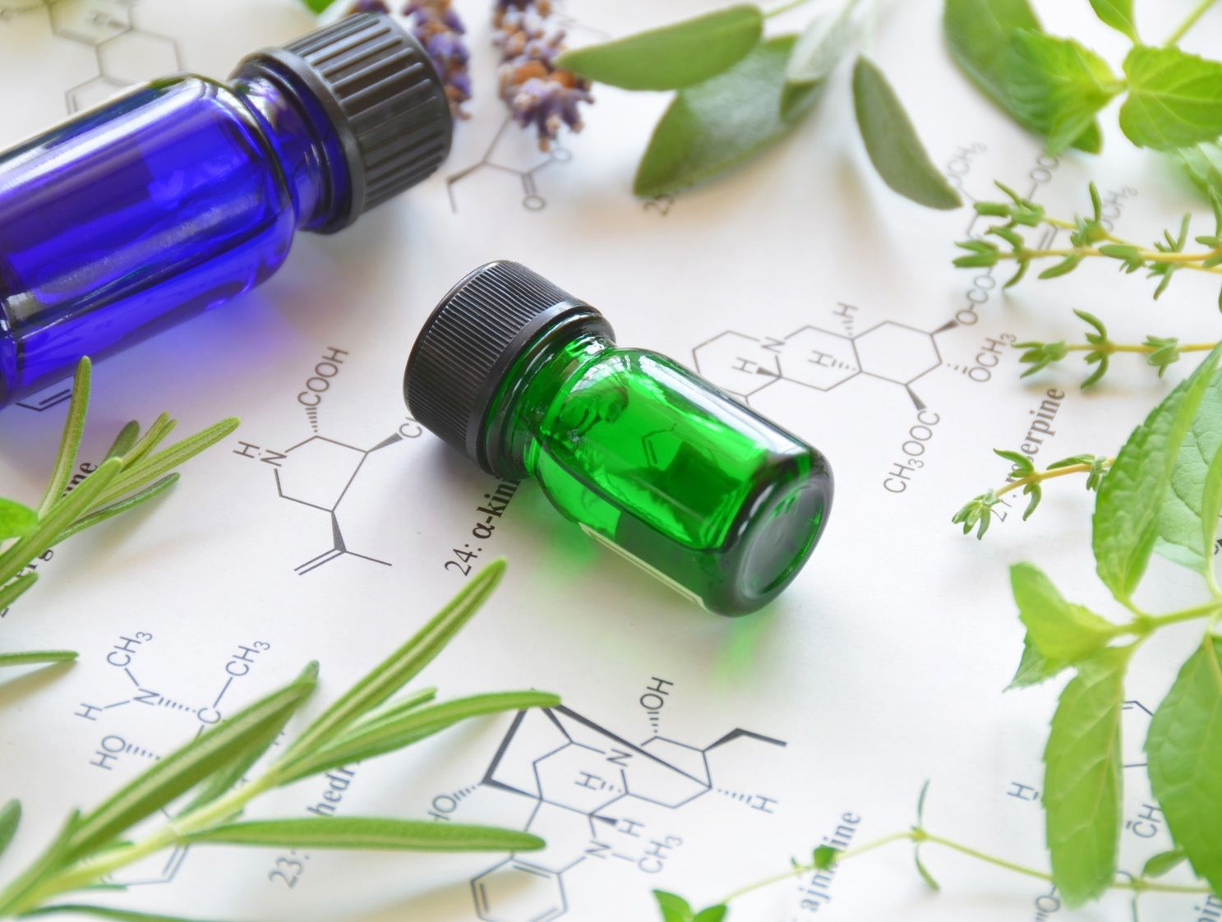

Medicinal Plants
containing Terpenoids
It’s classification and application

Slide 2

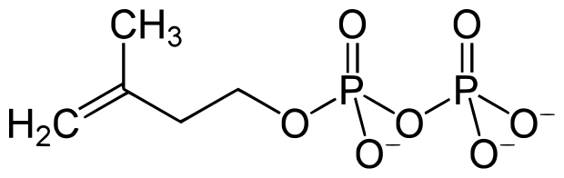
What are Terpenoids?
Terpenoids (isoprenoids), a subclass of the prenyllipids (terpenes, prenylquinones, and sterols), represent the oldest group of small molecular products synthesized by plants.
During the 19th century, chemical works on turpentine led to name "terpene" the hydrocarbons with the general formula C₁₀H₁₆ found in that complex plant product. These terpenes are frequently found in plant essential oils.
Chemical structure of the terpenoid -----→

Slide 3
Classification of Terpenoids
Isoprene units n | Carbon atoms n | Name | Examples
1 | 5 | Hemi-terpenes | isoprene
2 | 10 | Mono-terpenes | thymol, limonene, linalool, geraniol, borneol
3 | 15 | Sesqui-terpenes | δ-cadinene, abscisic acid, farnesol
4 | 20 | Di-terpenes | taxol, gibberelline, resin, alkaloids, ginkgolide
6 | 30 | Tri-terpenes | β-amyrin, stigmasterol, squalene
8 | 40 | Tetra-terpenes | β-carotene, retinol
9 – 30,000 | > 40 | Poly-terpenes | rubber
Essential oils (aroma)

Slide 4
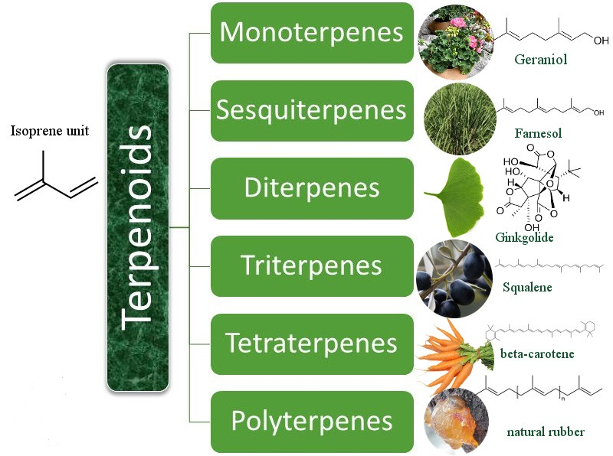

Slide 5
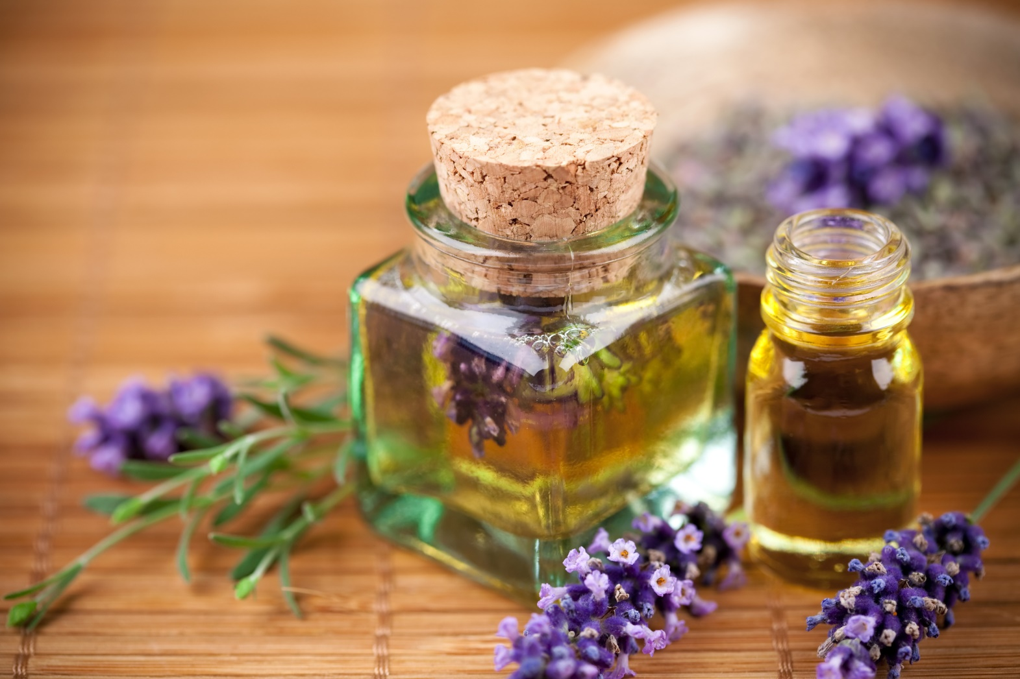
Essential oil (Olea aetherea) - is a concentrated
hydrophobic liquid containing volatile aroma compounds from plants.

Slide 6
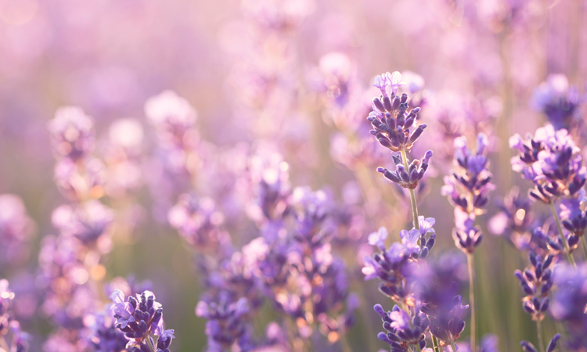
Essential oils are colorless or yellowish transparent
liquids, sometimes stained, with specific fragrant smell.
They are generally extracted by distillation, often by using steam. Other processes include expression, solvent extraction, absolute oil extraction, resin tapping, and cold pressing. They are used in perfumes, cosmetics, soaps and other products, for flavoring food and drink.

Slide 7

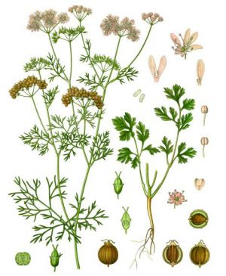
1. FRUCTUS CORIANDRI
OLEUM CORIANDRI
Coriandrum sativum
Apiaceae
Chemical composition: Essential Oil 1% (its main component is linalool, geraniol, borneol), 10-20% of fatty oils, protein substances.
Medicinal raw material: fruits.
Dosage forms: coriander fruits, fees (сборы), teas, coriander oil.
Application: As stomach, choleretic (желчегонный) and anti hemorrhoid means.

Slide 8
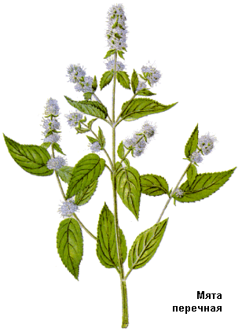
2. FOLIUM MENTHAE PIPERITAE
Mentha piperita
Lamiaceae (Labiatae)
Chemical composition: By GF XI requires at least 1% of essential oil, also it should contain at least 50% of menthol in the free state and in the form of esters. The leaves contain carotene, as well, as flavonoids, have a choleretic effect.
Medicinal raw material: leaves.
Dosage forms: peppermint leaves, infusions, fees, peppermint oil, mint flavored water, tincture, complex preparations, menthol.
Application: Water infusion, alcohol tincture - to improve digestion, nausea, as a choleretic agent. Peppermint oil is a part of fragrant water, mint liqueur, toothpastes and powders for rinsing. Mentol.

Slide 9
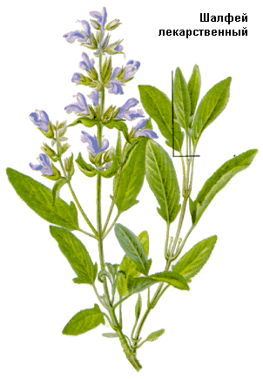
3. FOLIUM SALVIAE
Sаlvia officinalis
Lamiaceae (Labiatae)
Chemical composition: The essential oil (cineol, pinene, D-camphor), tannins, triterpene acids. According to FS and GF XI essential oil content should be not less than 0.8 and 1% in all the raw materials respectively. Components of essential oils are cineole (15%), pinene and other terpenoids.
Medicinal raw material: leaves.
Dosage forms: sage leaves, infusions, fees (emollient).
Application: In the form of infusions as an astringent and disinfectant for rinsing the mouth and throat.

Slide 10
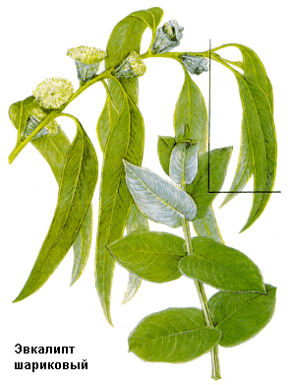
4. FOLIUM EUCALYPTI
Eucalyptus globulus, Eucalyptus cinerea
Eucalyptus viminalis
Myrtaceae
Chemical composition: Eucalyptus leaves contain essential oil (cineol) and tannins.
Medicinal raw material: leaves.
Dosage forms: leaves, decoction, tincture, briquettes, eucalyptus oil, chlorophillipt.
Application: As an anti-inflammatory and antiseptic, indicated for diseases of the upper respiratory tract, externally - for lotions and rinses, treatment of purulent wounds, inhalation.

Slide 11
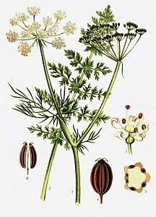
5. FRUCTUS CARVI
Carum carvi
Apiacaae (Umbelliferae)
Chemical composition: Essential oil (not less than 2%), fatty oil, protein, flavonoids. Essential oil is colorless, then gradually turns yellow. The components of the oil are ketones (carvone), that has a specific smell, and limonene.
Medicinal raw material: fruits.
Dosage forms: fruits of caraway, fees, teas, cumin oil.
Application: during the pain in the stomach and intestines. The essential oil is used to flavor medications.

Slide 12
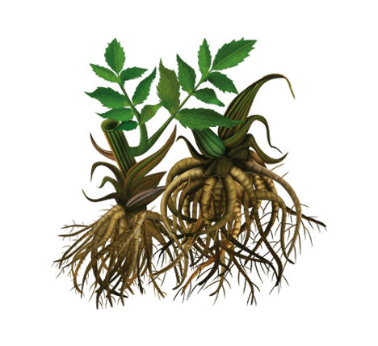
6. RHIZOMA CUM RADICIBUS VALERIANAE
Valeriana officinalis.
Valerianaceae
Chemical composition: The roots mainly contained to 2% of essential oil in the rhizome. Components of essential oils is ester borneol.
Medicinal raw material: rhizome with roots.
Dosage forms: rhizome with roots, infusion, tincture, camphor-Valerian drops, thick extract, soothing collection, tablets, pills, pellets.
Application: for many nervous diseases, disorders, insomnia, cardiac neurosis, as a sedative.

Slide 13
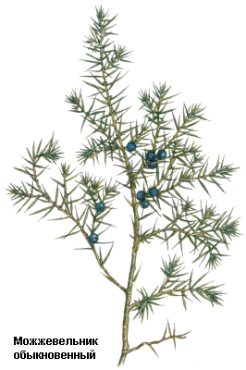
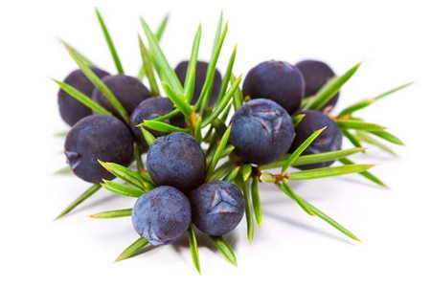
7. FRUCTUS JUNIPERI
Juniperus communis
Cuperssaceae
Chemical composition: Essential oils (mono-, bicyclic terpenes and sesquiterpenes) (not less than 0.5%), sugar, pectin, organic acids (malic acid, acetic acid), a fatty oil, resinous substance, pigment uniperin.
Medicinal raw material: fruits.
Dosage forms: fruits of juniper infusion, decoction.
Application: as a diuretic and expectorant (отхаркивающее средство). Contraindicated in nephritis and nephrosis.

Slide 14
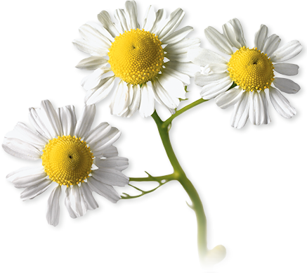
8. FLORAS CHAMOMILLAE
Matricaria recutita (syn. Matricaria chamomilla)
Asteraeae (Compositae)
Chemical composition: Essential oil (not less than 0.3%). Its component is a terpenoid - hamazulen. In addition, there are bitter substances, mucus, flavonoids.
Medicinal raw material: flowers.
Dosage forms: Chamomile flowers, extracts, fees.
Application: Inside – as a soothing antispasmodic and sudorific means; as lotions, mouthwashes, shampooing. Chamomile comes in various stomach and mitigation fees.

Slide 15
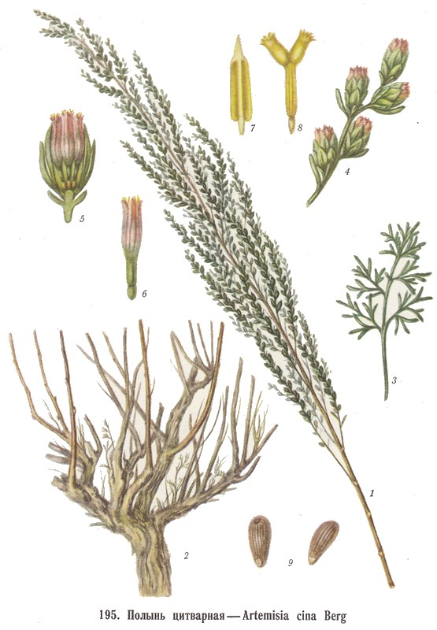
9. FLORAS CINNAE
Artemisia cina
Asteraceae (Compositae)
Chemical composition: Santonin - lactone, which is derivative of bicyclic sesquiterpenoids (not less than 2.5%), and content of essential oil (2.3%). The components thereof are cineole and pinene.
Medicinal raw material: flowers.
Dosage forms: flowers of Artemisia Cina, essential oil.
Application: As worming agent in round worms, ascarids. Essential "Darminol" Oil is used externally as an antiseptic, in the treatment of rheumatism, eczema, burns, radiation therapy.

Slide 16
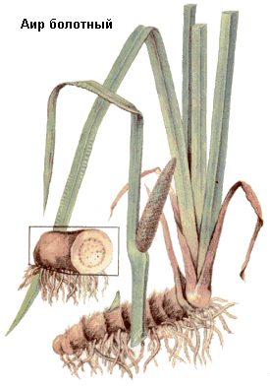
10. RHIZOMA CALAMI
Acorus calamus
Araceae
Chemical composition: It contains essential oil to 4.8% of the composition: pinene, camphene, borneol, -elements and other terpenoids, bitter glycoside akorin, starch, resin, tannins.
Medicinal raw material: rhizome.
Dosage forms: rhizome of calamus, bitter tincture, decoction gastric collection, complex preparations: vikalin and vikair.
Application: choleretic, diuretic, antimicrobial; tonic, increases appetite and gastrointestinal diseases with decreased secretion.

Slide 17
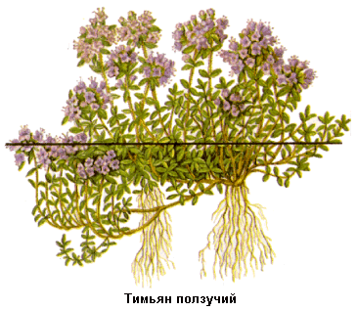
11. HERBA THYMI VULGARIS
Thymus vulgaris
Lamiaceae (Labiatae)
Chemical composition: Essential oil (0.8-1.2%), flavonoids, organic acids. The components of essential oil are thymol (40%), linalool and borneol.
Medicinal raw material: herba.
Dosage forms: The herb thyme, broth, briquettes, essential oil, thymol, liquid extract.
Application: as an expectorant for bronchitis and whooping cough, externally - as fragrant bath products, antiseptic and disinfectant (thymol).

Slide 18
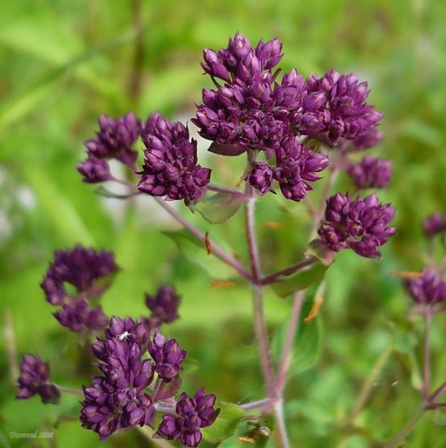
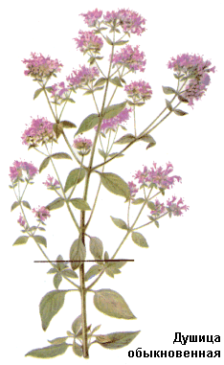
12. HERBA ORIGANI VULGARIS
Origanum vulgare
Lamiaceae (Labiatae)
Chemical composition: Essential oil (not less than 0.1%). Component - phenolic compounds mainly thymol. Tannins, ascorbic acid.
Medicinal raw material: herba.
Dosage forms: herba of origani vulgaris, fees, briquettes infusion.
Application: as an expectorant and stimulating bowel activity means.

Slide 19


