Slide 1

Complited by the student of the ERI TS group №12
Shyshniak Anastasiya
Checked by
Anastasyeva O. A.
Kharkiv Petro Vasylenko National Technical University of Agriculture
The Department of Transport Technology and Logistics

Slide 2
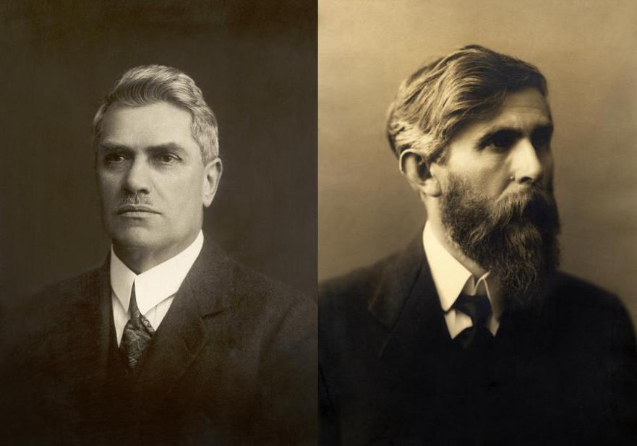
The origins of what became Škoda Auto go back to the early 1890s when, like many long-established car manufacturers, a company started manufacturing bicycles. Škoda factories were founded in 1869.
In 1898, after moving to their newly built factory, the pair bought a Werner "Motocyclette". Laurin & Klement's first motorcyclette, powered by an engine mounted on the handlebars driving the front wheels, proved dangerous and unreliable—an early accident on it cost Laurin a front tooth.
After World War I the Laurin & Klement company began producing trucks, but in 1924, after running into problems and being affected by a fire on their premises, the company sought a new partner.

Slide 3
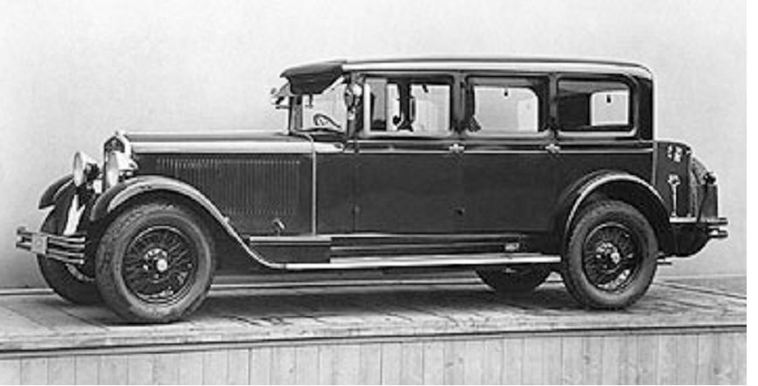
After a decline caused by the economic depression, Škoda introduced a new line of cars in the 1930s which significantly differed from its previous products. A new design of chassis with backbone tube and all-around independent suspension was developed under the leadership of chief engineer Vladimir Motous and modelled on the one first introduced by Hans Ledwinka in Tatra. First used on model Škoda 420 Standard in 1933, it aimed at solving insufficient torsional stiffness of the ladder frame.

Slide 4
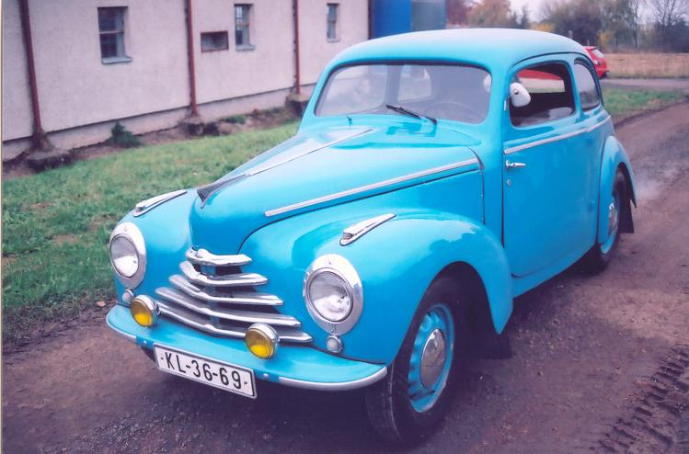
When, by July 1945, the Mladá Boleslav factory had been reconstructed, production of Škoda's first post-World War II car, the 1101 series began. It was essentially an updated version of the pre-World War II Škoda Popular. In the autumn of 1945, Škoda (along with all other large manufacturers) became part of the communist planned economy, which meant it was separated from the parent company, Škoda Works. In spite of unfavourable political conditions and losing contact with technical development in non-communist countries, Škoda retained a good reputation until the 1960s, producing models such as the Škoda 440 Spartak, 445 Octavia, Felicia and Škoda 1000 MB.

Slide 5
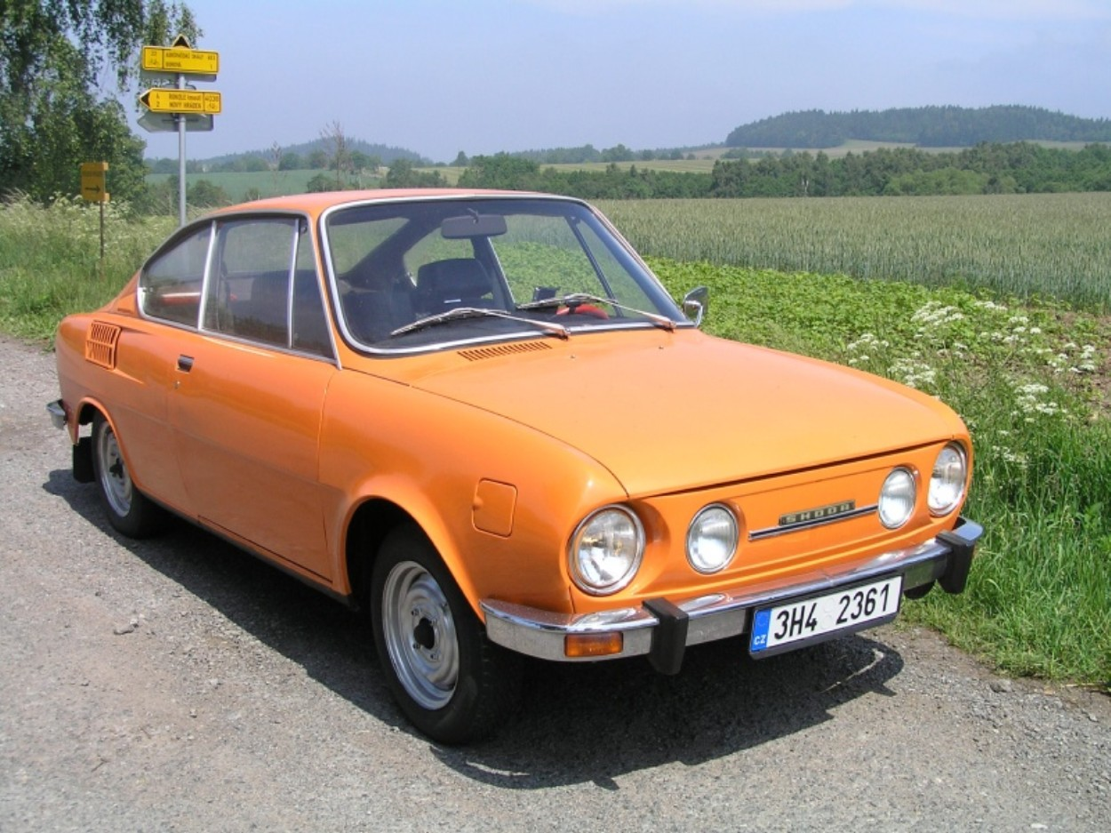
In the late 1980s, Škoda (then named Automobilové závody, národní podnik or abbreviated AZNP) was still manufacturing cars that conceptually dated back to the 1960s.
Sport versions of the Estelle and earlier models were produced, using the name "Rapid". Soft-top versions were also available. The Rapid was once described as the "poor man's Porsche", and had significant sales success in the UK during the 1980s.

Slide 6
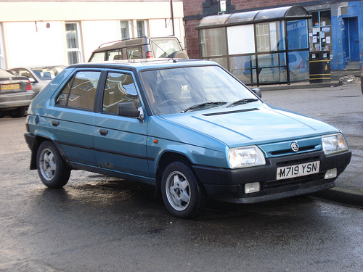
The fall of communism with the Velvet Revolution brought great changes to Czechoslovakia and most industries were subject to privatisation. In the case of Škoda Automobile, the state authorities brought in a strong foreign partner. Volkswagen was chosen by the Czech government on December 9, 1990, and, as a result, on March 28, 1991 a joint-venture partnership agreement with Volkswagen took place, marked by the transfer of a 30% share to the Volkswagen Group on April 16, 1991. By this stage, Skoda was still making its outdated range of rear engine saloons, although it had started production of the Favorit front-wheel drive hatchback in 1988 as an eventual replacement.
In the following years, Škoda became the fourth brand of the German group, as the Volkswagen Group raised its equity share first on December 19, 1994, to 60.3%, followed on December 11, 1995, to 70%.

Slide 7
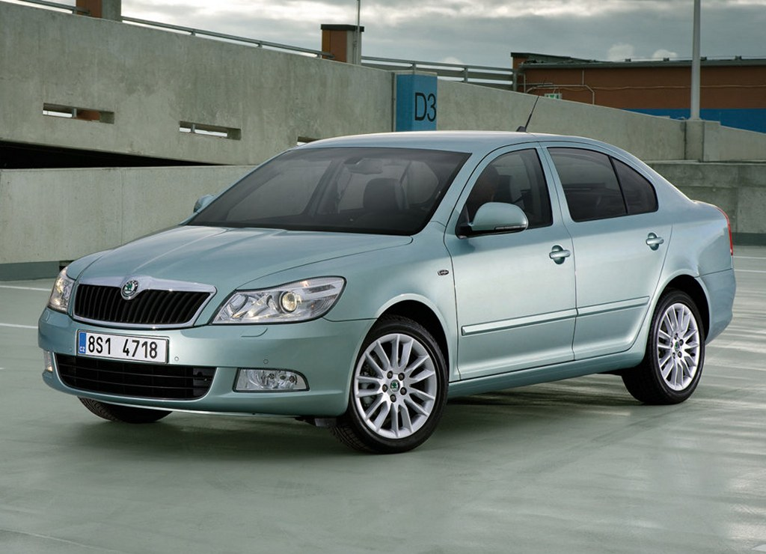
2010 was a year of important changes for Škoda Auto, in terms of both products and management. On 1 September 2010, Prof. Dr. h.c. Winfried Vahland assumed responsibility for the management of the company, becoming the CEO of Škoda Auto. Under Vahland's leadership, Škoda set forth plans to double the company’s annual sales to at least 1.5 million by 2018 (later known as the ‘Growth Strategy’, Czech: ‘Růstová Strategie’).

Slide 8
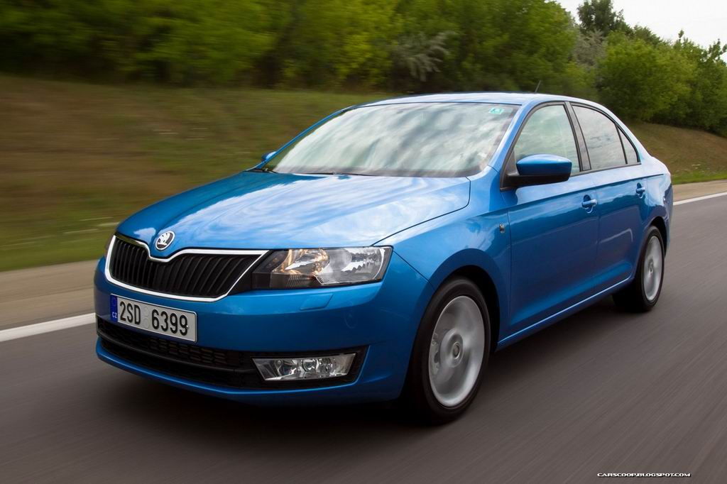
ŠKODA has maintained sound financial stability over recent years. In 2013 the brand achieved sales revenues totalling €10.3 billion (2012: €10.4 billion). Due to the weak economic situation in many European countries and the expansion of the ŠKODA model range, operating profit reached a modest 522 million euros (2012: €712 million). ŠKODA achieved a successful start to 2014: As well as recording the highest number of deliveries to customers in a first quarter ever (247,200; up 12.1%), ŠKODA recorded a significant increase in sales revenue (23.7%) to almost 3 billion euros. Operating profit increased 65.2% to 185 million Euros over the previous year.
Sales figures

Slide 9

Skoda Logo
Slavia Logo (1895 – 1905)
Bicycles and motorcycles were made at the Mladá Boleslav workshop under the Slavia brand. The logo was based on a wheel with lime leaves, which were to symbolise the Slav nations. The names of the company's founders (Laurin & Klement) were added and later became the main motif for the new logo.

Slide 10

Skoda Logo
L&K Logo (1905 - 1922)
​The design of the L&K logo was influenced by Art Nouveau, an artistic style at the beginning of the 20th century. The initials of the company's two founders are (probably in connection with the name Václav Laurin or laurel, lat. Laurus nobilis) surrounded by laurels in the shape of a wreath, which has been associated with victors and the famous since antiquity. The laurels possibly foretold the success of L&K.

Slide 11

Skoda Logo
ŠKODA Logo (1926 - 1933)
​Cars were produced in Mladá Boleslav under the ŠKODA brand from 1926. Although the name changed completely, the new logo shows continuity with the previous logo. The ŠKODA logo has a new, oval shape, but the brand name is still the dominant element in the centre and is surrounded by laurels.

Slide 12



Skoda Logo
ŠKODA Logo (1923 - 1990)
The logo with the famous "winged arrow" was first used in 1923. Its origin is shrouded in mystery, sometimes the author of the idea (the stylised head of an Indian wearing a headdress with five feathers) is said to be the commercial director of ŠKODA Plzen, T. Maglic. The blue and white circular logo, which is completed by a right-moving winged arrow with a stylised pinion, is currently used on some original ŠKODA parts (e.g. on window glass and engine blocks). This logo was used in conjunction with the ŠKODA Logo above for some years.​

Slide 13

Skoda Logo
ŠKODA Logo (1991 - 2011)
​The ŠKODA logo is viewed as one of the most original and stylistically clean manufacturing company trademarks in the world. The black and green logo, gives the ŠKODA brand a greater degree of originality – black symbolises the hundred-year tradition, green signalises environmental production.​

Slide 14

Skoda Logo
ŠKODA Logo (since 2011)
​Our current ŠKODA Logo was launched at the 2011 Geneva Motor Show in conjunction with the slogan "The New Power of ŠKODA". The traditional winged-arrow logo features a new spectrum of colours to look even more distinct and precise. The hue of the winged arrow has been changed from "natural green" to the new lush "ŠKODA Green". The outer area is highlighted with a chrome look.​

Slide 15
THANK YOU FOR ATTENTION!

