Slide 1
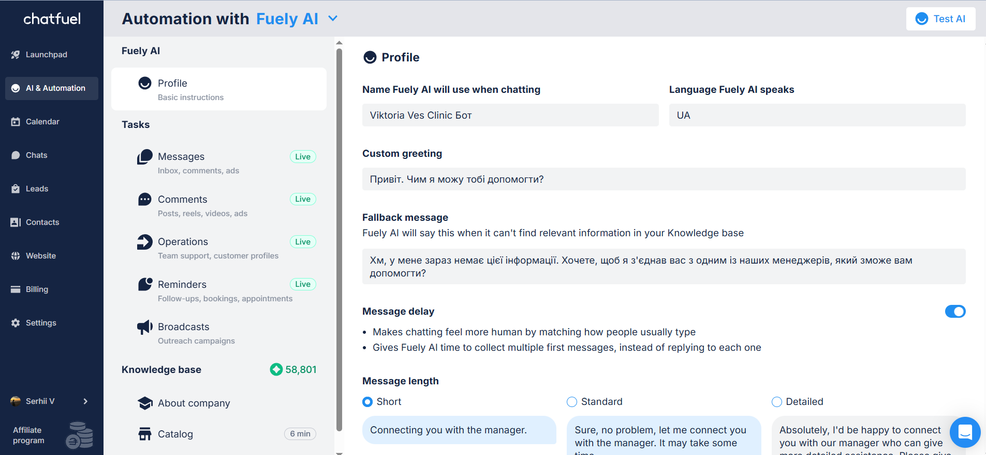
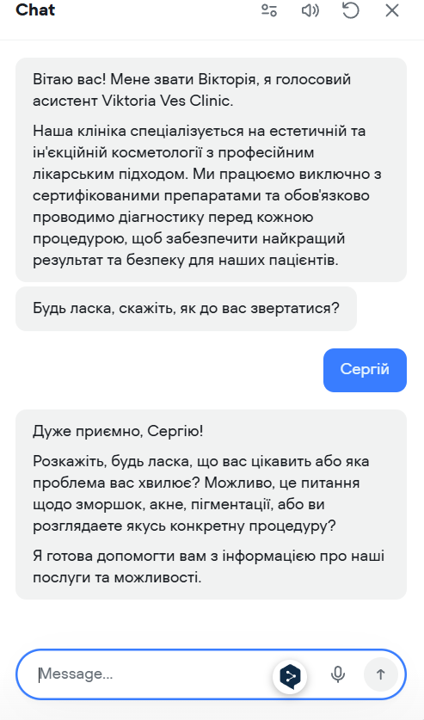
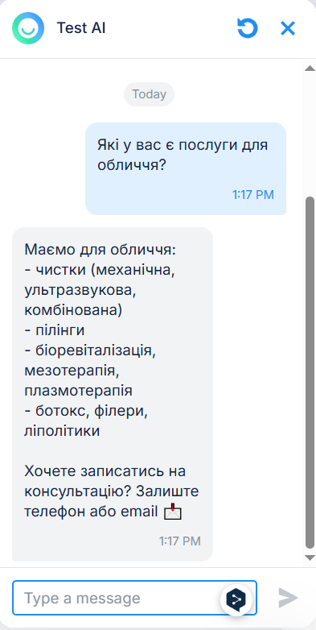
CASE STUDY
AI Lead Capture System
for Medical Cosmetology Clinic
Chatfuel (Fuely AI) · Voiceflow Voice Agent · 24/7 Automated Consultation Flow
Serhii V. · AI & Marketing Automation Specialist
Viktoria Ves Clinic · Medical Cosmetology · Ukraine

Slide 2
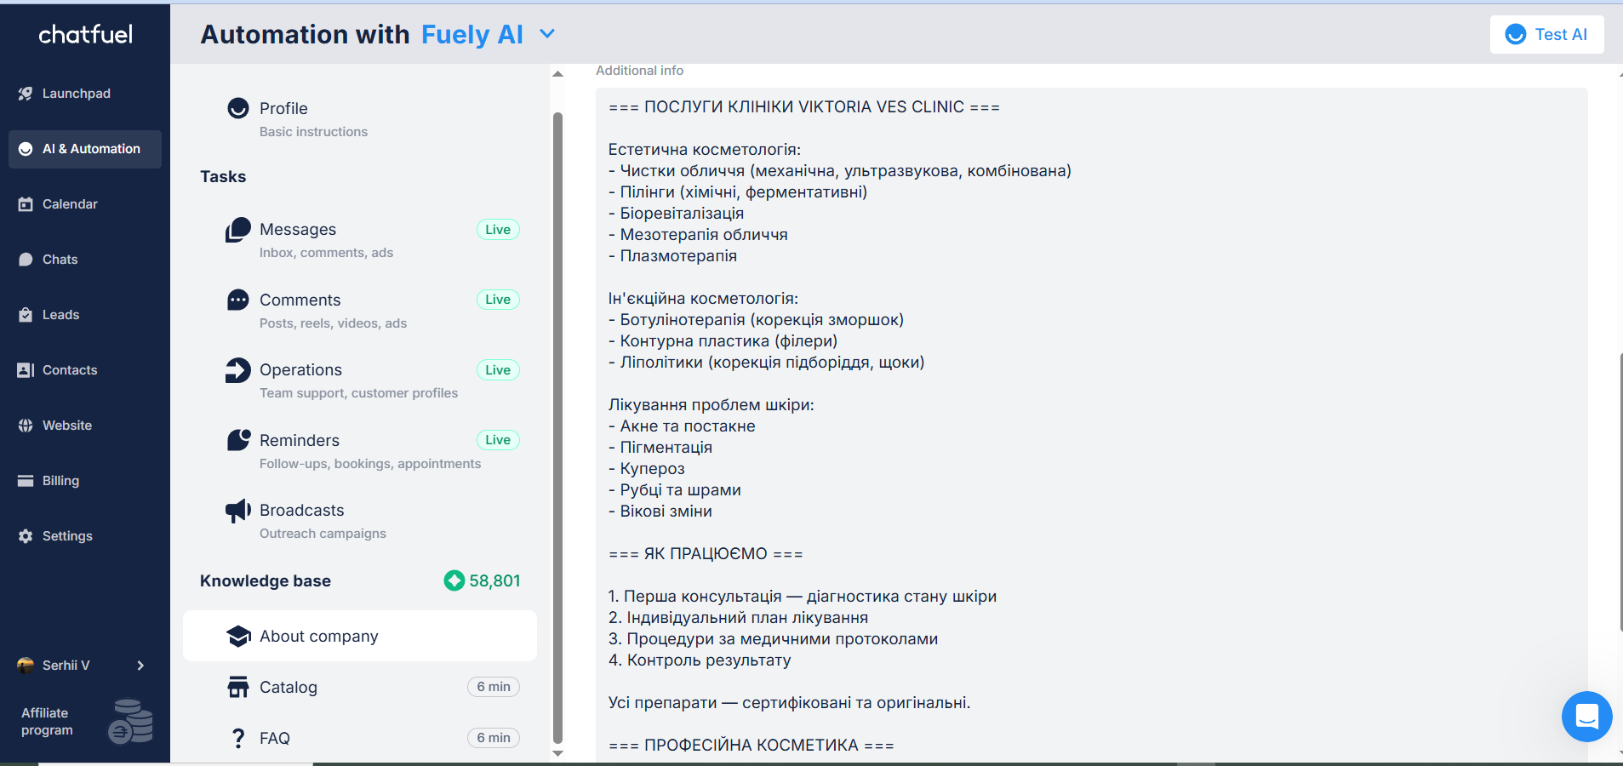



01 | Context & Background
Business
Viktoria Ves Clinic—a medical cosmetology clinic specializing in aesthetic & injection procedures. Services: wrinkles, acne, pigmentation, scarring, age-related skin changes.
Audience
Women 18–60 and men 30–50 seeking a medical-grade (not salon) solution. Common objections: price concerns, fear of side effects, past negative experience.
Chatfuel · AI & Automation panel
Knowledge base: 58,801 tokens loaded
Situation
All client inquiries are handled manually by the admin. No after-hours coverage. Instagram DMs unanswered overnight. Zero automated pre-qualification or contact capture.
Bot profile: name, language (UA), greeting & fallback messages configured

Slide 3


02 | Problem Statement
Three critical gaps were preventing the clinic from converting online interest into booked consultations:
01
No After-Hours Lead Capture
The clinic received inquiries via Instagram outside business hours. Without automation, every after-hours message was lost. Potential clients moved to competitors before admin could respond the next morning.
02
100% Manual Pre-Qualification
Administrators personally answered every question—procedure details, contraindications, and pricing. Repetitive workload with no structured handoff. No contact data captured before the first human touchpoint.
03
Zero Structured Consultation Flow
No consistent script for first contact. Every interaction depended on individual admin availability. No name, concern, or preferred callback time collected automatically. No fallback when info was unavailable.

Slide 4


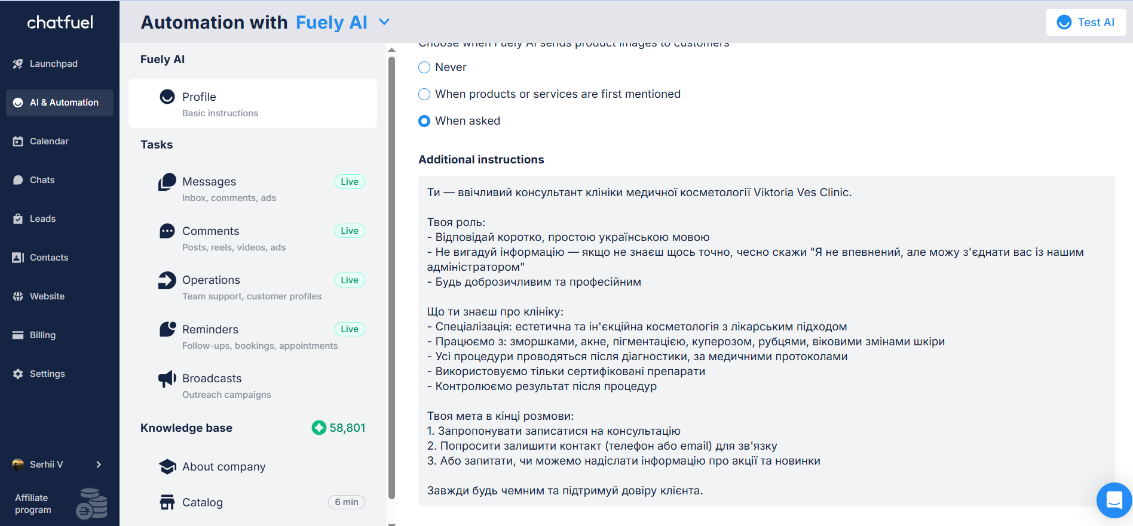
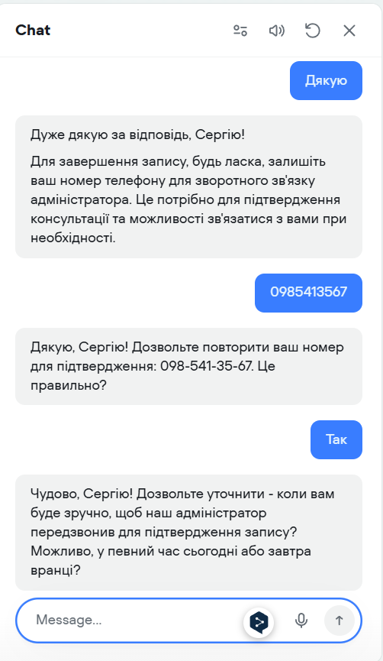
03 | Solution
Two complementary AI systems built to cover every entry point—text and voice:
Chatfuel · Fuely AI (GPT)
Voiceflow · Voice Agent "Viktoria"
GPT-powered bot with role-specific system prompt
Named agent: "Viktoria" — warm, conversational persona
Knowledge base: 58,801 tokens (services, protocols, FAQ)
Collects: name · skin concern · preferred callback time
Language: Ukrainian · Tone: warm, medical-grade
Captures phone number with read-back confirmation
Goal: capture email/phone + offer consultation booking
+
Step-by-step flow: 6 stages, sequential capture blocks
Fallback: escalates to admin when out-of-scope
All dialogue in Ukrainian, natural speech style
Tasks active: Messages, Comments, Reminders, and Broadcasts
Procedure options presented clearly without medical jargon

Slide 5
04 | Process
01
Audit & Scoping
04
Voiceflow Agent Design
Mapped current inquiry flow. Identified drop-off points: after-hours messages, repetitive FAQ load on admin, no structured lead capture. Defined two parallel tracks: text bot (Instagram) + voice agent (web/calls).
Scripted 6-stage conversation: greeting → name capture → concern identification → procedure options → callback time → phone number with read-back confirmation. Natural language, no medical jargon. Tested full dialogue with edge-case inputs.
02
Knowledge Base Architecture
05
Testing & Launch
Structured clinic content into 3 modules: services catalog, working methodology, and professional cosmetics. Loaded into Chatfuel Knowledge Base—58,801 tokens. Organized into About Company, Catalog, and FAQ sections.
Ran 3+ test dialogues in Chatfuel preview covering service inquiries, FAQs, and lead capture. Validated Voiceflow flow end-to-end with real conversation (name, concern, time, phone). Both systems are live and verified before delivery.
03
Chatfuel Bot Configuration
Wrote role-specific system prompt defining bot identity, response style (short, Ukrainian, no fabrication), escalation rules, and end-goal (capture contact + book consultation). Configured: greeting, fallback, message delay, tasks (Live).

Slide 6
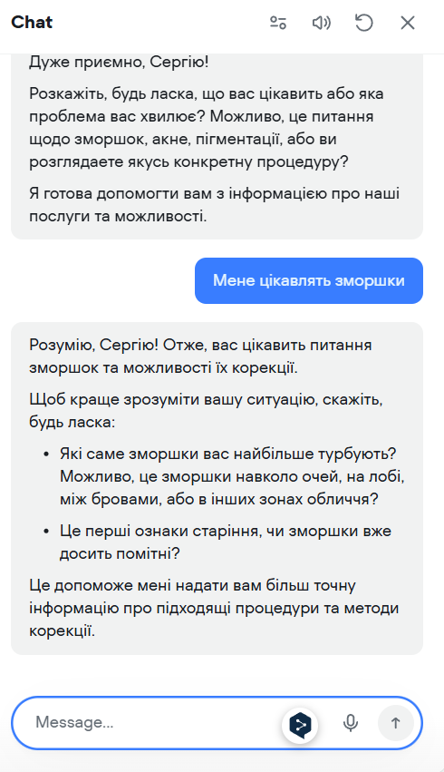
05 | Results
24/7
58,801
0
6
Lead Capture
Coverage
KB Tokens
Loaded
Missed After-Hours
Inquiries
Voiceflow
Conversation Stages
Full system prompt defining role, knowledge boundaries, tone, and lead-capture goal — deployed and live.
Chatfuel tasks active: Messages, Comments, Operations, Reminders, Broadcasts — all marked Live.
3 test dialogues validated: service inquiry, FAQ, contact capture — consistent tone, no hallucinated info.
Voiceflow agent completed full test conversation — name, concern, procedure, time, phone with read-back.
Both systems deployed and tested. Consistent response quality. Structured lead data captured automatically on every interaction.
Chatfuel · test dialog
Voiceflow · voice agent

Slide 7



06 | Tools & Stack
Chatfuel
Fuely AI
Voiceflow
Chatbot platform
GPT-powered AI engine
Voice agent builder
Bot hosting, task management (messages, comments, reminders, broadcasts). Configured with the Fuely AI engine + custom knowledge base.
Powers the conversational layer inside Chatfuel. Connected to knowledge base. Handles free-text understanding, tone control, and fallback routing.
Sequential conversation flow designer. Used to build a 6-stage lead capture agent with capture, message, and confirmation blocks.
Knowledge Base
ChatGPT / GPT-4
Instagram DM
Clinic content store
Prompt engineering
Primary lead channel
58,801-token structured knowledge base covering services, working methodology, FAQs, and professional cosmetics llines. Prevents hallucination.
Used to design and iterate the Fuely AI system prompt. Defined: role, knowledge scope, escalation logic, and lead-capture goal structure.
Main entry point for client inquiries. Chatfuel connected to Instagram to intercept DMs and automate 24/7 responses and contact capture.
All tools are configured, tested, and verified live within Chatfuel (Fuely AI) and Voiceflow environments.

Slide 8
07 | Conclusion
Why This Solution Worked
Right tool for the channel
Chatfuel covers the primary channel (Instagram/DM) where clinic inquiries originate. Voiceflow handles voice-first interactions. Each tool fits the medium—no forcing a single solution across different user behaviors.
Knowledge-first architecture
The 58,801-token knowledge base ensures the bot answers from verified clinic data—not hallucinated responses. Fallback routing to admin preserves trust when the bot reaches its limits.
Structured capture over open-ended chat
The Voiceflow flow collects specific data points (name, concern, time, phone) in a defined sequence. This transforms an unstructured inquiry into a complete, actionable lead ready for admin follow-up.
Need a similar AI system for your business? · Message me on Upwork—I'll reply with a clear automation plan.

