Slide 1
Project on
« International English Exams»
Prepared by 1 st year student
specialty Pharmacy,
Industrial Pharmacy
Bidzyura Maryna.
Teacher : Sakharuk Galina Olehivna

Slide 2
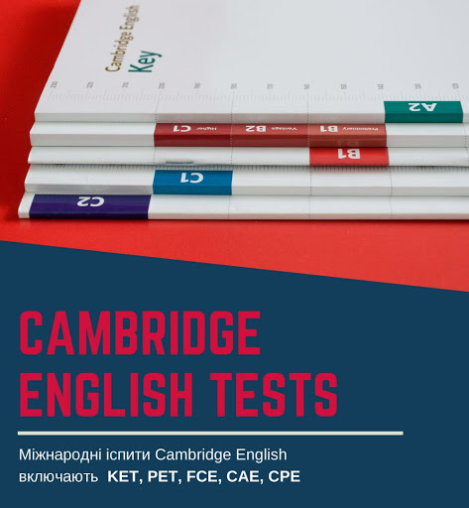
International Certificate in English
To start with : an International English Certificate is your opportunity to study or work abroad, get world-class certification, and prove that you really speak English. The best way to get an International Certificate in English is to take the Cambridge English exam at ILC.

Slide 3
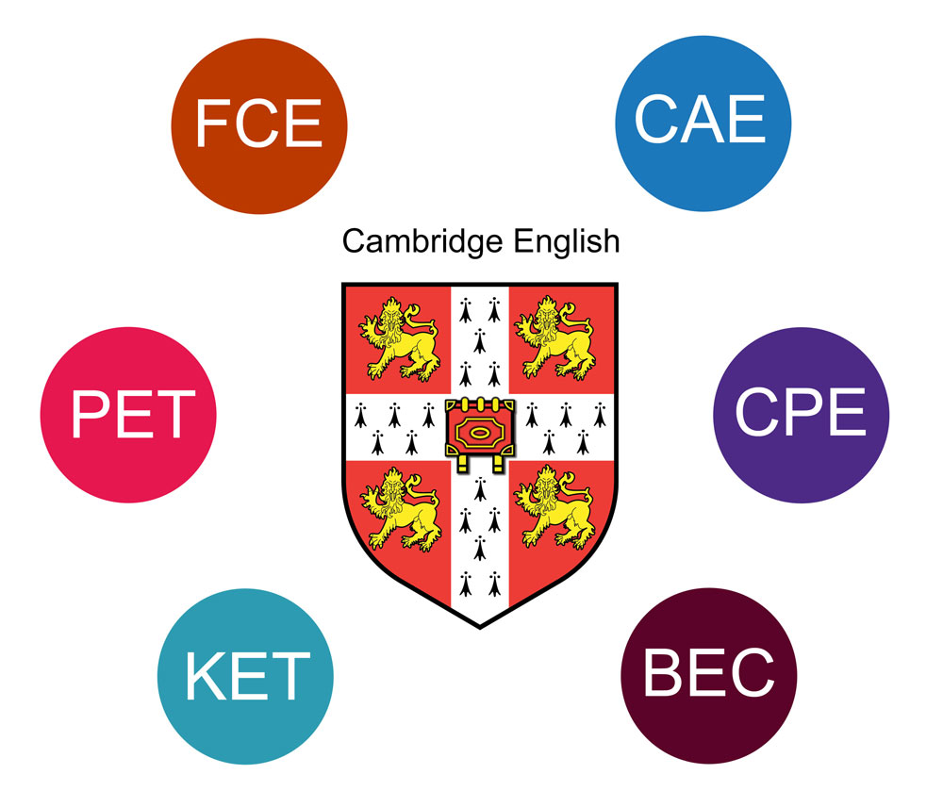
INTERNATIONAL ADULT ENGLISH EXAMS (PET, FCE, CAE)
Today I want to talk to you about international English exams (PET, FCE, CAE).
Cambridge English exams B1 Preliminary (PET), B2 First (FCE), C1 Advanced (CAE) are among the most common language exams in the world. Cambridge Assessment English certificates are valid for an unlimited period. You will never have to pass the exam again - your certificate will always be recognized by international universities, companies and educational institutions as a clear confirmation of internationally recognized standards of language proficiency. The ILC exam takes paper and computer-based exams.

Slide 4
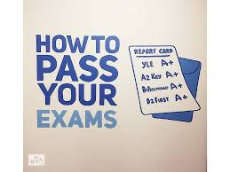
B1 Preliminary (PET)
Price UAH 2750
This exam is Intermediate-level. If you can read simple books and articles, write simple letters, and talk about general topics, then the B1 Preliminary (PET) exam is for you. B1 Preliminary is suitable for you if you plan to work or study abroad. This exam can also be an important experience and a preparation stage for higher level exams. B1 Preliminary (PET) annually totals more than 80,000 people in more than 80 countries. Having successfully passed the B1 Preliminary (PET) exam, you will receive the Cambridge B1 Level Certificate and pass it the excellent B2 Level Certificate that meets the B2 First (FCE) exam. Even if you fail B1 Preliminary, you can still obtain an A2 level certificate that meets the A2 Key (KET) exam.

Slide 5

B1 Preliminary (PET)
Exam format The B1 Preliminary (PET) exam consists of three parts that test four language skills (reading, writing, speaking and listening). Each skill corresponds to 25% of the total score: Reading: • Duration - 45 minutes • 6 tasks that need to read passages and answer questions Writing: • Duration - 45 minutes • 2 tasks, both of which require the writing of at least 100 words Audition: • Duration - about 30 minutes • five tasks • listen to the text or texts in each section and answer the questions • Each task is listened to twice
Interview: • 12 minutes duration • paired with another candidate • two examiners: one communicates with you, the other listens; both appreciate

Slide 6
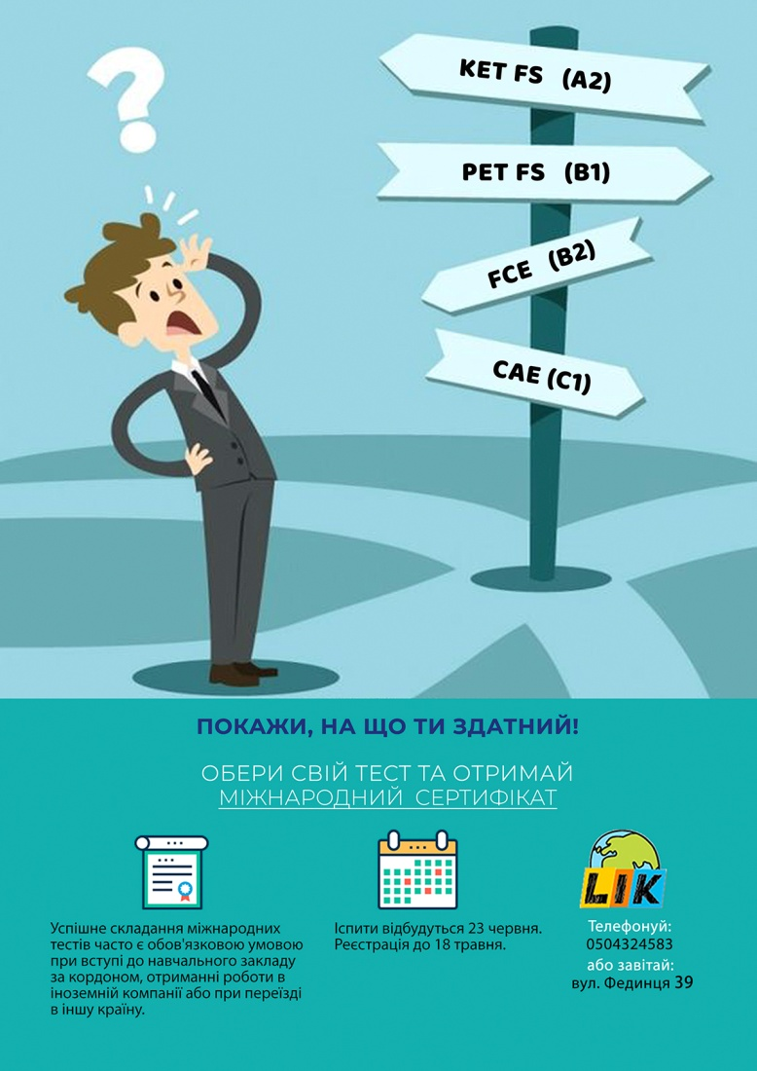
B2 First (FCE)
Price UAH 3450
This exam is above-average (Upper-Intermediate). If your English skills are sufficient for everyday communication, business and training, B2 First (FCE) is the exam for you. B2 First is the ideal choice if you want to study abroad or work and pursue a career in an industry that requires advanced language skills (eg: business, medicine, engineering). B2 First (FCE) annually totals more than 270,000 people in more than 100 countries.
Successfully passing the B2 First exam will give you a Cambridge Certificate of Level B2, and pass it perfectly - a Level C1 Certificate that meets the C1 Advanced Exam (CAE). Even if you fail B2 First (FCE), you can still obtain a B1 certificate that meets the B1 Preliminary (PET) exam.

Slide 7

B2 First (FCE)
Exam format
The B2 First exam consists of four parts that test five language skills (reading, writing, speaking and listening). Each of the skills corresponds to 20% of the total score: Reading and grammar: • duration - 1 hour 15 minutes • 7 different parts in the form of texts and grammatical tasks • 52 questions Writing: • duration - 1 hour 15 minutes • 2 parts, where the essay is a compulsory task, the second task to choose Interview: • 14-16 minutes duration • paired with another candidate • 4 parts • two examiners: one communicates with you, the other listens; both appreciate
Audition: • Duration - about 40 minutes • 4 parts • listen to the text or texts in each section and answer the questions • Each part is listened to twice

Slide 8
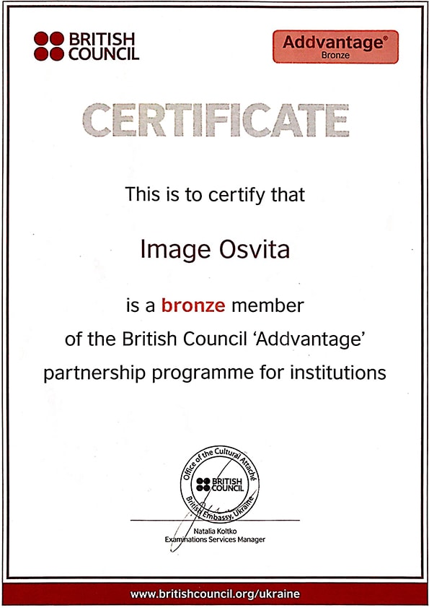
C1 Advanced (CAE)
Price UAH 3800
This exam is at a high (Advanced) level of English. If you are able to use sophisticated language structures and communicate easily and freely in a variety of situations, the C1 Advanced Exam (CAE) is for you. This certificate is recognized by employers and higher education institutions in many countries around the world as an absolute confirmation of a high level of English. Successfully pass the C1 Advanced Exam (CAE), you will receive a Cambridge Certificate of Level C1, and pass it perfectly - a C2 Level Certificate that meets the C2 Proficiency Exam (CPE). Even if C1 Advanced is unsuccessful, you can still obtain a B2 level certificate that meets the B2 First (FCE) exam.

Slide 9

C1 Advanced (CAE)
Exam format
The C1 Advanced Exam (CAE) consists of four parts that test five language skills (reading, writing, speaking, and listening). Each of the skills corresponds to 20% of the total score: Reading and grammar: • Duration - 1.5 hours • 8 different parts in the form of texts and grammatical tasks • 56 questions Writing: • Duration - 1.5 hours • 2 parts, where the essay is a compulsory task, the second task to choose
Interview: • 16-18 minutes duration • paired with another candidate • 4 parts • two examiners: one communicates with you, the other listens; both appreciate Audition: • Duration - about 40 minutes • 4 parts • listen to the text or texts in each section and answer the questions • Each part is listened to twice

Slide 10

Thanks for your attention!

