Slide 1
Bronchial asthma

Slide 2
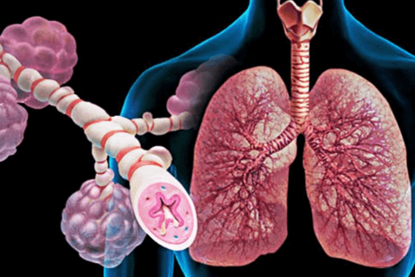
Bronchial asthma
This is bronchial asthma, a chronic disease that is most often manifested by periodic attacks of shortness of breath and wheezing.

Slide 3
A factor that can cause bronchial asthma
The exact causes of BA have not yet been established, but there are a number of factors that can cause bronchospasm.
animal hair, bird feathers;
cigarette smoke;
strong smells Do not use hygiene products that have a pronounced perfume smell;
professional factors;
household dust;
some medicines;
some products and nutritional supplements;
infectious diseases, especially acute respiratory viral infections;
emotional overloads.

Slide 4
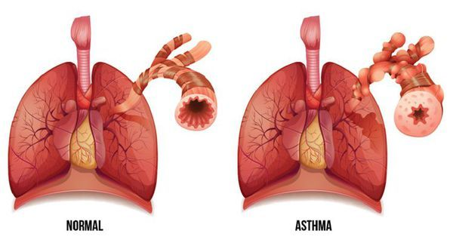

Slide 5
Symptoms
heaviness in the chest;
wheezing and wheezing in the chest;
paroxysmal cough, accompanied by secretion of mucous sputum;
episodic expiratory dyspnea (a condition in which the patient has difficulty exhaling);
attacks of suffocation, which occur both during the day and at night.

Slide 6

Diagnosis
General examination of the patient.
Lung percussion.
Auscultation of the lungs.
Assessment of allergic status using skin tests with allergens.
Laboratory tests:
sputum microscopy;
blood test.
Peak flowmetry.
Spirometry.
X-ray examination.
Bronchoscopy.
EKG

Slide 7
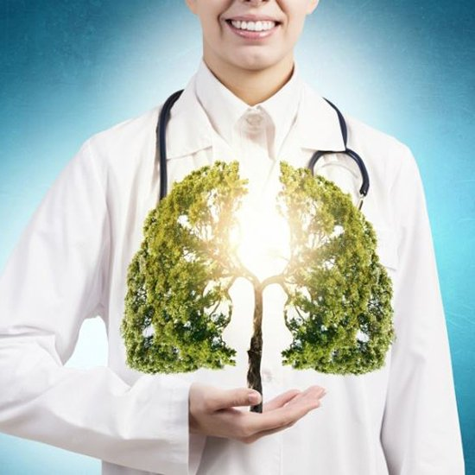
Treatment
Treatment of bronchial asthma is a complex process that includes teaching the patient to independently control the course of the disease (conducting peak flowmetry at home and evaluating the results), isolating him from exposure to allergens and triggers, and pharmacotherapy.

