Slide 1

Organic peat based growth stimulator
Manufacturer “A-Rise” Ltd.
Adress: 53a Peremohy av., Kyiv 03680, Ukraine
Tel. +38 (044) 323-04-40
E-mail: a-rise@mail.ua

Slide 2
Organic growth stimulator (OGS) features
OGS is produced using a new unique chemical-free technology. Made of organic low-level peat, OGS naturally stimulates plant growth and development. The unique production technology allows to extract all the natural biologically active substances out of peat: humic acid, fulvic acid, low-molecular acids, organic acids, amino acids, glucose, fructose, mannose, sucrose and other water-soluble carboxylic acids among which prevail succinic, oxalic, malic, fumaric, gallic, citric, salicylic acids, vitamins (В2, В12, PP etc.), major mineral elements, trace elements in the form of biologically available organic compounds.
The peat based OGS contains the following amount of humic and fulvic acids – 140 g/L including 40 g/L fulvic acids, 95-100 g/L humic acids. Such level of organic and biologically active compounds is unique to any producer.

Slide 3
OGS application
Plant cultivation
Peat based OGS is appropriate for all kinds of crops and any agro climatic zones, it’s highly recommended to use during all plant growth stages – from pre sowing seed priming and plant spraying during vegetation to soil treatment after harvest. The OGS is recommended to use in organic agriculture to get natural and organic yield.
OGS application goes well with all the common agro technical methods of crop cultivation, it takes no side expenses;
Pre sowing OGS treatment is compatible with pesticides;
Plant spraying with OGS is recommended to combine with organic/mineral fertilizers and pesticides.
Applied in the form of solution, peat based OGS can be used on its own as well as combined with crop protection substances and soluble fertilizers during scheduled treating. OGS is water-soluble, therefore it can be used in modern drip irrigation systems.

Slide 4
OGS effect:
Application of OGS in plant cultivation is allows to:
Increase grain crop harvest by 15- 20% (along with the increase of grain quality), potatoes yield by 40-50%, vegetable crops by 60%, grapes up to 80% (along with the rise of sugar level);
Stimulate growth; decrease crop ripping time by 10-12 days; increase crop keeping capacity;
Increase sprout, seedling and sapling survival rate by after transplanting;
Strengthen plant roots and respiration;
Decrease plant susceptibility to negative environmental conditions (drought, over-wetting, frost);
Reduce plant vulnerability to bacteria and fungus related illnesses;
Increase efficiency of nitrogen, phosphate fertilizers and pesticides along with the reducing of its amount by 20-30% and diminishing negative effects and stress;
Increase and renew soil fertility;
Strengthen soil biological activity (by stimulating different biologically active microorganisms which mobilize soil nutrients);
Increase water retentivity of soil, retaining its abilities during an intensive irrigation and usage of large amount of mineral fertilizers;
Reduce soil acidity and salinity;
Reduce nitrate nitrogen level in the cultivated crop;
Transform heavy metals, radionuclides, pesticides remnants in the soil into insoluble forms, preventing them from penetrating into the plants, underground waters and atmosphere;
Cultivate more organic high-quality crops with higher amount of vitamins, sugar and other valuable substances.

Slide 5
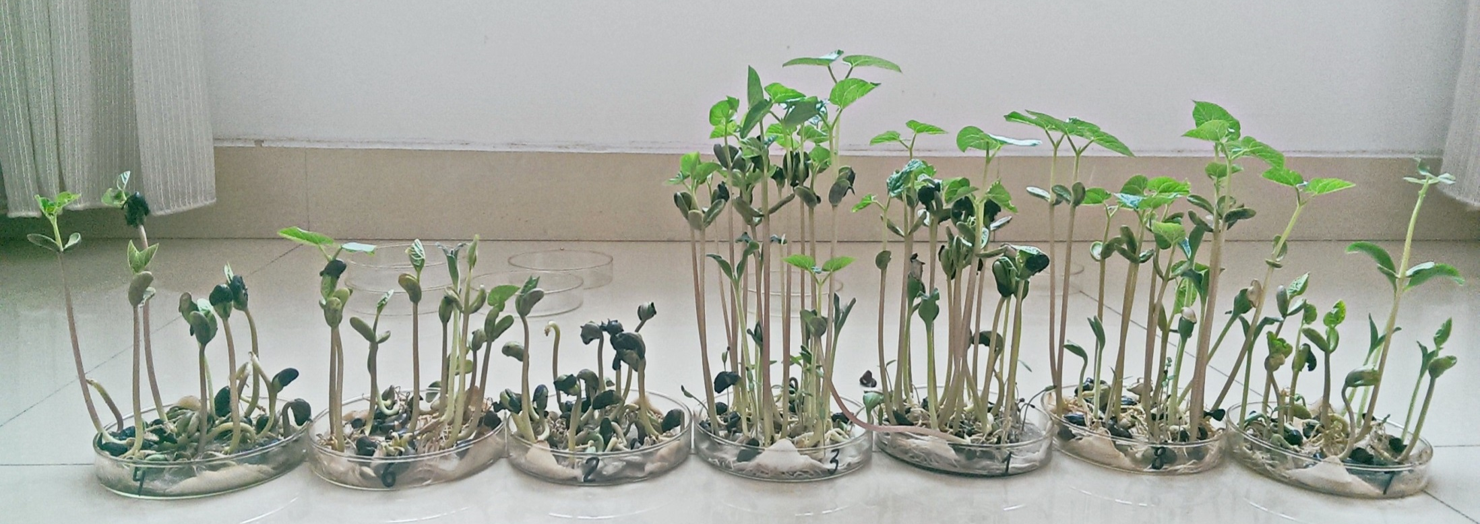
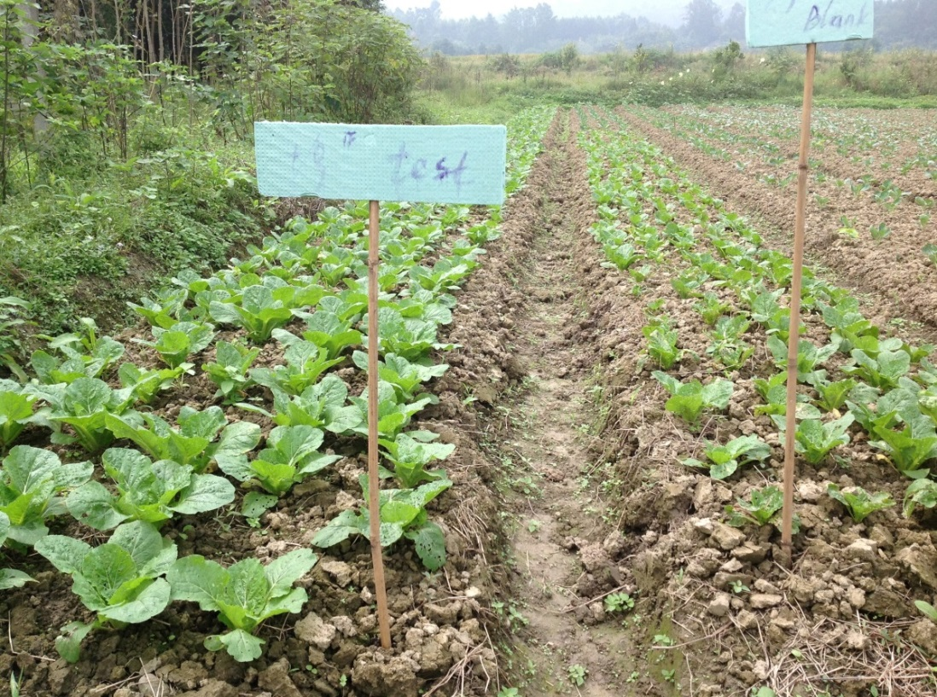
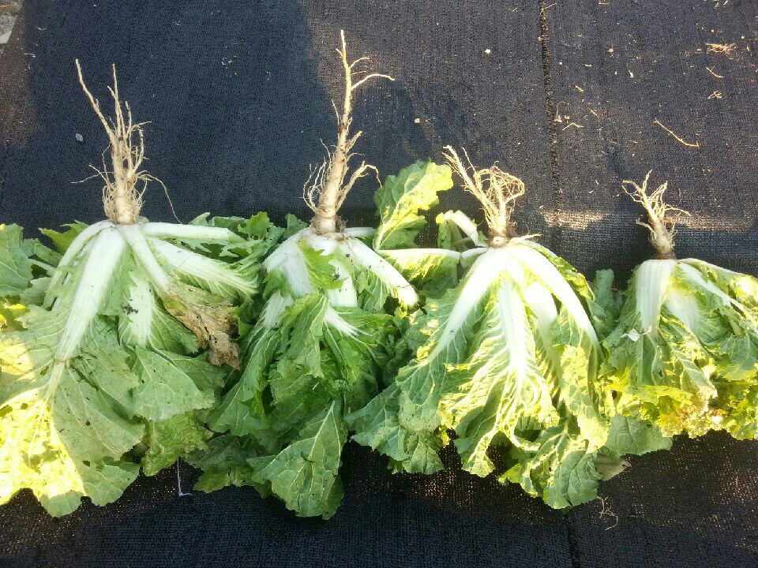

Slide 6
OGS application guidance
Seedling and sapling priming*:
Dissolve 40 g of OGS in 1 liter of water. Soak for 10-12 hours in the
solution.
Leaf and root treatment*:
Dissolve 500 g of OGS in 100 liters of water;
Treat once per 10-15 days, 2000 g of the solution to 1 hectare of crop.
*Precise treatment plan is made for each client individually depending on soil, crop and climate conditions

Slide 7
Animal husbandry
OGS enhances blood quality and illness resistance; increases additional yield of milk by 30-40%, meat growth by 20-30%.
Poultry breeding
OGS diminishes death rate; enhances growth.

Slide 8
Thereby
Thereby, peat based OGS application gives a magnificent result: not only the crop yield is increased by 10-50>%, but also the usage of mineral fertilizers and pesticides is diminished by 20-30%. Moreover, cultivated products become more organic and nutrient.
Looking forward to mutually beneficial cooperation with you!

