Slide 1


The Changing English Language under the Impact of the Internet

Slide 2

Introduction
English is a global language. You hear it on television, it is spoken by politicians from all over the world. Wherever you travel, you see ads and advertisements. Every time you walk into a hotel or restaurant in a foreign city, they understand English, and there will be menu in English. Changes in society and education have often been the dominant factors that have led to the evolution of language in times past, but it is certainly technology that has had the greatest impact on the way we speak in recent years. Emoji, LOL, ROFL, selfie, blogging – these words meant little or nothing just a few years ago, but now they are part of our everyday vocabulary.

Slide 3
The actuality of the topic is to study and improve the English language at the modern level. After all, English plays an important role in our time. Any language has a communicative function at the international level. Nowadays people want to use innovative technologies in every sphere of life.
The object of the study: English in Modernity.
Subject of research: the process of word formation due to modern social networks and other media.
The material of the study is expressions from social networks, as well as consider the structure of an e-mail.

Slide 4
The purpose of the study is to develop English as an amazing global resource that opens up unlimited opportunities for communication, and therefore allows us to find new opportunities and resources.
Research Assignment:
1. Investigate the lexical composition of the English language.
2. Investigate the structure of an email and look at several
examples.
3. Study newly created lexemes in social networks.
The practical value of the study in the possibility of further use of its results in translation and methodological research. The materials and conclusions of the course work can be used in the process of studying English, English lexicology for translation training.

Slide 5

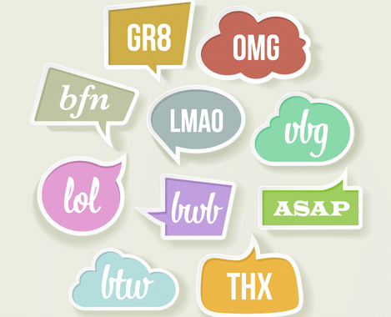
PECULIARITIES OF THE LEXICAL STRUCTURE OF ENGLISH LANGUAGES

Slide 6
1. Lit — коли відбувається щось приємне або захоплююче, ти можеш сказати, що це було “запально”.
Emily, the party last night was lit! Why didn't you come? — Емілі, вечірка минулої ночі була просто запальною! Чому ти не прийшла ? 2. Salty — ви можете сказати, що хтось “роздратований”, коли він сердиться через щось незначне.
Katia is so salty when she gets a bad assessment at school. — Катя роздратована, коли отримує погану оцінку в школі.
3. Shook — означає, що людина здивована або збита з пантелику.
— Did you hear the news? Emma is going to pick up documents from the university. — Ти чула новину? Емма збирається забирати документи з університету.
— I’m shook! I need to talk to her. — Я збита з пантелику! Мені потрібно поговорити з нею.

Slide 7
1. AEAP (As early as possible) — якомога раніше.
You should watch this series AEAP. — Ти повинен подивитися цей серіал, якомога раніше.
2. BF (Best Friend) —найкращий друг.
Surprise your BF with coloured paper or plasticine. — Зроби сюрприз для свого найкращого друга, використовуючи кольоровий папір або пластилін.
3. CWYL (chat with you later) — поговоримо пізніше.
Sorry, I'll be working late tonight, so CWYL. — Вибач, я сьогодні буду працювати допізна, тому поговоримо пізніше.

Slide 8

1. Edutainment — education (освіта) та entertainment (розвага) — цей
термін можна віднести всі додатки, в яких можна навчатися: дивитися
фільми в оригіналі, вивчати слова та відразу використовувати їх на
практиці.
Students can learn from edutainment in university with board games if the
games are carefully selected. — Студенти можуть навчатись в університеті за
допомогою додатків, якщо ігри добре підібрані для навчання.
2. Memoji — me (я) та emoji (емодзі) —це так звані персоналізовані
смайлики, які можна використовувати замість звичайних емодзі.
3. Rofling — гучно сміятися.
Everyone was rofling, when they heard a funny joke on TV. — Всі гучно засміялися, коли почули смішний жарт по телевізору.

Slide 9
CONCLUSIONS
Changes in society can be both beneficial and negative, as far as the impact of social networks on the Internet is concerned. The structure of the social network is essentially a dynamic virtual organization with trusting relationships between people. Social networks provide a platform for communication and information exchange between users, thus modeling relationships in the real world.
To summarize, English and the Internet have made a successful and worthwhile collaboration. The Internet is a great tool to communicate with just a click of the mouse. And English is a great tool for bringing people together and reconnecting.

Slide 10

Thank you all for your attention!

