Slide 1
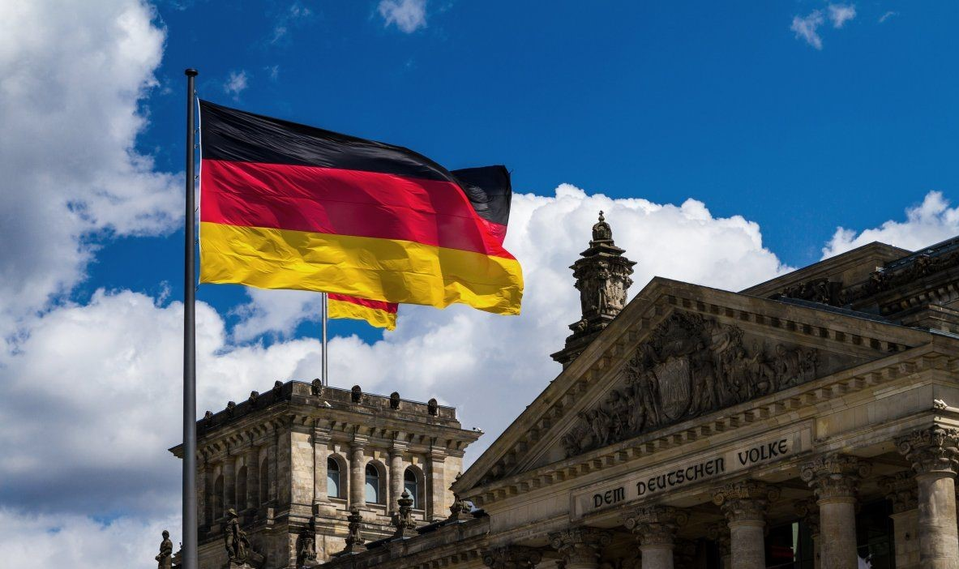
GERMANY

Slide 2
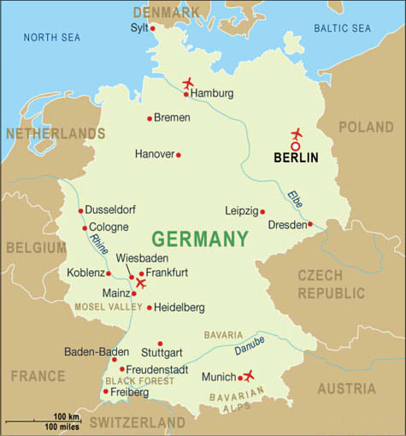
Geographical location
Germany is located in Central Europe. It borders Denmark, Poland, the Czech Republic, France, Austria, Belgium, Luxembourg and the Netherlands. It is washed by the Baltic and North Seas. The largest lakes: Bodensee and Gim. The highest point in Germany is Mount Zugspitze (2963m). There are also the Highlands and the Alps.

Slide 3
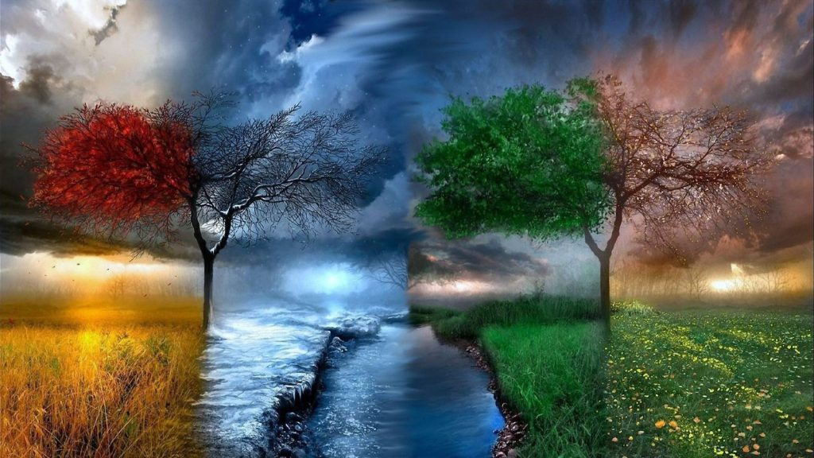
Climate of Germany
Germany's climate is temperate, maritime and transitional from maritime to continental. Winters are not very cold - the average January temperature is about 1 degree, and the average minimum temperature is -3 degrees. In summer, the average temperature is 18-20 ° C. In the upper parts of the Middle German Mountains - 4 ° C, in the Alps - 5 ° C and below. The average annual rainfall in the country as a whole is 600-700 mm.

Slide 4
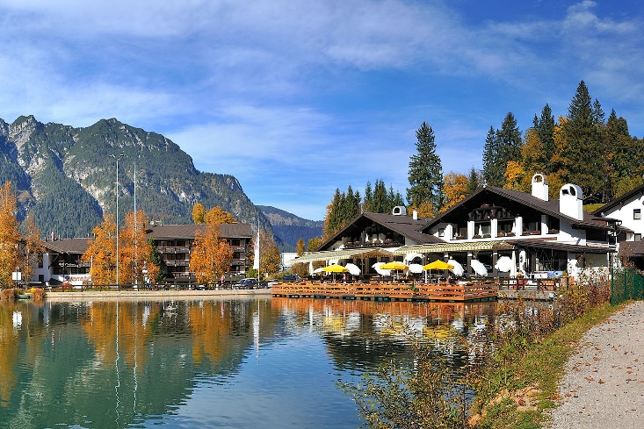
Availability of tourism resources
Balneological resources (resorts):
- Bad Kissingen - one of the most popular German resorts of the world level, where courses of treatment of digestive organs, respiratory organs, cardiovascular system, musculoskeletal system are held.
- Garmisch-Partenkirchen - the most popular and fashionable resort in the Bavarian Alps. It has been known for almost 2000 years.
- Bad Tölz - mud resort located in the region of Telzer Land, received official status as a resort in 1899.

Slide 5
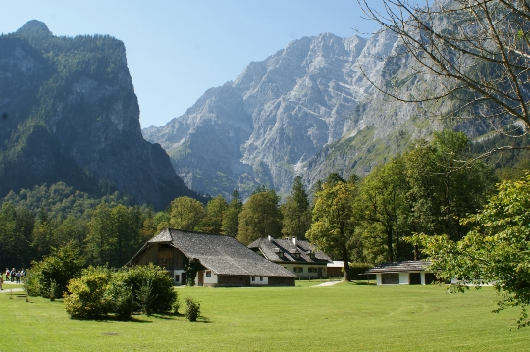
Nature reserve:
- Nationalpark Harz - it is the largest forest park in Germany, its area is almost 24 thousand hectares. The main attraction of the Harz - the legendary Broken.
- Bayerische Wald - merges with the Czech reserve and forms the largest forest in Central Europe.

Slide 6
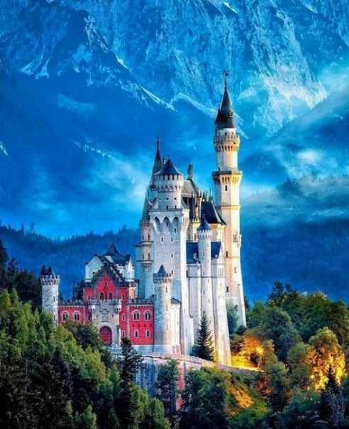
Cultural and historical resources:
- Schloss Neuschwanstein - romantic castle of King Ludwig II of Bavaria. One of the most popular tourist destinations in southern Germany.
- Schloss Sigmaringen - former residence of the Hohenzollern-Sigmaringen dynasty. Located in the city of the same name in the south of Baden-Württemberg.

Slide 7
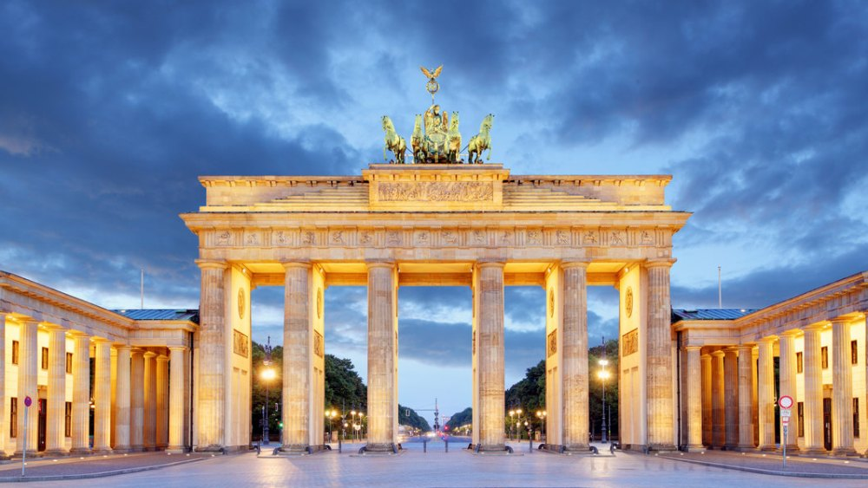
Tourist facilities
About 18 million tourists visit Germany every year, each of whom spends at least two nights at the hotel. The Dutch, Americans and Englishmen are the most active in Germany. The most popular German cities among foreign tourists are Berlin, Munich, Hamburg and Dresden. Places of interest in Germany are: the Brandenburg Gate, the Holocaust Memorial, the Berlin Wall, the Frauenkirche Church, the Allianz Arena and others.

Slide 8
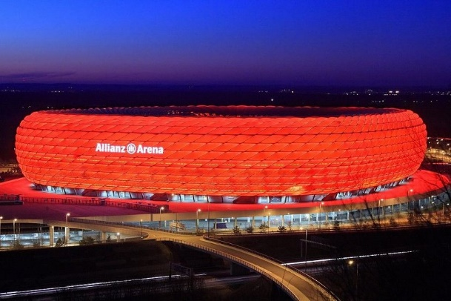
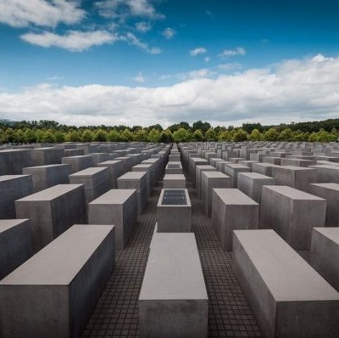
the Holocaust Memorial
the Allianz Arena and others

Slide 9
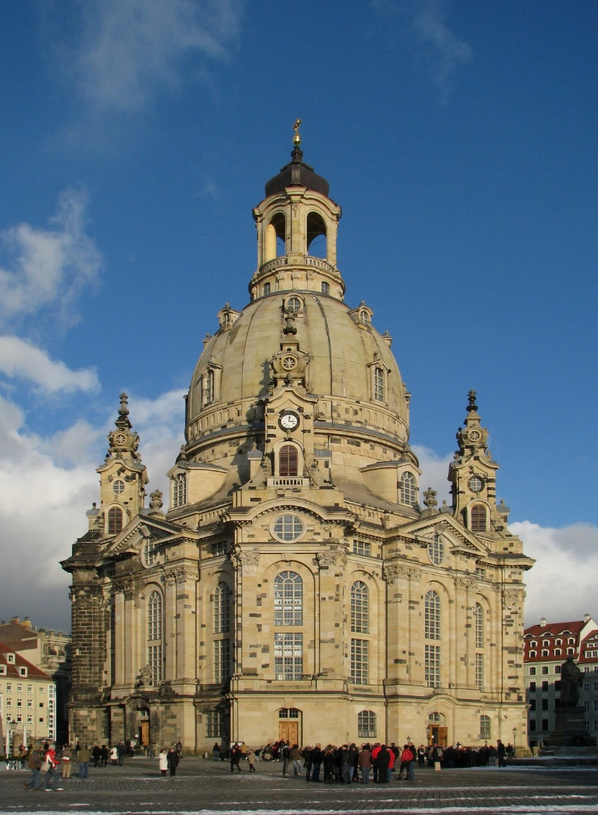
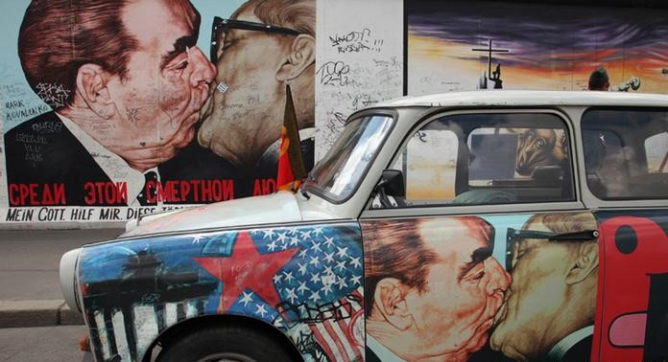
the Berlin Wall
the Frauenkirche Church

Slide 10
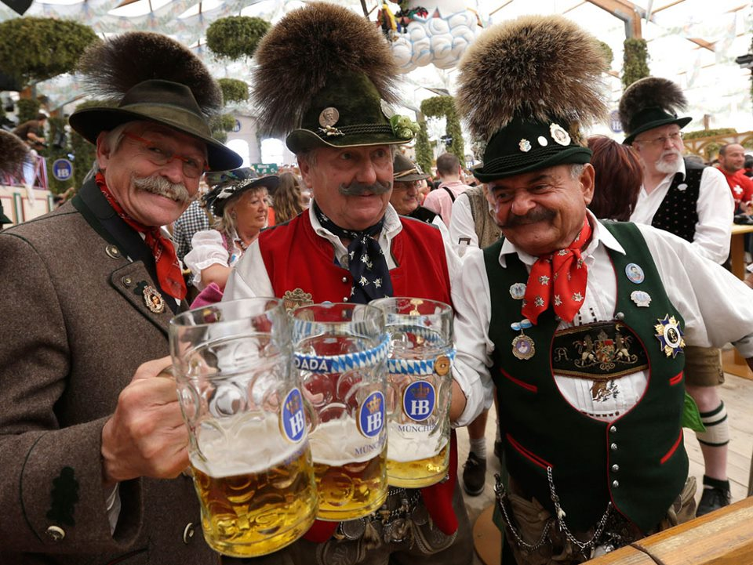
Interesting facts about Germany
In Germany, there are about 5,000 beers, 1,500 types of sausages, 300 types of bread and about 500 different types of mineral water. Every third brewery in the world is located in Bavaria.
Germany is one of the world's leading trade fairs. Ten million guests visit the country and participate in fairs annually.
Daylight saving time was introduced in Germany for the first time. It happened in 1916.

