Slide 1
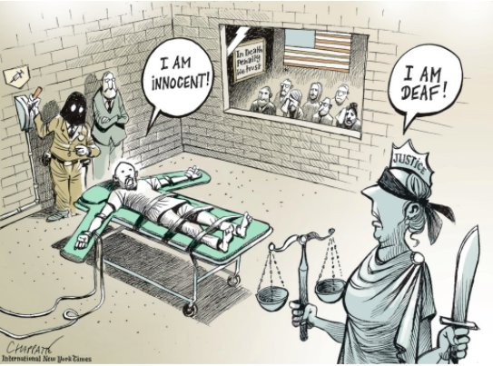
Capital Punishment

Slide 2
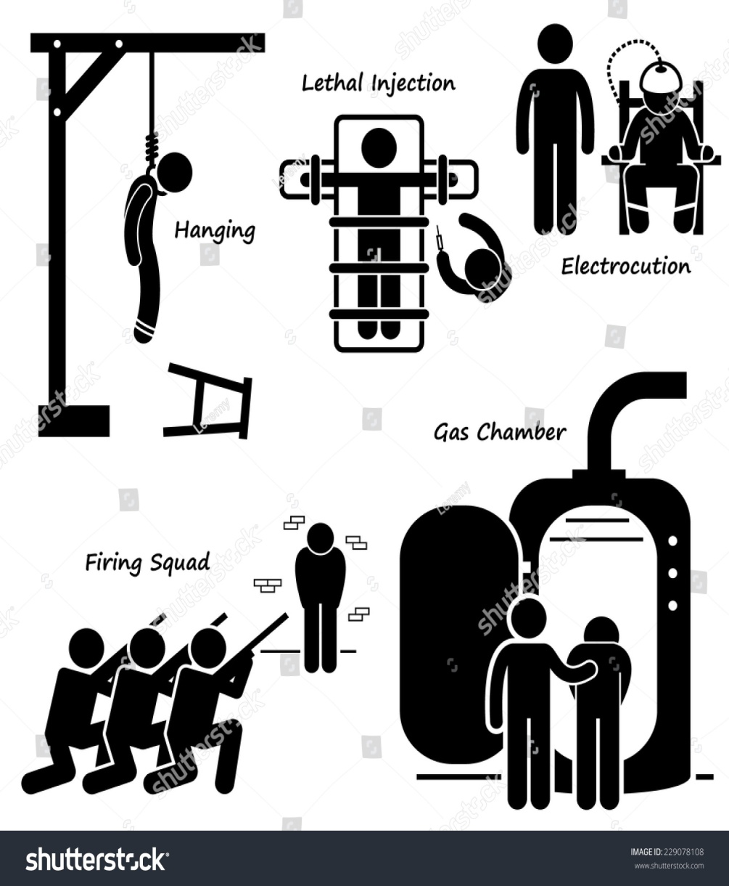
Capital punishment, also known as the death penalty, is the state-sanctioned killing of a person as punishment for a crime.
Capital punishment has long engendered considerable debate about both its morality and its effect on criminal behaviour.
Contemporary arguments for and against capital punishment fall under three general headings: moral, utilitarian, and practical.

Slide 3
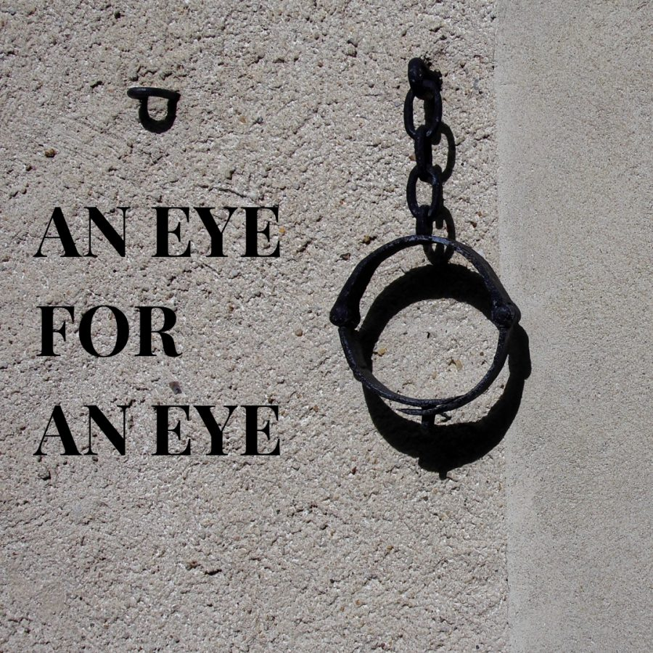
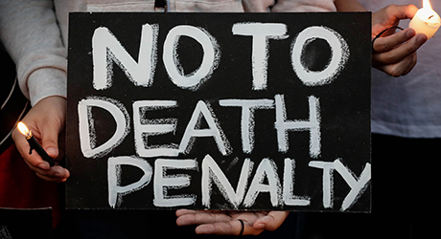
Moral arguments
Supporters of the death penalty believe that those who commit murder, because they have taken the life of another, have forfeited their own right to life.
Opponents of capital punishment, argue that, by legitimizing the very behaviour that the law seeks to repress—killing—capital punishment is counterproductive in the moral message it conveys.

Slide 4
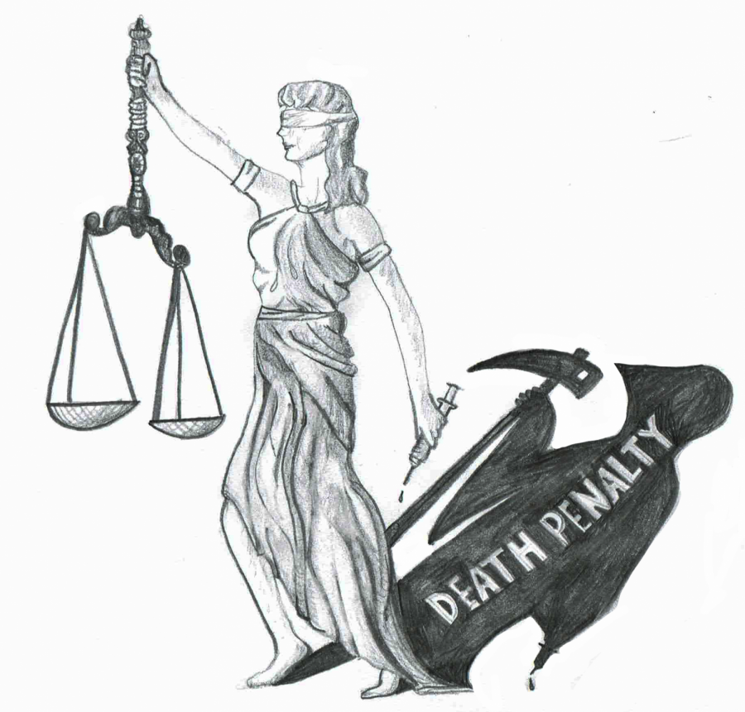
Utilitarian arguments
Supporters of capital punishment also claim that it has a uniquely potent deterrent effect on potentially violent offenders for whom the threat of imprisonment is not a sufficient restraint. Opponents, however, point to research that generally has demonstrated that the death penalty is not a more effective deterrent than the alternative sanction of life or long-term imprisonment.

Slide 5
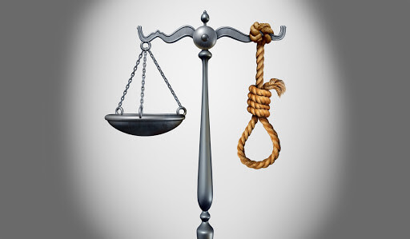
Practical arguments
There also are disputes about whether capital punishment can be administered in a manner consistent with justice. Those who support capital punishment believe that it is possible to fashion laws and procedures that ensure that only those who are really deserving of death are executed. By contrast, opponents maintain that the historical application of capital punishment shows that any attempt to single out certain kinds of crime as deserving of death will inevitably be arbitrary and discriminatory. They also point to other factors that they think preclude the possibility that capital punishment can be fairly applied, arguing that the poor and ethnic and religious minorities often do not have access to good legal assistance, that racial prejudice motivates predominantly white juries in capital cases to convict black and other nonwhite defendants in disproportionate numbers.

Slide 6
Thank you for attention!!!

