Slide 1

Relations between
Poland and Ukraine

Slide 2

Poland and Ukraine are the two biggest and most populated countries of Central and Eastern Europe – the large part of the European continent, which lies between the Russian Federation on one side and Western Europe on the other.

Slide 3
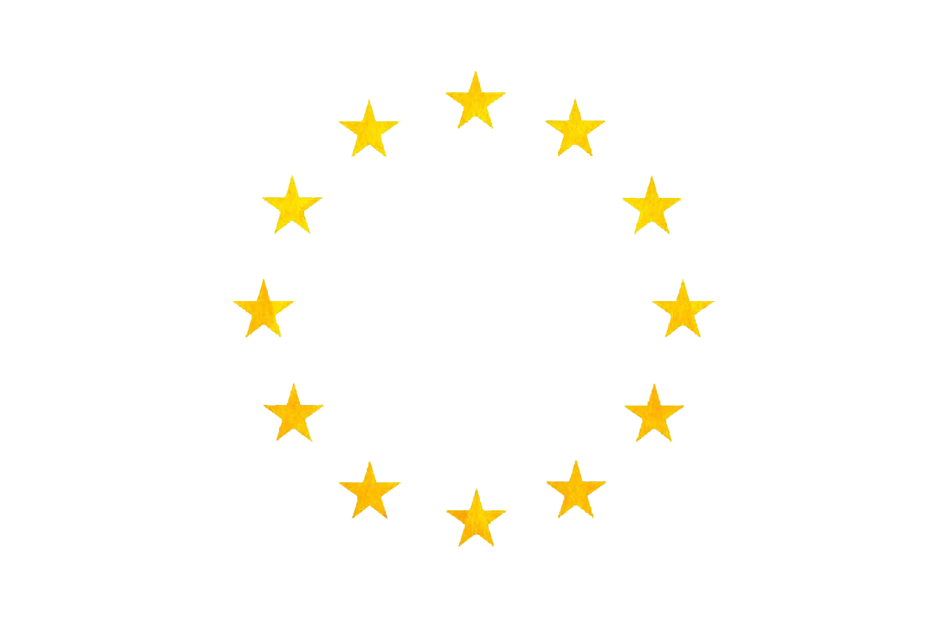
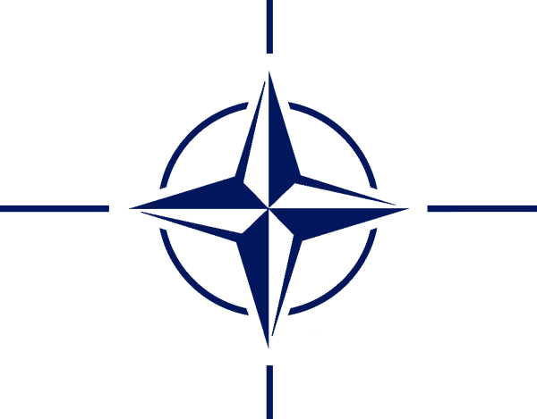
Since the end of the communist system in 1989 – 1991, Poland and Ukraine have developed their foreign and security policies in different ways. Poland has realized a successful transformation, which led to its integration with NATO and EU, while Ukraine has remained a weak and unstable country on the peripheries of the Western system, which made it prone to the Russian aggression in 2014 – 2015.

Slide 4
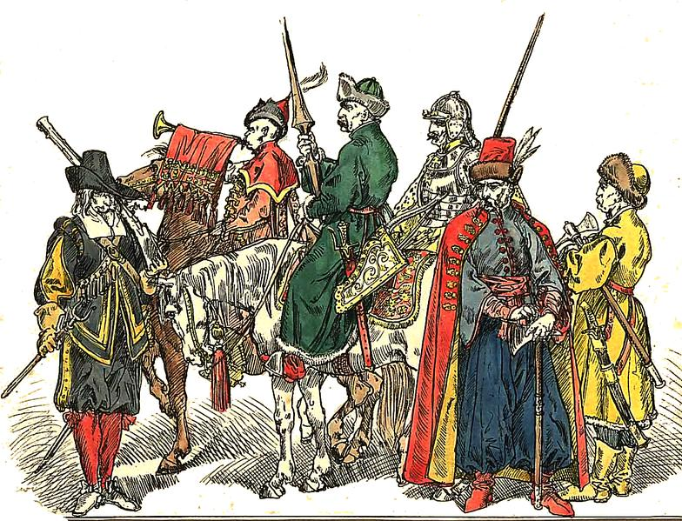
Historical Heritage
Polish-Ukrainian relations can be traced to the 16th-17th centuries in the Polish-Lithuanian Commonwealth and the often turbulent relations between that state and the mostly polonized nobility and the Cossacks. And even further into the 13th-14th centuries when the Kingdom of Poland and the Ruthenian Kingdom carried close ties. The next stage would be the relations in the years
1918–1920, in the aftermath of
World War I, which saw both
the Polish-Ukrainian War and
the Polish-Ukrainian alliance.

Slide 5
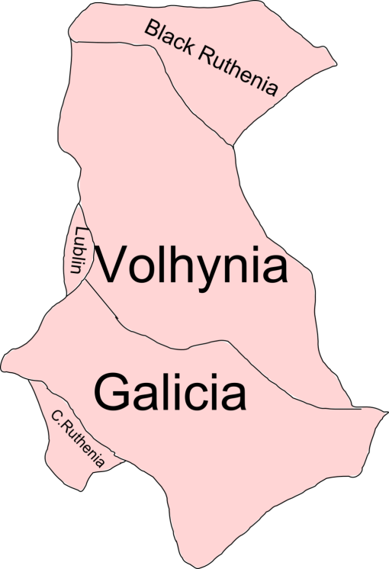
On October 13, 1990 Poland and Ukraine agreed to
the "Declaration on the foundations and general directions in the development of Polish-Ukrainian relations". Article 3 of this declaration said that neither country has any territorial claims against the other, and will not bring any in the future. Both countries promised to respect the rights of national minorities on their territories and to improve the situation of minorities in their countries. Nevertheless,
historical issues regarding the Ukrainian
Insurgent Army (UPA) and their massacres
of Poles in Volhynia and Eastern
Galicia remain a contested topic today.

Slide 6
Mutual Political Attraction
Both countries are interested in mutual cooperation for different reasons. In the case of Poland there are five main reasons:
First, history.
Second, the stability of the neighbourhood. Poland wants it Ukrainian neighbor to be astable, prosperous, democratic and "European" state.
Third, progressive integration and eventually accession of Ukraine to EU and NATO.
Forth, the relations with Russia.
Fifth, the international position of Poland. Poland wants to be the leading country in the EU Eastern policy, and in particular the "advocate" of Ukraine in the Western institutions and organizations.

Slide 7
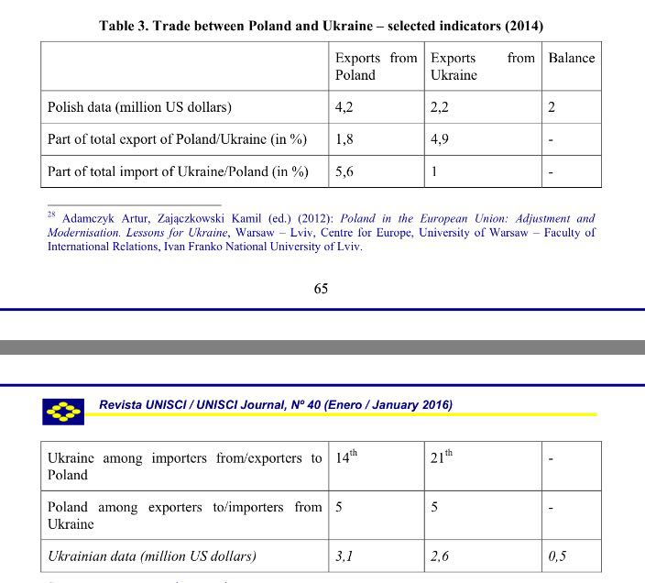
Limited Economic Opportunities

Slide 8
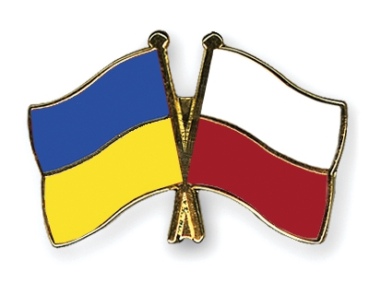
The economic cooperation is more important for Ukraine, Poland being the fifth trade partner, but also the forth place of Ukrainian foreign investments. Poland exports to Ukraine mainly electromechanical, chemical and mineral products, while it imports metallurgical, agroalimentary and mineral products. It has also a positive balance both in trade and in foreign direct investments.

Slide 9
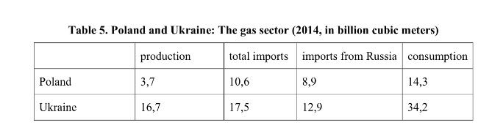
Poland and Ukraine have sought to develop their cooperation – for political, economic and strategic reasons. In the last case, the principal area of cooperation would be the energy sector, as the countries have been considerably dependent on the gas and oil import from the Russian Federation, which has been perceived as a threat for the two countries, in particular in the context of two Ukrainian-Russian gas crisis (2006, 2009), and later the undeclared war between the two countries.

Slide 10
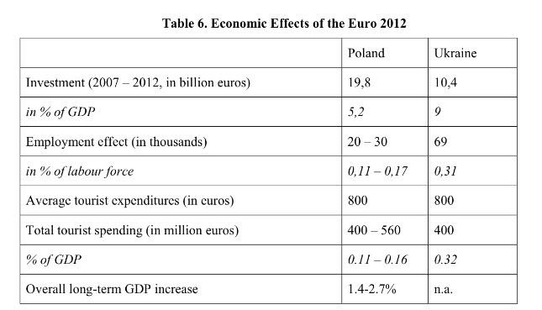

Slide 11

Growing People-to-People Contacts
Despite the policies of the communist regimes, the Ukrainian minority still lives in Poland, while the Polish one in Ukraine. According to the official censuses conducted in the two countries, there were 144 thousand Poles in Ukraine (0,3% of the population) (2001)32 and 51 thousand Ukrainians in Poland (0,1%) (2011). The situation is slightly different on the local level – in the borderland region, in particular in Przemyśl (Poland) and Lviv (Ukraine) there are some tensions between the two communities.

Slide 12
Military Weakness
The perspective of the NATO enlargement towards the East was at first unwelcomed by the member states – this was due in particular to the strong objection from Russia. In 1994 the Alliance launched the Partnership for Peace, which Poland joined in the same year. In 1997 Poland, together with the Czech Republic and Hungary was invited to join NATO. In 1999 it became a member of the Alliance.
The independent Ukraine successfully managed to take control of most of the formerly Soviet military arsenal located in its territory; however it had to give up to Russia the nuclear weapons (1994) and share with it the Black Sea Fleet, which was stationed in the Ukrainian Crimea till 2017. Ukraine was unable to join NATO because of the unwillingness of several Western European member states, strong opposition from Russia, as well as the negative attitude of the majority of the Ukrainian population, largely fuelled by Soviet and Russian propaganda.

Slide 13
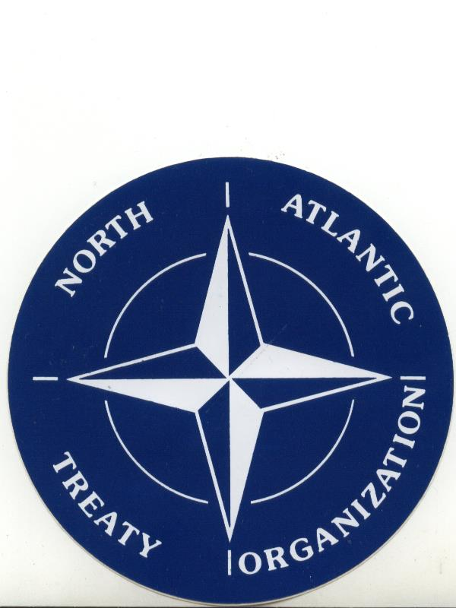
Poland was a fervent supporter of the NATO enlargement policy, in particular to Ukraine. Such policy steamed from four reasons. First, it believed that the accession towards NATO would contribute to democratization, modernization and stabilization of Ukraine. Second, the enlargement of NATO was perceived as an element of the enlargement of the European structures. Third, Poland feared Russia and its expansionist policy. Forth the membership of Ukraine in NATO was to contribute to the development of Polish-Ukrainian cooperation, especially in the defense area, as Poland was already a member of the Alliance.

Slide 14
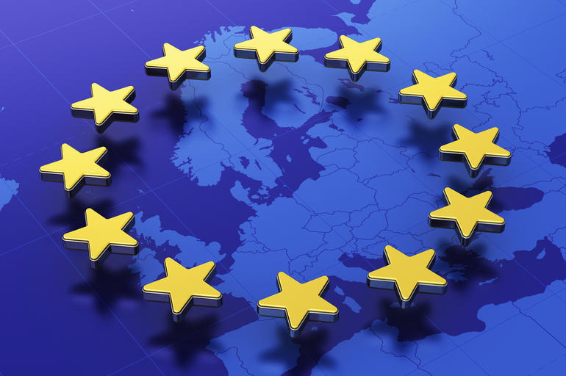
The European Context
Since the very beginning of the nineties, Poland aimed at joining the European Communities (since 1993 the European Union).
The negotiations were concluded successfully in 2002; and two years later, Poland joined the EU. Ukraine has also declared since the early nineties that it wanted to join the EU.
Despite the fact that Ukraine is a European state and fulfils the criteria required for being a candidate, the EU member states have never recognize its membership perspective.

Slide 15
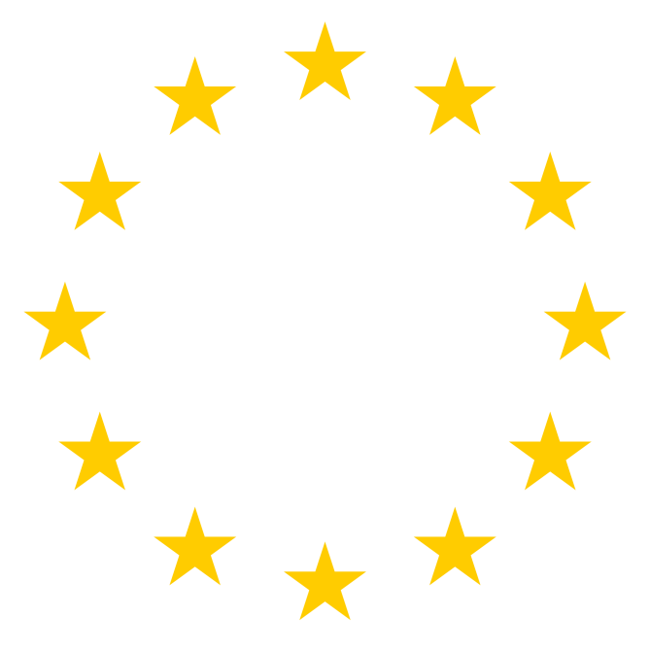
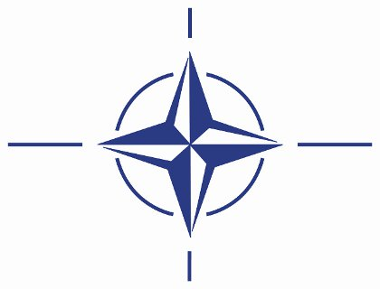
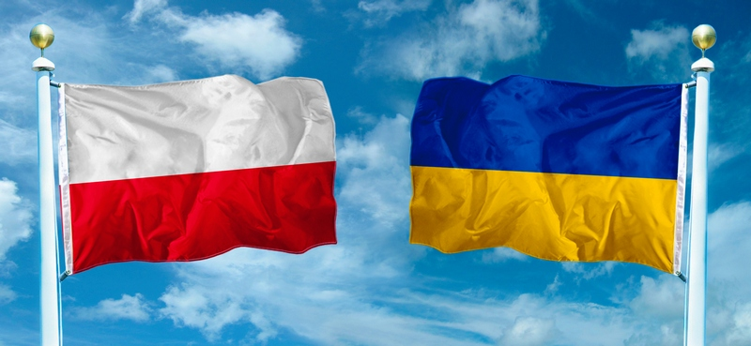
To sum up, despite their mutual interest, Poland and Ukraine belong to two different geopolitical areas in Europe, one being member of NATO and EU, and the other one being in their periphery. Such situation has complicated significantly the bilateral relations and makes it almost impossible to transform them into a "strategic partnership".

Slide 16
Thank you for your attention!

