Slide 1
achievement during this time
Company Achievemet
2019
The activities of a company associated with buying and selling a product or service. It includes advertising, selling and audiences.
94%
2018
45%
01
STRATEGY
People who work in marketing try to get the attention.
02
STRATEGY
People who work in marketing try to get the attention.

Slide 2
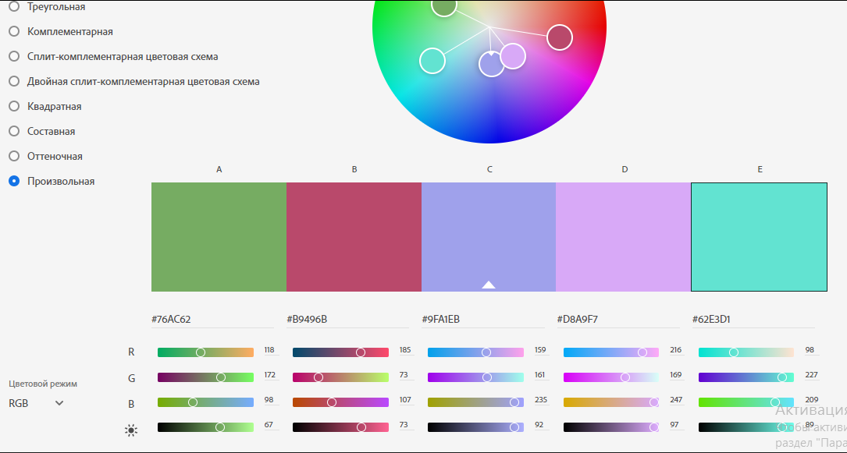
Палітра яку я обрала для завдання 1

Slide 3


KING
KING

Slide 4


