Slide 1
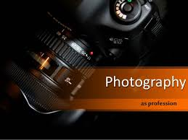
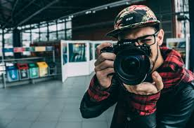
Profession: photographer!

Slide 2
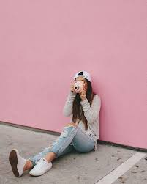

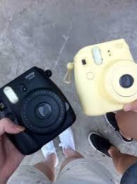
Who is it?
A photographer is a person who receives photos using a camera.

Slide 3
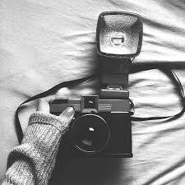
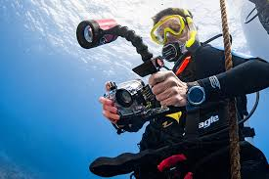
What he does?
Today, thanks to digital technology, the photographer has a new range of works:
processing of images with the help of special programs that allow you to do with anything you want to remove any defects, smooth out all the flaws and generally embody the most incredible fantasy.

Slide 4
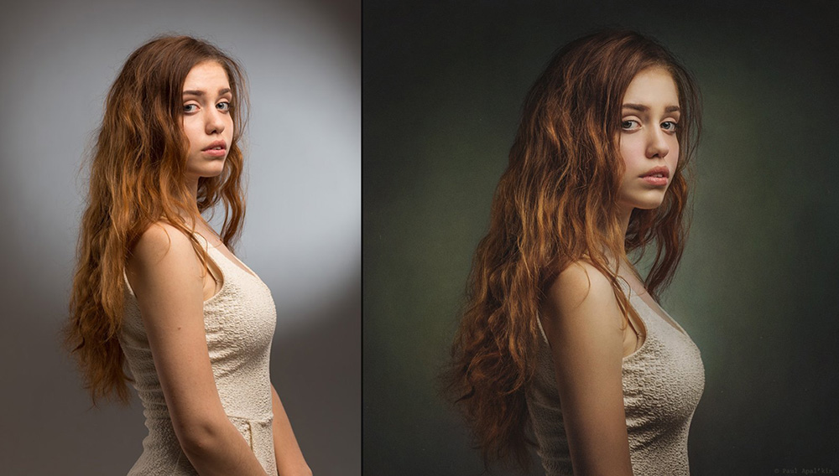
Example of photo processing
Before … After ...

Slide 5

Pros of the profession:
A big plus of the profession is freedom. Many photographers prefer to work freelancers freelancers. Usually they cooperate with several publications or photo studios, where they send their works.

Slide 6
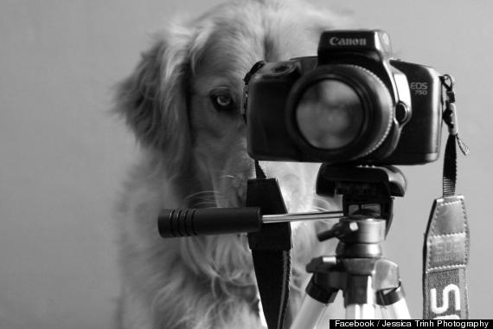
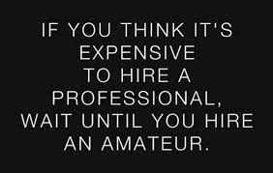
Profession minuses:
Work in a highly competitive environment.

Slide 7
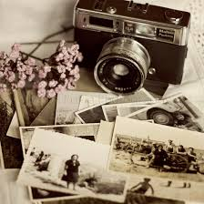
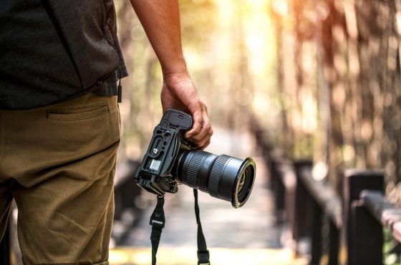
How to become a professional photographer?
Quickly learn everything in photography is impossible. Few people imagine that the period of development of a professional photographer lasts at least five to six years.
Market conditions are constantly changing; if a person is poorly oriented in them, he has to wade through a huge number of difficulties. What worked five or six years ago is no longer applicable today. This applies to both practical work and vocational education.

Slide 8
Photographer profession includes different areas of activity:
1. Photojournalist (photo-reporter) - photographer, engaged in photojournalism.
2.Paparatstsi - photo reporters, to shoot scenes from the private life of movie and show stars, politicians without their consent.
3. Photo artist-photographer, engaged in artistic photography.
4.Advertising photographer - photographer, engaged in advertising photography.
5.Wedding photographer - photographer, specializing in shooting weddings.

Slide 9
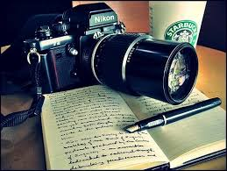
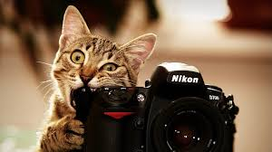
Education
Higher education in the photos are available at many universities. But now, according to professional photographers, this education does not meet modern requirements

Slide 10
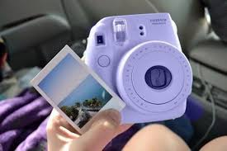
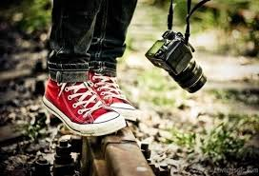
Simple tips how to become a self-taught photographer!
- constantly train your eyes
-whatever you do - look for photographic subjects and camera angles
-if your attention is scattered and you forget about the photo, make yourself a reminder

Slide 11
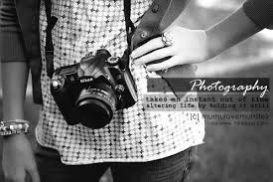
As a result:
A photographer is an artist. This is a creative person.

Slide 12
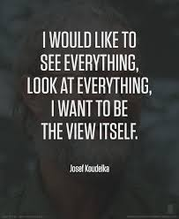
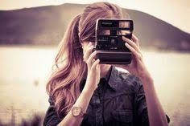
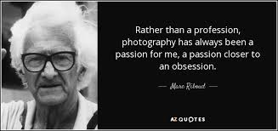

Thanks for watching!

