Slide 1
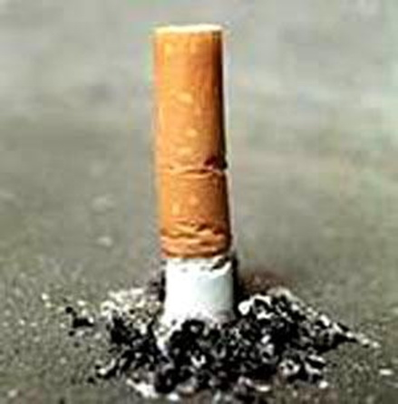
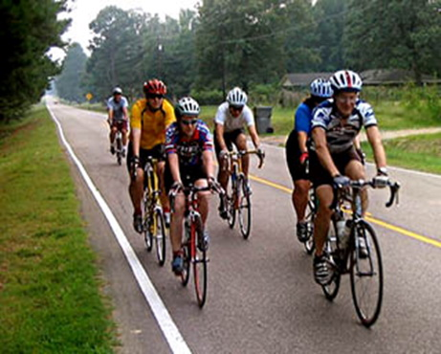
The subject is “Harmful habits. Smoking. The healthy way of life’’.

Slide 2
1. “Keep smiling, you are special”
2. “I am glad we’re in the same class”
3. “It’s nice to work with you”
4. “Be happy, you are special”

Slide 3
Our today’s motto is “Each Person is a Creator of a Temple Called the Human body”.

Slide 4
Well, He Eats Like a Pig
Well, he eats like a pig. He can't get enough.
He smokes like a chimney. Four packs a day.
He sleeps like a log. What more can I say?
He drinks like a fish Scotch on the Rocks.
When he gets real mad, he hardly talks.
He cries like a baby, when he's feeling sad.
He's the dearest friend I've ever had.

Slide 5
These questions will help you:
a) Why do young people smoke?
b) What makes them try their first fag?
c) What situations can provoke children’s addiction to smoking?
d) Is smoking dangerous for smokers only?
e) What do doctors say about the health risk in families of heavy smokers?
f) What is your opinion concerning the problem of passive smoking?
g) Are anti-smoking posters helpful in discouraging people from smoking?
h) Is addiction to smoking less dangerous than addiction to alcohol or drugs?

Slide 6

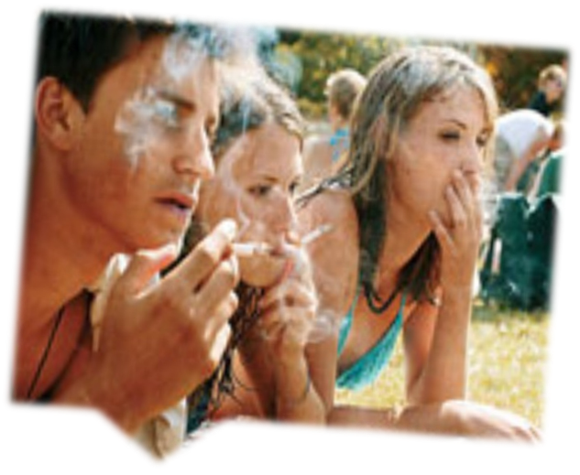
There are a lot of factors which influence on people’s health badly, but first of all it depends on us weather we`ll be healthy.
We suggested to inspect one of the most burning causes that worse our life. That is smoking among teenagers.

Slide 7

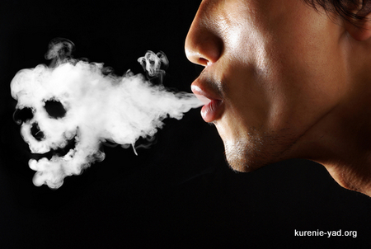
The process of smoking is a dry refining of tobacco during which human’s body gets:
toxic gases: carbon monoxide, sulfur dioxide gas, hydrogen sulfide.
acids: formic acid, cyan hydric acid, acetic acid.
radio substances: cobalt.
As well as: nicotine, ammonia, arsenic, lead and other.

Slide 8
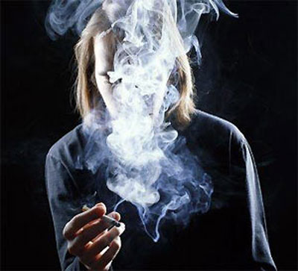

The result of smoking is the following
25% of these substances burn down, 25% - smoker pull into himself, 50% - take the air which we breathe. And we become passive smokers.

Slide 9

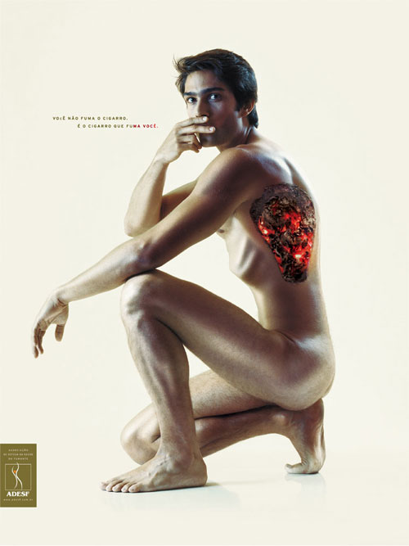
Diseases of the respiratory tract;
Change of color of teeth;
Smoking makes your life shorter for 1-4 years;
Vasoconstriction;
A deterioration of activity floor;
Financial hardship;
The first step to drug addiction.

Slide 10
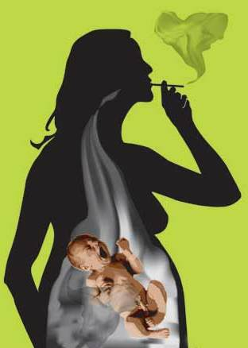

Smoking of a prospective mother is a reason of a retarded development of her child.

Slide 11
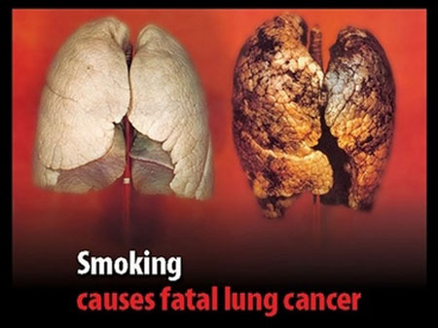

Slide 12
Our body is a magnificent temple and you are to decide either to be healthy and happy or ruin your life. It’s your world.

Slide 13
Sports and exercises are necessary and very important to every person. If you want to be healthy, strong and beautiful you should go in for sport.

Slide 14

Swimming pools

Slide 15
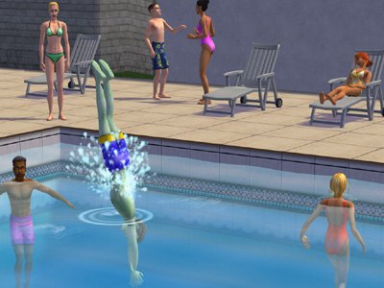
Swimming

Slide 16
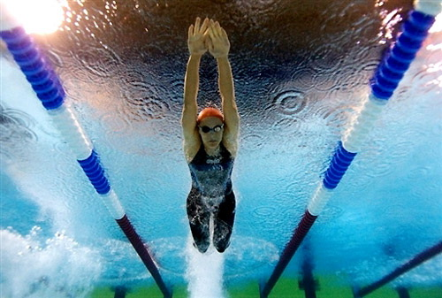

Slide 17
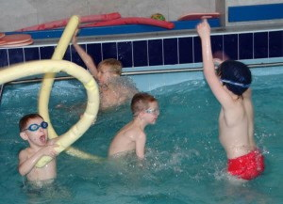

Slide 19
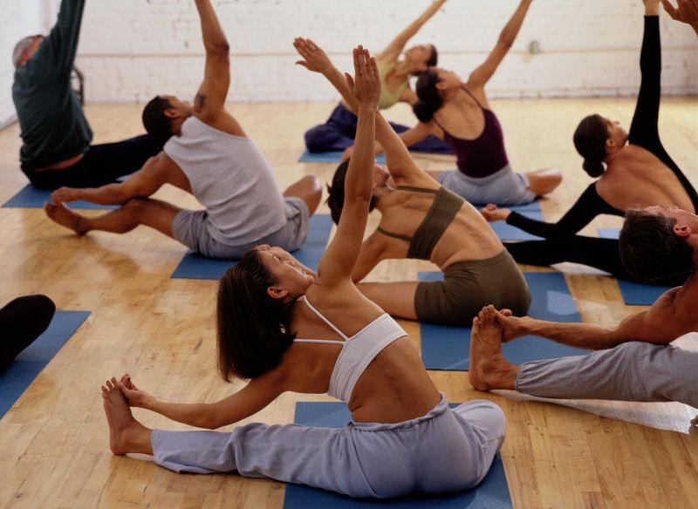

Slide 20
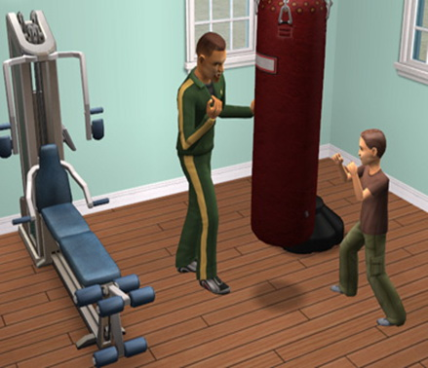

Slide 21
Some rules for you:
When you get up, air the room.
Do morning exercises every day.
Don’t hurry when you have a meal.
Work and have an active rest.
Eat in time.
And remember: “Early to bed and early to rise, makes a man healthy, wealthy and wise”.

Slide 22
7. Breathe in as much fresh air as you can.
8. Keep your feet dry and warm.
9. Keep you body clean.
10. Clean your teeth twice a day.
11. Take long walks in the open air as much as you can.
12. Eat healthy food. Never eat anything too hot or too cold, both are bad.
13. Get plenty of sleep.

Slide 23
14. Vitamins play a very important role in human health. Overdose of some vitamins may be harmful, so people must take normal doses of vitamins.

Slide 24
