Slide 1





Successful man, who built a business company with no big money

Slide 2


This man is Henry Ford. Yes, that Ford who founded the famous Ford Motor Company>>

Slide 3
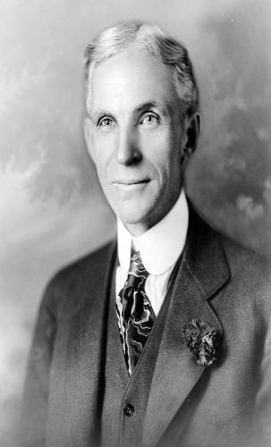
First of all,Henry Ford was so smart guy. He was born in a farm family. Henry was first born alive boy in his father and mother.At 16, he left home for the nearby city of Detroit, where he found apprentice work as a machinist. He returned to Dearborn and work on the family farm after three years, but continued to operate and service steam engines and work occasional stints in Detroit factories.

Slide 4



Years passed, and Henry's reputation as a talented engineer grew. In 1903, he and a group of investors founded the Ford Motor Company. They had a bold vision: to make cars affordable and accessible to the common man. This vision, which was quite revolutionary at the time, was inspired by Henry's desire to change the way people lived and traveled.

Slide 5
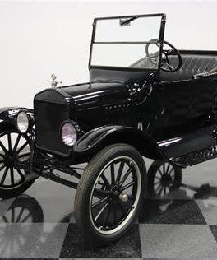
Henry's first major success came with the Model T, introduced in 1908. It was a simple, durable, and affordable car that quickly became popular. People from all walks of life could now own a car, and the Model T became known as the "car that put the world on wheels." It was the beginning of a transportation revolution

Slide 6
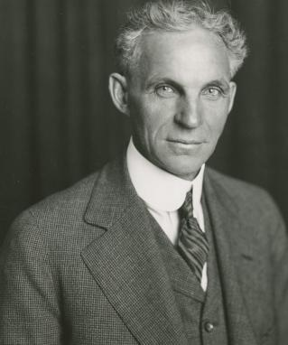
The Ford Motor Company's success soared, and it soon became one of the most profitable and influential companies in the world. Henry's relentless pursuit of innovation and efficiency led to the creation of various models, and the company's production capacity grew rapidly. Henry Ford's success was not limited to just the business realm; it had a profound impact on society. His innovations transformed the way people lived, worked, and traveled. Thanks to his vision and determination, the world saw a shift from horse-drawn carriages to automobiles as a means of transportation.

Slide 7





Henry Ford's legacy as an industrialist and inventor continued to grow. He became an icon of American ingenuity and entrepreneurship. His success wasn't just in creating a successful business; it was in changing the world and making it more accessible to everyone. He had shown that with dedication, innovation, and a vision for the future, anyone could achieve greatness.

Slide 8



THANK YOU

