Slide 1
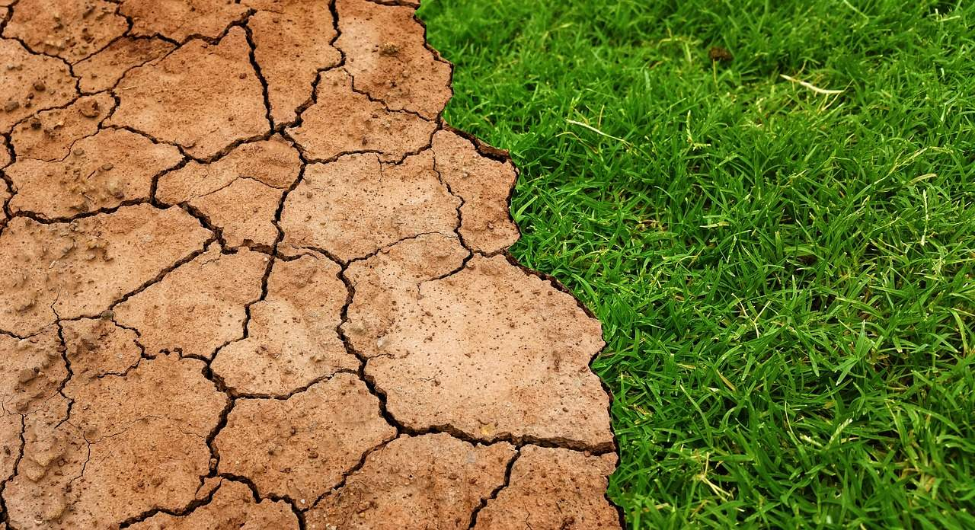
SOIL DEGRADATION

Slide 2
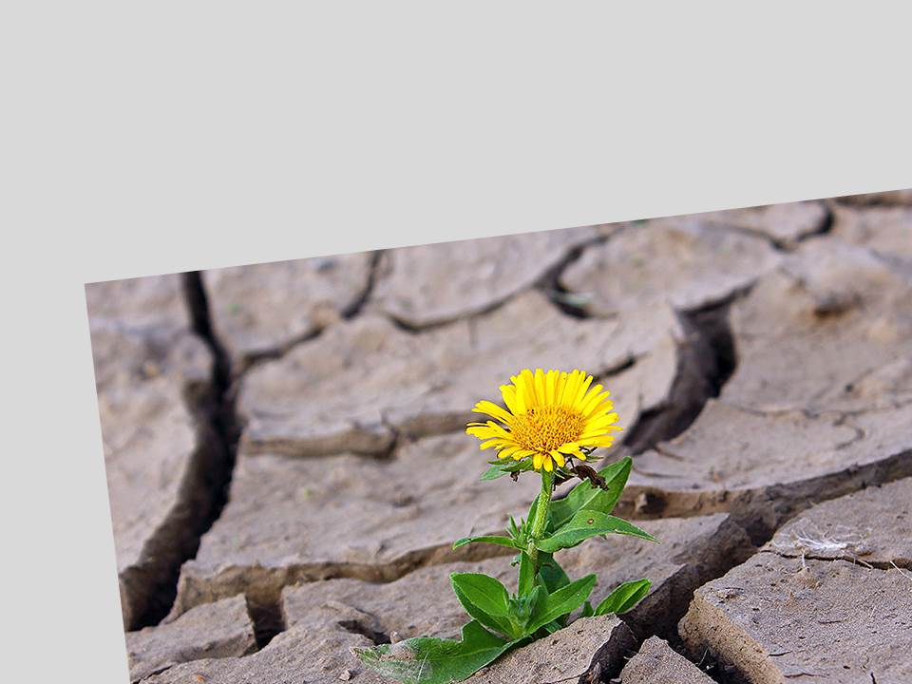
According to the State Statistics Service, the structure of Ukraine's soil cover is 24 million hectares, and in addition, Ukraine has 8% of the world's chernozem reserves and, unfortunately, a high level of plowing. "25% of the earth's surface is degraded soil. And this share is growing. If this trend continues, by 2050 the share of degraded soils will be 90%.

Slide 3


SOIL DEGRADATION - deterioration of soil properties due to changes in soil conditions due to human economic activities or natural processes stimulated by these activities, accompanied by loss of soil productive and environmental functions.

Slide 4
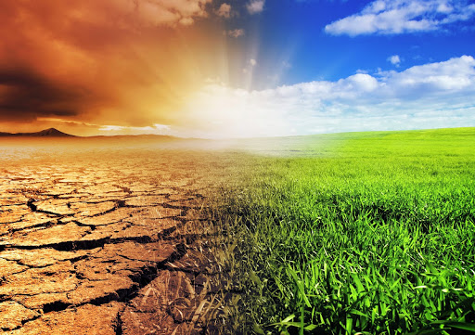
According to the survey, the greatest soil degradation is observed by farmers in Kharkiv, Sumy, Donetsk, Luhansk, Chernihiv, Kirovohrad and Mykolayiv regions. About 50% of respondents observe a decrease in soil fertility in Chernivtsi, Zakarpattia, Cherkasy, Poltava, Ternopil, Rivne, Odessa and Kherson regions «.

Slide 5
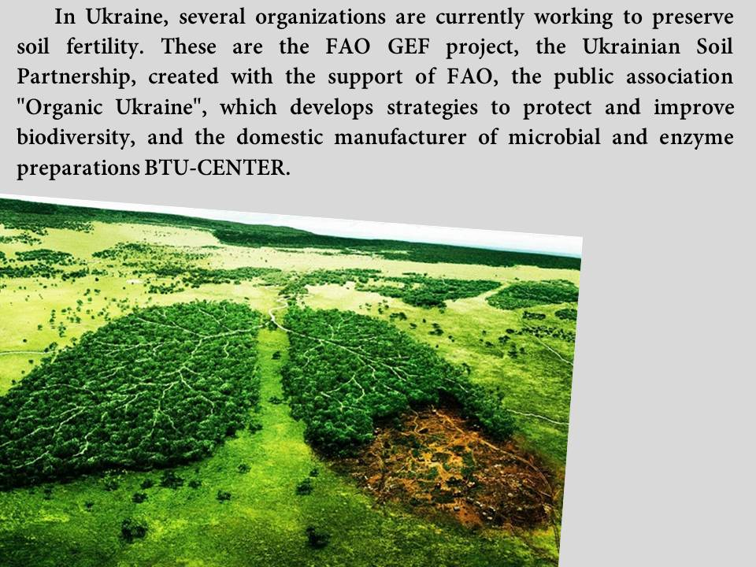

Slide 6

The company started researching soil remediation issues due to the problem of emissions in the oil and gas industry. The use of microbiological preparations on soils contaminated by oil and reservoir spills allowed to revive them in 1-3 years. In total, in the last 15 years, BTU-CENTER has developed about 67 drugs for the agro-industrial sector, 50 of which are organically certified.

Slide 7
In order to maintain soil fertility and prevent degradation in BTU-CENTER recommend:
to promote the rational use of soil properties;
implement resource-saving tillage systems as No-till;
reduce the pesticide load on the soil.

Slide 8
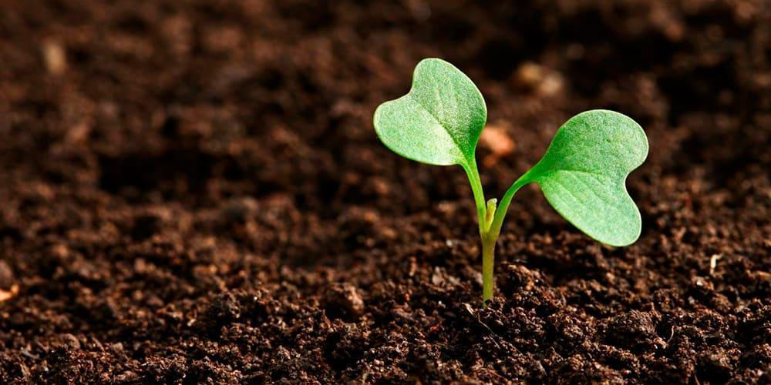
Among farms from the central and western parts of Ukraine, a decrease in soil fertility was noted by 50 to 80% of farmers. According to the agrarians, the following technological processes have been identified that promote the improvement of the soil:
crop rotation - 36%;
application of microbial drugs - 27%;
tillage technology - 26%.

Slide 9
Causes of soil degradation:
water erosion of soils;
burning straw and stubble in the field;
deep plowing with rotation of the layer;
prolonged irrigation;
soil compaction;
nitrogen fertilizers (except potassium, sodium and calcium nitrate);
reducing the number of trees;
man-made contaminated lands.

Slide 10

Thus, the policy of soil regeneration should become a mandatory document for every farm, a clear algorithm for the implementation of which the company "Organic Ukraine" promised to offer soon. Because feeding the world while preserving the planet are two key tasks of modern agriculture.

Slide 11

Thanks for your attention!

