Slide 1








Professional Presentation Design Expert
PowerPoint Design Mastery
Transforming ideas into visually stunning presentations that captivate and convert
Creative Design
Data Visualization
Animation
3D Elements
Available for hire | Contact: expert@powerpointdesign.pro
Date: 2025-11-24

Slide 2












My Design Philosophy
Presentation is not just a collection of slides, but a powerful visual storytelling tool capable of captivating, persuading, and inspiring the audience.
Visual Storytelling
Innovation & Logic
Creating visual narratives that are aesthetically pleasing and functionally effective
Combining innovative design with flawless logic to create unique and memorable presentations
Clear Communication
Impactful Results
Deeply understanding the message to be conveyed and using all available tools to enhance it visually
Creating presentations that achieve their goals and leave a lasting impression on the audience
2/10

Slide 3



















Design and Visualization
Unique Color Palettes
Typography Mastery
Developing harmonious color schemes that match brand identity, from bold colors to minimalism.
Creating bold headings and combining fonts—serif for classics, sans-serif for modern styles.
Serif: Classy & Timeless
Sans-serif: Modern & Clean
Negative Space
Custom Illustrations
Clean layouts with sufficient "white" space allow content to breathe and highlight key points.
Developing unique graphical elements that match the message and strengthen brand identity.
Key Message
Supporting details
3/10

Slide 4







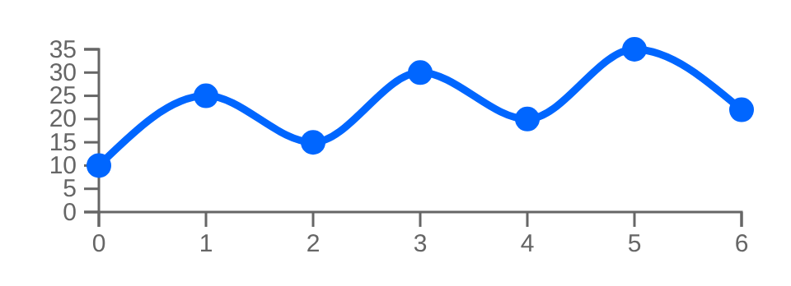




Data Visualization
Transform complex data into visually appealing stories. My approach focuses on artistic infographics, interactive elements, and highlighting key metrics.
Artistic Infographics
Interactive Charts
Key Metrics Focus
I create infographics with artistic sensibility that make complex data accessible and engaging.
I integrate interactive elements that allow the audience to engage with data, improving understanding and engagement.
I use bold contrasts, visual weight, and optimal spacing to highlight the most important numbers, transforming them into standalone visual elements.
Replace standard charts with creative visual representations
Design interactive elements that enhance engagement
Convert key numbers into visual focal points
4/10

Slide 5















Animation and Interactivity
Morph Effect
Animation Sequencing
Create smooth, cinematic transformations between slides for a continuous visual flow.
Create synchronized sequences for objects to appear and move in a predetermined order.
Hover to see transformation
Sequential movement
Interactive Elements
Micro-animations
Develop slides with clickable buttons and triggers for a personalized experience.
Subtle animations that draw attention to key elements without overwhelming the slide.
Interactive Element
Hover to interact
Subtle opacity animation
Transform your presentations into engaging experiences
5/10

Slide 6










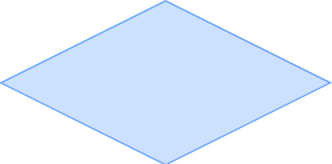







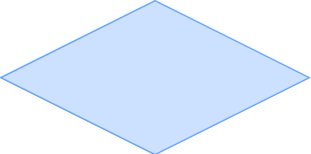
3D and Multimedia
Integrating 3D models, cinematography, and advanced multimedia elements to create an immersive experience.
Interactive 3D Models
Cinematography
Immersive Experience
Rotate and animate 3D models to add depth and realism, allowing complex concepts to be visualized from all angles.
Images with subtle moving elements create dynamic slides that draw attention to specific details and add movement to content.
Create presentations that break beyond standard boundaries, offering the audience a more engaging experience.
6/10

Slide 7























Corporate Report - Case Study
Transformation of complex financial data into a clear visual story for an annual corporate report, using minimalist design with brand colors.
Financial Data
Result
Annual figures
Clear visual story
Operational metrics
Filter
Design
Visualize
Brand-consistent design
Performance indicators
Improved data comprehension
Visual Appeal
Data Comprehension
Brand Professionalism
Enhanced aesthetic experience
Simplified complex information
Strengthened brand identity
7/10

Slide 8









Creative Pitch - Case Study
Startup Investment Pitch
Visual Storytelling Approach
A bright, bold presentation design for a startup seeking investment, focusing on visual storytelling to engage investors.
Problem
Each slide told a part of the story, highlighting the problem market pain points.
Key Elements
Solution
Custom illustrations reflecting product uniqueness
Visualized the product solution in an innovative way that was immediately understandable.
Unusual typography for added individuality
Impact
Showcased potential market impact with dynamic visual elements that conveyed growth.
Visual storytelling across slides
Created an unforgettable impression, effectively conveying the team's passion and innovation.
8/10

Slide 9












My Advantages
My presentations don't just look good—they deliver real business results by solving problems, engaging audiences, and strengthening brands.
Solving Business Problems
Increasing Engagement
Strengthening Brand
Unique visual solutions
Strategic presentation of financial data
Modern design approaches
Brand identity reflection
Interactive elements
Professional image enhancement
Effective investor communication
Dynamic visualization techniques
Product launch impact
9/10

Slide 10











Contact Me
Ready to transform your ideas into visually captivating presentations? Let's discuss your next project and how I can help you achieve your goals.
Email
Phone
Social Media
valgomenuk11@gmail.com
+380964616140
Let's Work Together
10/10

