Slide 1
ASDP
A SMART DATING PLATFORM

Slide 2

PROBLEM:
THE USER BASE OF DATING SERVICES
FOR A DATING SERVICE, THERE IS ALWAYS A QUESTION OF HOW TO ATTRACT THE FIRST USERS. INNOVATIVE FEATURES AND A BEAUTIFUL INTERFACE WON'T HELP IF THERE ARE NO FEMALE PROFILES AND NO ONE TO COMMUNICATE WITH.
A SMALL DATABASE OF PROFILES AFFECTS THE LENGTH OF SESSIONS, USER RETENTION RATES, AND THE OVERALL VALUE OF THE APPLICATION. WHY PAY FOR FEATURES IN A SERVICE WHERE THERE ARE NO PROFILES?

Slide 3

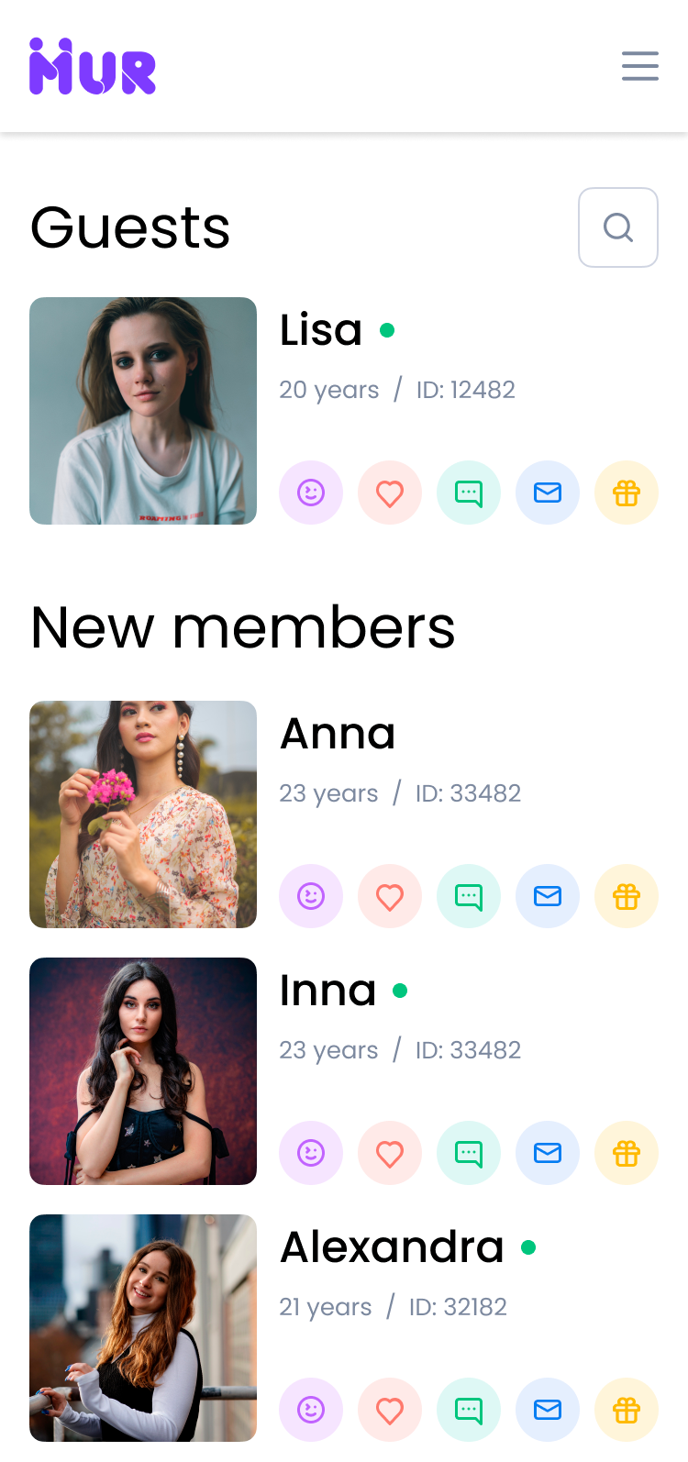
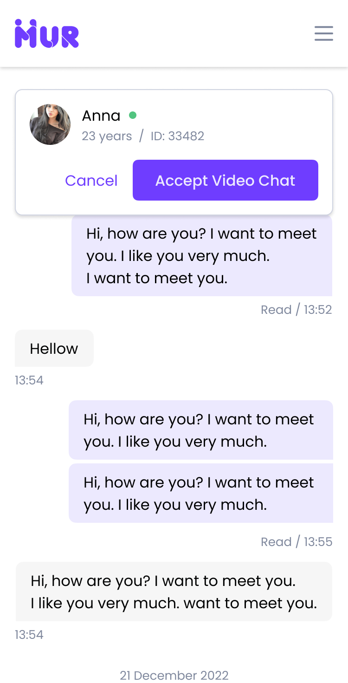
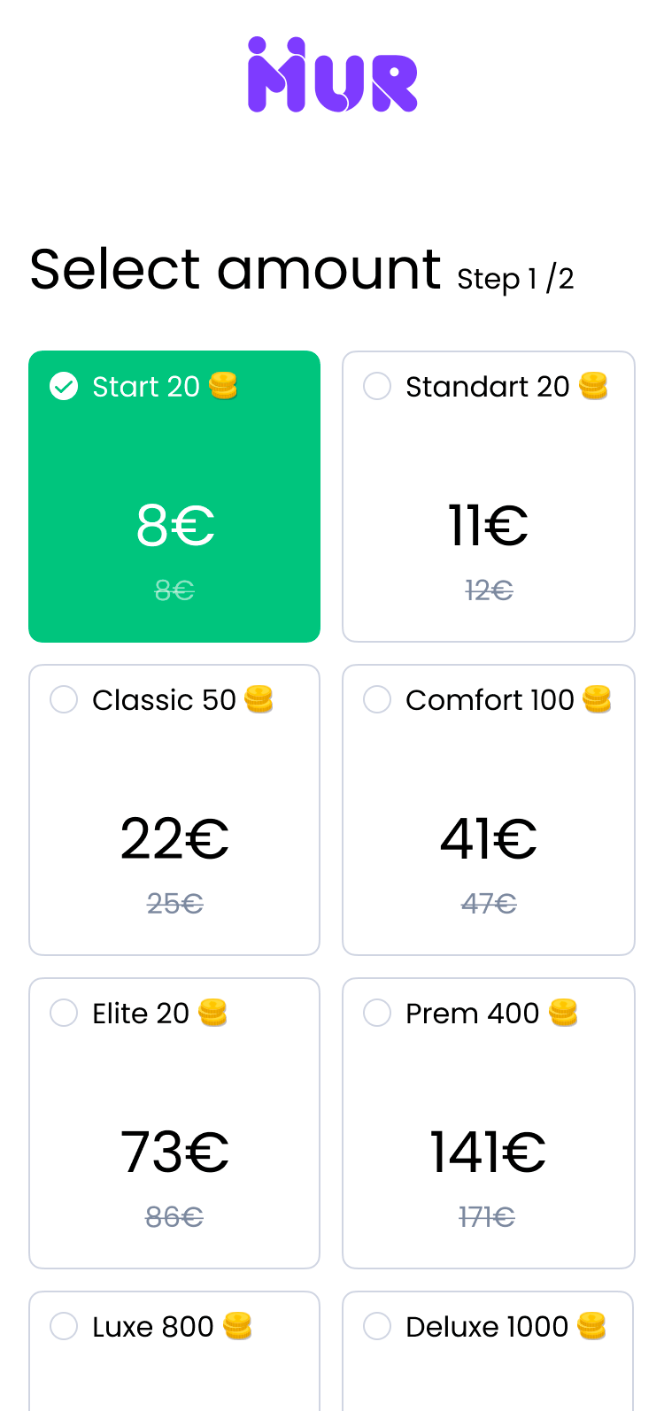
SOLUTION:
ASDP IS A SMART DATING PLATFORM FOR QUICK AND CONVENIENT DATING WITH NEW PEOPLE ALL OVER THE WORLD
A HUGE NUMBER OF GIRLS' PROFILES, OPEN FOR COMMUNICATION
A CONVENIENT CHAT
FOR CASUAL
COMMUNICATION
FREE REGISTRATION
AND AFFORDABLE
TARIFFS

Slide 4
HOW IT WORKS:
ASDP CONNECTS MARRIAGE AGENCIES
WITH MEN FROM ALL OVER THE WORLD
AGENCY 1
AGENCY 2
AGENCY N
ASDP
VERIFIED PROFILES OF GIRLS
CHAT, VIDEO CHAT, EMAILS, GIFTS
JOHN
BEN
JACK

Slide 5
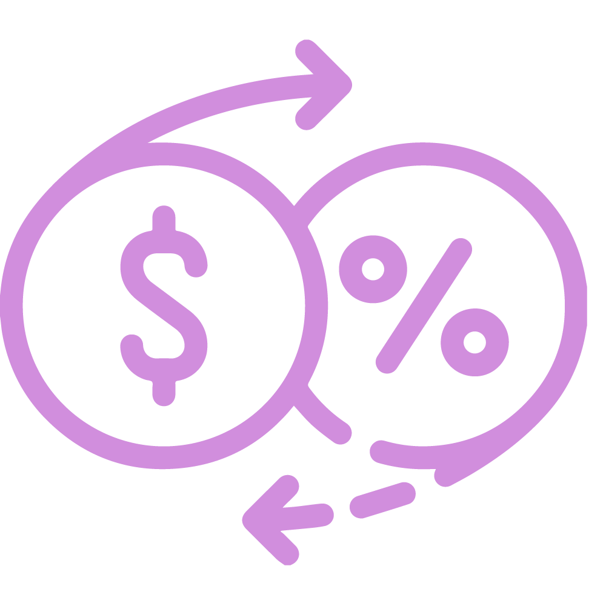
BUSINESS MODEL:
FREEMIUM
AGENCY:
-40%
USD/MONTH
USERS:
+40$
USD/MONTH

Slide 6
MARKET OPPORTUNITY:
UNITED STATES, SOUTH AMERICA AS AN MVP
MARKET SIZE:
$XX BLN
THE MARKET VOLUME OF TRADITIONAL DATING MODELS (TINDER OR ZOOSK) + DATING AGENCIES OR ONLINE PURCHASED TICKETS FOR SPEED DATING
XXX%
COMPOUND ANNUAL GROWTH RATE (CAGR) FROM 2022 TO 2027
GO TO MARKET PLAN 2023:
CONNECT 5 AGENCIES
XXX+ VERIFIED PROFILES OF GIRLS
WEBSITE TRAFFIC OF XXX USERS
MONTHLY REVENUE OF $XXX
CURRENT NUMBERS:
AGENCY CONNECTED – 2
VERIFIED PROFILES OF GIRLS – XXX
WEBSITE TRAFFIC – XXX USERS
source: Statista

Slide 7



WE FOLLOW:
TINDER IS AN APPLICATION DESIGNED FOR ROMANTIC ENCOUNTERS WITH A FREEMIUM BUSINESS MODEL
IT IS CONSIDERED FROM THE PERSPECTIVE OF USING ARTIFICIAL INTELLIGENCE IN THE DATING INDUSTRY

Slide 8


FINANCIAL:
INVESTMENT FOR X% SHARE OF THE COMPANY
GENERAL EXPENSES
? $
XXX $
XXX $
2022
2023
07.2023 – 06.2024

Slide 9
PIPELINE:
LAUNCH
MULTI-LANGUAGE
SCALE PLATFORM
AI CHAT
AUGUST 2023
OCTOBER 2023
Q3 2024
JUNE 2023
SEPTEMBER 2023
FEBRUARY 2024
CRYPTOCURRENCY PAYMENTS
SUBSCRIPTION
ASIA MARKET

Slide 10
GROSS INCOME EXPECTED:
LAUNCH
MULTI-LANGUAGE
5 AGENCIES
XXX $ REVENUE/M
AUGUST 2023
OCTOBER 2023
FEBRUARY 2024
Q2 2024
JUNE 2023
SEPTEMBER 2023
JANUARY 2024
CRYPTOCURRENCY PAYMENTS
SUBSCRIPTION
SCALE PLATFORM
AI CHAT
10 AGENCIES
XXX $ REVENUE/M

Slide 11
ASDP
THANK YOU!

