Slide 1
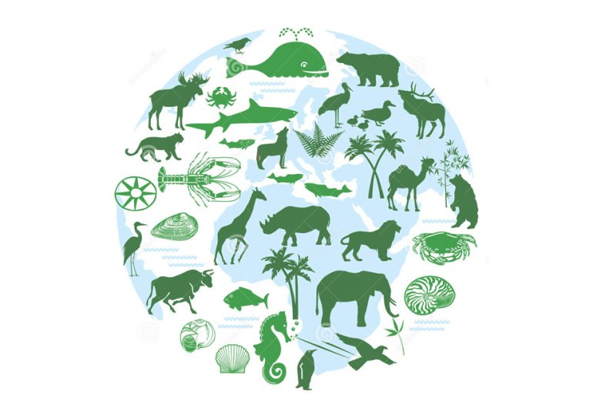
Reduction of species diversity

Slide 2
The world's forest population - birds, mammals, amphibians and reptiles - has shrunk by more than 50% in the past 40 years. Scientists warn that this could have catastrophic consequences for forest ecosystems and accelerate climate change - many animals play an important role in maintaining tree health.

Slide 3
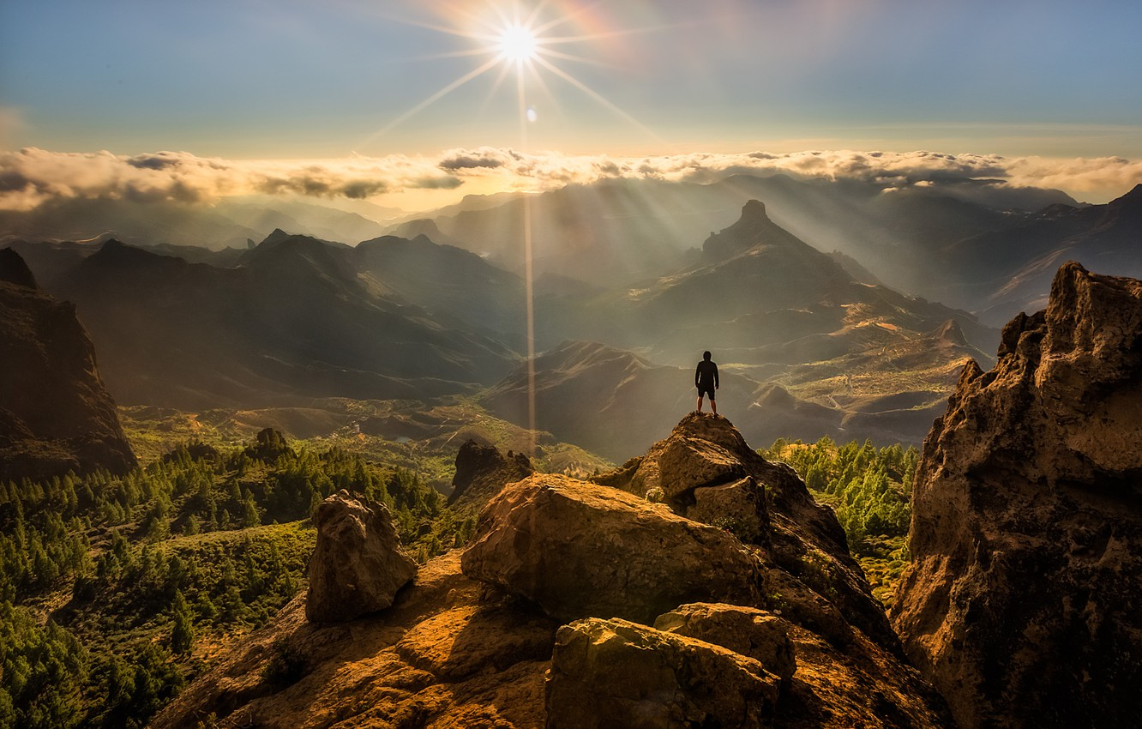
The main reason for such an unprecedented threat to biodiversity is human and his activities. This is stated in a recently published report of the Intergovernmental Scientific and Policy Platform on Biodiversity and Ecosystems (IPBES).

Slide 4
Biodiversity is rapidly declining due to factors such as:
land use change;
climate change;
invasive species;
excessive operation;
environmental pollution.
Such natural, or more often man-made, factors called catalysts, for the most part, interact and reinforce each other.

Slide 5
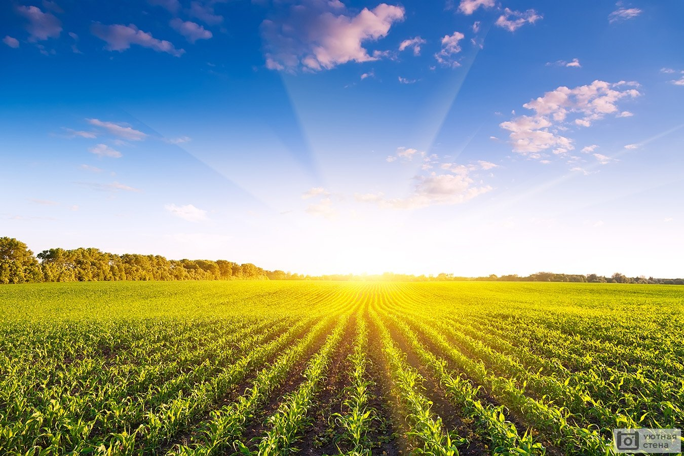
Agriculture is significantly affected by biodiversity loss:
from the 16th century more than 9% of animals that have been domesticated for food or use in this area have already died out;
more than 1,000 species are endangered;
land productivity decreased by 23% due to their degradation;
declining pollination populations each year result in crop losses of $ 577 billion.
All these factors exacerbate the food crisis and lack of resources. Already, every ninth person on the planet suffers from hunger.

Slide 6
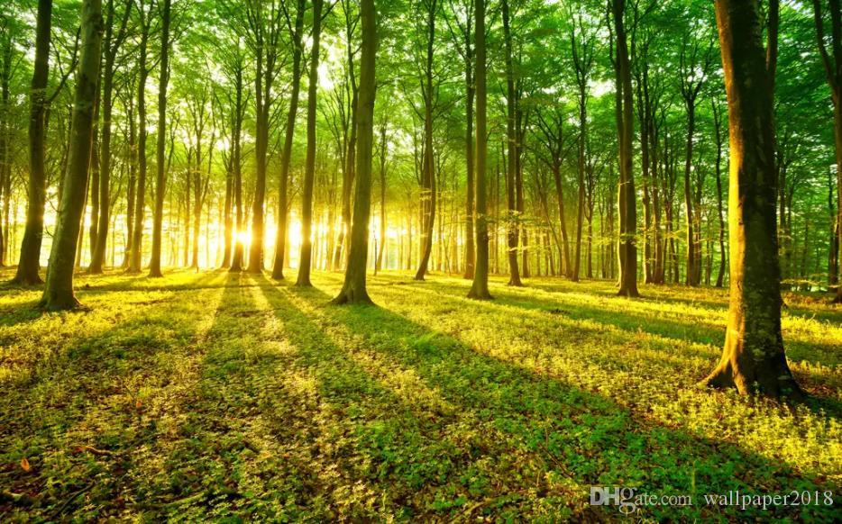
In addition, the destruction of trees and forests that absorb CO2 from the atmosphere is accelerating the pace of climate change. This change leads to melting glaciers, rising sea levels, increasing extreme weather events and other negative consequences. As it is one of the main causes of biodiversity loss, these two negative factors will constantly reinforce each other, only exacerbating the situation.

Slide 7
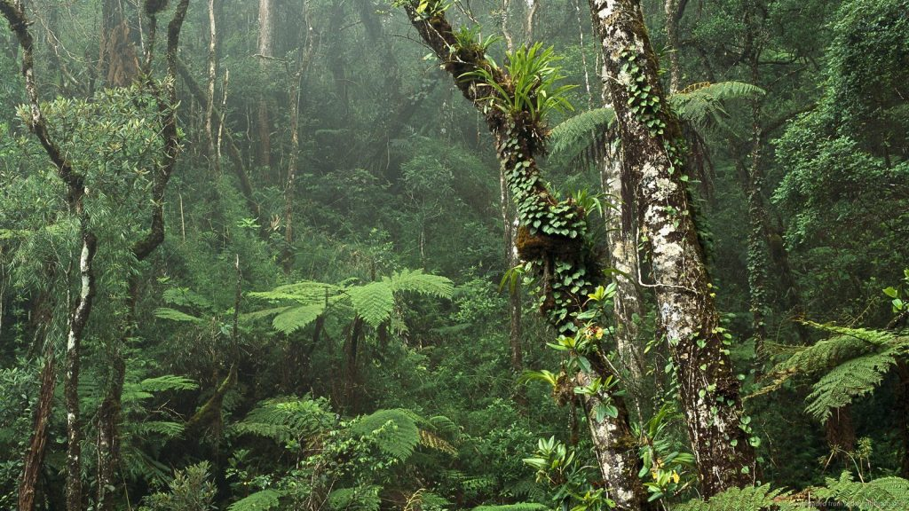
Currently, the most vulnerable to global warming are tropical forests, including the Amazon. Scientists predict that if greenhouse gas emissions are not reduced, 75% of the wildlife living there will be in danger. Thus, in the period from 2001 to 2014, the bird population in the western part of the Amazon forest declined sharply. That the reduction is due to increased rainfall. They reduced the birds' chances of survival and affected their reproduction.

Slide 8
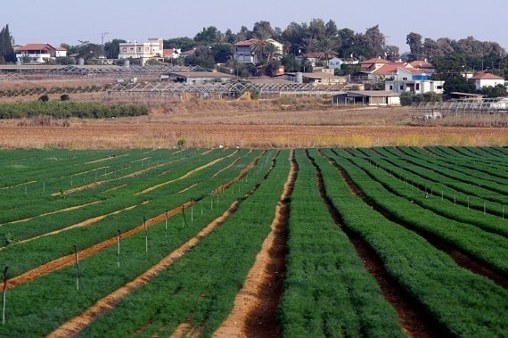
Tips for improving biodiversity for farmers
Changing the existing negative nature of land use will both improve the state of biodiversity in general and ensure the sustainability of the necessary conditions for agriculture.
for giant agrarian formations, it is useful to implement the practice of economical land use;
optimization of land use;
preservation of remnants of land in the natural ;
close to natural state;
should be paid to limiting and regulating the use of synthetic fertilizers and plant protection products.
In general, it is better to develop small-scale farming as opposed to large agricultural holdings, as it has a much smaller negative impact on ecosystems.

Slide 9
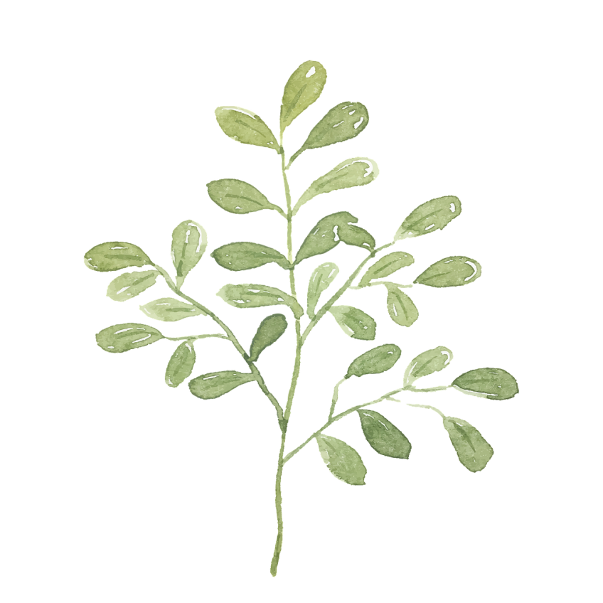
Biodiversity loss has a negative impact on some aspects of human well-being, including food security, vulnerability to natural disasters, energy security and access to clean water and raw materials. It also affects people's health and public relations. So the world community must do everything, to reduce the impact of human activities on the reduction of species diversity

Slide 10

Thanks for your attention!

