Slide 1
Tabloids in Ukraine

Slide 2
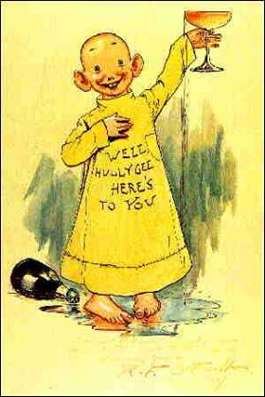
Yellow press.
Expression was born in the USA. In 1895 in the New York newspaper The World appeared a series of funny drawings, among the characters of which was a certain boy dressed in a yellow shirt. Therefore, he was nicknamed the "yellow baby." Another newspaper, The New York Journal, began publishing a similar series.

Slide 3

Between these two newspapers, a dispute arose over copyright because of the "yellow kid". The editor of "New York Press" contemptuously called both competing newspapers "yellow press". Since then, this expression has been inculcated as a designation of a vile, deceitful, corrupt press, chasing a cheap, low-grade sensation.

Slide 4
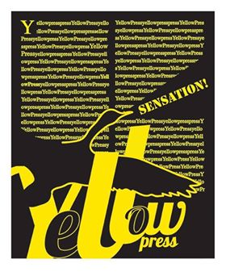
With the independence of Ukraine, the structure of the Ukrainian media has changed significantly. Every year the number of periodicals increased, various types of print media appeared, including the yellow press.

Slide 5
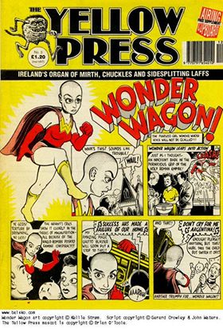
Tabloid or yellow press - is the name of a small-format newspaper with a compressed text and notable announcements, photographs, headlines.

Slide 6
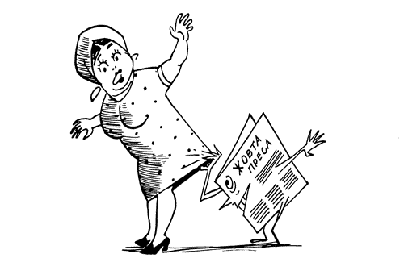
Tabloids have been created to provide more comfortable conditions for reading the press in public places for people who do not have the time to keep up-to-date and analytical news.

Slide 7
Signs of tabloid:
Format – A-3;
Content – reliable information of sensational and scandalous nature;
The specifics of advertising activity – the publication of small compressed advertisements that are easy to see in the general mass of information;
The audience to which it is directed – created for people of middle and senior age, since this stratum is made up of the able-bodied population;
A specific model for submitting information – compressed text, messages, pressed to size notes, notable announcements, scandalous photos, screaming headlines.

Slide 8

Among the main features of the "yellow press" are the following:
sensationalism;
low cost of publication;
distortion of information;
tendency of simplification;
general decline in journalistic standards;
the predominance of illustrations over the text;

Slide 9
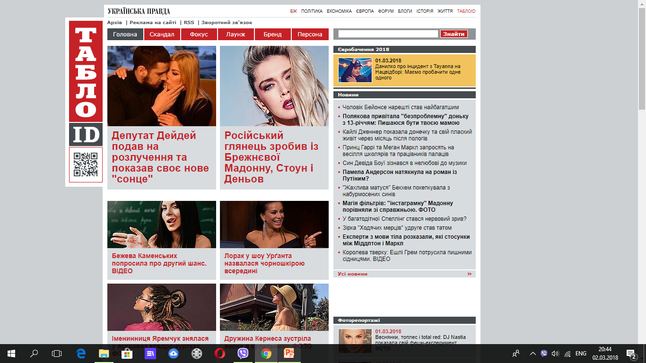
The most popular tabloid in Ukraine – «ТаблоID»

Slide 10

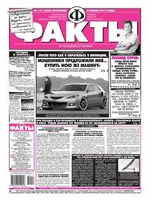
«Facts and comments»

Slide 11
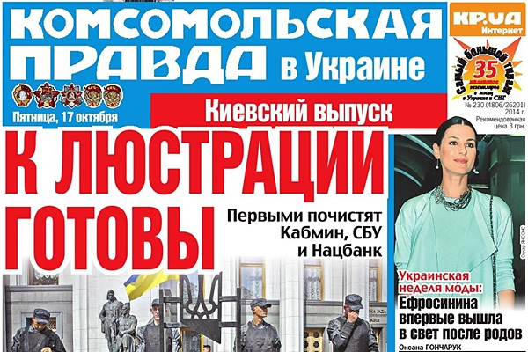
«Komsomolskaya Pravda in Ukraine»

Slide 12
Thank you for attention

