Slide 1
Marketing kit
В2В
QALight

Slide 2

About the training center
QALight training center is one of the leaders in the IT education market in Ukraine. We teach testing, development and management to those who want to become part of the IT family, as well as improve the professional level of specialists already working in IT.
>35
PRACTITIONERS
8
YEARS IN THE MARKET OF IT EDUCATION
26
AREAS OF STUDY

Slide 3
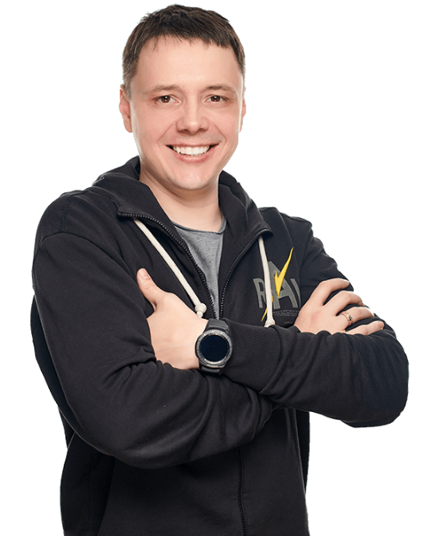
History
The training center was founded by Nikolai Boboshko in 2012. Currently, he is the CEO of the company and a trainer.
Over 8 years of work, we have expanded the number of areas of study to 26 disciplines, and have successfully graduated more than 10,000 students.

Slide 4
Trainers
QALight trainers are, first of all, experienced practitioners in the IT market, each of whom makes changes to the training material every 6 months based on the needs of the market. This allows us to provide students with the most up-to-date knowledge both when they study from scratch and when they upgrade their qualification.
Our trainers are current employees of the largest IT companies in Ukraine and the world, such as SoftServe, Playtech, Intertelecom, Oracle, Global Logic, EPAM, Ciclum, Miratech and many others.

Slide 5

IT-courses for companies
Tech Skills: programming
Java
Python for beginners
Javascript basic
Full stack development on the Laravel framework
PHP based CMS development

Slide 6

IT-courses for companies
Tech Skills: testing
QA
Test automation with Selenium Webdriver (Python, Java, or C #)
WEB services testing
Load testing with Jmeter
Mobile application testing
Java for automatizors
Git for automatizors
Creating an automation project and writing UI tests
Writing combined UI and API tests. Writing BDD tests

Slide 7
IT-courses for companies
Tech Skills: additional skills
Practical SQL
Unix and networks
HTML5 and CSS3
WEB-servers and WEB-services

Slide 8

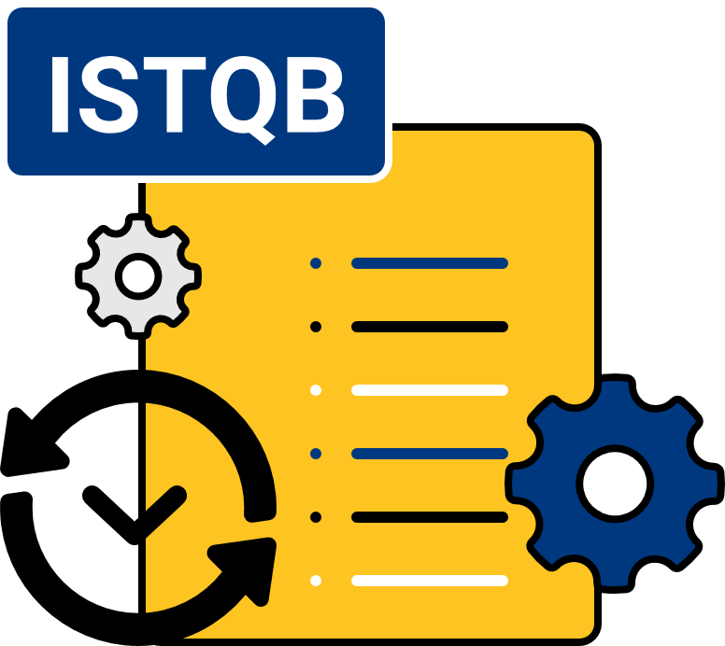
IT-courses for companies
Soft Skills: IT management
IT Project Manager
HR-manager at IT company
ISTQB certification
Preparation to ISTQB certification Foundation Level based on Syllabus Version 2018

Slide 9
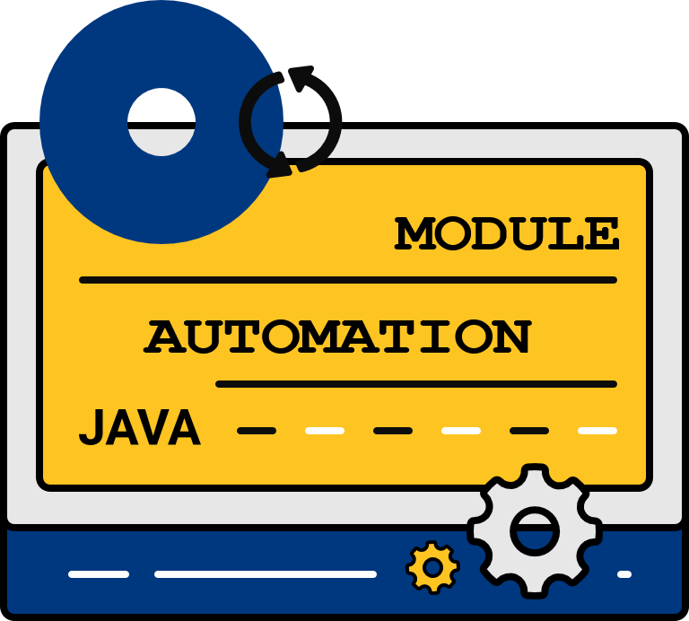
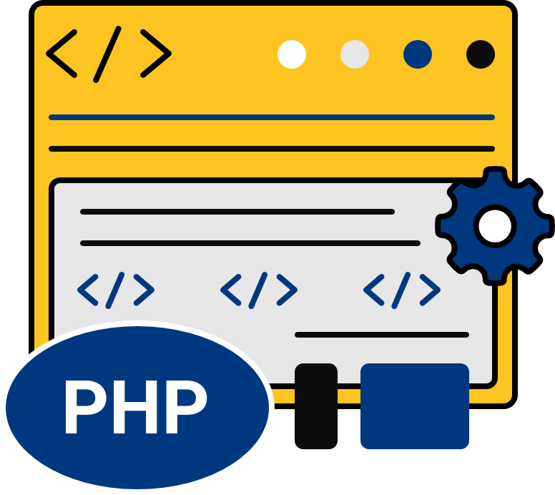
Modules
Apart from individual courses, QALight provides modular training that enables the graduation of complex specialists with deep knowledge. In addition, the module contains courses with a 15% discount.
Basic testing module
Advanced test automation module
FullStack Wеb Developеr
- QA
- Practical SQL
- The basics of Unix and networks
- WEB-servers and WEB-services
- Load testing
- How to write a resume and get an interview
- Java for automatizors
- Git for automatizors
- Creating an automation project and writing UI tests
- Writing combined UI and API tests. Writing BDD tests
- Full stack development on the Laravel framework
- Javascript Basic
- HTML5 and CSS3
- PHP based CMS development

Slide 10

Teaching
How students are taught in our
training center?

Slide 11


Features
Student training consists of:
Planned group lectures with a trainer
Self-study of the materials provided by the trainer
Homework assignments aimed at reinforcing the material
Completion tests to check the acquired skills and review the material

Slide 12
Teaching
the general workload also includes self-study and consultations with a trainer
during classes, surveys and tests are regularly conducted (to control the students knowledge)
at the end of the course, a final certification is carried out (to confirm your qualifications of a beginner specialist)
after successfully passing the final certification, you receive certificates confirming your skills
based on the results of the training, our training center will provide the company with a student progress report
* Our training center produces only well-trained specialists.

Slide 13


The training process
All training at QALight takes place online in the ZOOM video conferencing program, which helps corporate clients follow the global practice of remote work during the quarantine period.
We provide our students with teaching materials, individual support, and lecture notes that they can revise if necessary.
+

Slide 14
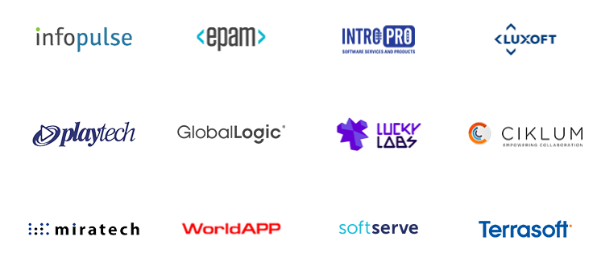
Our graduates work at:
An indicator of the quality of our education is our working students

Slide 15
Discount for B2B clients
The offer for corporate clients includes a discount:
-5%
This offer applies to all modules and courses of the QALight training center when concluding a contract with a legal entity.

Slide 16
Bonus: technical support
A technical specialist is assigned to each group, who, if necessary, can help the student with the software for smooth learning.
Students can contact the technical administrator at any time regarding the set-up, operation and interaction with programs and servers necessary to acquire skills and knowledge

Slide 17
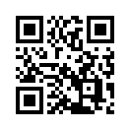
Thank you!
Kyiv
Vadim Getman str., 2,
offices 210, 211
+38 (097) 78 010 78
+38 (099) 78 010 78
+38 (063) 78 010 78

