Slide 1
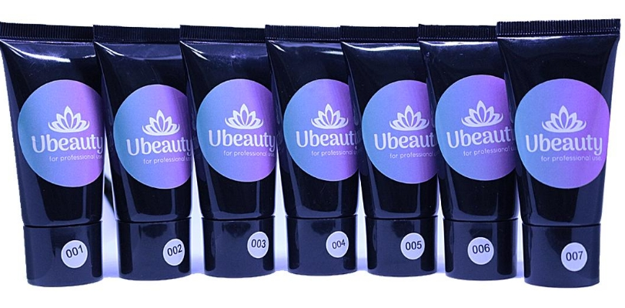
ACRYLGEL 3.0

Slide 2
CONTENTS
Purpose of UBEAUTY ACRYLGEL
Advantages and disadvantages
Unique Characteristics of UBEAUTY ACRILGEL
Comparative characteristics
Types of work
Salon Extension ASTET EXPRESS
Curved French
Arch extensions
Correction
The cost

Slide 3
Purpose of UBEAUTY ACRYLGEL
A gel with a high degree of resistance. Particularly suitable for modeling nails with a pronounced C-curve and for extreme nail lengthening.
Modeling one-phase gel of the consistency of a dense jelly. Contains only medical reagents. Suitable for any type of nail plate.
Suitable for different kinds of work:
Stretching, correction, correction, repair, ideal for AQUARIUM.
Stronger, more elastic and lighter than any acrylic or gel available in the nail industry.
Allows to build up on the top forms and model on the forms at any speed comfortable for the master, it is also suitable as a strengthening the base of the natural nail plate for further application of gel varnish.
It is removable by peeling.

Slide 4
The uniqueness of UBEAUTY ACRYLGEL
Odorless
Does not stretch
Doesn't stick
Does not drip
No peeling
No baking in the lamp
No dust
No sugar
No air bubbles
No bubbles
No yellowing
Resistant
Plastic
Submissive
Work without restriction
Super strong
Hypoallergenic
Natural
Dries only in a lamp

Slide 5
Types of work
Clients have problematic and weak nails or nails with a natural tendency to trapezoidal shape, but want to get an even, thin, extra strong and water-resistant base for manicure gel lacquer;
Create a reliable shield against aggressive and negative external influences (constant contact with household chemicals, water, professional detergents and other chemicals, etc.);
Master especially succeeds in the lay-out French, but you do not want to spend time, effort and materials for the sawing of the smile;
Often have to create designs in the style of colored or multi-color French gels, but do not have the necessary shades of pigments or dyes. The solution is simple: you can mix acrylic gel with any shade of gel polish from the master's palette and bring to life any client's whim;
No less pleasant is the gel-acrylic and the correction of modeled them nails. The technique is completely identical to work with gels and acrylics and does not require additional expenses from the master both for liquids and for tools and equipment.

Slide 6
STRENGTHENING ( ALIGNMENT )
Perform preliminary preparation of the nail plate;
Apply a primer;
Apply rubber base
Apply the selected shade of Acryl Gel;
Dip the brush in alcohol and distribute the material in a thin layer on the nail.
The brush should glide smoothly over the material to distribute it as evenly as possible.
Dry the coating in the lamp: 2 minutes in the UV machine and 1 minute in the LED lamp.
If we cover with gel lacquers, it means to cover the base, and if we leave it like that, to cover with a top.

Slide 7
CURVED FRENCH
Perform preliminary preparation of the nail plate;
Apply a primer;
Apply the rubber base
Moisten a brush with alcohol and with long strokes begin to flatten the acrylic gel to form a tongue for the french laying. Light curing for 30 seconds.
Smile and dry it for 90 seconds.
Smooth the border between the nail bed and the smile with a cutter or file.
Seal with a top.
Bake in the curing lamp.

Slide 8
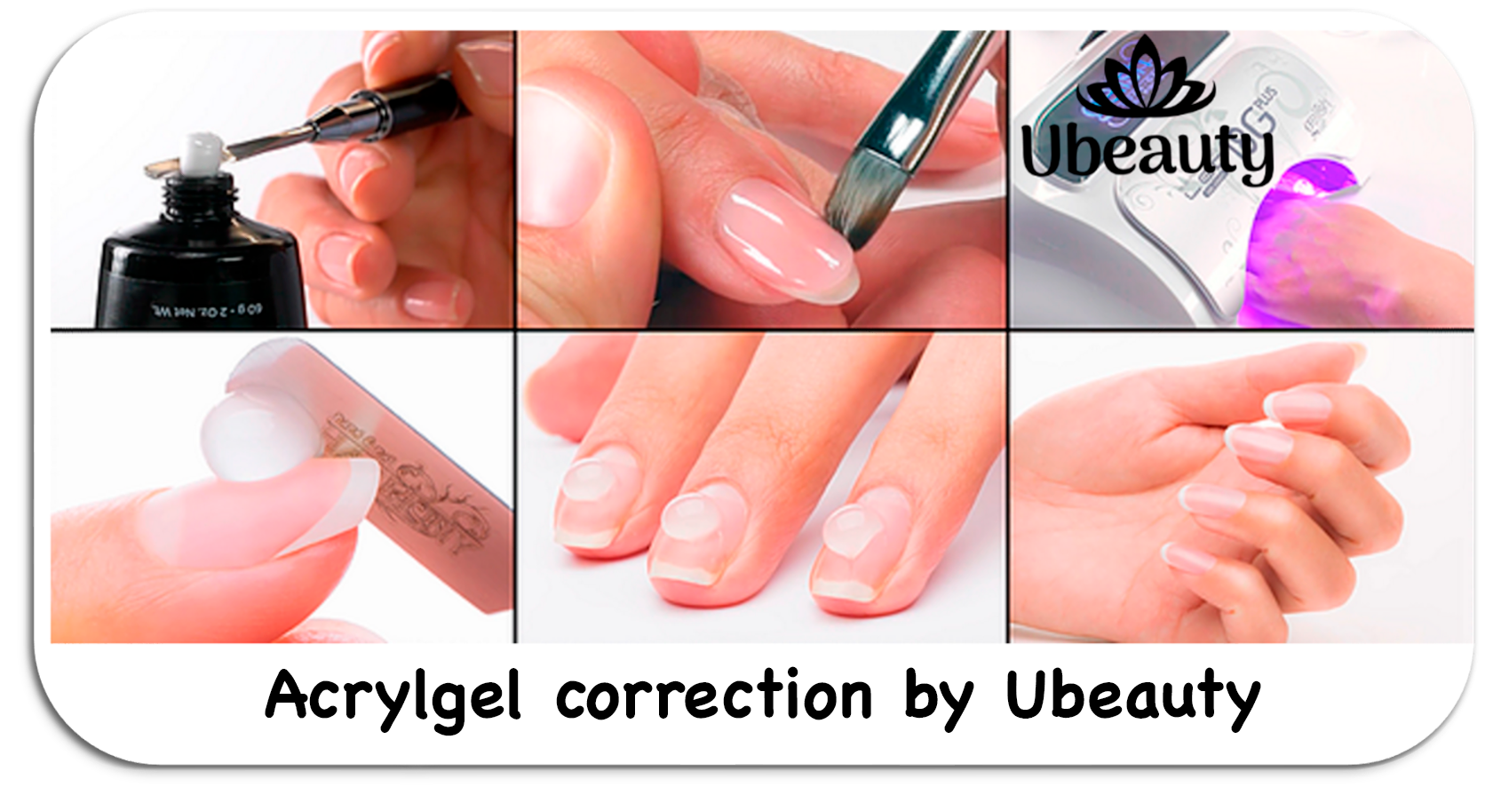

Slide 9
ARCH EXTENSION
Perform preliminary preparation of the nail plate;
Apply a primer;
Apply the rubber base.
Take a drop of acrylgel, apply it to the nail with a spatula. Soak a brush in alcohol and start smoothing, forming an extended nail. Dry in a lamp for 30 seconds.
Now clamp the arch with tweezers, and then with a clothespin. Hold for 30 seconds, then finish drying in the lamp for another 30 seconds.
Then take off the clothespin and dry for another 30 seconds without the clothespin.
Remove sticky layer. Then file free edge with a file.
Remove dust, degrease, push the cuticle away, base and dry in the curing lamp
Then we cover the nail with any gel-lacquer in two layers.
Apply topcoat without a sticky layer and dry.

Slide 10
CORRECTION
Perform preliminary preparation of the nail plate;
Apply a primer;
Apply the rubber base ALL THE LONGEST
Apply the selected shade of Acryl Gel;
Dip the brush into the alcohol and spread a thin layer of material on the nail.
The brush should glide smoothly over the material to distribute it as evenly as possible.
Dry the coating in the lamp: 2 minutes in the UV machine and 1 minute in the LED lamp.
If we cover with gel lacquers, it means to cover the base, and if we leave it like that, it means to cover with a top.

Slide 11
Salon extension ASTET EXPRESS
The top forms for extensions are made of durable plastic and look like tips. The master forms the future substrate by laying acrylic gel in the plastic blank, and then fixes it on the nail. The material in the process of polymerization in the lamp hardens and the form is removed
Using the top forms for nail extensions, you can save on the purchase of disposable forms. The top molds are reusable. They last forever until they are lost.
The technology allows you to achieve a neat and natural result,
Nail extensions with top-forms allows to reduce the time of the master's work: it is not necessary to substitute the form, cut it out, adjust the size.
The method is suitable for working with problematic nails (trapezoidal and ramp-shaped). In addition, it allows you to work with plates without a free edge, when the lower form cannot be substituted.
The master does not need to work through the stress zone, but only to work on the free edge. This technique is much easier than building up on the lower forms or on tips.
The method allows nail-masters to perform complex 3D designs, lay out an aquarium design so that not a single decorative element goes into the file.

Slide 12
Perform preliminary preparation of the nail plate;
Choose the right size for each nail;
Apply the CAUCUCUK BASE;
Apply the selected shade of Acryl Gel on the reusable mold
Dip a brush into the alcohol and distribute the material EQUALLY over the mold.
Apply the form to the nail plate and fix it;
Spread the free edge on the inside evenly.
Light dry: 2 minutes in a UV machine and 1 minute in an LED lamp.
Remove the top form, trim the cuticle area, apply a top; design as desired.
After the top form is removed, the result is a glossy surface of the artificial plate, which does not require additional processing.
The result is as thin as possible, close to the natural nail.

Slide 13
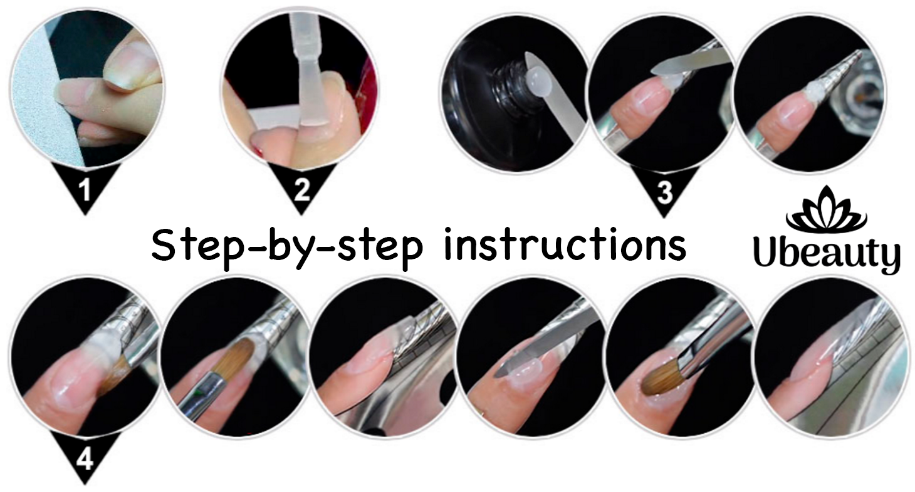

Slide 14
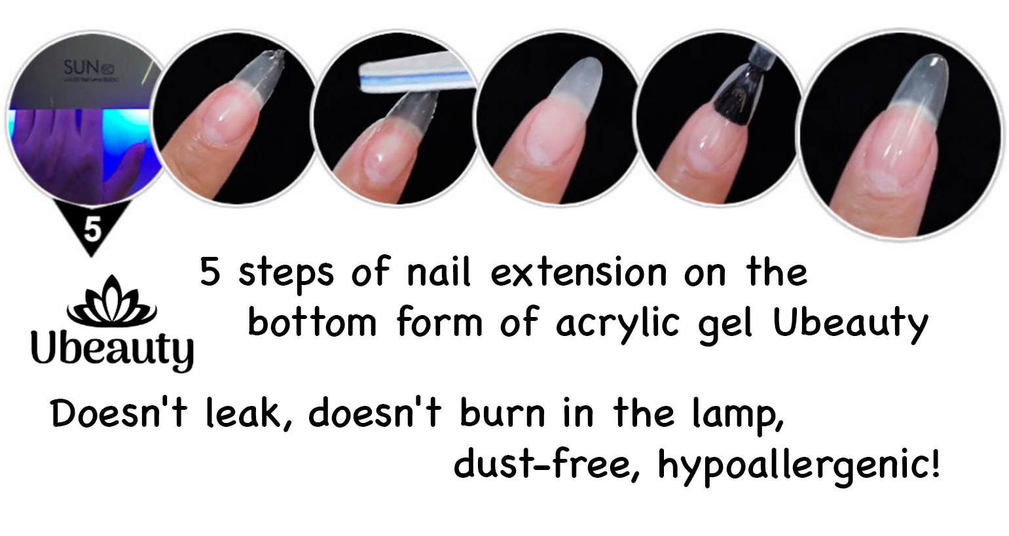

Slide 15
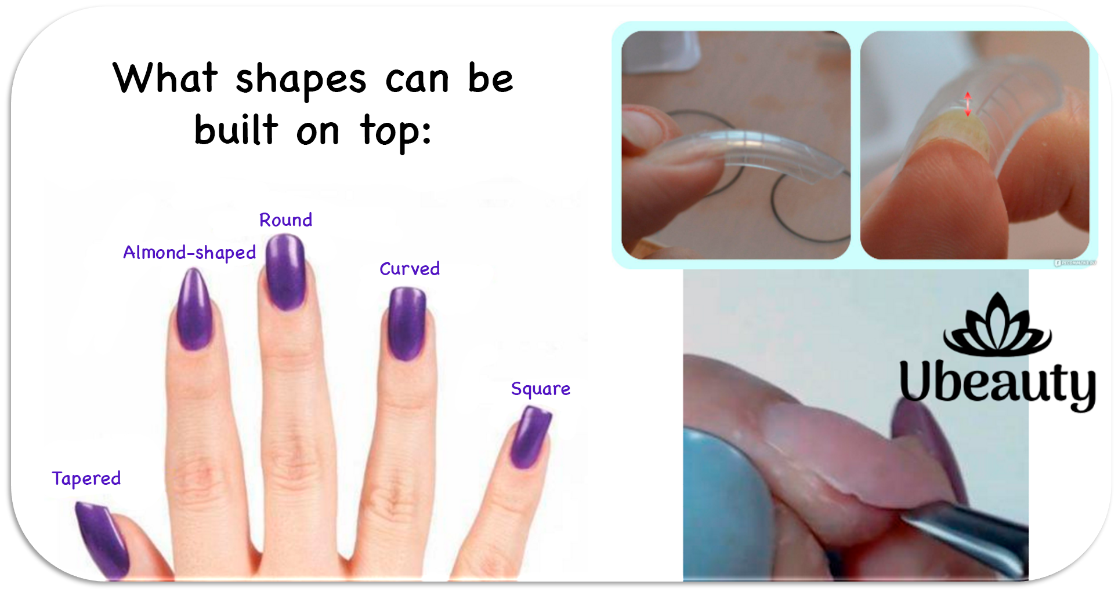

Slide 16
COST OF AUGMENTATION
Extension with gel
30ml gel = 18 customers = $3
Extension with acrylic
20g powder = 20 customers = $1,75
Extension with acrylgel
30ml = 25 customers = $0,75

