Slide 1
THE ROYAL ARMY VETERINARY CORPS

Slide 2
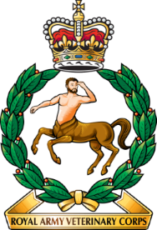
CONTENT
Origins
Public outcry
First World War
Inter-war
Second World War
Post-war
Today

Slide 3
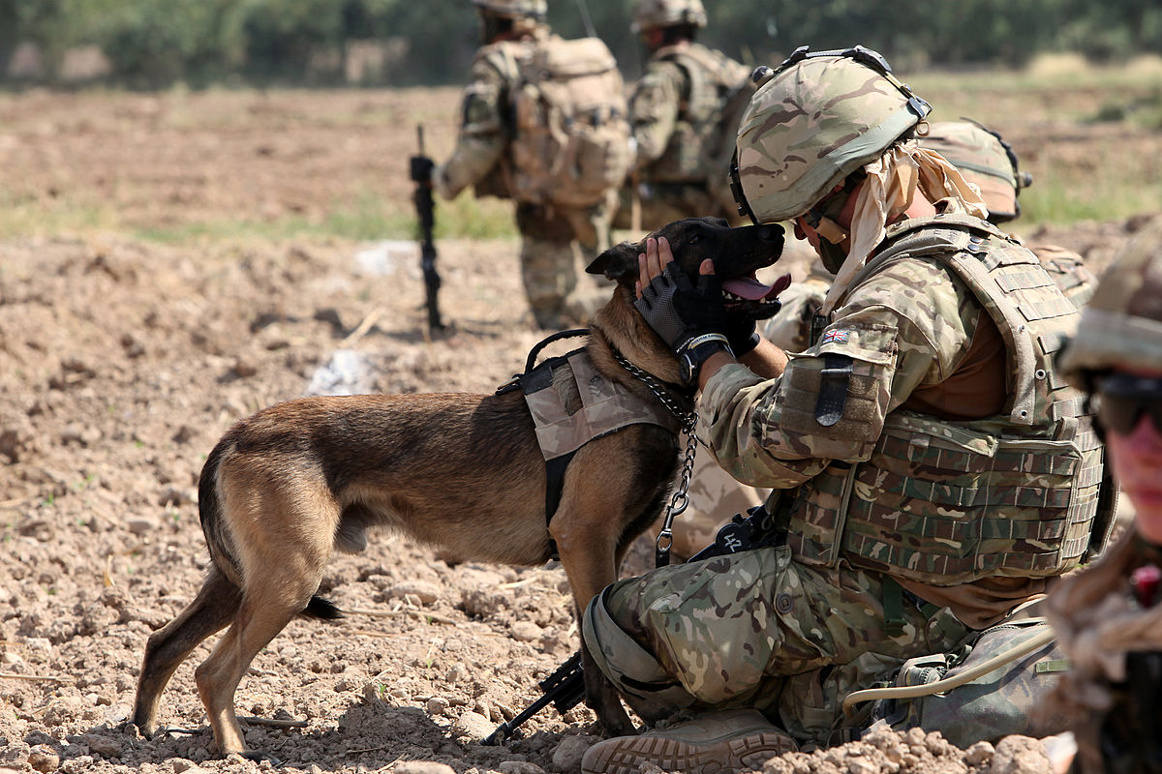
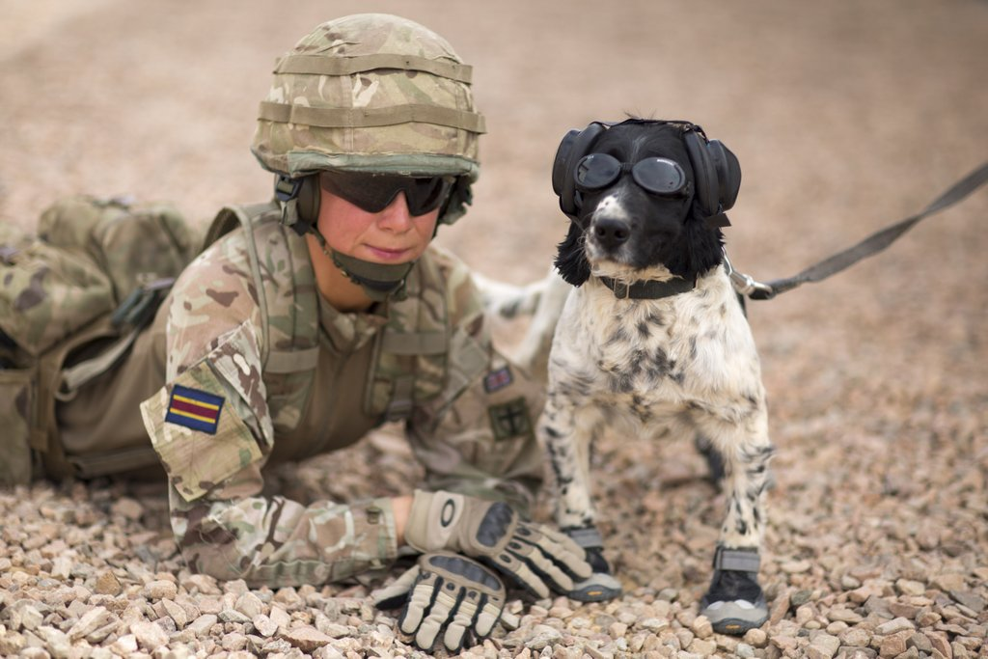
This corps is responsible for the provision, training and care of animals in the British Army. With origins dating back to the 1790s, it has served in many campaigns, including the recent conflicts in Iraq and Afghanistan.

Slide 4
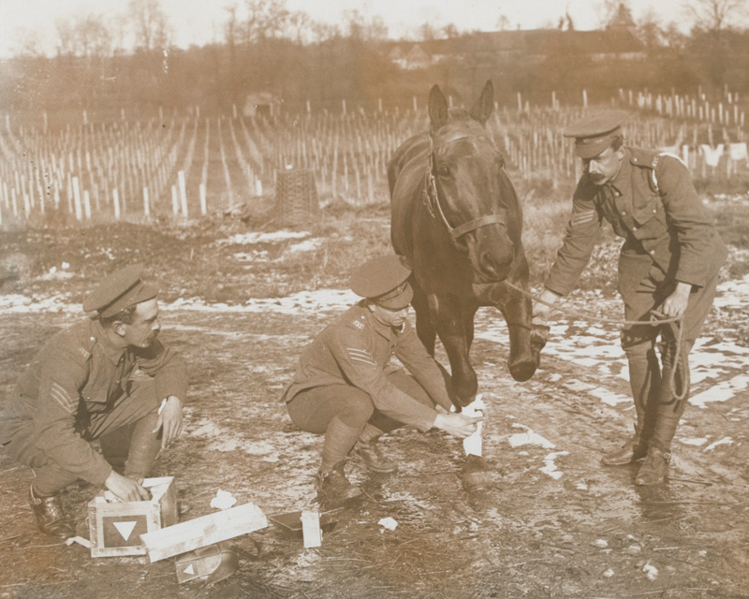
ORIGINS
From 1796, veterinary surgeons were commissioned into cavalry regiments to care for the British Army's horses and mules. Their work had previously been carried out by contracted farriers.

Slide 5
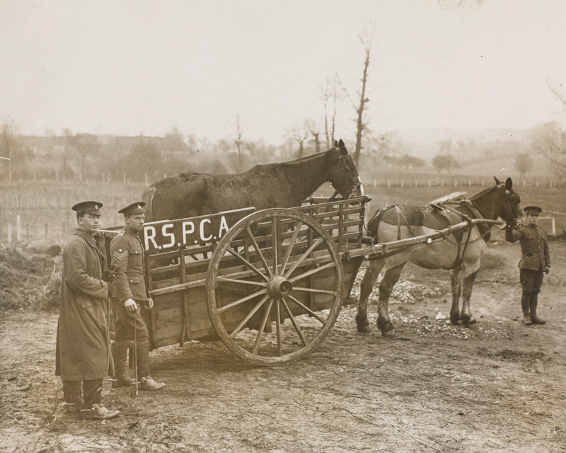
PUBLIC OUTCRY
In 1898, veterinary provision for most sick and injured animals was transferred to the same depots as the Army's Remount Service. Formed in 1887, the Remount Service was responsible for supplying replacement horses and mules.

Slide 6
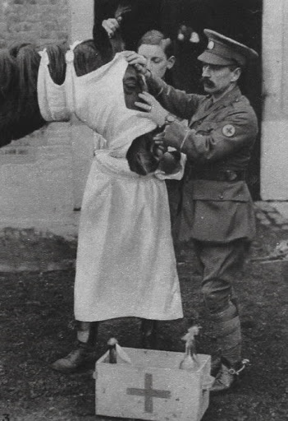
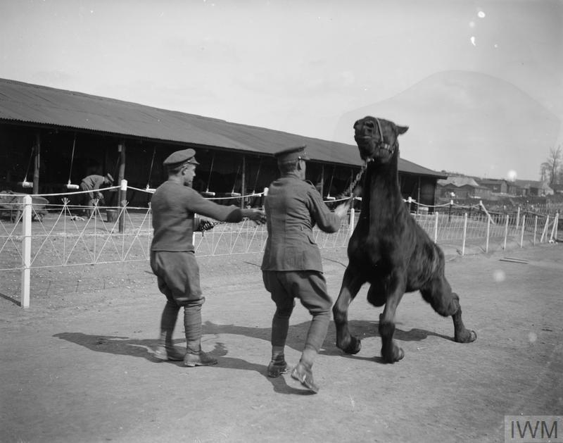
FIRST WORLD WAR
During the First World War (1914-18), the AVC tripled its officers, and the number of other ranks grew forty-fold. By 1918, nearly half of all veterinary surgeons in Britain were serving in the corps.

Slide 7
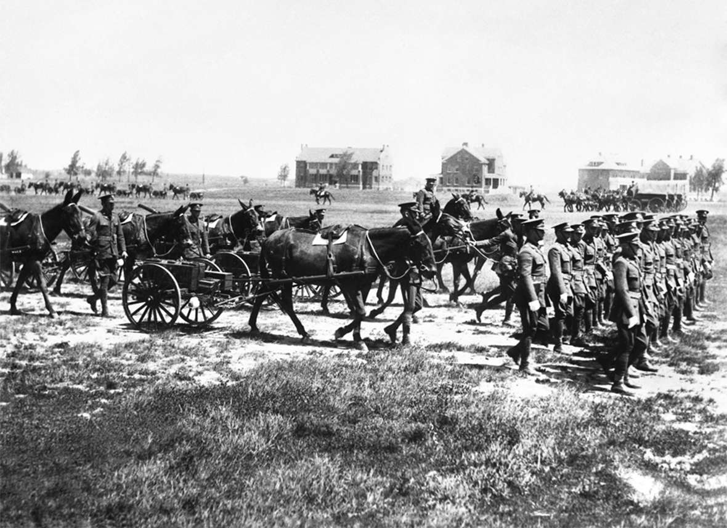
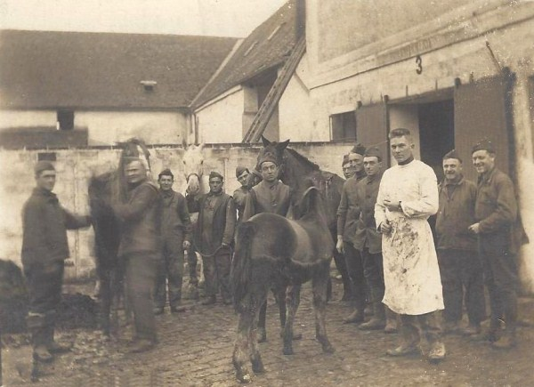
INTER-WAR
The mechanization of the Army meant that fewer men were needed to care for the declining number of horses. The Royal Army Veterinary Corps (RAVC) was reduced in size in the 1920s and the Army Veterinary School, established at Aldershot in 1880, was closed.

Slide 8
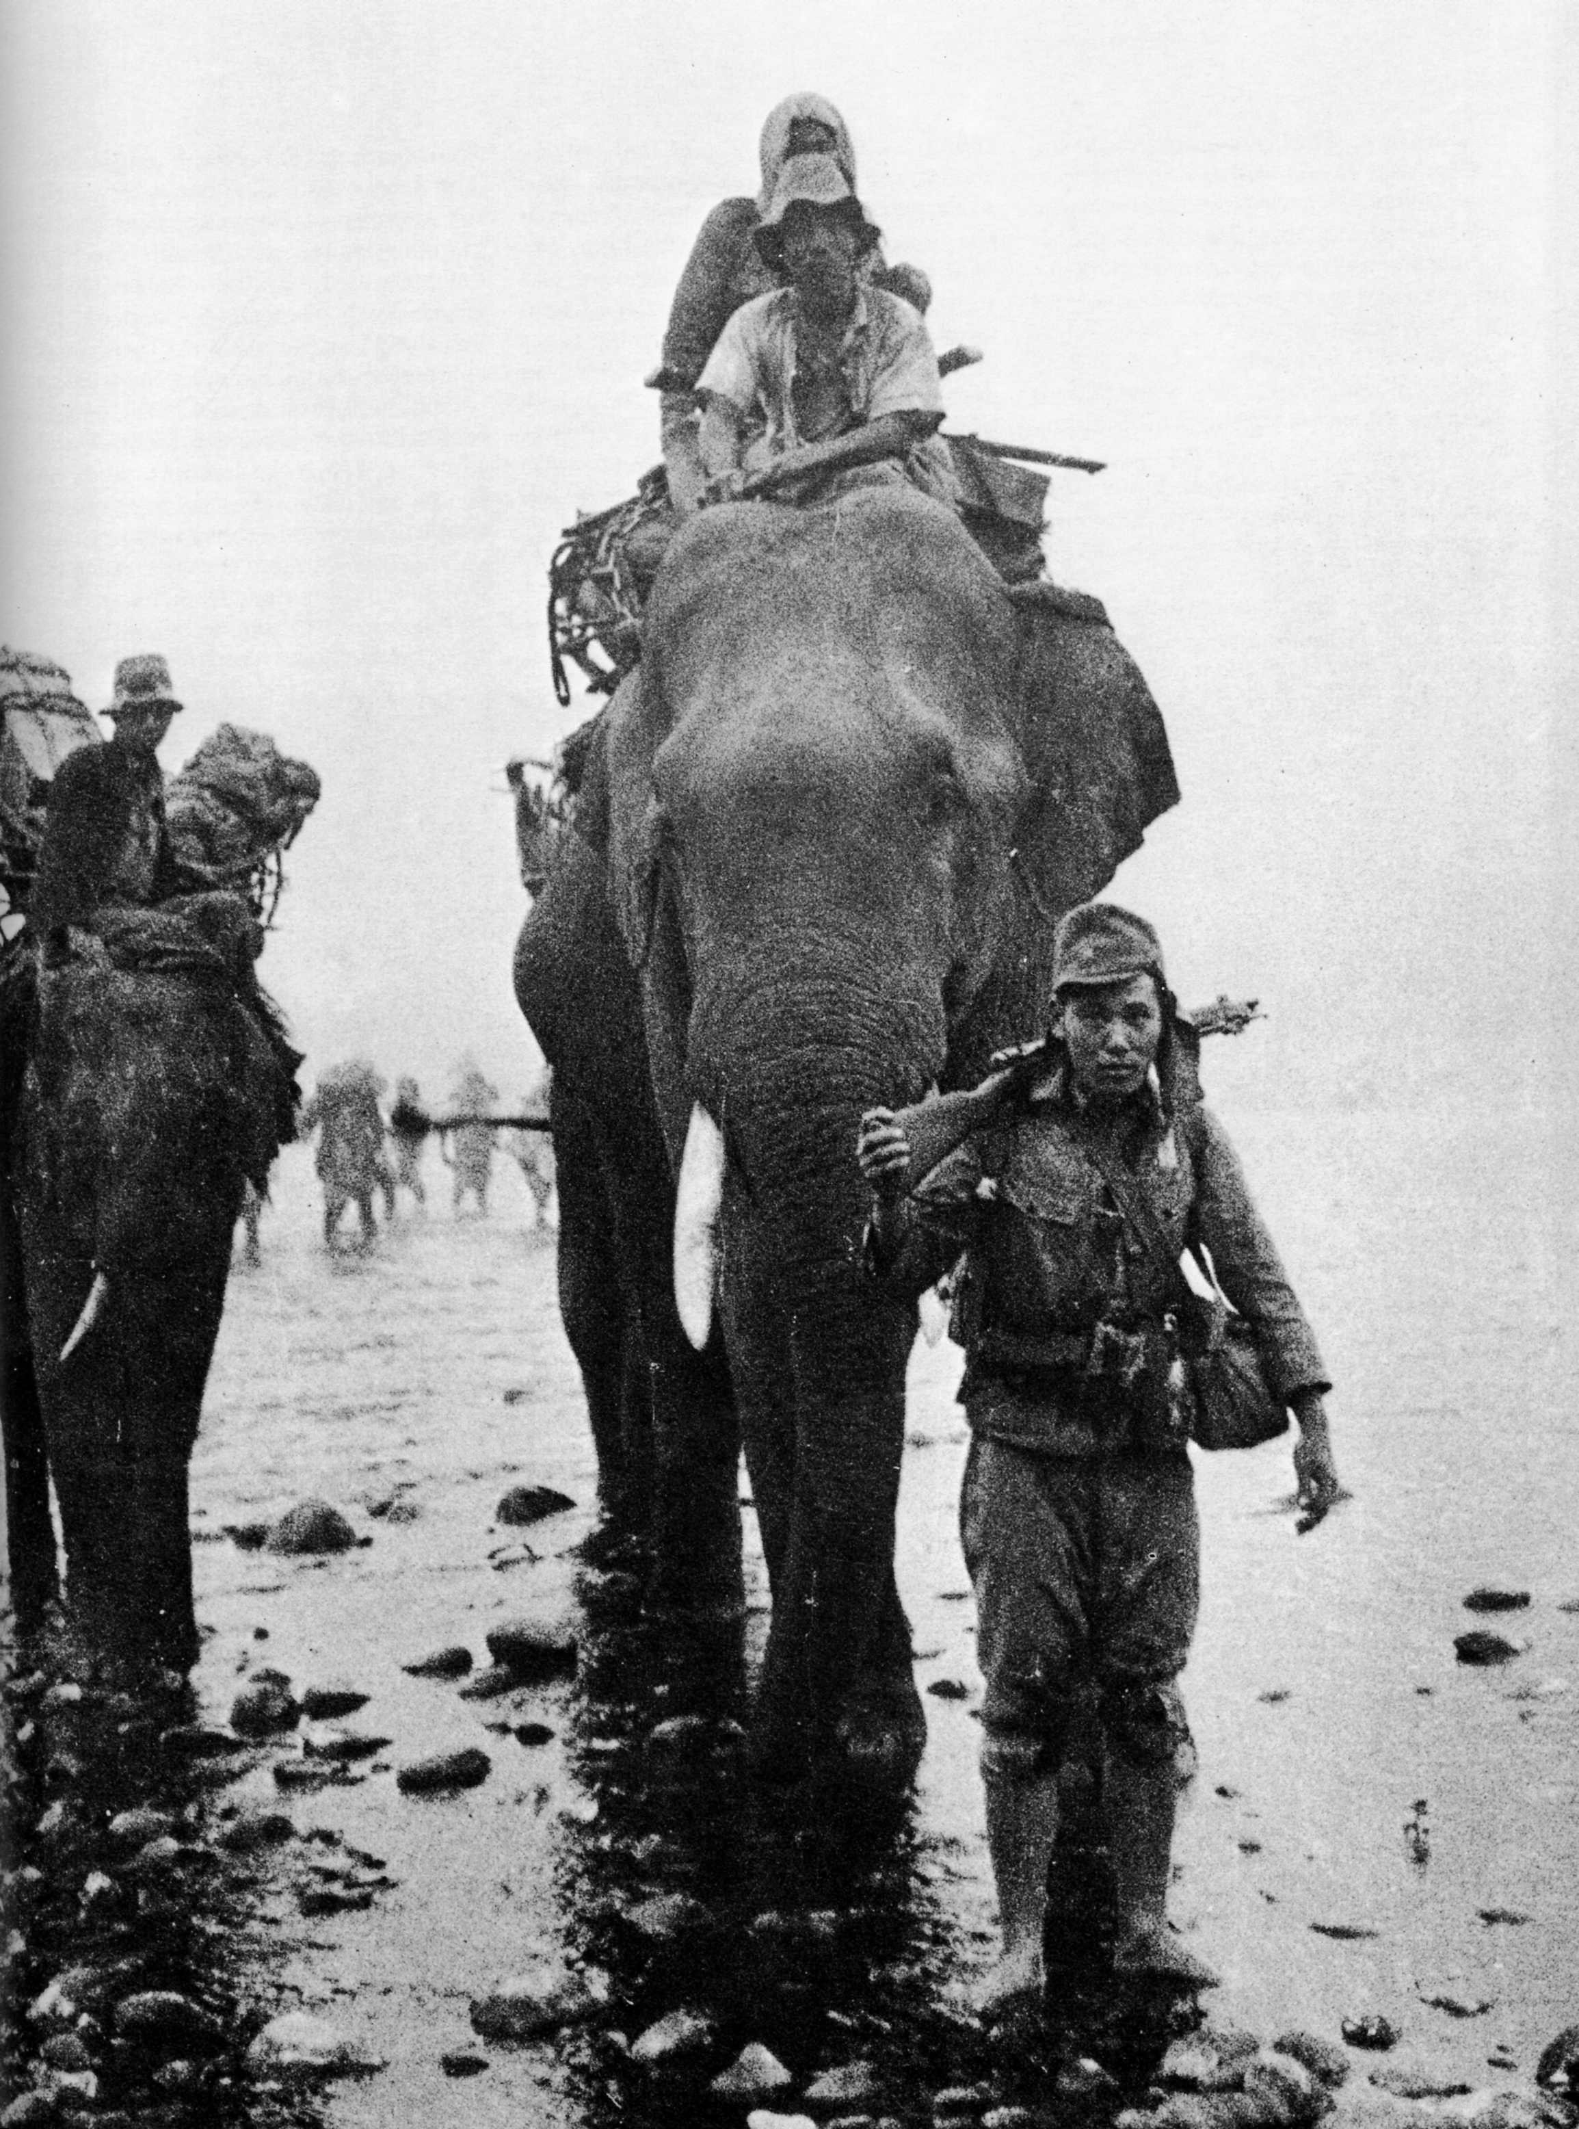
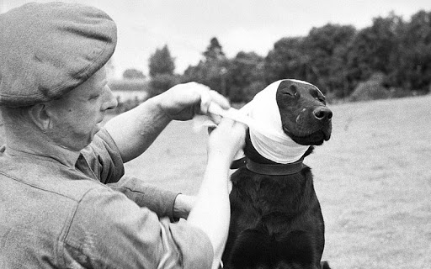
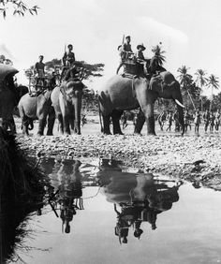
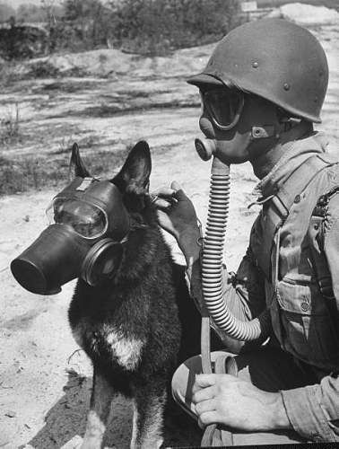
SECOND WORLD WAR
During the Second World War (1939-45), members of the corps served in Palestine, Syria, East Africa, Greece, Italy and Burma. The animals they cared for ranged from horses and mules, in Europe and the Middle East, to elephants and bullocks, in the Far East.

Slide 9
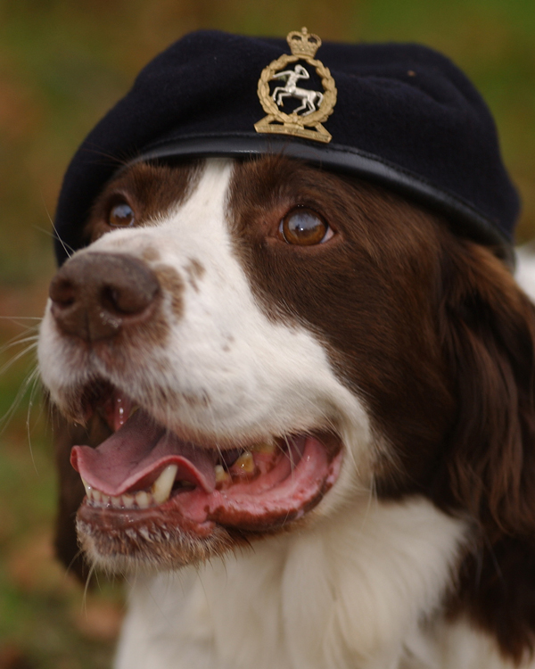
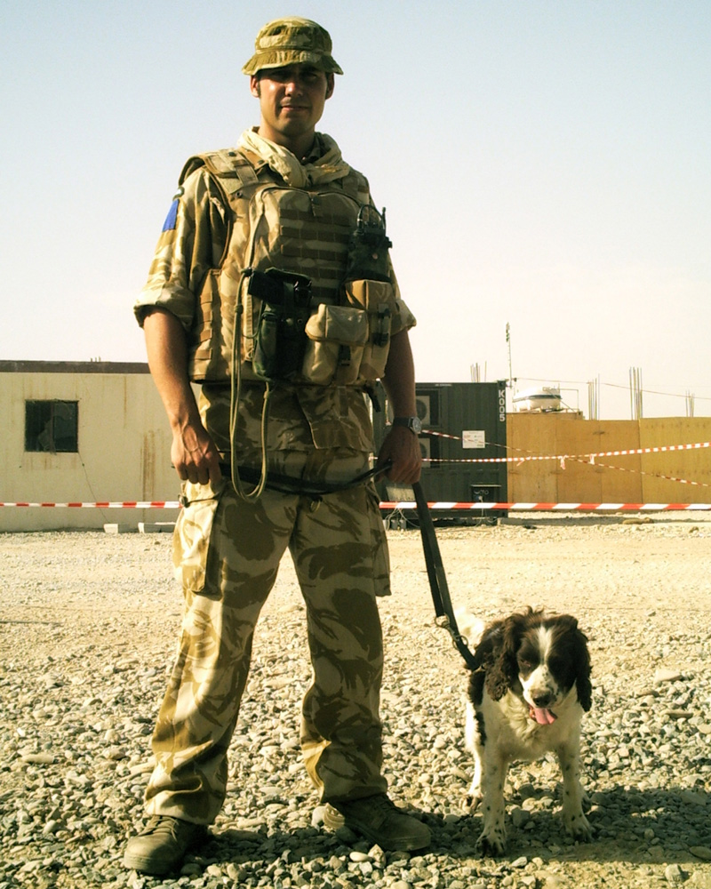
POST-WAR
Since 1945, staff numbers have not dropped dramatically. The use of dogs in such varied locations as Malaya (1948-60), Northern Ireland (1969-2007), Bosnia (1992-95) and most recently in Iraq (2003-11) and Afghanistan (2001-14) has seen the care of these animals become an increasing priority.

Slide 10
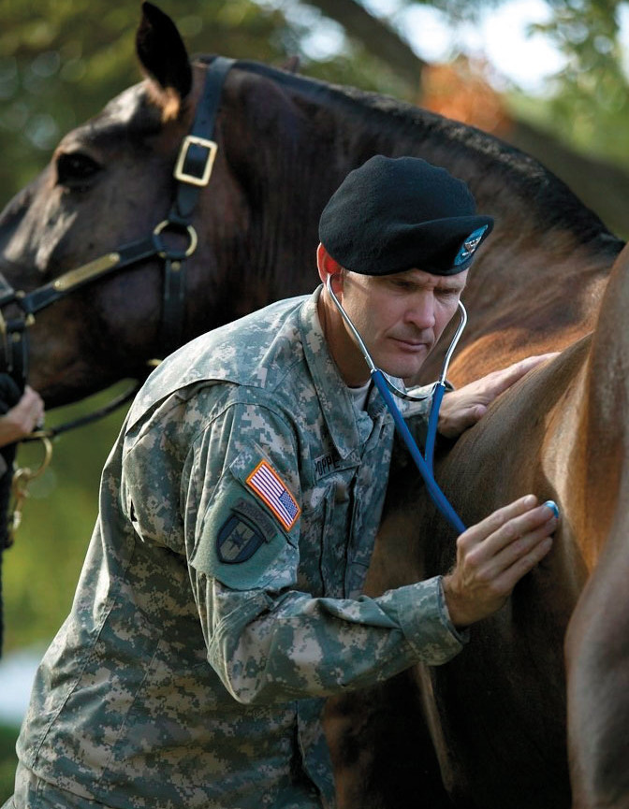
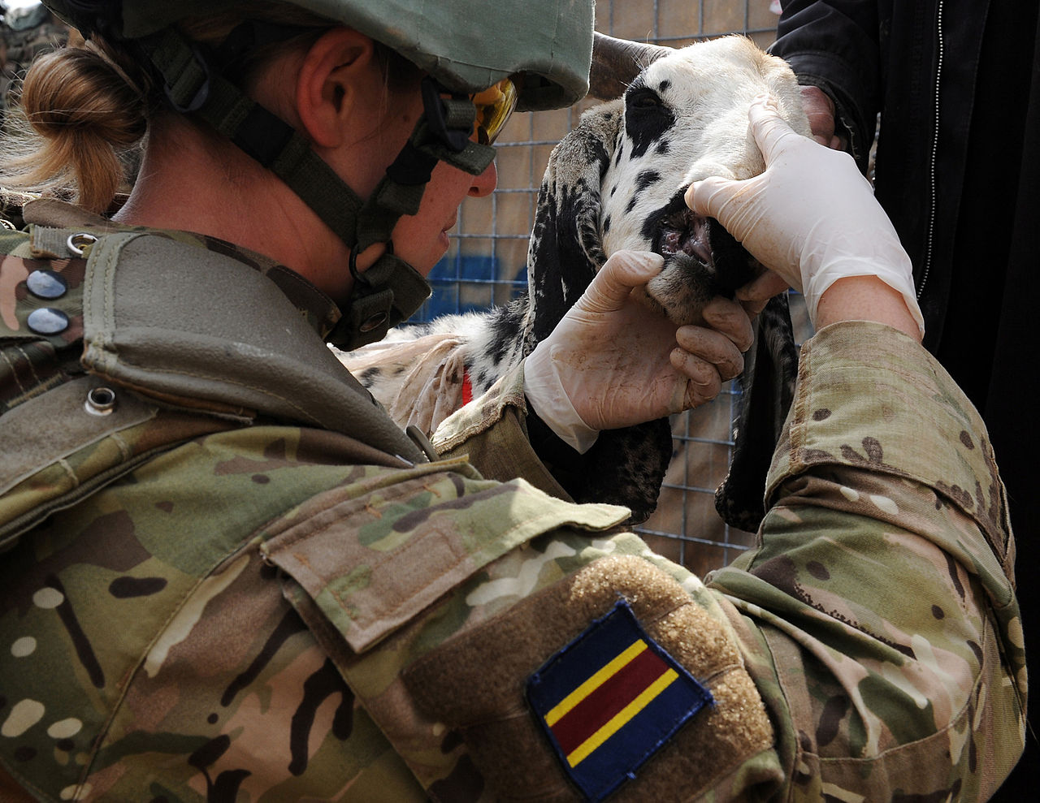
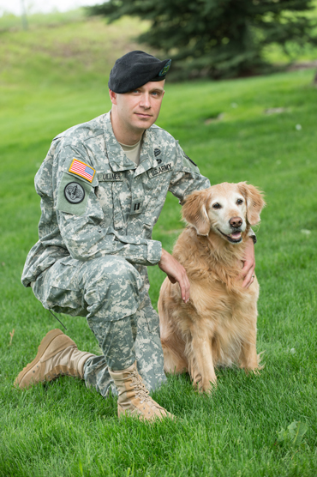
TODAY
Many dogs serve with the RAVC's 1st Military Working Dog Regiment, which was set up in 2010. Its animals and their handlers locate IEDs, help clear routes, buildings and vehicles, and guard and patrol key installations to assist and enhance security.

Slide 11
THANKS FOR YOUR ATTENTION

