Slide 1
Employment conditions and contracts:
Ukraine and Europe practice

Slide 2
Ways of legal registration of hiring employees in Ukraine
Labour Code
Civil Code
Employment agreement
Employment contract
Civil law contract
may be concluded for an indefinite period of time. The written forms of agreements are not essential to bind a business.
is executed for a certain term and applicable for the certain termed employees. Also, the contract is always made in the written form.
is an independent-work contract or service agreement. Made in written form

Slide 3
Main types of labor agreements in Ukraine
Labor agreement for indefinite term
This type of agreement is the most common in Ukraine and by default, employees are hired for an indefinite term. The indefinite term labor agreement is regulated by the labor law of Ukraine, internal rules of a Company and a collective agreement.
Fixed-term labor agreement
The main difference between fix-term labor agreement and the first one is that the Parties limit employment term to a specific period of time. Note that Ukrainian law provides certain limits regarding repeated concluding fixed-term labor agreements
Seasonal work
If you need to hire people on seasonal base for the specific scope of work, Ukrainian law allows toconclude a special type of agreement for this purpose with indication of type and scope of work as well as term of employment.

Slide 4
Labor (employment) contract’s elements
• The rights, obligations, and liabilities of the parties, including the terms of
their material liability;
• The duration of the contract;
• The remuneration and organization of an employee’s labor;
• The grounds for termination, including early termination.

Slide 5
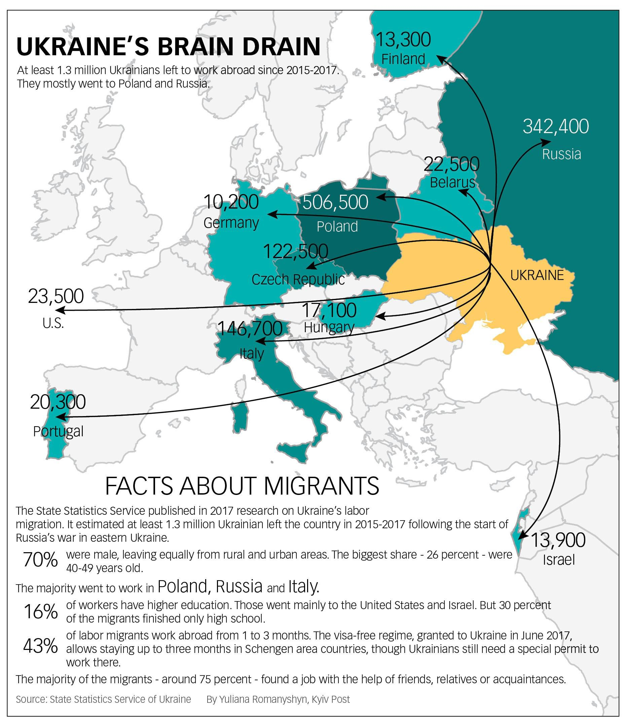
Geography of employees emigration

Slide 6
Pre-hire checks
Poland
Required
Italy
Required
Permissible
Czech Republic
Required
Ukraine
Immigration compliance.
Criminal and credit reference checks, reference and education checks.
Required
Immigration compliance, valid ID and, except for first-time employment, their labor book, documents confirming education, health status, etc.
Permissible
An employer cannot require an additional documents/information, not specifically required by law, as a condition precedent to the employment.
Immigration compliance. Entry health check.
Permissible
Reference and education , criminal records and credit reference checks , information concerning pregnancy, financial and family affairs of the applicant.
Immigration compliance, a statutory list of so-called regulated activities, initial medical examinations
Permissible
Certain limited personal data, information on criminal convictions

Slide 7
Immigration
Poland
Free movement of employees from all countries of the EU and EEA as well as Switzerland. In general, citizens of other countries require a work permit and a work visa (or other residence permit).
Italy
Depending on the duration and reason of the immigration, work permits are required for anyone who is not an Italian national or EU citizen.
Czech Republic
Nationals of the EU, EEA and Switzerland enjoy the right to work in the Czech Republic. Nationals of any other country must typically obtain a residence/work permit. Employers employing non-EU/EEA/Swiss employees must notify the relevant labor authority and comply with the given procedure.
Ukraine
Employers must generally obtain work permits to hire foreign individuals. There are exceptions for special categories of individuals who may be hired without a work permit and special categories of employers that can hire foreigners without a work permit. A foreign employee should obtain a temporary residency permit to stay in Ukraine on a long-term basis.

Slide 8
Hiring options
Employee
Poland
Employment relationship under an open-ended employment contract, fixed-term employment contract and employment contract for a probationary period; part-time and full-time. It is unlawful to discriminate against employees on the basis of their working part-time or working under a fixed-term contract.
Italy
Indefinite, fixed-term, full-time or part-time. Part-time and fixed-term employees have the right not to be discriminated against due to their status. Additional engagement options are available, such as on-call employment, job sharing or apprenticeships.
Czech Republic
Indefinite, fixed-term, full-time or part-time. Part-time and fixed-term employees have the right not to be discriminated against on the basis of such status.
Ukraine
Employment can be for part-time or full-time employment and for different durations:
• indefinite (most commonly used)
• fixed-term or when an employee insists on the fixed-term employment agreement due to personal reasons)
• until completion of an agreed-upon project, when it is impossible to determine the project's duration.

Slide 9
Hiring options
Independent contractor
Poland
A person engaged under civil law agreement is not an employee in the meaning of the Polish labor law. Nevertheless, a contractor will be deemed to be an employee if an individual is engaged under the other party's supervision and subject to control of the place, hours of work and the manner of performance.
Italy
Independent contractors can be engaged directly by the company, provided that certain requirements are met. Freelancers can also be engaged on an open-term basis, but there is increased misclassification exposure.
Czech Republic
Independent contractors can be engaged. Such an engagement may be subject to the risk of exposure for misclassification (so-called "illegal work").
Ukraine
The use of independent contractors is permitted, but contractors can be reclassified as employees by the relevant authorities if misclassified. Penalties may be imposed in case of reclassification

Slide 10
Hiring options
Agency worker
Poland
Temporary work is widely used for short periods of employment, in order to cover the absence of permanent employees or to perform seasonal works. Over a period of 36 successive months, a single user-employer may use the services of an individual provided by a work agency for a total period not exceeding 18 months.
Italy
Agency workers are common. Agency workers have the right to equal treatment to employees in relation to pay and other benefits terms
Czech Republic
Agency employees have a right to treatment equal to other employees in relation to pay and other employment terms.
Ukraine
Engaging agency workers is common for employers that need temporary employees from time to time or that cannot hire the employees directly due to global headcount reasons.

Slide 11
Employment contracts
Contract
Poland
An employment contract must be concluded in writing; Must include:
Italy
Written employment agreements are required according to national collective bargaining agreements. Certain clauses are not valid if they are not put in writing (eg, probationary clause, non-compete covenant).
Czech Republic
Obligatory written employment contract. It must include
Ukraine
An employment agreement must be made in writing and specify the employee's name and the terms and conditions of employment, including position, duties, employment commencement date, place of work, working time, probationary period, wages, etc.
• Type of work
• Place of performance of work
• Date of commencement of work
• The parties to the employment contract
• The type of employment contract
• The date of concluding the employment contract
• The conditions of work and pay.

Slide 12
Employment contracts
Probationary periods
Poland
An employment contract for a probationary period is a separate employment contract. A probationary period cannot be longer than three months.
Italy
Permissible, with statutory limits, depending on the category and level of the employee (maximum duration is 6 months for executives − the so-called dirigenti).
Czech Republic
Permissible – maximum 3 months for regular employees, maximum 6 months for so-called managerial employees.
Ukraine
Generally, probationary periods may not exceed 3 months (they can be 6 months in certain circumstances, subject to the applicable trade union's consent). The probationary period must be reflected in the employment agreement.

Slide 13
Thank you for attention!

