Slide 1
Why do people commit a crime?
Who helps the guilty, shares the crime.

Slide 2
Crime is a deliberate act that causes physical or psychological harm, damage to or loss of property, and is against the law.
Criminology is the study of crime and criminals by specialists called criminologists. Criminologists study what causes crime and how it might be prevented.

Slide 3
Reasons why people commit crimes
There’s no escape from the fact; the crime rate continues to increase every single day despite the governments taking so many precautionary measures. There are many reasons why people commit crimes: - Poverty - Peer Pressure - Drugs - Religion - The Society - Unemployment - Deprivation - Unfair judicial system

Slide 4
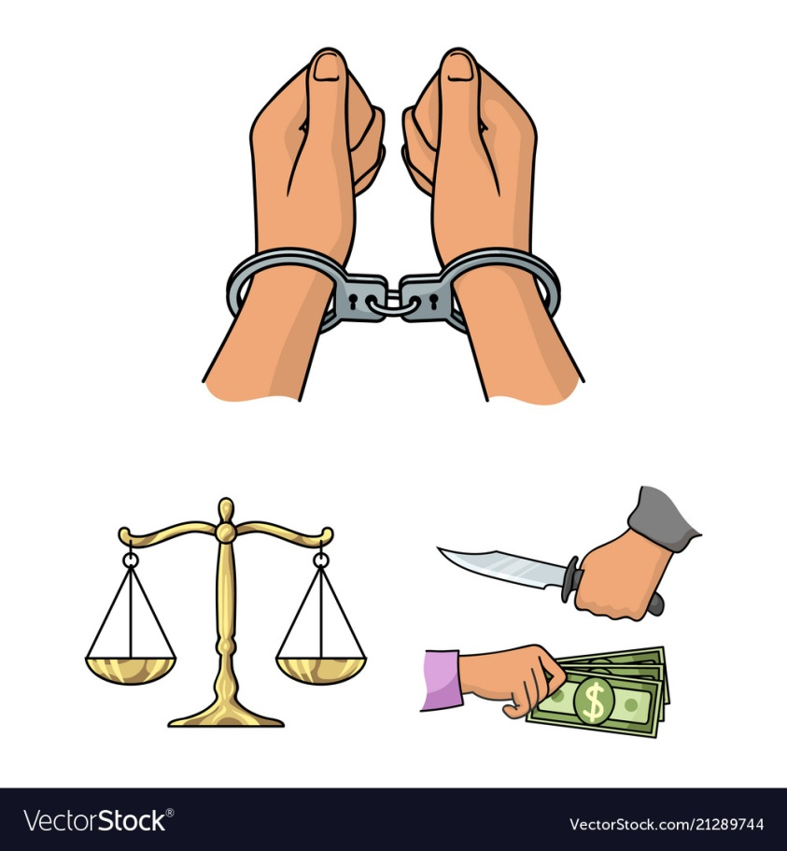
Reasons for committing a crime include greed, anger, jealously, revenge, or pride. Some people decide to commit a crime and carefully plan everything in advance to increase gain and decrease risk. These people are making choices about their behavior; some even consider a life of crime better than a regular job—believing crime brings in greater rewards, admiration, and excitement—at least until they are caught. Others get an adrenaline rush when successfully carrying out a dangerous crime. Others commit crimes on impulse, out of rage or fear.

Slide 5
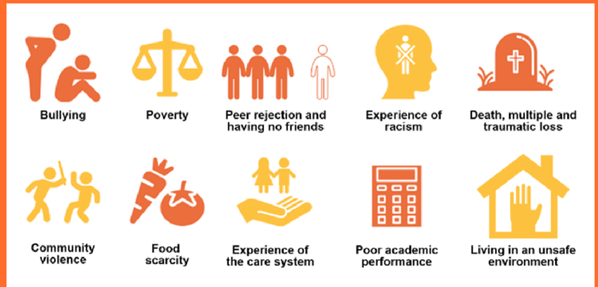
Factors that Influence Criminal Behavior
Criminology has uncovered a number of factors that can lead someone toward crime.
Biological Risk Factors
Adverse Childhood Experiences
Negative Social Environment
Substance Abuse

Slide 6
Thank you for attention!!!

