Slide 1
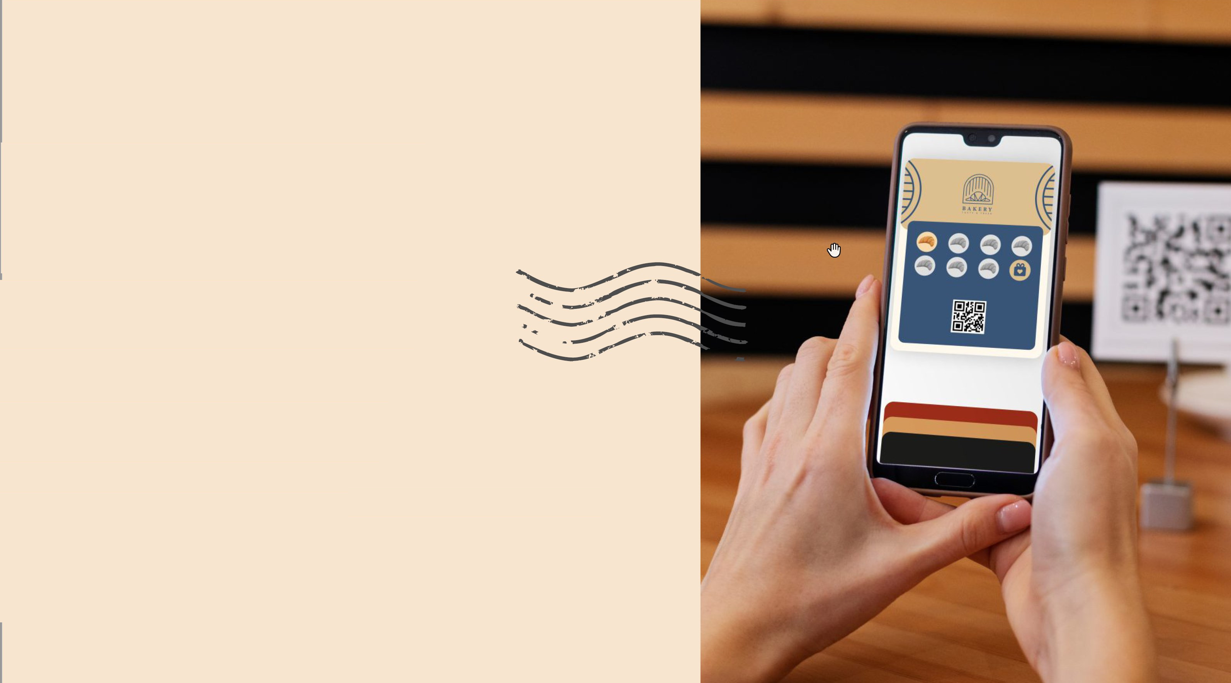

The Solution
Wallet-Native
«Invisible" Loyalty
• .
15-Second Join:
Scan QR Add to Wallet.
No apps. No passwords
Zero Workload:
Unattended Kiosk Mode for
self-service rewards.
O-Level Integration:
Works alongside any POS
Live in 5 minutes.

Slide 2

Competitive Differentiation
Why We Win: The 7stamp Moat
Feature | 7stamp | Loopy Loyalty | CandyBar | PassKit
Experience | Native Wallet | Wallet | Web-App | Developer API
Join Speed | 15 Seconds | 30 Seconds | 30 Seconds | 1 Minute+
Staff Work | Zero (Kiosk) | Moderate | High (Manual) | Moderate
Integration | 0-Level | Low | Low | High (API)
Best For | Busy SMBs | Digital Mktg | Small Cafes | Enterprise

