Slide 1
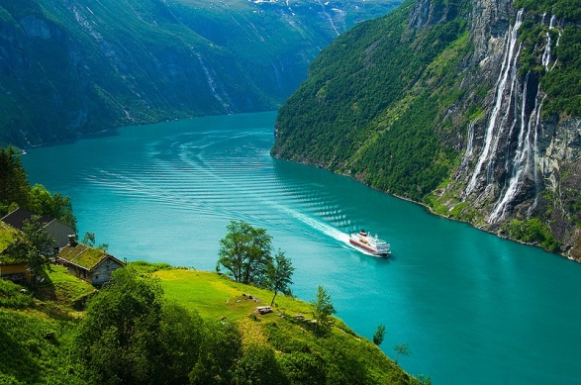
Macro-environment in Norway

Slide 2
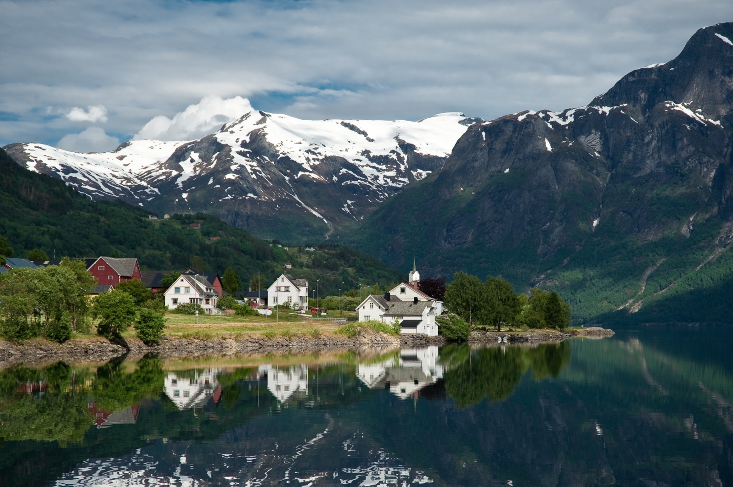
Norway, country of northern Europe that occupies the western half of the Scandinavian peninsula. Nearly half of the inhabitants of the country live in the far south, in the region around Oslo, the capital. About two-thirds of Norway is mountainous, and off its much-indented coastline lie, carved by deep glacial fjords, some 50,000 islands.

Slide 3
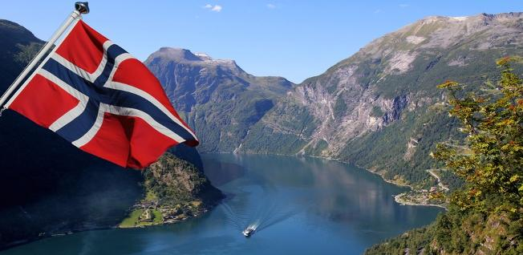
Norway is a politically stable, modern and highly developed country with open and mixed economy.

Slide 4

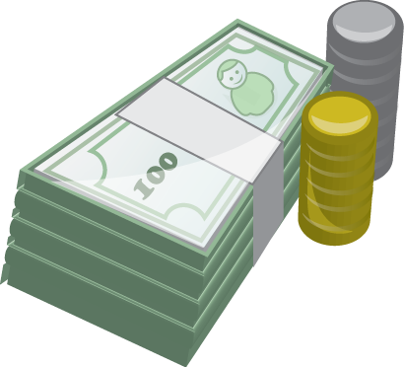
Easy to do business
According to the publication Ease of Doing Business 2015, Norway ranks 6th among the 189 countries listed.
Strong economy
The Norwegian State owns the world’s biggest investment fund, The Government Pension Fund Global, with a value getting close to 900 billion USD (Summer 2015
).

Slide 5

Some world-class industries
Norway has developed some world-class industries. these are oil and gas, maritime and the marin (seafood) sector.
Country of choice for clinical trials
Hospitals, clinics and research institutions have invested resources into designate clinical trial units.

Slide 6



Productive and competitive
According to the World Competitiveness Scoreboard in 2015, Norway was the 7th most competitive country in the world.
Rich in resources
The country is rich in natural resources, including oil and gas, hydropower, fish, forests and some minerals.

Slide 7
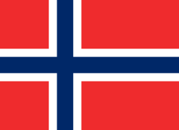
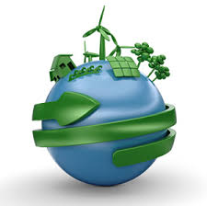
Economy system of Norway
Since the end of World War I, Norway has had to seek opportunities for income abroad. The exploitation since the late 1970s of major new oil reserves in the North Sea has had considerable impact on the Norwegian economy.
In the early 1980s, the nation's economy became increasingly dependent on oil revenues, which stimulated domestic consumption and, at the same time, increased costs and prices, thus hampering the competitiveness of Norway's other export industries. The drastic decline of oil prices in 1986 caused the value of Norway's exports to fall by about 20%.
Norway has a mixed economy with the government owning over 50% of domestic businesses and employing 35% of the workforce. State ownership is most dominant in the oil and mining sectors. At considerable expense, the government provides subsidies for industry, agriculture, and outlying regions. About half of the total goes to agriculture.

Slide 8
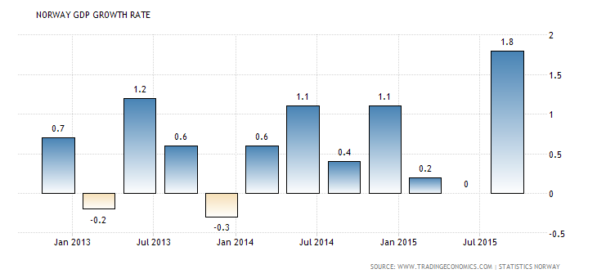
Norway GDP Growth Rate

Slide 9
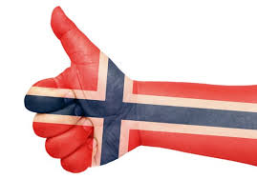
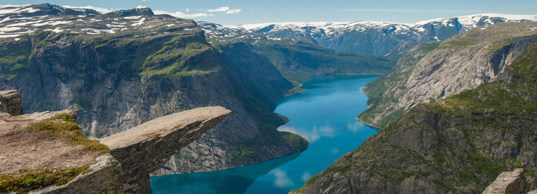
Ecology in Norway
Norway is often held up as an example to the rest of the ecotourism industry, and prides itself on its green credentials.
By taking a tour through Norway, you can enjoy the dual satisfaction of a wilderness experience.
Activities such as hiking, kayaking and skiing are some of the most popular things to do in the fjords. Heading into the north you can visit Lofoten. From mid-October to mid-January, you can embark on a nature safari to try and catch a glimpse of sea eagles, seals and killer whales.
Staying active and green is a hallmark of a holiday in Lofoten and Norway. Golf, hiking, biking, rafting and kayaking all feature highly on the agenda. Other activities from Lofoten include seeing the northern lights, fishing and the Lofotr Viking Museum.

Slide 10
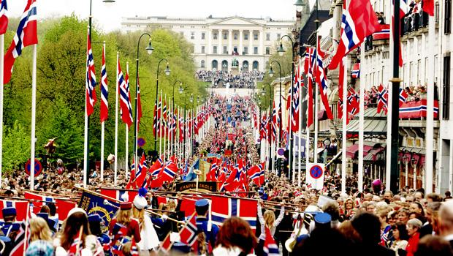
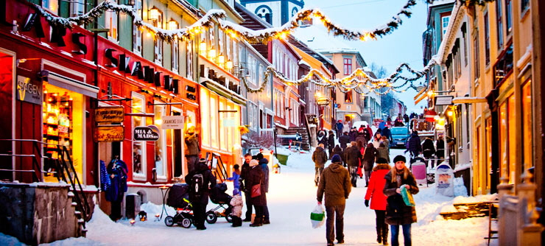
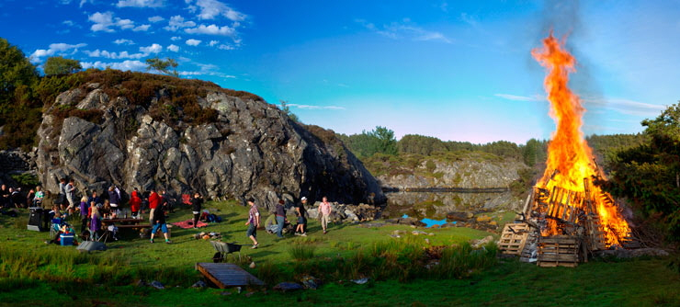
Social life in Norway
On festive occasions folk costumes are worn and folk singing is performed—especially on Constitution Day. Popular festivals include Midsummer’s Eve, St. Olaf’s Day, and Christmas

Slide 11
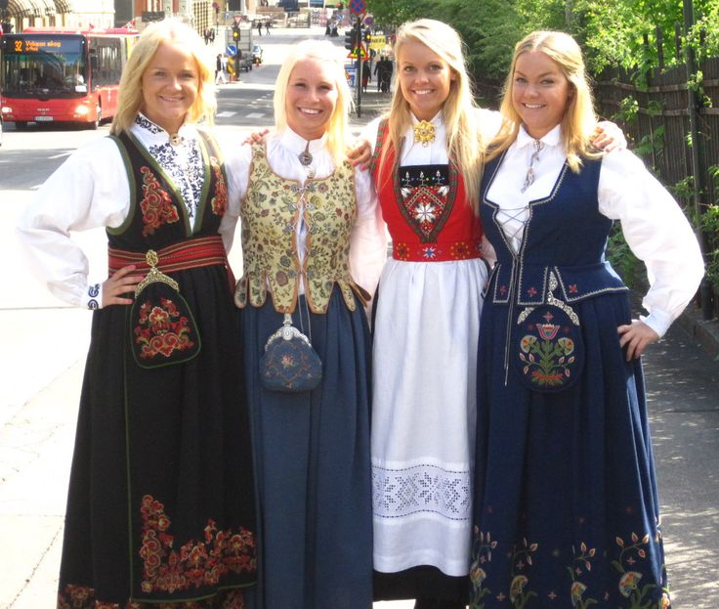
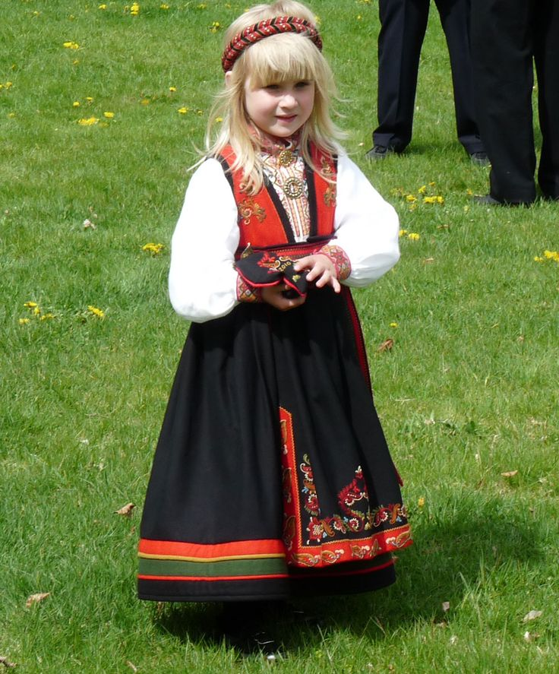
The national costume, is characterized by double-shuttle woven wool skirts or dresses for women, accompanied by jackets with scarves.

Slide 12
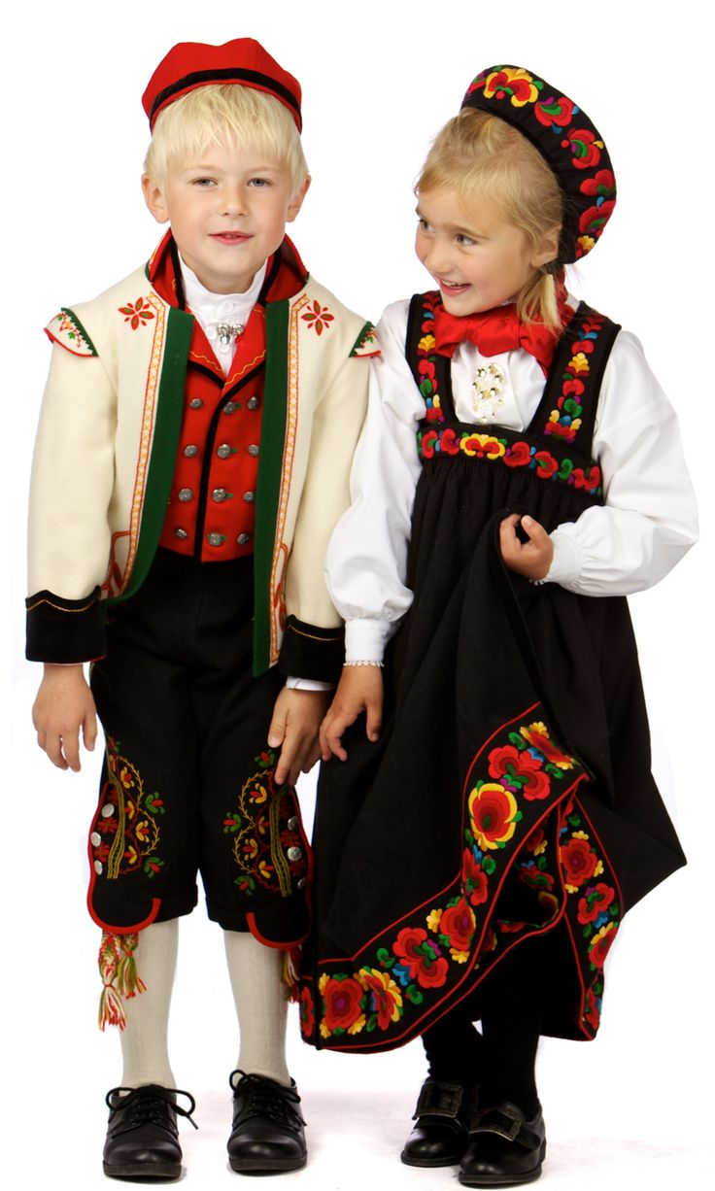
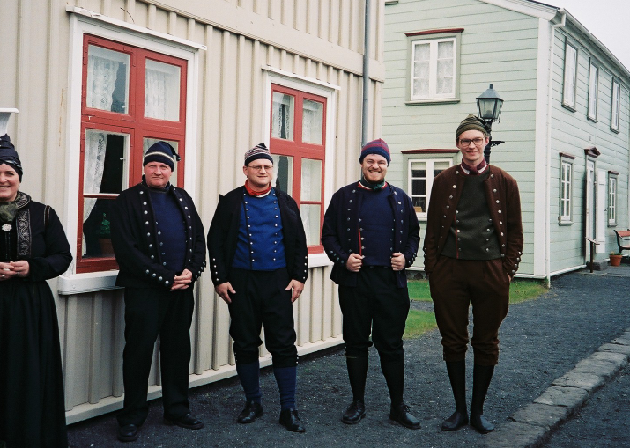
The costume for men generally consists of a three-piece suit that also is very colourful and heavily embroidered.

Slide 13
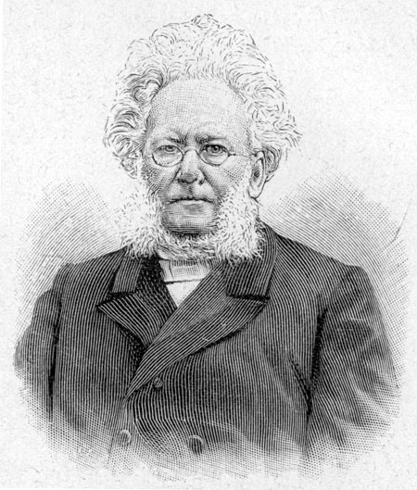
Cultural life
Henrik Ibsen (1828 - 1906), is probably one of the three most respected dramatists in the world, and is performed almost as much as Shakespeare around the world.

Slide 14
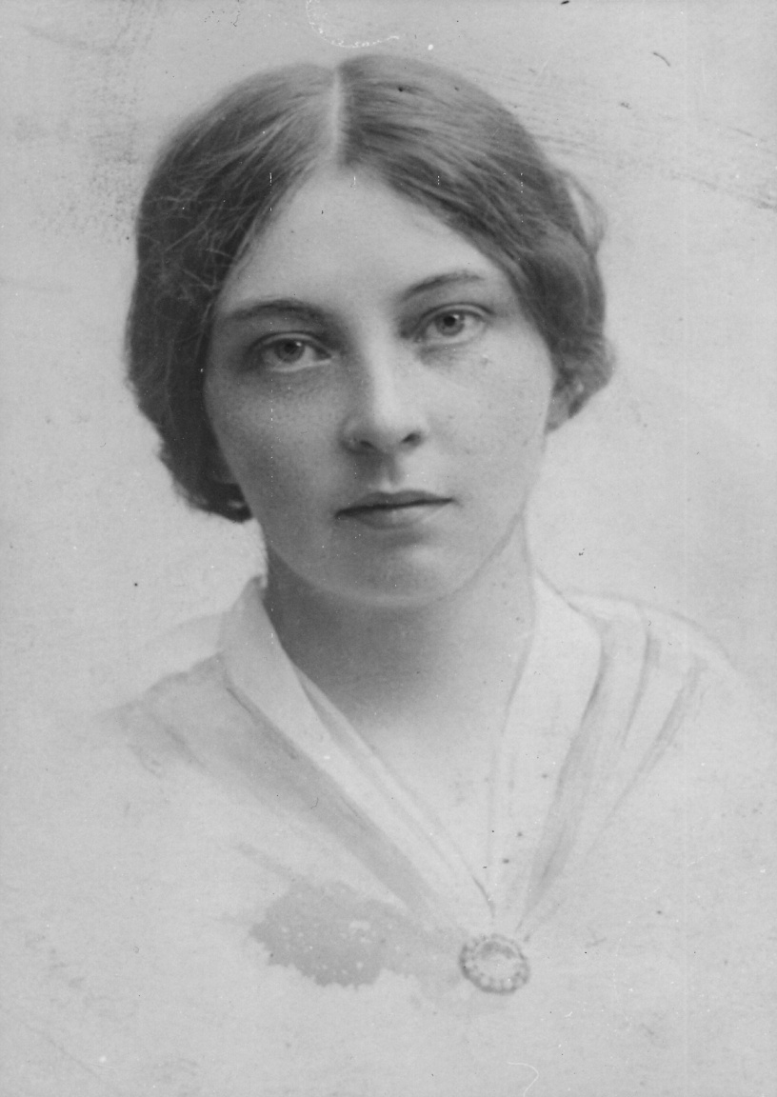
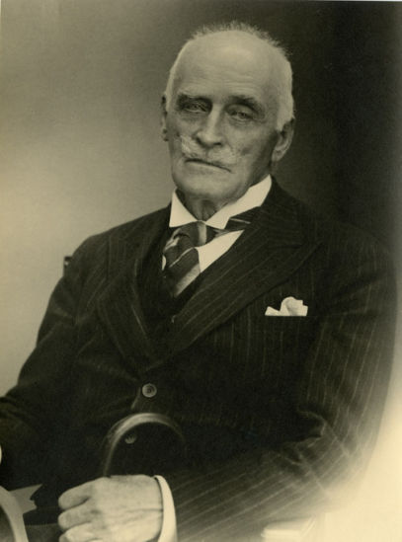
Norwegian authors have received the Nobel Prize for Literature: Sigrid Undset (1882-1949) in 1928, Knut Hamsun (1859-1952) in 1920.

Slide 15
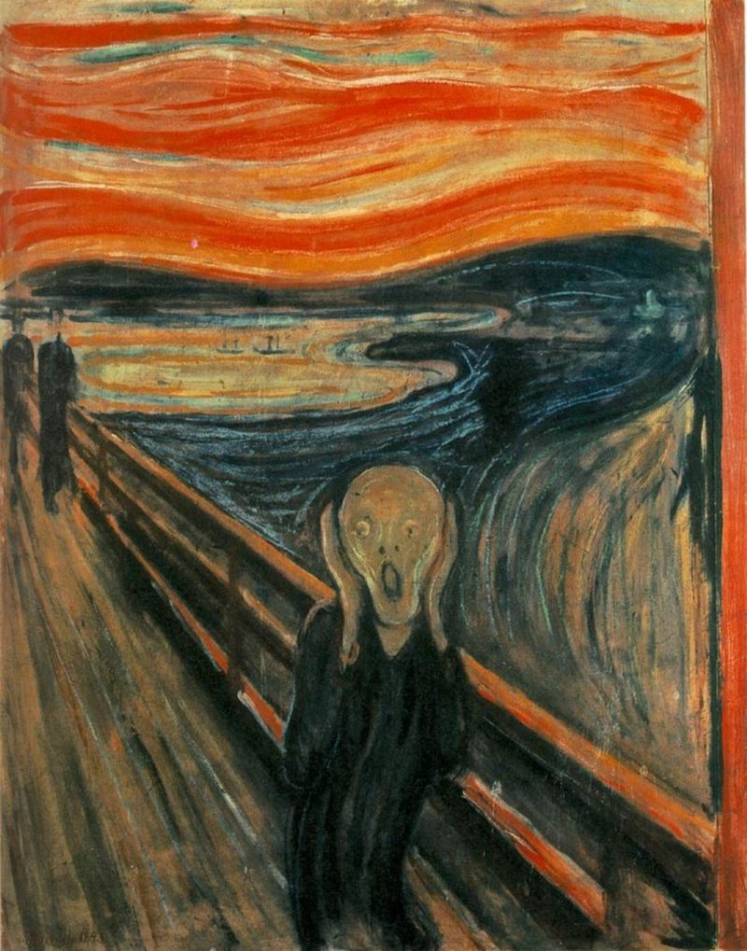
The Norwegian painter Edvard Munch (1863-1944) was one of the pioneers of the expressionist movement in modern painting.
His endlessly-reproduced Scream, an unnerving expressionist exploration of existential angst.

Slide 16
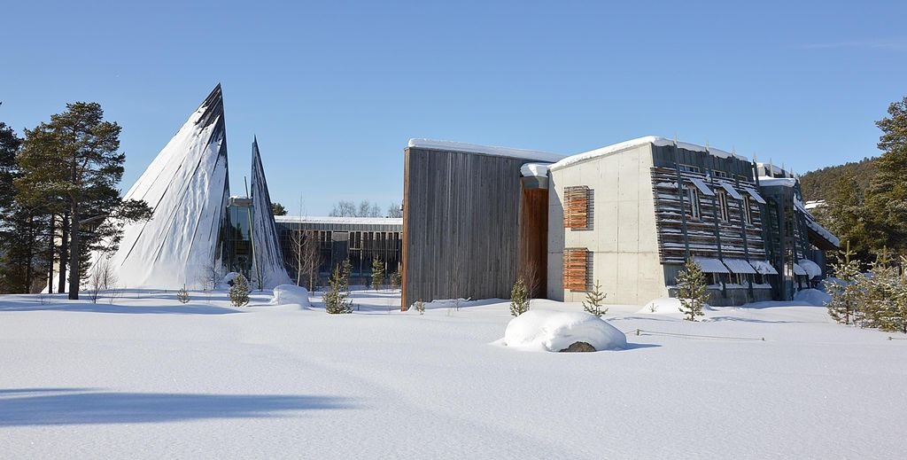
One of the most striking modern buildings in Norway is the Sami Parliment.

Slide 17

Thank you for attention!

