Slide 1

CONCEPT OF "WATER" IN ENGLISH LITERATURE OF 20-21 CENTURIES

Slide 2

The object of this thesis is linguistic and cultural concept of "water" in the national linguistic picture of the world of the English people.
The subject of the work is the characteristics of the concept of "water" in English linguistics.

Slide 3
The purpose of the work is a comprehensive linguistic and cultural study of the concept of "water" in the English language consciousness.
to evaluate and describe the conceptual, figurative, value characteristics of the concept of "water" in English linguistics
1
to explore the meaning of the concept of "water" in the phraseology of the English language
2
3
to explore the national and cultural features of the concept of "water"
3

Slide 4
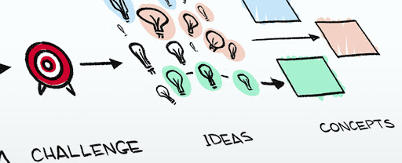
"Concept" is a multidimensional mental formation that reflects the cultural and historical experience of the people and the peculiarities of its worldview and has a verbal expression. We can differentiate typical concepts for English linguistic culture, in addition to the concept under study, and their expression in common paremias.

Slide 5
freedom | Where there is a doubt there is a freedom (Де є місце сумнівам — там є свобода).
justice | To give someone elbow room (вільний простір)
happiness | The happiness in your pocket, don't spend it all. (Краще синиця у руках, аніж журавель у небі)
love | Old love and wood will burn as soon as they get the chance. (Старе кохання, як дерево – згорить за першої нагоди).
friendship | Friendship is like money, easier made than kept. (Дружба, як гроші, легко заробити, аніж зберегти).

Slide 6
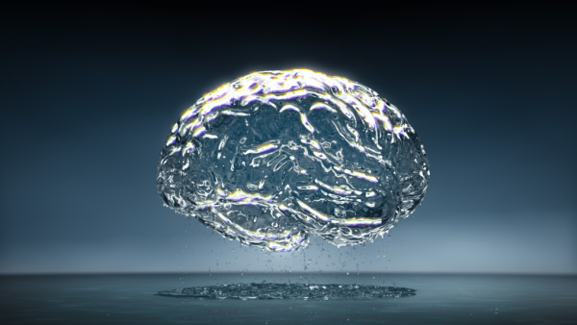
The concept of "water" conveys the specifics of the national and cultural worldview of the English ethnic group, captures the national identity and reflects the characteristics of the people as a whole ethnic community.

Slide 7
Paremias accumulate, store, broadcast information about the history, culture, customs, life, folk experience of native English speakers | It is good fishing in troubled waters; It’s no safe wading in an unknown water; Still waters have deep bottoms; Carry (draw) water in a sieve.
Some paremias has philosophical nature | Courtesy is like oil on troubled waters; People in hell want ice water, too; A great ship asks for deep water.
The most common members of the thematic groups: "reservoirs and their parts" | Cross the stream where it is shallowest . It is easy to swim if another holds up your chin.

Slide 8
Example 1.Well, about this time he was found in the river drownded, about twelve mile above town, so people said. They judged it was him, anyway; said this drownded man was just his size, and was ragged, and had uncommon long hair, which was all like pap; but they couldn’t make nothing out of the face, because it had been in the water so long it warn’t much like a face at all. They said he was floating on his back in the water.
Example 2. I sung out for Jim about a dozen times, but I didn’t get any answer; so I grabbed a plank that touched me while I was “treading water”, and struck out for shore, shoving it ahead of me
Example 3. Before he was t’other side of the river I was out of the hole; him and his raft was just a speck on the water away off yonder (51, с. 34). I got a good piece below the house and then dumped him into the river (51, с. 35). Well, I seemed to be in the open river again by and by, but I couldn’t hear no sign of a whoop nowheres (51, с. 86).

Slide 9
The concept of «water» in the near periphery. W. Wordsworth "Prelude" | She was an elfin pinnace; lustily I dipped my oars into the silent lake, And, as I rose upon the stroke, my boat Went heaving through the water like a swan
The concept of «water» in the near periphery. Samuel Coleridge | Day after day, day after day, We stuck, nor breath nor motion; As idle as a painted ship Upon a painted ocean. Water, water, everywhere, And all the boards did shrink; Water, water, everywhere, Nor any drop to drink

Slide 10
The concept of «water» in the far periphery
Examples from the work of W. Wordsworth | It was a close, warm, breezeless summer night, Wan, dull, and glaring, with a dripping fog. And deals it out, their regular nourishment Strewn on the frozen snow. Incessant rain was falling, or the frost Raged bitterly, with keen and silent tooth.

Slide 11



Conclusion
The concept of "water enshrined national and unique ideas and knowledge about water in all its manifestations and properties.
The concept of "water" in literary texts contains the national specifics of understanding the image of water, and it manifests the ancient mythological idea of ​​the British about the activity of nature.
In some works, the authors glorify water and make it a symbol of peace and harmony (Wordsworth), while others see it as a mystery and a terrible element (Coleridge).

Slide 12


