Slide 1
Business meeting
IN WARSAW

Slide 2


warsaw
Warsaw, the capital of the Mazovia region and the nation(since 1918), with its communication channel to the whole world via The Chopin International Airport, is one of the fastest developing cities of the European Union. The leading CEE financial centre hosts the headquarters of many banks and companies and offers great business opportunities. Warsaw has an extraordinarily dynamic stock exchange, where both central-eastern and western companies list their shares. It is also an immense scientific and academic centre, a furnace of talents in many areas of knowledge – from humanistic sciences to economy and from management to information technology (about 370.000 students).
Mazovia is one of the most dynamically developing regions in Poland and in Central-Eastern Europe. It is an attractive area for economic investment, not only due to its cross road geographical placement, but as a result of Mazovia’s role in the national economy.The region produces as much as 20% of the national income and attracts 30% of all foreign investments. Its present industrial potential together with well developed telecommunication infrastructure, agricultural capacity and the most productive human resources in the country, create an unlimited perspective of fast returns on investments.

Slide 3
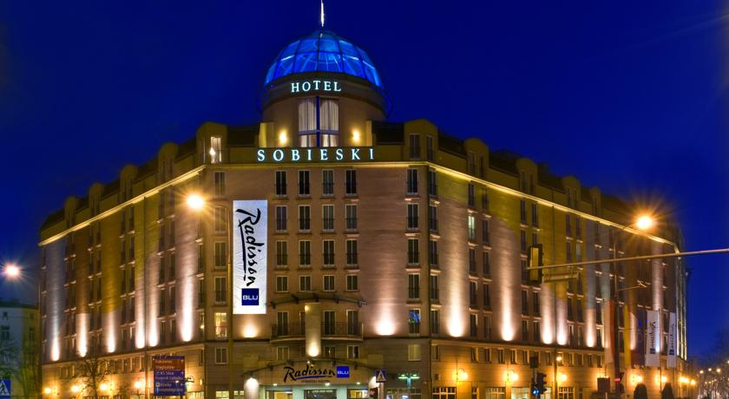
Date: 18th May – 20th May
Location: Radisson Blu Sobieski Hotel, Warsaw
Located in the business district near the heart of Warsaw, this hotel lies within walking distance of the railway station and only 6 kilometers from the airport. Guests enjoy easy access to many corporate offices, the EXPO XXI conference center and attractions like the Fryderyk Chopin Museum. Each of the 435 rooms and suites boasts amenities such as a mini bar, satellite channels and a convenient work desk. The Trylogia Restaurant serves authentic Polish cuisine, while the elegant Marysieńka hosts Super Breakfast Buffet and can be reserved for private events.
Home to a SPA and fitness center, a beauty salon and a secure, indoor parking garage with 147 spaces, the hotel promises Warsaw visitors a stress-free stay. The versatile meeting rooms can accommodate up to 800 guests and are well-suited for conferences, banquets and weddings.

Slide 4
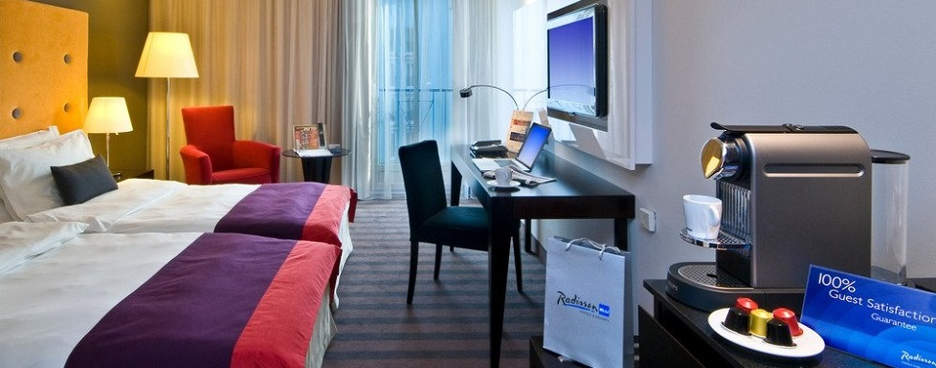
Rooms
The hotel boasts 435 comfortable rooms, including 69 Business Class rooms and 47 Suites, all of which are the perfect place to relax. All standard rooms are equipped with free high-speed Internet access and in-room safes including laptop charging facilities, LCD televisions, in-room movies, coffee & tea making facilities, iron and ironing board, mini bar and individually controlled air conditioning. Business Class rooms additionally feature Nespresso coffee machines, daily newspapers, free in-room movies, bathrobes and slippers, well-appointed bathrooms with heated floors and rain showers.

Slide 5
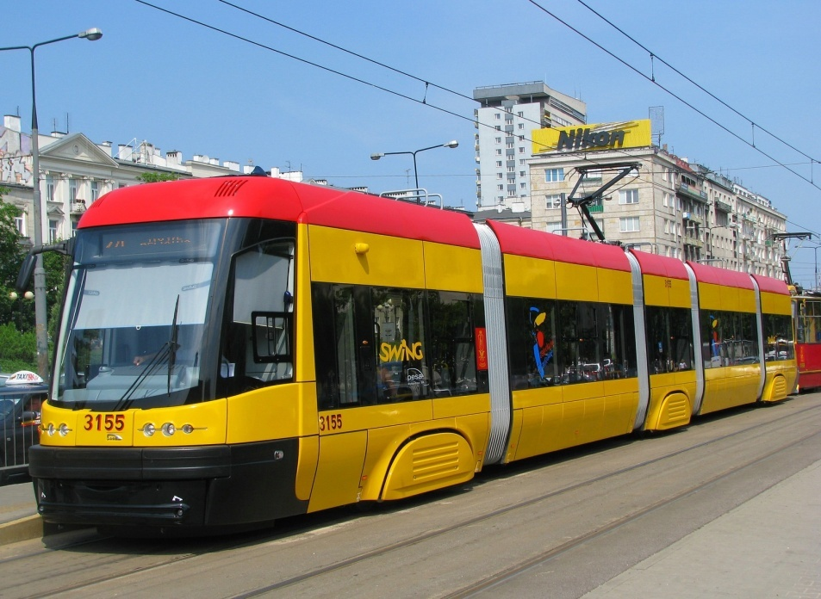
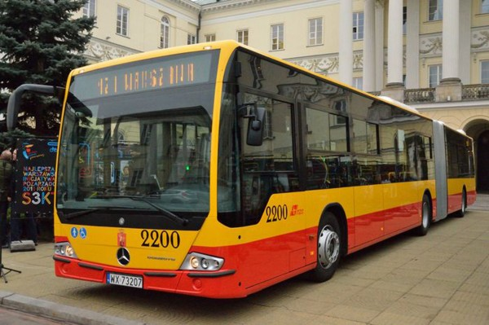
Transportation
The hotel is situated 300 km from Krakow, 120 km from Lodz, and 290 km from Katowice. By train: Central Railway Station in Warsaw is located only 1 km away from the hotel. Located on the Jerozolimskie Avenue, it may be easily reached by bus lines no. 127, 128, 130,157, 158, 175, 422 and 504 and tram lines no. 7, 8, 9, 22, 24 and 25. From the airport: Radisson Blu Sobieski Hotel Warsaw is just 6 km away from the largest airport in Poland. The hotel provides taxi transfer straight to and from the airport for an additional charge.

Slide 6
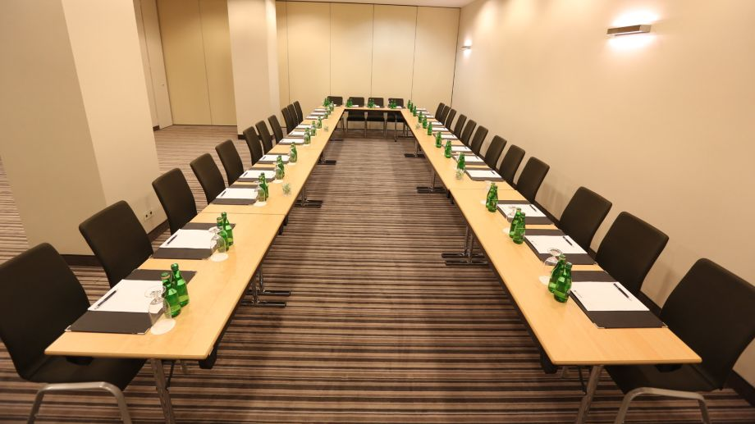
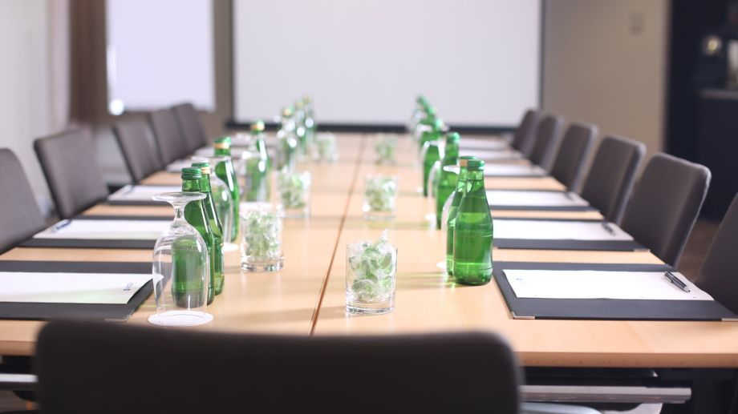
Conference hall
Each meeting room includes audiovisual equipment and Free high-speed, wireless Internet, and the 1,030-square-meter Grand Ballroom can host up to 800 guests.
Package for 4 hours
• Conference room rental with "The Golden Sixty Minutes" standard
• Head table for the trainer equipped with: toolbox, paper tissues, mint/sweets
• In-room naturally flavored mineral water
•Сoffee break (coffee, tea, bottled sparkling and still mineral water, flavored mineral water,
hot chocolate, low fat crunchy biscuits)
• Lunch by the conference room – Chef’s buffet menu including: soup, sandwiches, fresh vegetables with dressing, 2 desserts
• Beverages: coffee, tea, flavored mineral water
• Flipchart, markers, notepads, pens, wireless internet access
• LCD projector
• Screen

Slide 7


18th May
12: 00 – 14:00 – Check in
14:00 – 14:30 – Free time (take a shower etc)
14:30 – 15:00 – Dinner
15:00 – 15:30 – Introduction
15:30 – 16: 30 - Discussing main topics of the meeting
16:30 – 17:00 – Coffee break
17:00 – 19:00 – Continuous of the meeting
19:00 – 20:00 – Supper in the hotel’s restaurant “Trylogia Restaurant”
20:00 – 21:30 – Walk through the city
21:30 – 22:00 – Return to the hotel

Slide 8

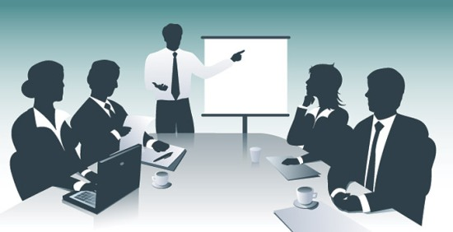
19th of May
9:00 – 10:00 – Breakfast in the hotel’s restaurant “Marysieńka Restaurant”
10:00 – 12:00 – Discussing topics of the meeting
12:00 – 12:30 – Business lunch
12:30 – 14:30 – Continuous of the meeting
14:30 – 15:00 – Free time
15:00 – 16:00 – Dinner in the hotel’s restaurant “Trylogia Restaurant”
16:00-19:00 – Excursion
19:00 – 20:00 - Supper in the hotel’s restaurant “Trylogia Restaurant”
20:00 – Free time

Slide 9

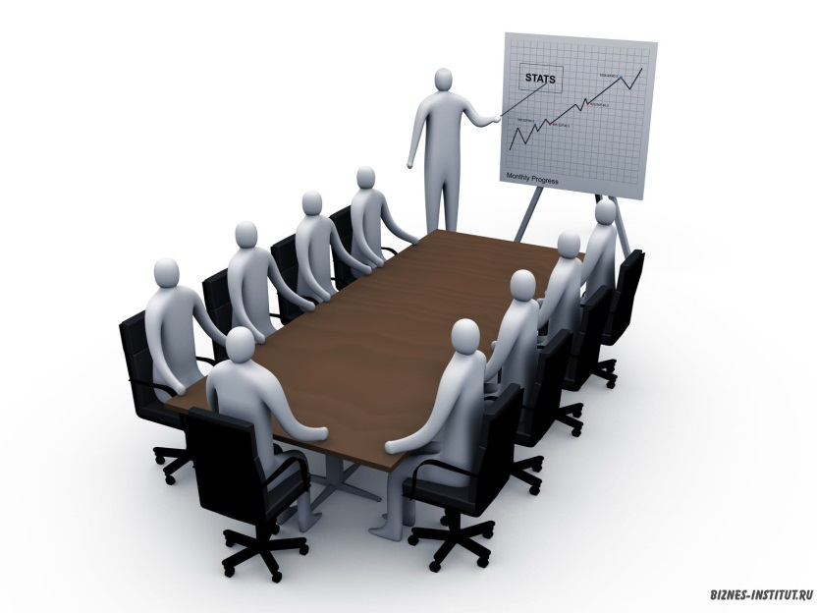
20th of May
9:00 – 10:00 - Breakfast in the hotel’s restaurant “Marysieńka Restaurant”
10:00 – 12:00 – Check out
After 12:00 – transportation to the stations

Slide 10

Prices:
Hotel – 1600/room × 50 = 80 000 zl
Conference hall – 140 zl/person × 50 = 7000 zl
Parking – 160 zl per 2 nights – one car
Excursion - 140 zl/person × 50 = 7000 zl
Total: 94 000 zl without parking

Slide 11
Thank you for attention!

