Slide 1

Strategy and Business Models

Slide 2



1. Digital Marketing and Strategy
The rise of mobile internet has led to huge shifts in the way consumers and business users interact with the internet.
Today, the world wide web is widely accessible and information is available immediately ‘on the go'. This has not led to changes in the way a marketing strategy is established, but the role of Digital Marketing within this strategy is becoming increasingly important.

Slide 3
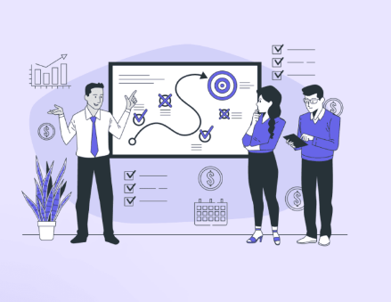
1.1. What does strategic marketing mean?
Strategic marketing deals with the way in which customers can be offered value in a sustainable manner, that is, in the perception of those customers, superior and distinctive to the value offered by competitors and potential providers.
A marketing strategy is usually determined for a period of three to five years (which in practice may be longer than the time the Marketing Director/CMO remains in their job!).

Slide 4

Digital technology can also be used in an organization's production or service processes. This can have far-reaching consequences for ways of thinking and working. For this reason, Cruise Company Royal Caribbean equips their ships with state-ofthe-art technology, making it possible to monitor guests’ behavior, and to adjust their service accordingly, ie. They adopt an increasingly customized approach.
Digitization also has an effect on prices. Due to openness (transparency) on the internet, downward price pressure has increased. All prices, product specifications and ratings are public.
Rapid developments surrounding the internet make it necessary to test the marketing strategy regularly for future sustainability.

Slide 5
2. Marketing Strategy
The marketing strategy is formulated by answering the following questions:
1
2
3
4
What does the organization want to achieve?
What is the current and future situation in the market? What are the opportunities and what are the threats?
What are the possibilities and competencies of the organization in the technical, financial and organizational fields? What are their strong points and what are their weaknesses?
What conclusions can be drawn from looking at these strengths and weaknesses in relation to the opportunities and threats? What should the organization do to ensure lasting success in the future?
5
6
7
How can the organization best segment the market and what choices
does the organization make regarding target markets and positioning?
What does the organization need to change in order to achieve this?
Broadly speaking, what will the new marketing mix look like?
What needs to happen in technical, financial and organizational terms to achieve this?

Slide 6
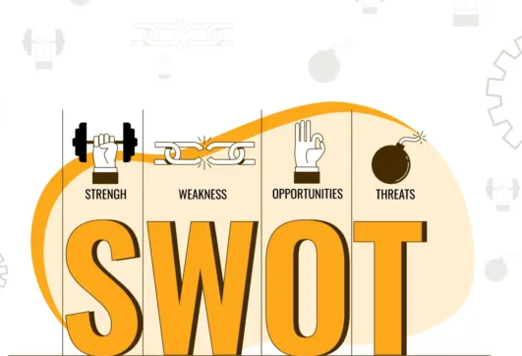
Examining the consequences of the organization's strengths and weaknesses in relation to expected market developments, opportunities and threats is called a ‘confrontation analysis'. The entire process of cataloguing the opportunities and threats in the market, determining the strengths and weaknesses and performing the confrontation analysis is called a SWOT analysis. SWOT stands for ‘Strengths, Weaknesses, Opportunities, Threats’.
When all developments and opportunities have been analyzed, the organization will determine the best way to segment the market, deciding which target markets are most attractive and how the brand will be positioned in the coming years.
After the basic choices for the next three to five years have been made, they are translated into objectives for the following years. Preferably as SMART (Specific, Measurable, Acceptable, Realistic, Time-bound) as possible.

Slide 7
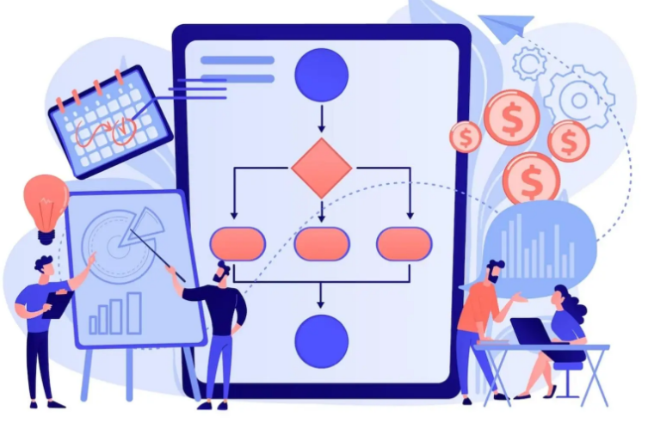
3. The business model
Every organization has a business model. A description of how the company creates value for customers and is then compensated in the form of revenue is always present. The business model is a way to coherently consolidate the various factors that influence the way an organization operationalises its strategy. It is a description of how the strategic objectives must be realized in a profitable, sustainable way.
When looking at a business model, we must examine not only the strategy, but also how it is translated: the way in which the organization and business processes must be arranged.

Slide 8
3.1. Formats for the business model
A business model can have different formats, ranging from simple to very complicated. All of them will contain the following elements:
The value proposition for the customer: what problem does the organization solve for the customer?
Contextually relevant: When we talk about partners, we mean sites where you can find a lot of information about the same subject or topics that are closely related. This might be a blog about travelling to Greece or an enthusiast who
The earnings model: which revenue sources does the organization have, what are the most significant costs and how will the organization make a profit?
20% of the buyers endorse the e-retailer on social media (loyalty)
20% of the buyers endorse the e-retailer on social media (loyalty)
The key resources: what knowledge, individuals, technology, products, facilities, and tools enable the organization to create the value proposition for the customer?
The core processes: which processes enable the organization to deliver value successfully to the customer and to achieve a competitive advantage?

Slide 9
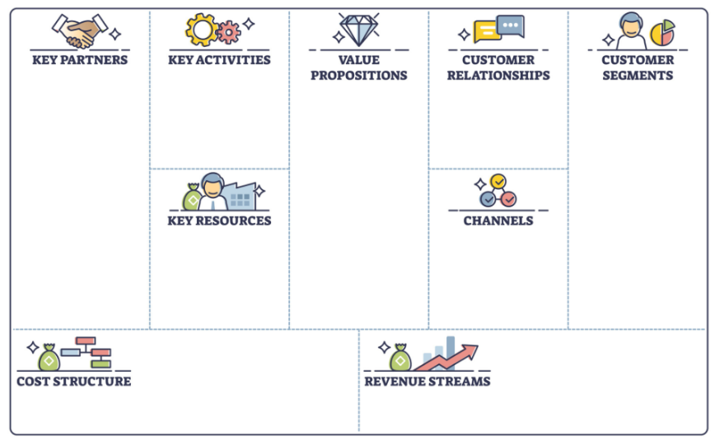
Search engine algorithms are secret
Within the business world, the business model canvas by Osterwalder and Pigneur (2009) is a popular framework for understanding business models.
The model has nine components or building blocks:
1. customer segments
2. value proposition
3. channels
4. customer relationships
5. income sources/revenue streams
6. key resources
7. key activities
8. key partners
9. cost structure

Slide 10
4 Customer Relationships
Osterwalder and Pigneur (2009) identify several different possibilities for maintaining customer relationships:
A personal point of contact . A personal representative is specifically assigned to a customer and maintains a long-term relationship with him or her. In business services (B2B), this representative is often called a (key) account manager.
1
Co-creation. Co-creation is a strategy where business processes are realized in collaboration with customers. This can be applied to a variety of processes, eg. product development, user generated content, service and customer service .
2
Communities. Organizations can offer the opportunity for customers to enter into & partnership through an online community so that they can share knowledge and experiences with each other and with the organization.
3
4
Personal assistance. Personal Assistance means direct contact with employees during or after sales in stores, through call centers, by email or using ‘Live Chat”. There is no ‘fixed’ representative since all team members are trained to assist customer.
5
Self-service. In the case of self-service, there is direct contact with the customer, enabling them to personally acquire the necessary information and services.
6
Automated services. Automated Services are a form of self-service that make use of automated processes.

Slide 11
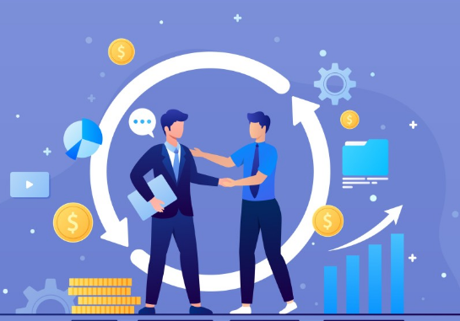
Questions that organizations must ask before making a decision regarding this building block are:
What type of relationship do each of our customer segments expect?
What type of relationships do we already have?
What impact does this have on costs?
How are customer relations integrated with the rest of our business model?

Slide 12

5 The revenue streams
According to Osterwalder and Pigneur, the building block ‘Revenue Streams’ represents the money that an organization generates from each of the customer segments. After deducting the expenses from these revenue streams, the remainder will be profit.
Questions that organizations must ask are:
What value are our customers actually willing to pay for?
What do they currently pay for?
How do they pay at the moment? How would they like to pay?
How much does every revenue stream contribute to the total turnover?
Such questions are closely linked to pricing strategy. In recent years, many online retailers have struggled to understand what customers are willing to pay for, ie. what represents real value to them. This has led to many organizations deciding to provide their ‘valuable’ content free of charge and earn money through, eg. advertising revenue. More recently, a change has become apparent.

Slide 13

6 Key resources
In order to achieve a competitive advantage, an organization needs to make sure their value proposition is more attractive than the competition’s and build a solid relationship with its key target customer segments. To ensure this, the organization will need specific resources. Key resources may be physical, financial, intellectual or human in nature.
Questions that should be posed by an organization when putting this essential ‘building block’ in place are:
What resources are key to our value proposition?
What resources are needed for our distribution channels?
What resources are needed for building and maintaining customer relations?
What resources are needed to generate our revenue?
For ecommerce, it is desirable that an organization can provide real-time information to (potential) customers, to its own management and also to its partners in the value chain. The customer must receive the right product, at the right time, via the correct channel.

Slide 14

7 Key activities
The ‘key activities’ building block describes the most important steps the organization needs to take to create the value proposition, to reach their customer segments cost-effectively, to build customer relationships and to generate revenue.
Questions that should be raised when completing this building block are:
What key activities are needed for our value proposition?
What key activities are necessary for our distribution channels?
What key activities are necessary for our customer relationships?
What key activities are needed to realize revenue streams?
Key activities within organizations that focus heavily on Digital Marketing are often related to online product realization, Digital Marketing communications, online sales, digital CRM, order processing and the generation, analysis and interpretation of data.

Slide 15
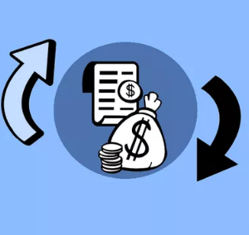
9 Cost structure
Each of the elements within the business model comes at a price. If the organization has decided to opt for cost leadership (generally implying low price), the costs should be kept as low as possible. An organization that chooses a differentiation strategy and distinguishes itself from the competition by delivering superior value will be faced with higher costs.
Questions that should be raised when completing this building block are:
What are the most important costs inherent to our business model?
Which key resources are the most expensive? Which key activities are the most expensive?
The organization must determine whether the fixed costs are relatively high or low and which activities and resources contribute the most cost. it remains to be seen whether a financial advantage can be obtained by increasing scale and/or optimizing cooperation between departments or with external partners.

Slide 16

    3.3. Check, execute and innovate the business model
You will need to review the business model as a whole again:
The business model itself: is it consistent, distinctive, and efficient and does it provide sufficient earning opportunity?
The organization's competencies: are the necessary knowledge, resources, systems and skills available or can they be acquired?
The potential reactions of competitors: are you strong enough to ward them off? (If it's a new launch, are you prepared for the incumbents to fight back?)
Future resilience: can you respond to changes and growth by adapting your business models accordingly without encountering any major problems?

Slide 17

Houtgraaf and Bekkers (2013) highlight four features that strengthen the structure and thus, importantly, the business model’s (and the business’s) chance of success:
1. Uniqueness: The degree to which the business model is unique and distinctive in terms of customer groups and its ability to earn money.
2. Efficiency: The extent to which the business model is an efficient whole, so that the added value exceeds the cost.
3. Fit: The internal consistency of the components of the business model, the extent to which they work in a coherent way towards a single end result.
4. Profit boosters: The possibilities for strengthening and enhancing the organization's objectives in the long-run. Eg. outsourcing competitors, a lock-in of customers or mutually enhancing scale and focus benefits. An example of this is Google, who, due to the search engine’s dominant market position, is able to compel organizations to post interesting and unique content on their websites. Otherwise they won't appear in Google search results. Google then shows popular and unique content to its users in what are called ‘featured snippets’. This allows Google to further strengthen its position as a search engine ie. its share of the search market.

Slide 18

Houtgraaf and Bekkers (2013) provide the following four systematic steps that bring structure to a business's quest for improvements and can ensure that any new or customized business model is a balanced one:
Step 1 Describe your current business model in detail. Describe how all components are currently put together.
Step 2 Describe the changes in the world around us in relation to the components in your current business model. Also indicate where you think the (potential) weak points/components are.
Step3 Examine any possible adjustments. In general, there will be a variety of possibilities or scenarios. Analyze the pros and cons of these scenarios and select the best.
Step 4 Keeping in mind future stability, eg. current and future trends, do another run-through of your model. When doing so, try to work out how competitors might respond.

Slide 19

  3.4. Role of Digital Marketing in the business model
Digital Marketing is a way to shape an organization's marketing activities: using the internet or internet related technology. Choosing Digital Marketing has important consequences for the business model. The value proposition can change, especially within service organizations: eg. there is a world of difference between a training organization that offers traditional classes in a classroom setting, and one that provides online classes only. This also means choosing a target audience which is digitally ‘savvy’.
The communication/sales channels also look different: either only digital channels or a mix with traditional channels could be present. Of course, variants are possible, eg. communicating through mobile or social media The customer relationships can be formed through co-creation, communities and/or automated services.

Slide 20

4. Determining the impact of new internet technology on Digital Marketing
In the event of the emergence of a new internet technology, the effects on an existing business can be seen on four levels:
1 the business model
2 the marketing strategy
3 the marketing instruments
4 the marketing operation

Slide 21

The benefits to the user of accessing the web via a smartphone compared to via a desktop PC include:
1. Ubiquity (omnipresence): Content and data can be sent and received anywhere and at any time.
2. Context Sensitivity: The content of messages can be customized to the {time, location, individual, and anything else that is measurable by the smartphone’s sensors.
3. Identification: The owner can be identified, and his/her movements can be tracked. (subject to privacy regulations).
4. Command and Control functions: The smartphone can be remotely operated via sensors/chips and so on.

Slide 22

  4.1. Impact on the business model
From a manager's point of view, digitization has a positive influence on the value proposition and the generation of customer value. When deciding the extent to which to digitize, the most important consideration s the effect it will have on demand. Sometimes the benefits of a new technology are so significant that an organization is compelled to completely change their business model to ensure survival.

Slide 23

Changing the marketing strategy also changes the business model. They cannot be seen as separate from each other. The choices affect market segments, channels, customer relationships, core processes, core business, the earnings model and the cost structure.

Slide 24
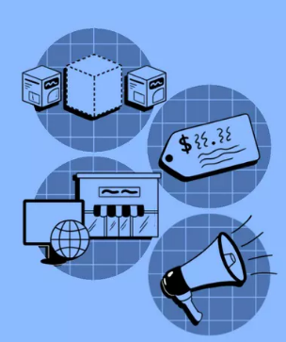
  4.3. Consequences for the marketing instruments
The emergence of a new internet technology doesn't always have far-reaching consequences for the marketing strategy and business model. Sometimes, it only leads to changes in the way in which the marketing tools are arranged.
Some examples:
Product: On a platform for co-creation, Mentos asks students to come up with a ‘sweet of the future’
Distribution: Brabantia sells its household items on a number of large online stores.
Price: Amazon uses its algorithm to adjust its prices according to demand, competitors’ prices, as well as a number of other factors.
Promotion: Red Bull communicates via offline advertising and events, as well as online via its own website, app and on social media.

Slide 25
Thank You

